Slide 1
Testing

Slide 2


Initial Testing Design
Misunderstanding lead to wasted time pursuing SQL testing
Final database used MySQL
Different than SQL
Only past experience in testing was in Testing with Calvin
Styled testing after traditional unit tests

Slide 3

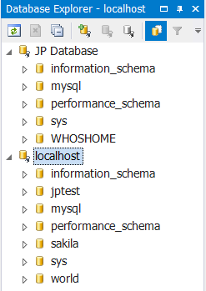

Setup
Created localhost database as a development environment
MySQL Workbench
Used existing creation scrips
Better understood what team members had done earlier in the sprint
Installed Eclipse and brushed up on Java

Slide 4

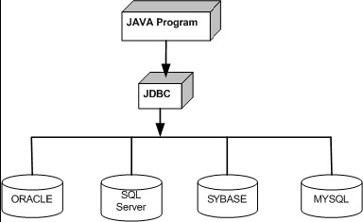
Database Test Program
Used Java for testing program
Used local database for more control in the development process and safety
Backbone of tests is the Java Database Connectivity (JDBC) API

Slide 5
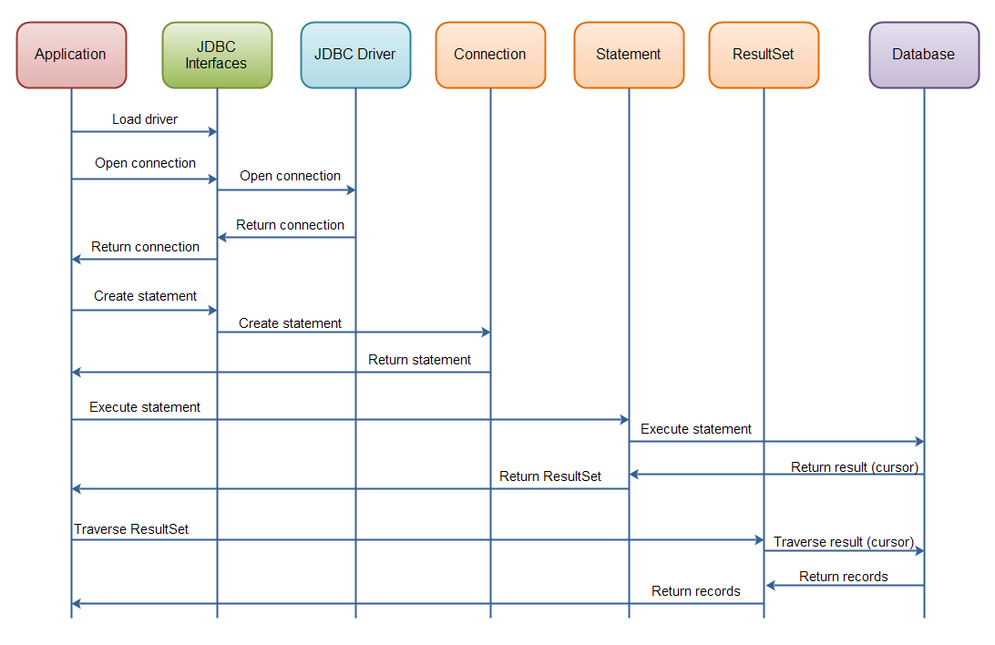
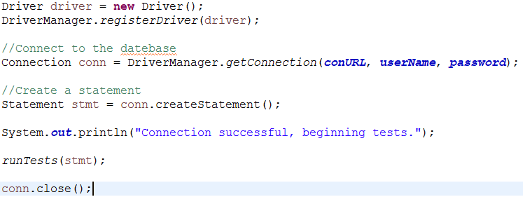
Overview of JDBC component interaction

Slide 6
GitHub

Slide 7

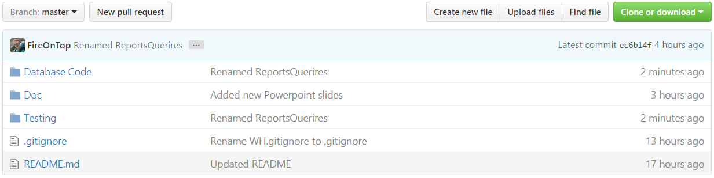
GitHub setup
GUI based interface... controversial but I found it helps for basic commands
File structure for all parts of the projects
Code
Documentation
Anything else

Slide 8
Scrum Master

Slide 9
Scrum Master Overview
Frist Scrum master of our JP
Did most of the initial technical writing for the group
Group members focused on additions and edits
One of the biggest lessons learned was that organization is key
Project notebook
Meeting and daily scrum logs
Design documents
Weekly status reports

