Slide 1
Data population

Slide 2


Tools:
DBForge (MySQL)
Mockaroo

Slide 3
Mockaroo
Online tool for data population
Creates insert statements
Saved hours of creating data

Slide 4
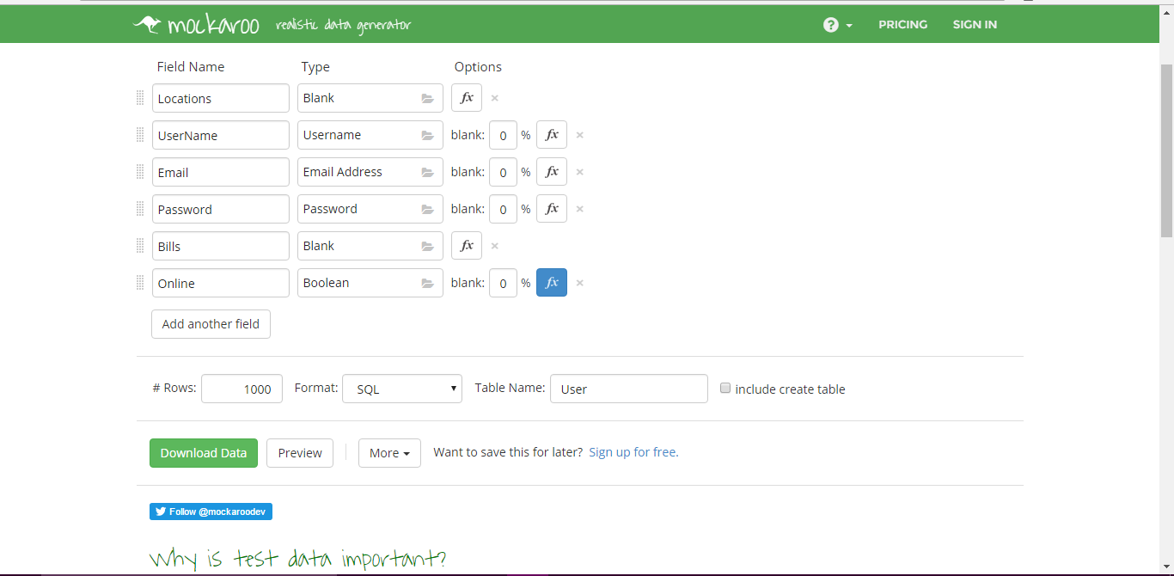

Slide 5
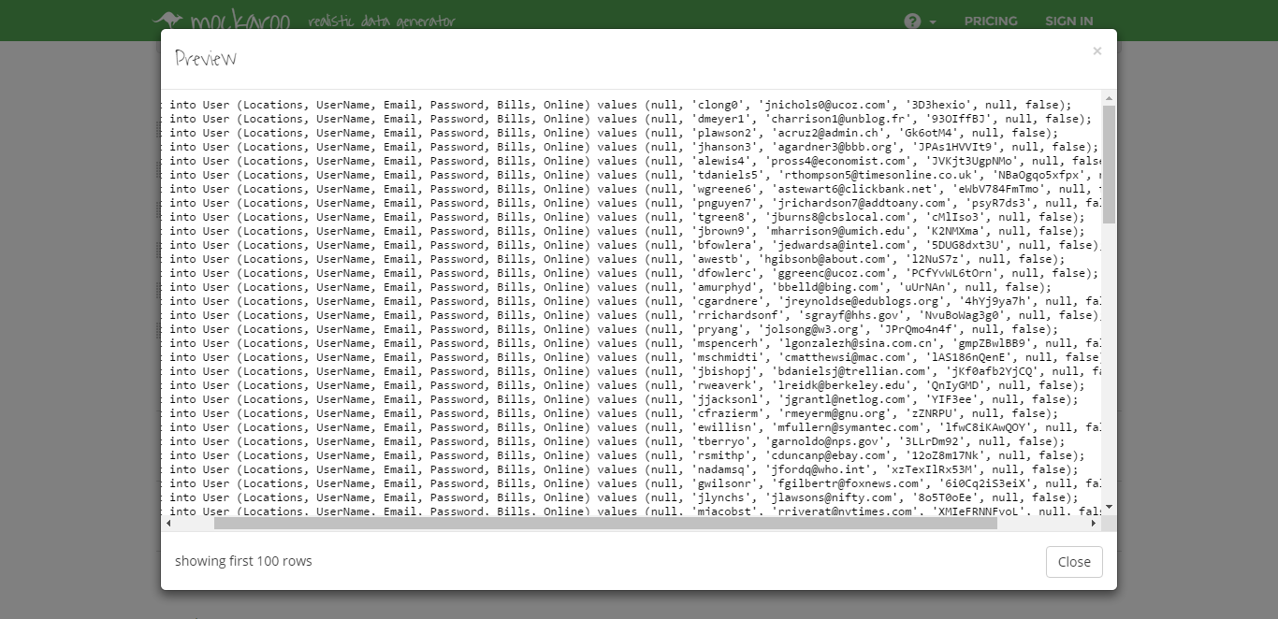

Slide 6
Customized Population:
Mockaroo
Good tool for population
Bad for deeper understanding of data/database
Solution: Write custom population statements

Slide 7
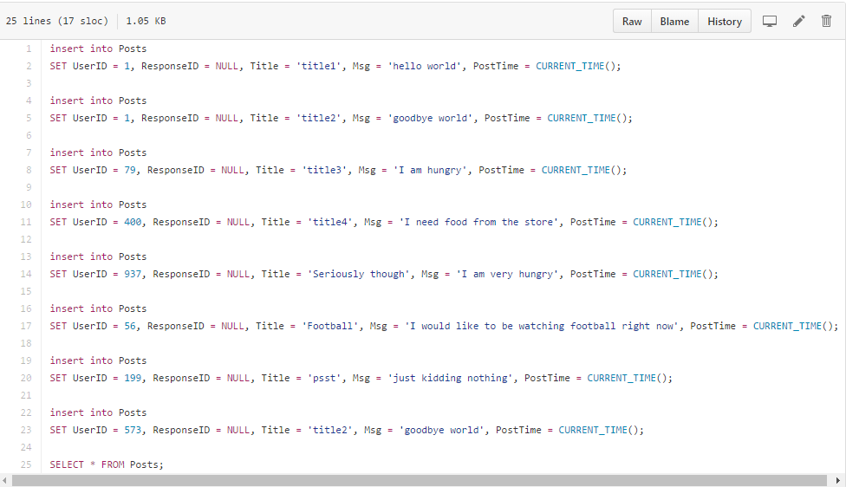
Posts

Slide 8
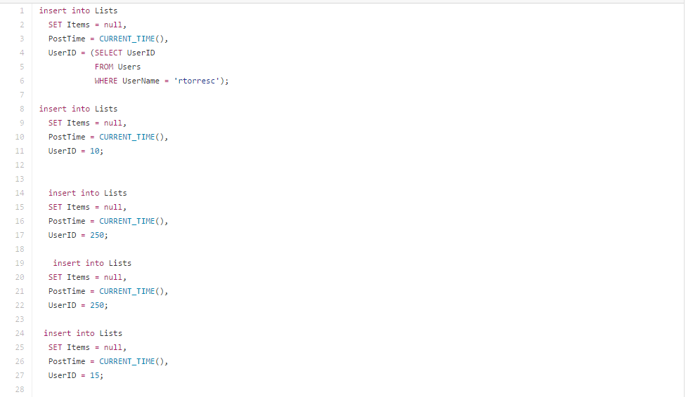
Lists

Slide 9
What’s Next?
Further database development
Begin creating application

Slide 10
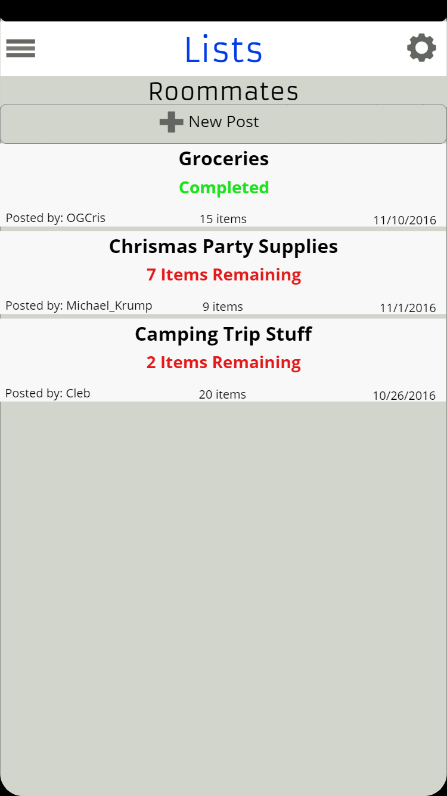
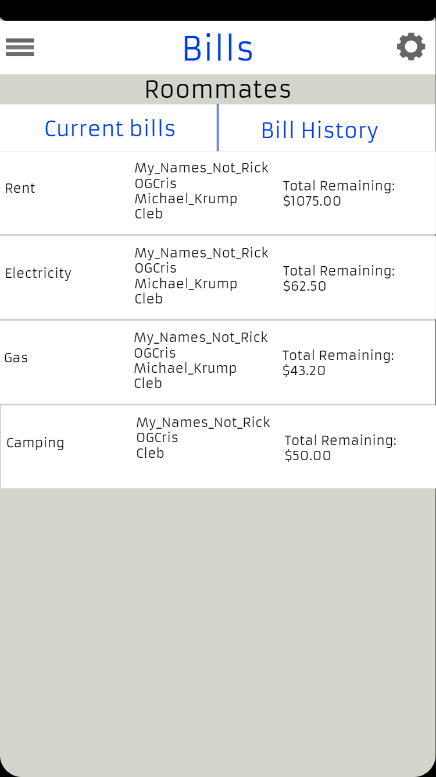
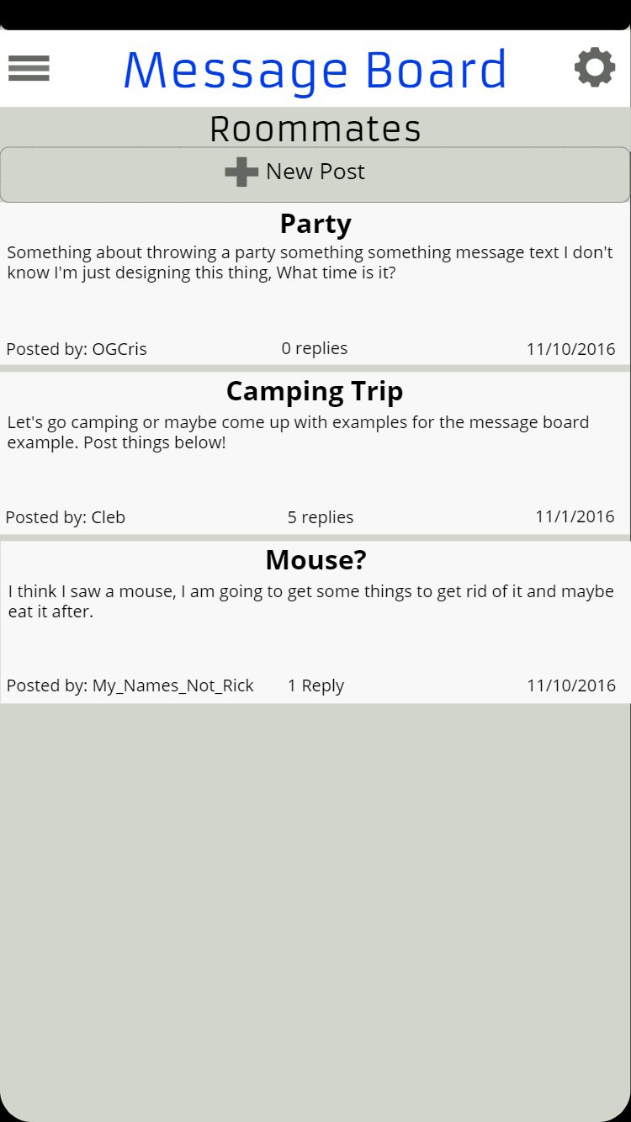

Slide 11
