Slide 1
AJ Cosmetics
By: Andy, Jasper, Jia Yang and Justin

Slide 2
Table of contents
Problem statement
What are we making
Business needs
Our analysis for digital innovation
Method
Result
Discussion
Conclusion
References
QNA

Slide 3
Problem statement
In the beauty industry, sellers tend to use perfect models to make products appealing to sell them and cause customers to spend time to try it on. This may cause confusion to customers and damage brand reputation. Therefore, by coding a software that is able to show how the product actually looks like, the software will allow customers to see what they are buying and receiving.

Slide 4
What are we making?
An interactive and personalised virtual makeup software
Adjust the digital face to look like user
Apply and stack different kinds of makeup onto the digital face
Company products
Share the products with others easily
Do not have to buy the product to try

Slide 5
Our business needs
Time efficiency - It is time consuming to try on beauty products.
Customer Satisfaction - Lower possibility of customer dissatisfaction.
Prevent fear - Customers can try out new products without fear.
Lower spendings - Find the most suitable beauty product with little spendings.

Slide 6
It is time consuming to try on beauty products in physical stores
How our digital innovation can reduce the time taken to try on beauty products
Only have 11 Sephora outlets.
Average time of 20-30 minutes to travel there
Look for makeup
30 minutes or more to apply the makeup
Remove it wastes another 5 minutes
Might have to queue up to try the makeup
Discourage them to try on the makeup
When tried at home, the makeup is not no their liking
Customers can try on make-up at anytime and anywhere
Saves the customer time and hassle
With one click the makeup applied can be changed to another colour or design
The customer will not have to worry about queues or if the product is available

Slide 7
Allow customers to try out new products without fear
How our digital innovation can encourage people to try out new products
Allergy or mismatching product information causes customers to hold back from trying new products
Different images used could confuse customers.
Customers may feel product isn’t as appealing afterwards
Causes brand reputation damage
Customers are able to explore new products
Allow customers to consider if the product is good
Purchase products with confidence
Be more open to try out new products
Build trusts with beauty brands

Slide 8
Discover the beauty product that looks best with little spendings
How our digital innovation can lower the spendings
Customers would be able to try on the makeup at their convenience.
Customers will be able to adjust the model to their face shape and their different features of the their face to make it as realistic as possible.
Allow customers to enjoy the products that they buy.
Save travelling expenses.
Influencer recommends products
Not everyone would be more good looking
Spend more on other products
Increase inflation and Cost Of Living
Only can keep a certain budget for Beauty products
Important for business to satisfy needs of customer
Retain customer and attracting new customer
Generate more revenue

Slide 9
Lower the possibility of customer dissatisfaction
How our digital innovation can lower customer dissatisfaction
People will want to buy the product but might not want to go out
May be because they are lazy, not well or they don’t know how to go there
Can see product online but don’t know how they will look after putting on the make-up
They might give up on buying product
People will want to buy makeup online but will also give up because don’t know how they will look
Customers can try on products at their own home
Will not have to go to physical store to try makeup
Game can replicate the looks, colour of the make-up and if there is any effect over time if you use the make-up
Game will have lots of types of beauty products
Customers can safely decide what to buy
Notes:
Business needs: Virtual makeup eliminates the element of surprise and the possibility of customer dissatisfaction once the product is delivered.
When some people see a commercial on television, they will want the product very quickly but they might not want to go out to make-up stores and try the make-up. This may be because they are lazy, they are not well enough to physically go to the store or they don’t know how to go to the store. If they can’t go to the store, they will not be able to try the make-up themselves unless their neighbor has the make-up that they want. This will cause them to give up on buying the product.
Then they will want to buy the product online but they might also give up on buying the product because they don’t know how they will look with the make-up, such as the shade of red of the lipstick.
Digital innovation:
With the help of a digital software like a game, customers will be able to try on the product that they want in the comfort of their own home. This way, they will not have to go out to the physical store to try the make-up. They can just try the make-up at home. The game could have a virtual version of the make-up and copy the exact look, color and effect of the make-up. This way, people will know how their face will look after they use the make-up. The app will also have other types of make-up like lipstick and lipstick remover. Then they can safely decide which make-up they want.

Slide 10
Method
<How we fulfil the business needs?>

Slide 11
We created a digital model
Allows individuals to modify:
Face colour
Face shape
Type of hair
Eye size

Slide 12
We created a digital model
Allow individuals to change the different features
Eyeliner
Mascara
Lipstick
Blush
Eyebrow

Slide 13
The benefits
All the business needs are met
Try on the makeup at their own comfort (convenient)
Save travelling time, trying on makeup
Queue
Workers
Eliminate the element of surprise
Beauty product looks realistic

Slide 14
The benefits
More willing to try different combinations
Explore their creativity
Do not need to worry about money
Reduce spendings
Online
Sums total cost
Travelling cost

Slide 15
How we advertise our website
Through social media influencers
Makeup influencers
Put a QR code poster at the physical store
Sephora

Slide 16
Result
<What we came up with?>

Slide 17
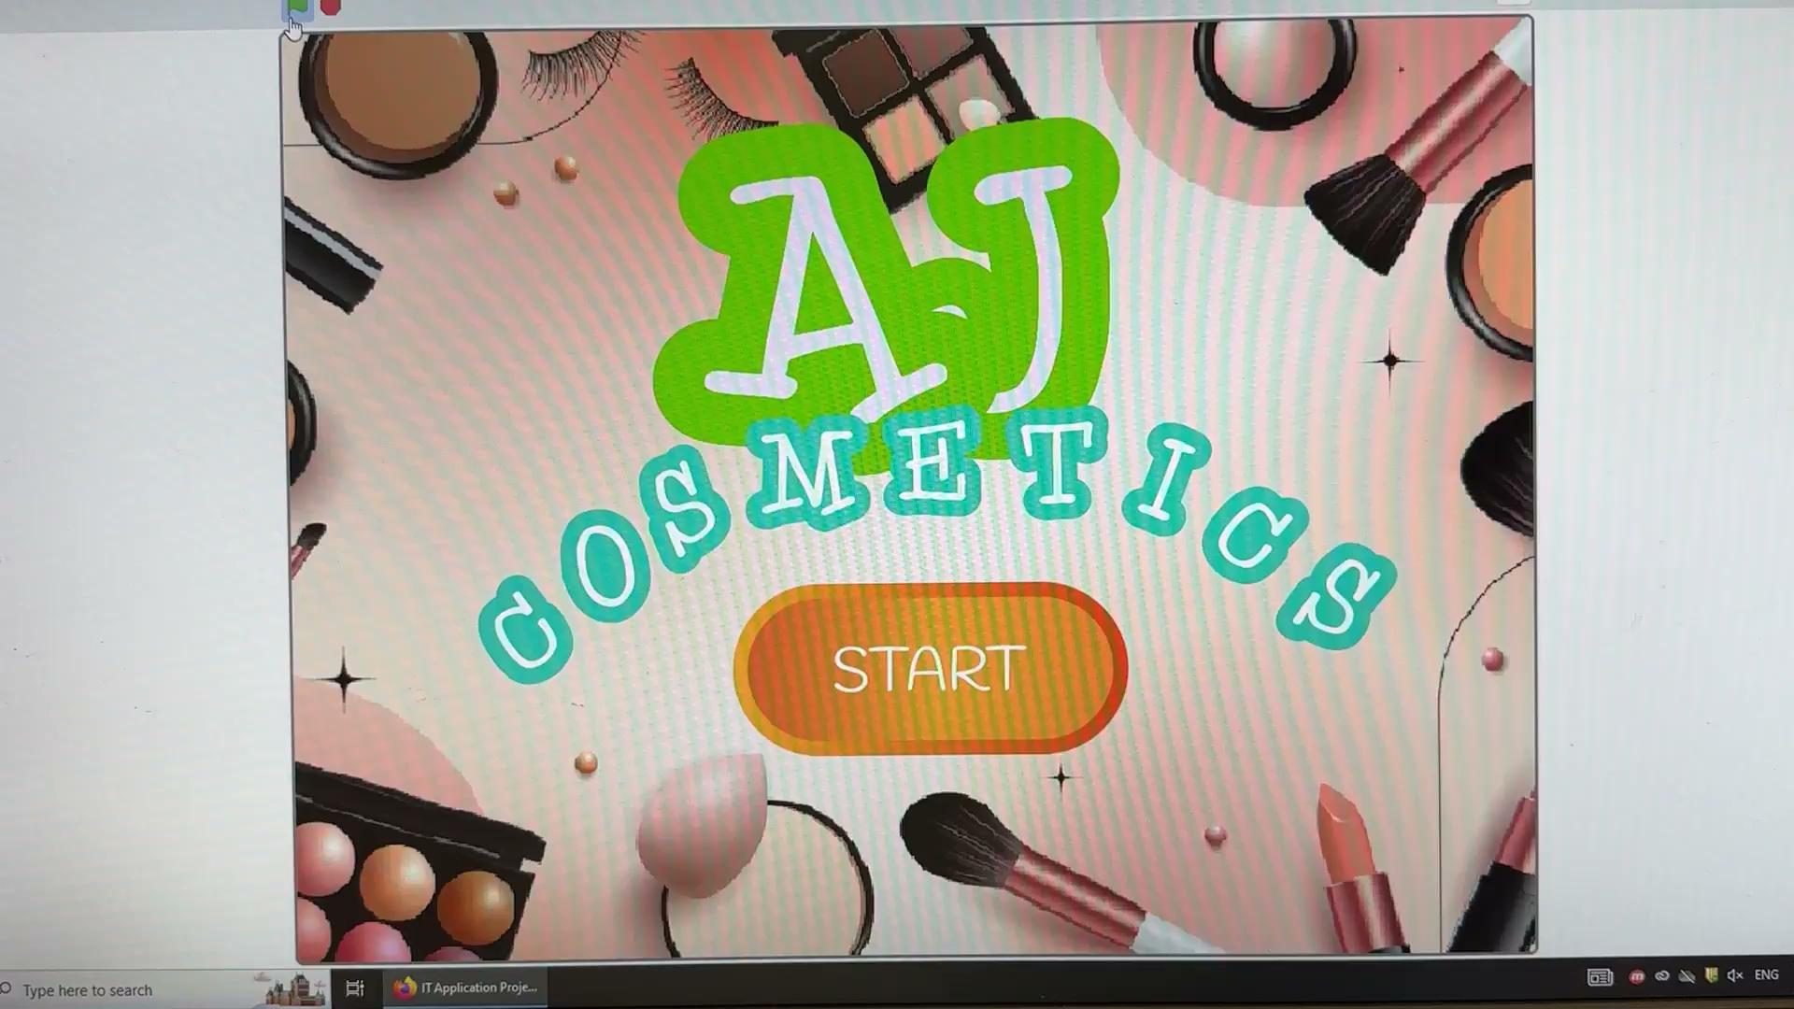
Solution: Virtual Makeup Software
Demonstration of our game and how our game works
Video on how the game works

Slide 18
Discussion

Slide 19
Discussion
Virtual Try On with camera
We tried video sensing but unable to make it work
Product Recommendation
Record the products that are popular with customers
Social Media Sharing
Encourage users to share their looks and experiences
Feedback
Make informed decisions about the app's future direction and features

Slide 20
Conclusion

Slide 21
Conclusion
Time efficiency
Customer Satisfaction
Prevent fear
Lower spendings
Find the most suitable make up easily
Gain competitive edge
Reach more customers

Slide 22
References
Other make-up games
Sephora products
Face features

Slide 23
THANK YOU

Slide 24
QNA

