Slide 1

Healthcare Operations Benchmarking Case Study
Anonymized data workflow, benchmarking, and risk-monitoring example
A portfolio example showing how structured data rules and benchmarking can support operational review and decision-making.
THE DOMAS GROUP LLC
© 2026 The DOMAS Group LLC. All rights reserved.
Anonymized portfolio case study

Slide 2
Objectives
Provide actionable insights and flag communities needing closer observation.
Establish analytic benchmarks and hypotheses to guide ongoing risk monitoring and improvement.
© 2026 The DOMAS Group LLC. All rights reserved.
Anonymized portfolio case study
Notes:
Notes:
1. Weight values <70 lbs or >450 lbs were considered erroneous and excluded from analysis.
2. If weight event occurred, weight was not accessed for a week.

Slide 3
Data Overview
Dataset | Type | Records
Weights | Time-series | De-identified event data
Falls | Event-based | De-identified incident data
Key Business Rules Applied:
Each weight record represents a single, valid measurement per resident per day.
Implausible weights (< 70 lbs / > 450 lbs) were excluded to ensure realistic clinical ranges.
Only the most recent weight per day was retained for accurate trend modeling.
Monitoring intervals and threshold events (±5 % / ±10 %) were calculated consistently across communities.
Fall-related incidents were isolated using a standardized ‘is_fall’ flag.
Days-between events were calculated per resident, then summarized using resident-median → global median.
Repeat-fall rates were based on the minimum interval between consecutive falls.
Community-level rates (e.g., incidents per 100 residents) were normalized using unique resident counts.
© 2026 The DOMAS Group LLC. All rights reserved.
Anonymized portfolio case study

Slide 4
Benchmark Discovery - Weight
 | Benchmark | What It Captures | Why It Matters
1 | % of Residents with ≥ 1 Weight-Change Event (≥ ±5 % / 30 d or ± 10 % / 180 d) | Prevalence of residents showing clinically meaningful change in body weight. | Signals the proportion of residents potentially at nutritional or health risk; high values may indicate unstable populations or measurement inconsistency.
2 | Weight-Change Events per 100 Residents | Frequency of threshold-crossing events normalized to population size. | Allows comparison across communities regardless of census; rising rates suggest recurring instability among monitored residents.
3 | Median Days Between Weigh-Ins | Typical cadence of resident weight monitoring. | Reflects adherence to expected monitoring schedules; longer intervals reduce ability to detect early risk.
4 | % Residents with > 30 Days Between Weigh-Ins | Share of residents exceeding recommended weigh-in frequency. | Highlights monitoring gaps that may delay detection of weight-related health decline or safety risk.
¹ Centers for Medicare & Medicaid Services. State Operations Manual: Appendix PP – Guidance to Surveyors for Long Term Care Facilities. Rev. 173, November 22, 2017. Accessed November 11, 2025. https://www.cms.gov/medicare/provider-enrollment-and-certification/guidanceforlawsandregulations/downloads/appendix-pp-state-operations-manual.pdf
© 2026 The DOMAS Group LLC. All rights reserved.
Anonymized portfolio case study
Notes:
Notes:
1. Weight values <70 lbs or >450 lbs were considered erroneous and excluded from analysis.
2. If weight event occurred, weight was not accessed for a week.

Slide 5
Benchmark Discovery - Weight
 | Benchmark | What It Captures | Why It Matters | Current State
1 | % of Residents with ≥ 1 Weight-Change Event (≥ ±5 % / 30 d or ± 10 % / 180 d) | Prevalence of residents showing clinically meaningful change in body weight. | Signals the proportion of residents potentially at nutritional or health risk; high values may indicate unstable populations or measurement inconsistency. | Redacted
2 | Weight-Change Events per 100 Residents | Frequency of threshold-crossing events normalized to population size. | Allows comparison across communities regardless of census; rising rates suggest recurring instability among monitored residents. | Redacted
3 | Median Days Between Weigh-Ins | Typical cadence of resident weight monitoring. | Reflects adherence to expected monitoring schedules; longer intervals reduce ability to detect early risk. | Redacted
4 | % Residents with > 30 Days Between Weigh-Ins | Share of residents exceeding recommended weigh-in frequency. | Highlights monitoring gaps that may delay detection of weight-related health decline or safety risk. | Redacted
¹ Centers for Medicare & Medicaid Services. State Operations Manual: Appendix PP – Guidance to Surveyors for Long Term Care Facilities. Rev. 173, November 22, 2017. Accessed November 11, 2025. https://www.cms.gov/medicare/provider-enrollment-and-certification/guidanceforlawsandregulations/downloads/appendix-pp-state-operations-manual.pdf
© 2026 The DOMAS Group LLC. All rights reserved.
Anonymized portfolio case study
Notes:
Notes:
1. Weight values <70 lbs or >450 lbs were considered erroneous and excluded from analysis.
2. If weight event occurred, weight was not accessed for a week.

Slide 6
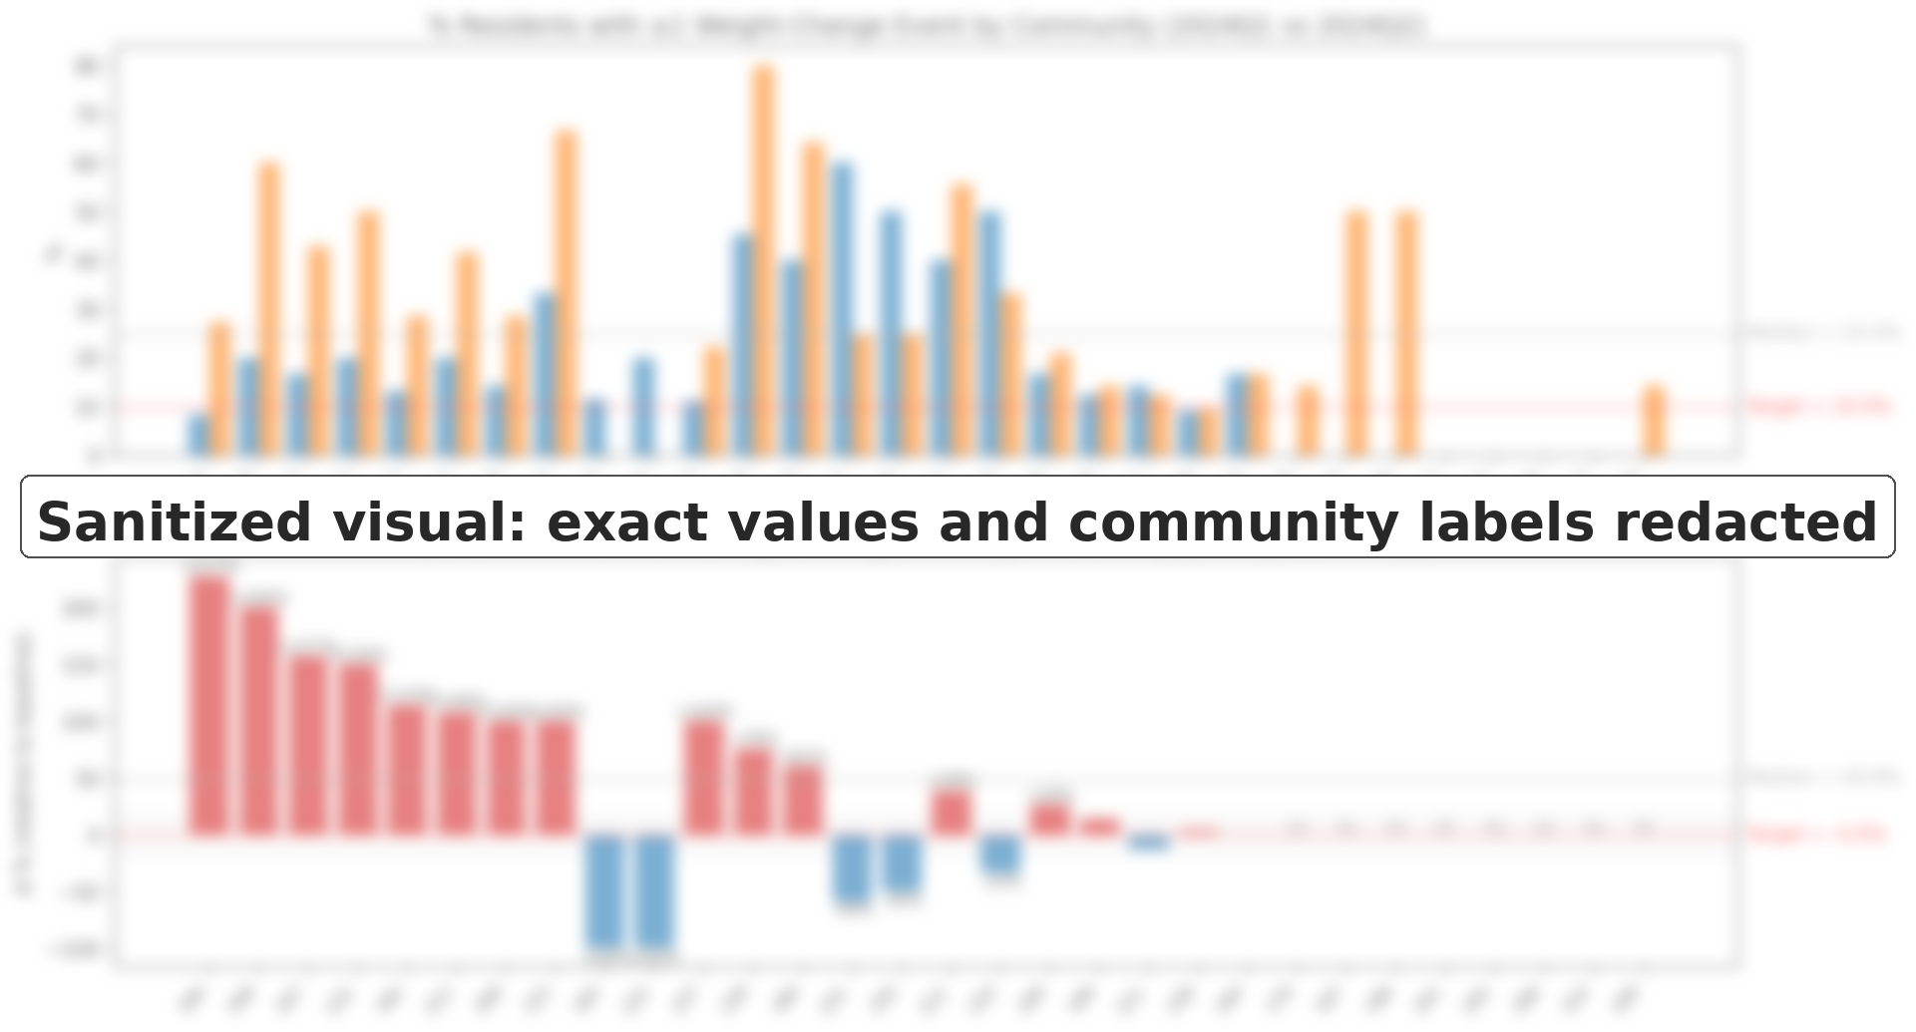
Benchmark 1
A subset of communities showed increases in the proportion of residents with clinically meaningful weight-change events, flagging areas for closer monitoring and data-quality review.
¹ Centers for Medicare & Medicaid Services. State Operations Manual: Appendix PP – Guidance to Surveyors for Long Term Care Facilities. Rev. 173, November 22, 2017. Accessed November 11, 2025. https://www.cms.gov/medicare/provider-enrollment-and-certification/guidanceforlawsandregulations/downloads/appendix-pp-state-operations-manual.pdf
© 2026 The DOMAS Group LLC. All rights reserved.
Anonymized portfolio case study
Notes:
Notes:
1. Weight values <70 lbs or >450 lbs were considered erroneous and excluded from analysis.
2. If weight event occurred, weight was not accessed for a week.

Slide 7
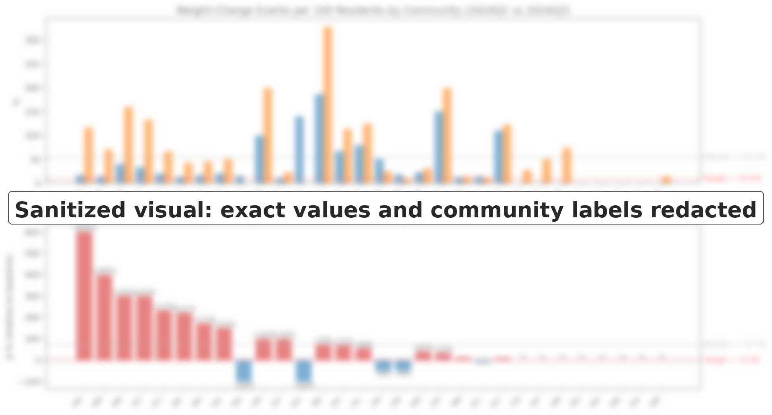
Benchmark 2
Event frequency varied across communities after normalizing by resident count, helping distinguish broad resident involvement from repeated events among smaller groups of residents.
© 2026 The DOMAS Group LLC. All rights reserved.
Anonymized portfolio case study
Notes:
Notes:
1. Weight values <70 lbs or >450 lbs were considered erroneous and excluded from analysis.
2. If weight event occurred, weight was not accessed for a week.

Slide 8
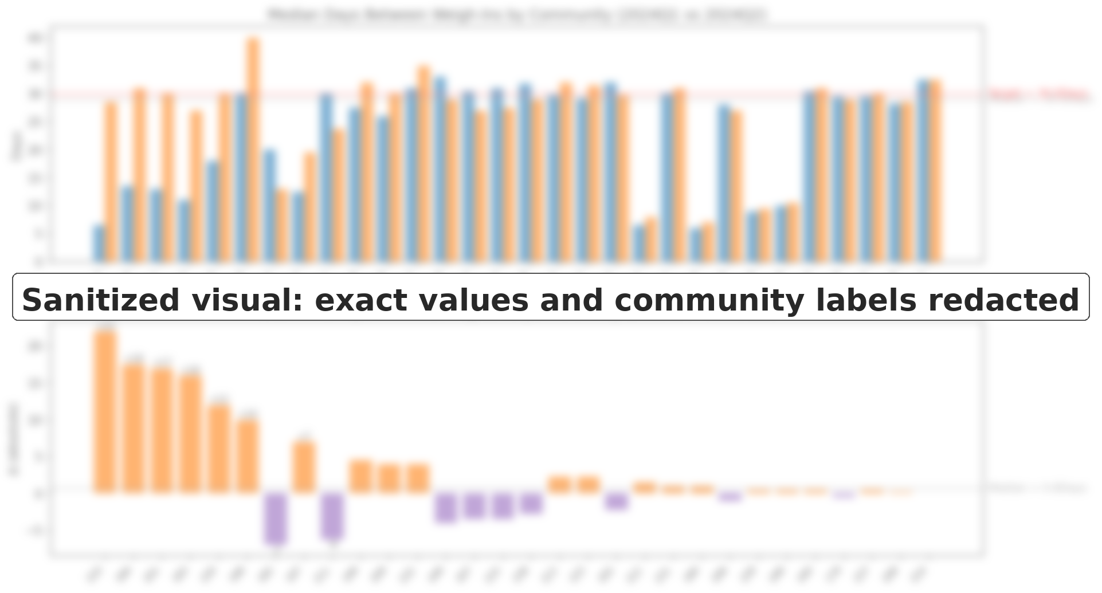
Benchmark 3
Several communities showed longer intervals between weigh-ins, potentially delaying detection of early weight changes and weakening routine monitoring cadence.
© 2026 The DOMAS Group LLC. All rights reserved.
Anonymized portfolio case study
Notes:
Notes:
1. Weight values <70 lbs or >450 lbs were considered erroneous and excluded from analysis.
2. If weight event occurred, weight was not accessed for a week.

Slide 9
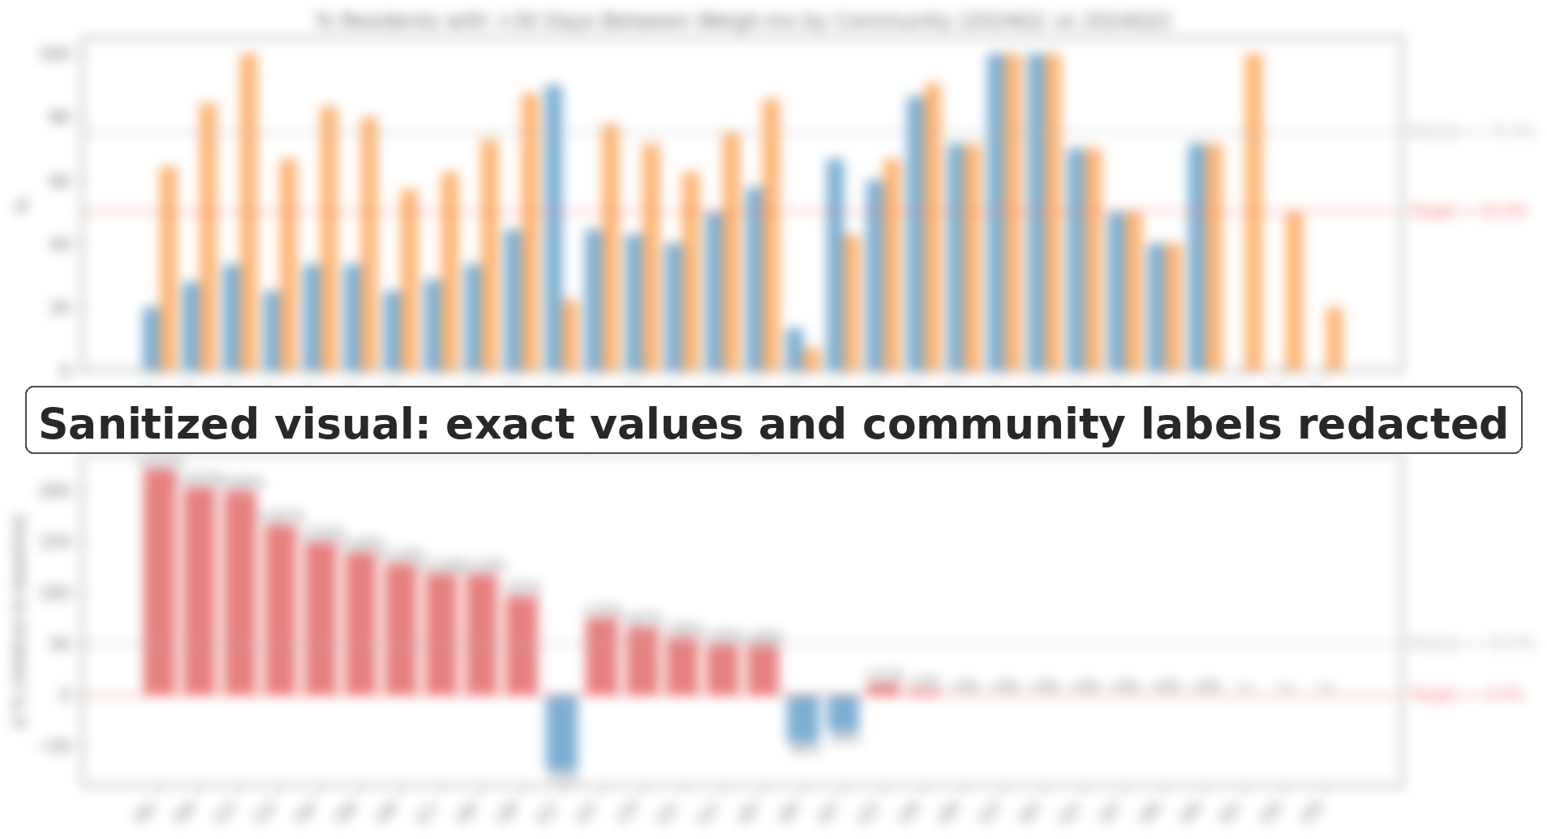
Benchmark 4
Many communities had residents exceeding the expected monthly weigh-in cadence, underscoring the risk of missed early warning signs when monitoring frequency declines.
© 2026 The DOMAS Group LLC. All rights reserved.
Anonymized portfolio case study
Notes:
Notes:
1. Weight values <70 lbs or >450 lbs were considered erroneous and excluded from analysis.
2. If weight event occurred, weight was not accessed for a week.

Slide 10
Benchmark Discovery - Incidents
 | Benchmark | What It Captures | Why It Matters
1 | % Residents with Repeat Fall <30 Days | Share of residents falling again within 30 days. | Rapid recurrence indicator; mirrors readmission-style quality triggers.
2 | Falls per 100 Residents | Frequency of fall incidents normalized to population size. | Core safety metric; rising rates flag environments or workflows needing review.
3 | Median Days Between Falls | Typical interval between repeat falls (among residents with >1). | Shorter intervals imply unresolved risk or insufficient recovery after events.
4 | Fall-to-Weight-Event Ratio | Relationship between fall frequency and weight-change events. | Tests whether physiological instability precedes adverse safety events.
¹ Centers for Medicare & Medicaid Services. State Operations Manual: Appendix PP – Guidance to Surveyors for Long Term Care Facilities. Rev. 173, November 22, 2017. Accessed November 11, 2025. https://www.cms.gov/medicare/provider-enrollment-and-certification/guidanceforlawsandregulations/downloads/appendix-pp-state-operations-manual.pdf
© 2026 The DOMAS Group LLC. All rights reserved.
Anonymized portfolio case study
Notes:
Notes:
1. Weight values <70 lbs or >450 lbs were considered erroneous and excluded from analysis.
2. If weight event occurred, weight was not accessed for a week.

Slide 11
Benchmark Discovery - Incidents
 | Benchmark | What It Captures | Why It Matters | Current State
5 | % Residents with Repeat Fall <30 Days | Share of residents falling again within 30 days. | Rapid recurrence indicator; mirrors readmission-style quality triggers. | Redacted
6 | Falls per 100 Residents | Frequency of fall incidents normalized to population size. | Core safety metric; rising rates flag environments or workflows needing review. | Redacted
7 | Median Days Between Falls | Typical interval between repeat falls (among residents with >1). | Shorter intervals imply unresolved risk or insufficient recovery after events. | Redacted
© 2026 The DOMAS Group LLC. All rights reserved.
Anonymized portfolio case study

Slide 12
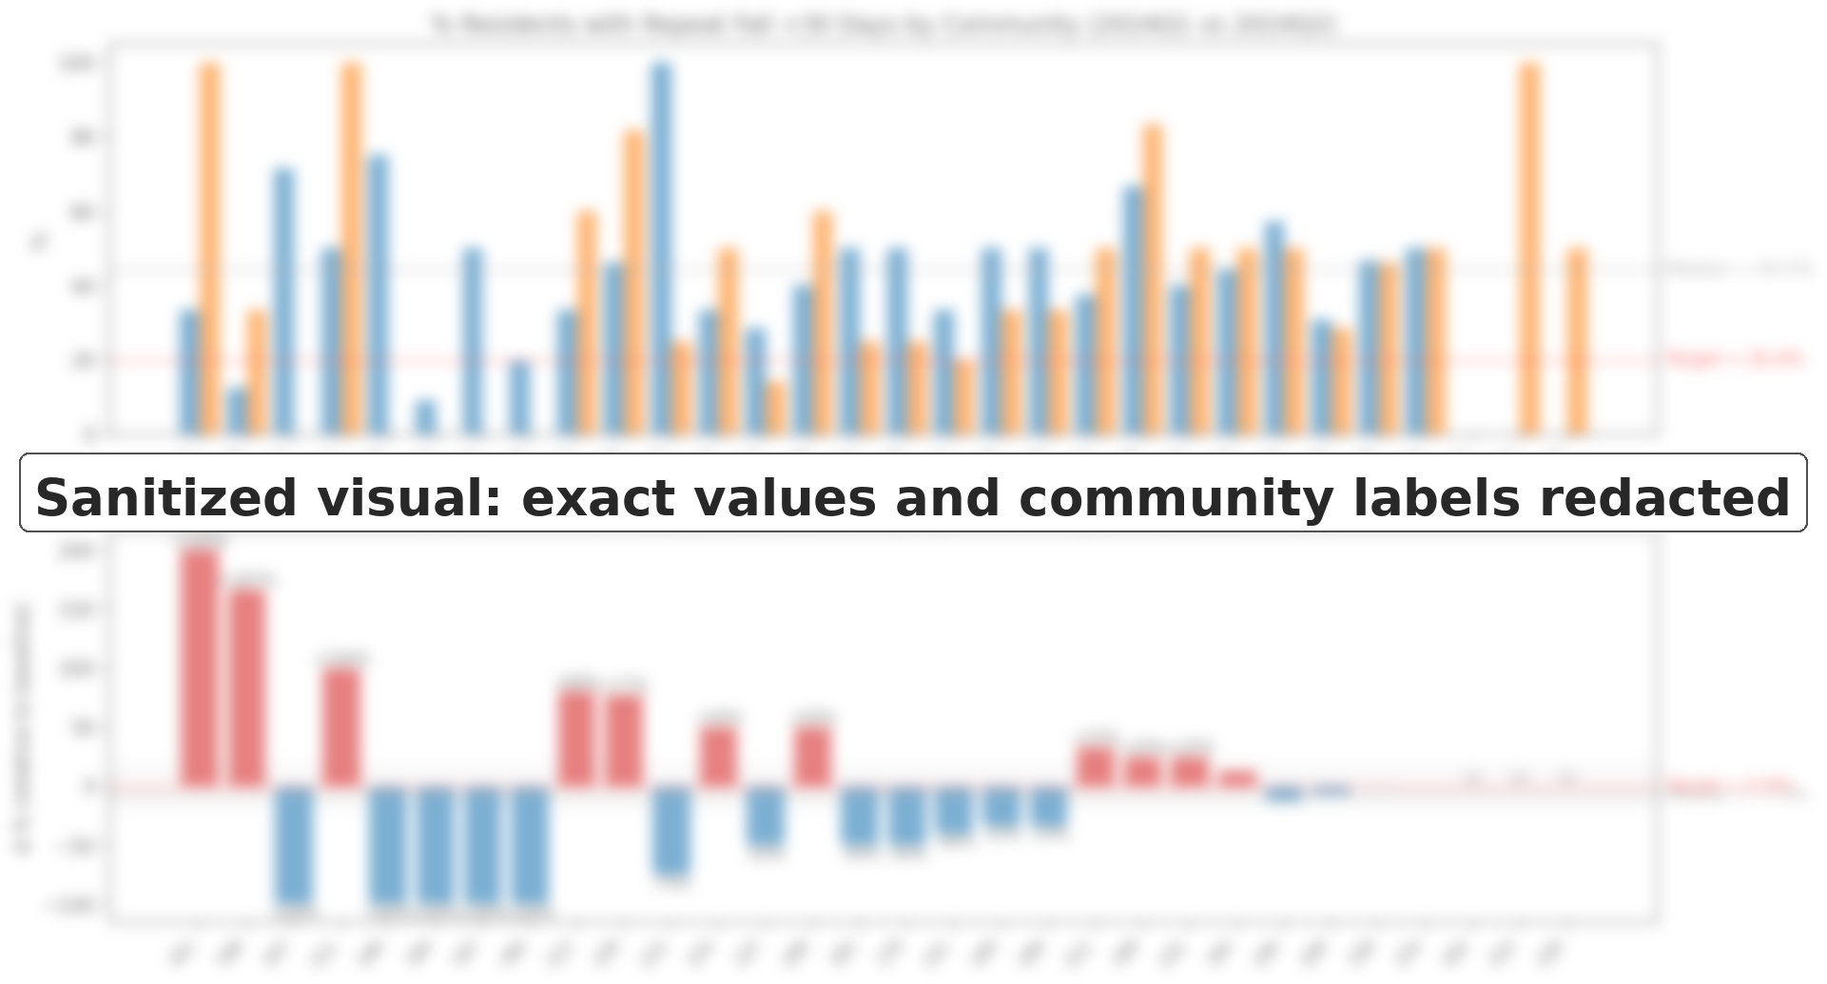
Benchmark 7
Repeat falls increased across many communities, with several showing notable spikes that warrant closer review.
© 2026 The DOMAS Group LLC. All rights reserved.
Anonymized portfolio case study

Slide 13
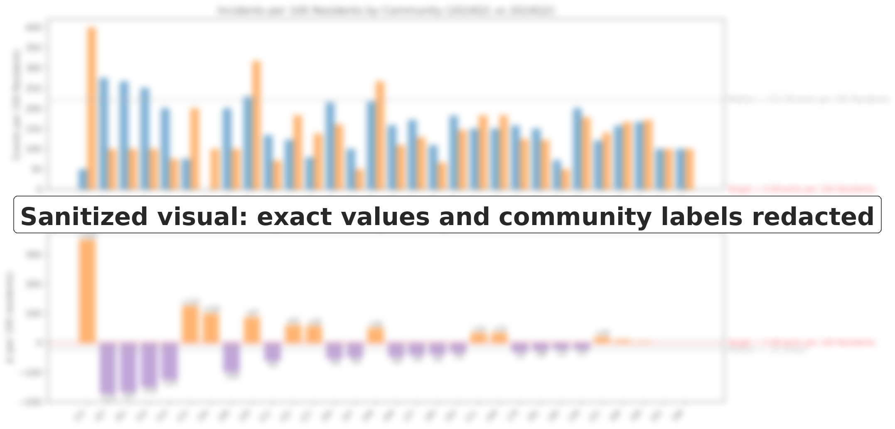
Benchmark 8
Incidents per 100 residents increased in some communities, while most remained relatively stable or decreased.
© 2026 The DOMAS Group LLC. All rights reserved.
Anonymized portfolio case study

Slide 14
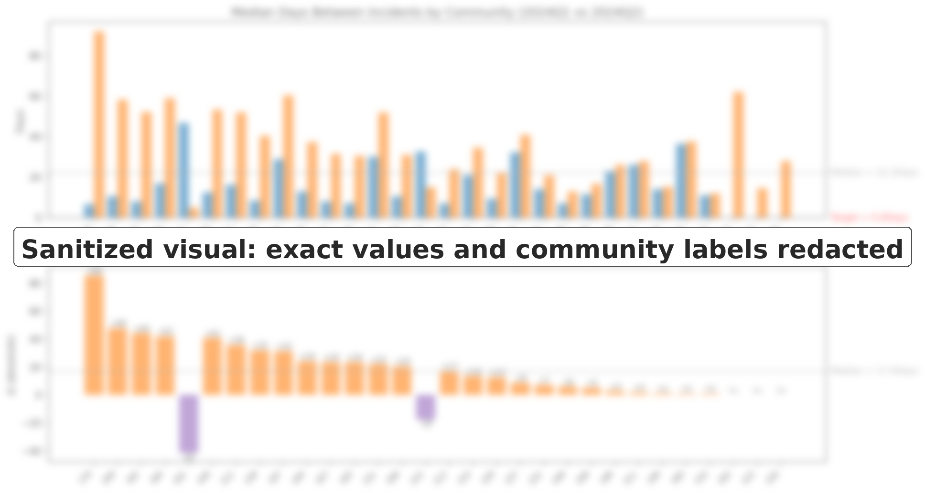
Benchmark 9
Median days between incidents increased across most communities, with some showing substantial increases in time between events.
© 2026 The DOMAS Group LLC. All rights reserved.
Anonymized portfolio case study

Slide 15
Recommendations
To improve weight monitoring compliance and reduce fall risk, we recommend prioritizing communities that show multiple signals across weight and incident benchmarks, such as:
High % of residents with ≥1 weight-event or fall incident, or high events per 100 residents
Median weigh-in intervals >30 days or >30% of residents exceeding the 30-day weigh-in threshold.
High repeat-fall rates (<30 days) or sharp decreases in median days between incidents
© 2026 The DOMAS Group LLC. All rights reserved.
Anonymized portfolio case study
Notes:
Notes:
1. Weight values <70 lbs or >450 lbs were considered erroneous and excluded from analysis.
2. If weight event occurred, weight was not accessed for a week.

Slide 16
Additional Hypotheses & Analytic Opportunities
1. Hypothesis: Communities that weigh residents or document incidents less frequently may appear “stable” simply because events aren’t recorded.
Confirm the true resident denominator per quarter to assess missingness, under-reporting, and census-driven distortion of event rates.
2. Hypothesis: Communities with inconsistent weigh-in patterns may also show higher fall rates or shorter intervals between incidents.
Assess communities with unusually low measurement frequency as potential under-detectors rather than low-risk sites.
3. Hypothesis: Spikes in events may align with specific operational changes, staffing patterns, or seasonal/holiday periods.
Analyze whether spikes in incidents or weight events align with staffing changes, new processes, or seasonal factors.
4. Hypothesis: Weight changes and fall risk vary by BMI range, hydration status, diagnoses, or acuity scores rather than operational issues.
Incorporate height/BMI, hydration-related flags, diagnoses, or acuity indicators to test whether variation reflects case-mix rather than operational inconsistency.
© 2026 The DOMAS Group LLC. All rights reserved.
Anonymized portfolio case study

Slide 17
Ready to turn recurring reporting friction into a
decision-ready data system?
DOMAS helps teams clarify data rules, validation logic, workflows, and reporting
so decisions are easier to trust and repeat.
Explore data workflow and decision-support services:
datasystems.thedomasgroup.com
THE DOMAS GROUP LLC
Meagan Foster, MPS · Founder
© 2026 The DOMAS Group LLC. All rights reserved.
Anonymized portfolio case study

