Slide 1


Daniel Padilla
Prabhjyot Grewal
Shrusthi HC
Notes:
Hi everyone, we’re excited to present our project for DataFest.
Where should a large tech company like Meta move if they want to relocate out of California?

Slide 2
Location
Client wants to move out of the western United States
Excluding California, Oregon, Washington, Nevada
Office Space Size
Must be greater than 40,000 sq ft. and cheaper then their current rent due to stressful economic conditions and continued mass layoffs
Urban Area
Client prefers to be in an urban area
In order to attract the best employees, the location must have a large number of pickleball facilities and a growing tech community
In-State Amenities
Problem Statement
As tech giants like Tesla and X (formerly Twitter) exit California for lower taxes, cheaper rents, and reduced political friction, Meta now faces similar challenges — from rising operational costs to increasing public backlash.
Our goal: Identify the best relocation options for Meta (or a comparable tech firm) by analyzing:
Notes:
As many of you know, companies like Tesla and X (formerly Twitter) have already left California. Why? They’re looking for lower taxes, cheaper rent, and less political pressure from residents.
Our client — in this case, we're playfully using Meta as the example — is considering a similar move, and we've built a data-driven model to help guide that decision.
The company has four key criteria:
First, no western states — so we excluded California, Oregon, Washington, and Nevada.
Second, the new location must offer large office spaces, greater than 40,000 sq ft.
Third, they want to be in an urban area, not rural or spread out.
And finally, they want an environment that supports employee satisfaction

Slide 3
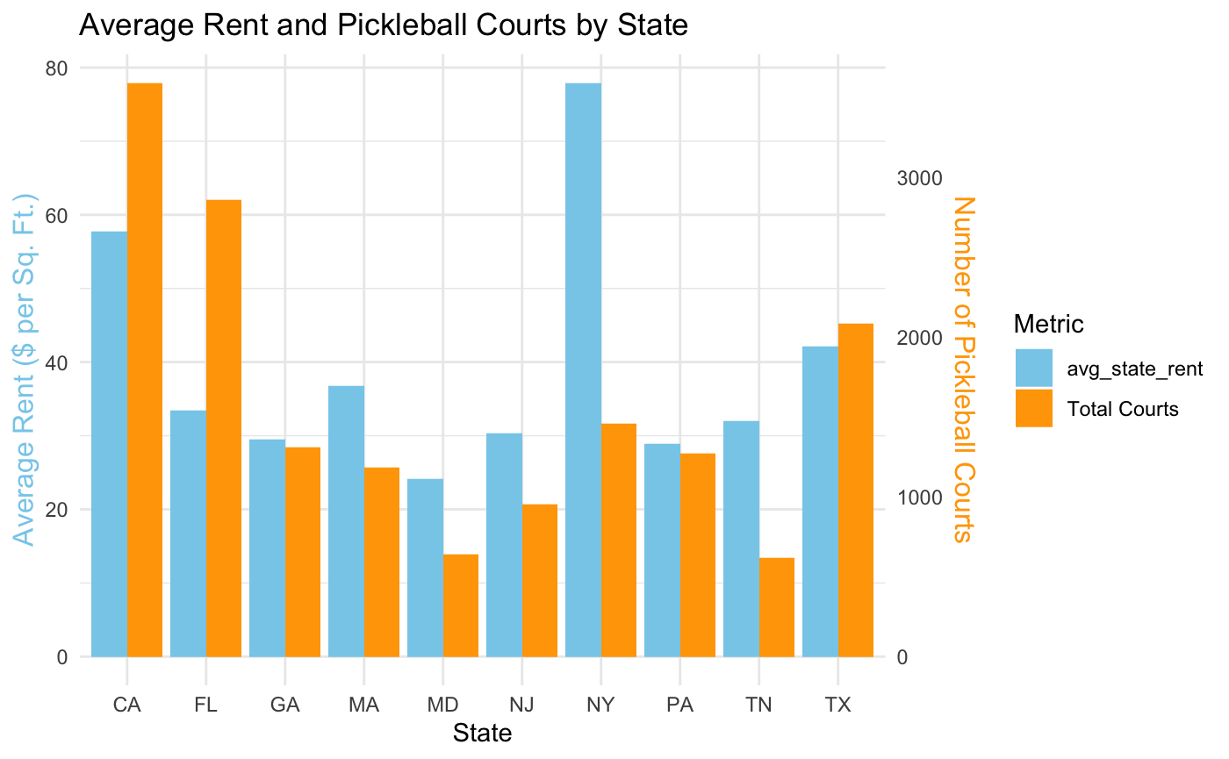
Possible States for Meta to move to
80
Average Rent for offices spaces with more than 40,000 sq .ft., not in the western USA, and in an urban area
Number of pickleball courts in 2023 (https://usapickleball.org/)
Based on these metrics Florida or Texas is a good candidate for relocation
70
78
50
40
30
20
60
10
BAR GRAPH INFO 1
BAR GRAPH INFO 1
BAR GRAPH INFO 1
BAR GRAPH INFO 1
Notes:
Script:
This chart shows our early exploration comparing average rent and pickleball court availability by state.
While this was a fun angle, we quickly realized that for a company like Meta, rent and regional tech density carry far more weight than local recreation.
That’s why we decided to dig deeper into economic factors, including unemployment trends and office infrastructure.
This helped us narrow our focus to states like Florida, Georgia, and Texas — which not only meet the basic relocation requirements, but also offer strong economic indicators.

Slide 4
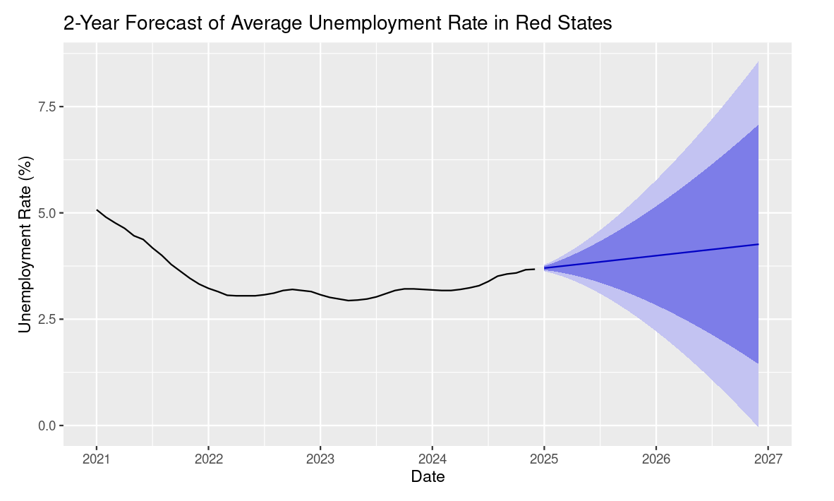
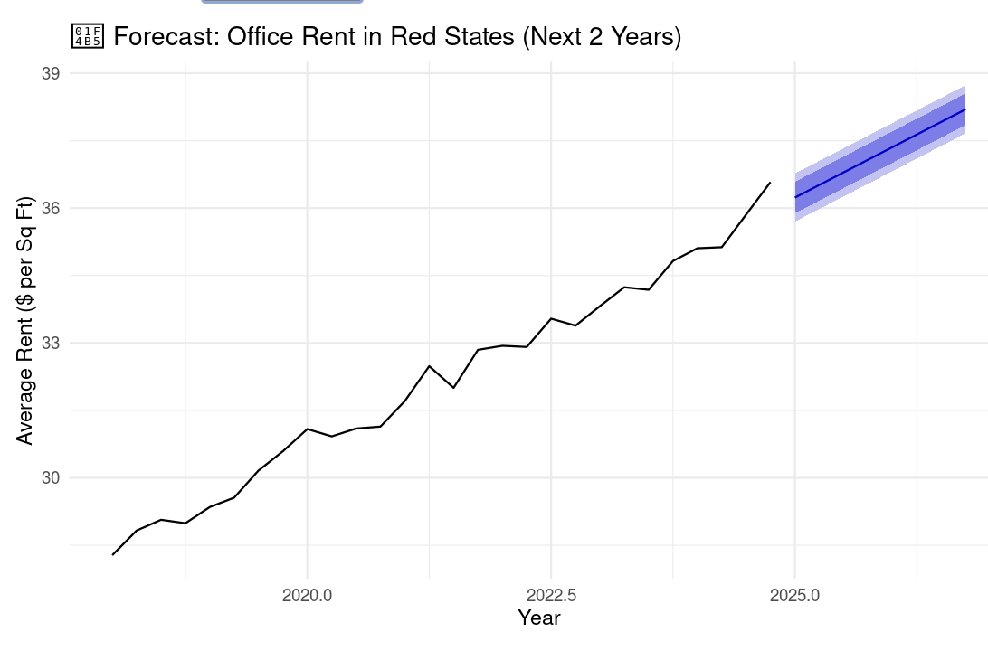
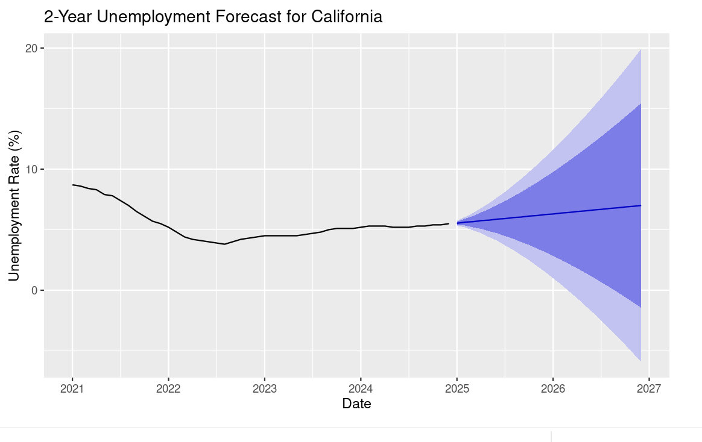
Forecasting Unemployment and Rent Cost
Unemployment in red states is projected to remain stable
Average office rent in red states is lower than in California
Notes:
But beyond just rent and pickleball, there are deeper reasons Meta may want to relocate.
Over the past year, Meta has faced growing political pressure in California, particularly in the Bay Area. There have been high-profile protests outside their offices and coordinated campaigns attacking the company’s stance on privacy, AI, and content moderation.
One striking example was the “Zuck crosswalk hack,” where activists projected a deepfaked version of Mark Zuckerberg’s voice onto city streets — a viral moment that symbolized public distrust in Meta's own technology and even Zuckaberg is not safe with AI moderation.
–
In this section, we explored the future of unemployment and rent trends in red states, using only post-COVID data starting from 2021 as COVID data would heavily influence our data for our clients.
On the top left, the graph shows that unemployment in red states is projected to remain stable with only modest increases expected over the next two years — a sign of a healthy and reliable labor market. similar to the bottom left graph showing unemployment forecast for california which is slightly higher
On the right, we forecasted average office rent. While it’s gradually rising, it remains significantly lower than in California, offering a valuable window for companies to secure space before prices climb further.

Slide 5
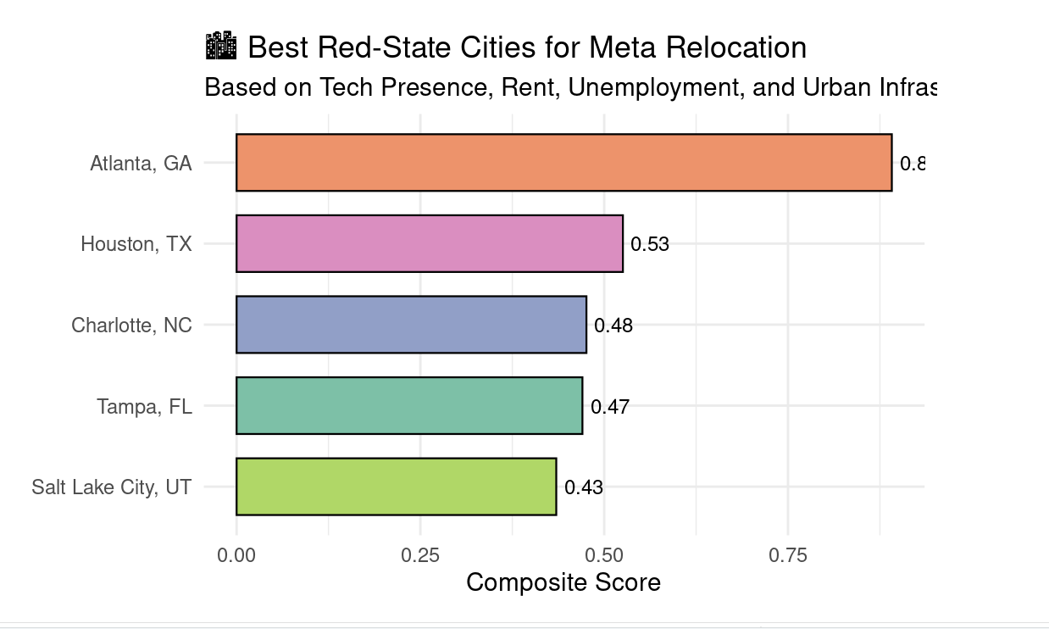
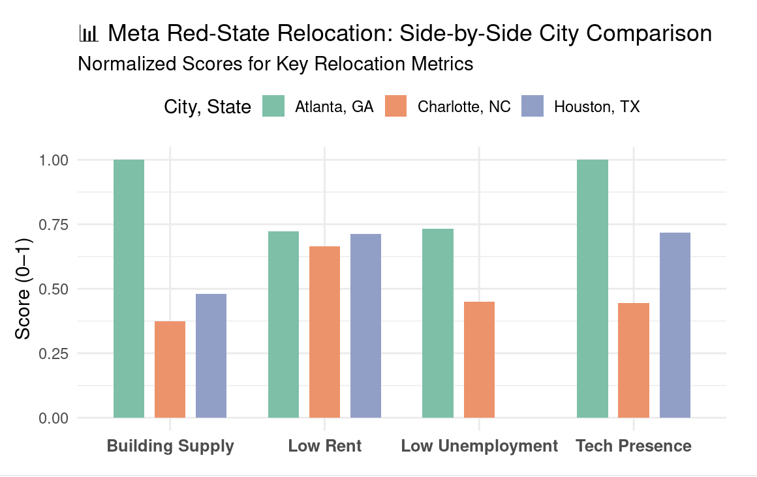
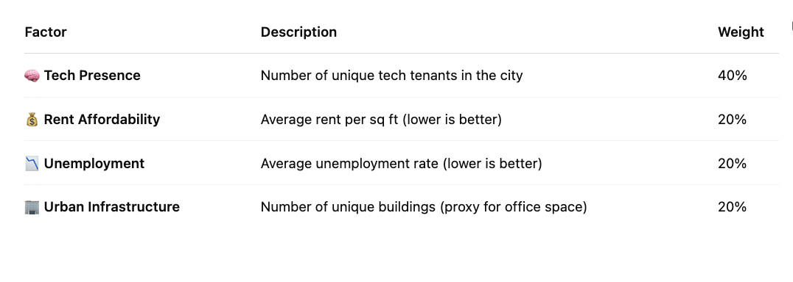
Best Cities For Relocation
Other than rent cost, Meta may consider the cities tech presence, unemployment rates, and urban infrastructure
Notes:
Now that we’ve forecasted the economic trends, we wanted to narrow things down even further — not just to states, but to the specific red-state cities that make the strongest case for Meta to move to.
So we created a composite scoring model based on four key criteria:
Tech presence — the number of unique tech tenants already operating in the city. This was weighted the heaviest at 40%, because for a company like Meta, being in a tech hub is critical.
Rent affordability — with a (20% weight). However Meta being a tech giant this does not pose a heavy percentage on to our model
Unemployment — lower unemployment signals a healthier and more stable job market (20%).
Urban infrastructure — measured by the number of unique large office buildings (20%), showing whether the city can actually support large corporate campuses.
On the right, the horizontal bar chart shows our top five red-state cities, based on their total composite scores. Atlanta stands out as the clear front-runner, followed by Houston, Charlotte, Tampa, and Salt Lake City.
On the bottom left, you’ll see a side-by-side breakdown of how each of these cities performed across the four metrics. For example, Atlanta scores extremely high in both tech presence and infrastructure, while Charlotte performs best in rent affordability which for a company like Meta doesnt really matter

Slide 6
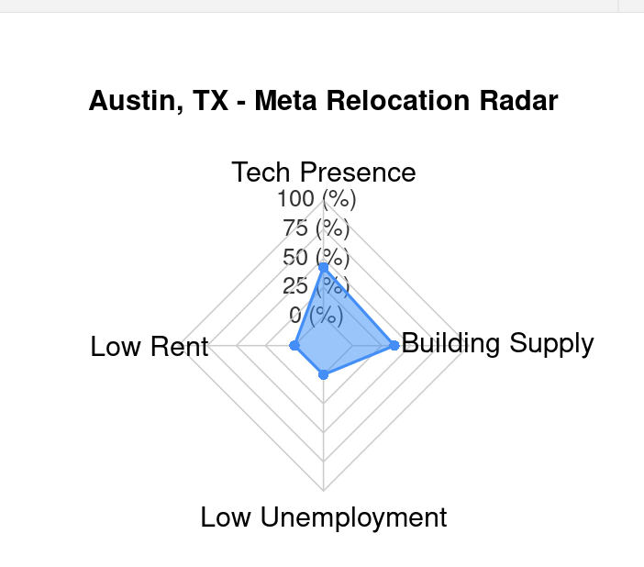
Where should Meta move?
Why Atlanta Wins:
Top composite score combining affordability, tech presence, economic strength, and office supply
Texas has no state income tax
Proven tech migration hub (Tesla, Oracle, Apple already here)
Robust infrastructure, university pipeline, and cultural vibe aligned with Meta’s workforce.
Texas has the 3rd most pickleball courts in the USA
The city ranks highest in key strategic metrics: affordable rent, tech ecosystem density, economic growth, and abundant office space. Already home to Tesla and Oracle, Austin offers regulatory freedom, talent access, and a culture that aligns with Meta’s future-facing mission.
Notes:
Unique_buildings is building supplies this is
Buildings located in red states
With over 40,000 sq ft
In urban areas (CBD)
Leased by tech-related companies
But ultimately, Austin, Texas came out on top.
Why? It has:
The highest composite score across all factors.
No state income tax — that’s huge for cost savings.
It’s already a tech hub, with Tesla, Oracle, and Apple expanding there.
And it offers a culture and infrastructure that aligns with Meta's needs.
The radar chart here shows how Austin leads in tech presence and infrastructure, while still performing well in rent and employment. These finding can also apply to medium to large tech companies that are considering to move out of california.
Ultimately, our data shows that relocating to a red-state city like Atlanta isn’t just cost-effective — it’s a strategic move for long-term growth and stability for Meta’s

Slide 7
Problem Statement
As tech giants like Tesla and X (formerly Twitter) exit California for lower taxes, cheaper rents, and reduced political friction, Meta now faces similar challenges — from rising operational costs to increasing public backlash.
Our goal: Identify the best relocation options for Meta (or a comparable tech firm) by analyzing:
📍 Office space availability ( >40,000 sq ft)
🌆 Urban location preferences
📉 Local unemployment rates
🧠 Regional tech ecosystem strength
This analysis provides a data-driven recommendation for where Meta should move next.

