Slide 1

SPATIAL ARCHITECTURE & ENVIRONMENTAL PSYCHOLOGY
NICOLI PASTICCERIA
A Holistic Study of Customer Journey, Wayfinding Friction, Sensory Zoning, and Dwell-Time Affordance
LIB1020 Design Case Study • Architectural Space Planning & Behavioral Analysis

Slide 2
THE SPATIAL EXPERIENCE FRAMEWORK
Mapping Customer Journey Across Five Experiential Thresholds
PHASE 01
Street Approach
Residential enclave, minimal signage, GPS-dependent discovery.
Anchor: 1 - Path x Find
PHASE 02
Threshold Gate
Dense foliage veil, psychological filtering, entrance obscurity.
Anchor: 2 - Entrance Gate
PHASE 03
Courtyard Hub
Prospect & refuge, dappled daylight, acoustic & seating nodes.
Anchor: 3 - Central Hub
PHASE 04
Pastry Sanctuary
High visual saliency, vitrine merchandising, ordering flow.
Anchor: 4 - Bakery Counter
PHASE 05
Third-Place Dwell
Tactile velvet booths, domestic shelving, user autonomy.
Anchor: 5 - Interior Seating

Slide 3
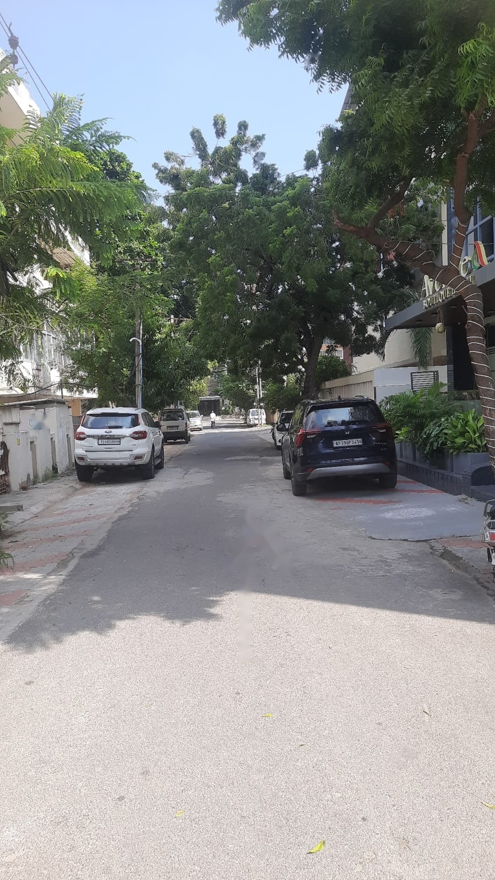
ZONE 01 // ARRIVAL & APPROACH
Street Approach & Signage Legibility
Navigating Residential Fabric without Commercial Markers
PHYSICAL & SPATIAL OBSERVATION
Quiet residential lane lined with mature neem trees, parked vehicles, and low-scale residential gates. Total absence of commercial pylon signs, roadside billboards, or elevated illuminated brand markers.
ENVIRONMENTAL PSYCHOLOGY & WAYFINDING
High reliance on external digital wayfinding (GPS). Creates an intriguing 'speakeasy' discovery effect for deliberate visitors, but imposes noticeable cognitive friction and doubt for first-timers.
DESIGN CRITIQUE & RECOMMENDATION
Context-sensitive environmental cues—such as refined sidewalk pavers, branded planters, or low bollards—would reassure pedestrians without disrupting neighborhood residential harmony.

Slide 4
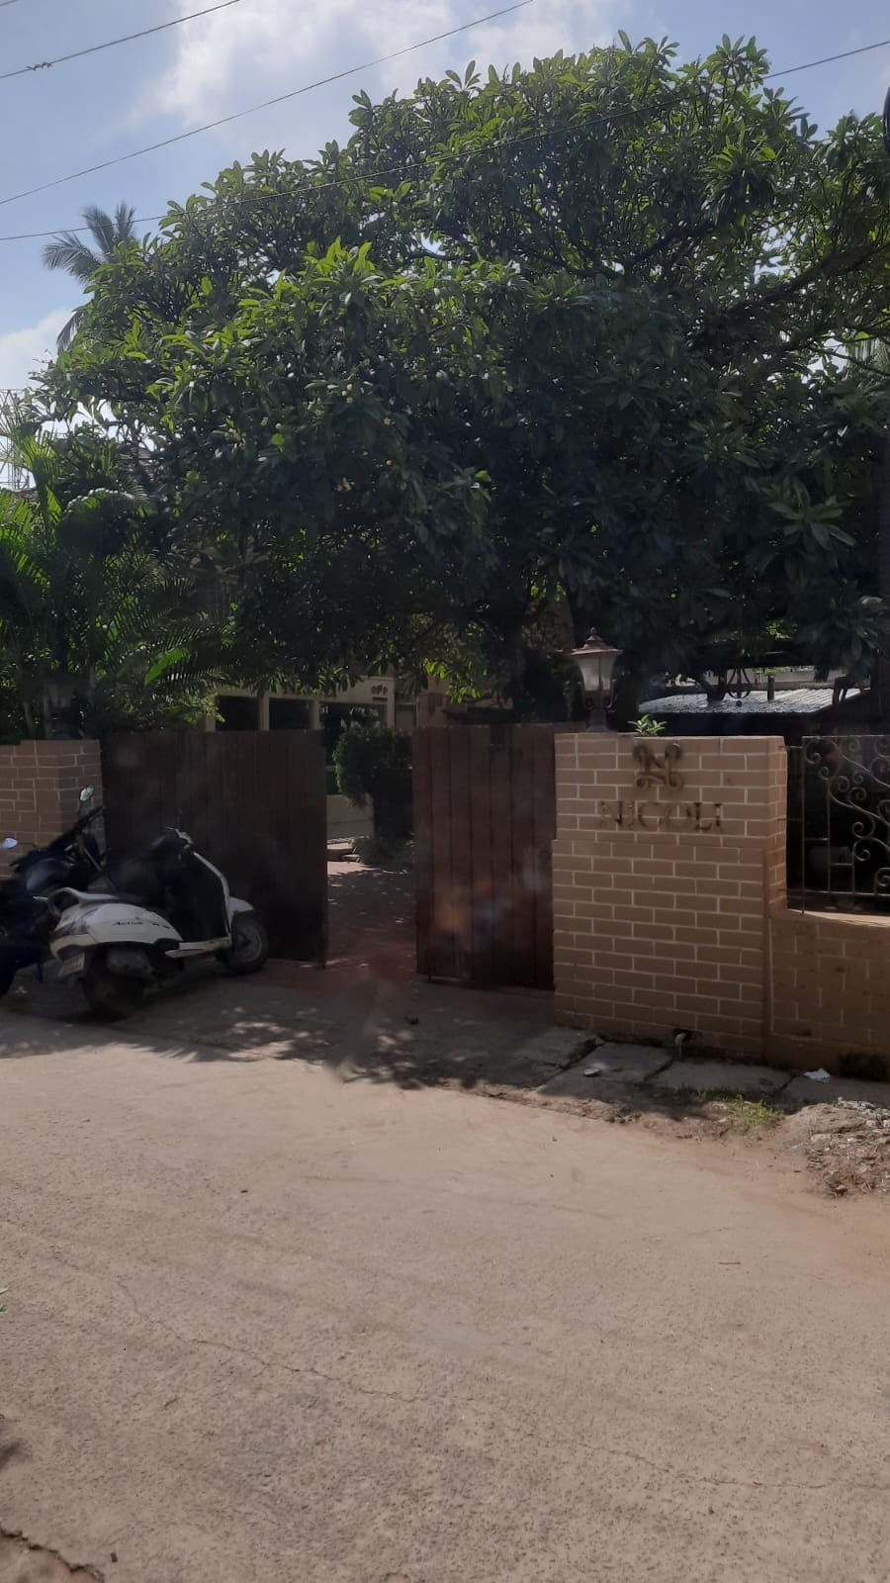
ZONE 02 // THRESHOLD TRANSITION
Entrance Threshold & Foliage Screening
Boundary Transition and Sensory Filtering at the Gate
PHYSICAL & SPATIAL OBSERVATION
Earth-toned brick pillars with metallic serif 'NICOLI' lettering, weathered wooden split gates, and dense overhead tree canopy casting a deep shadow over the entrance threshold.
ENVIRONMENTAL PSYCHOLOGY & WAYFINDING
The dense vegetation functions as a sensory airlock, shielding visitors from vehicular street noise. However, deep shadows obscure interior sightlines, triggering approach hesitation.
DESIGN CRITIQUE & RECOMMENDATION
Implement warm, low-glare ground uplighting on the brick pillar and entrance path to establish an unmistakable visual beacon during overcast afternoons and twilight hours.

Slide 5
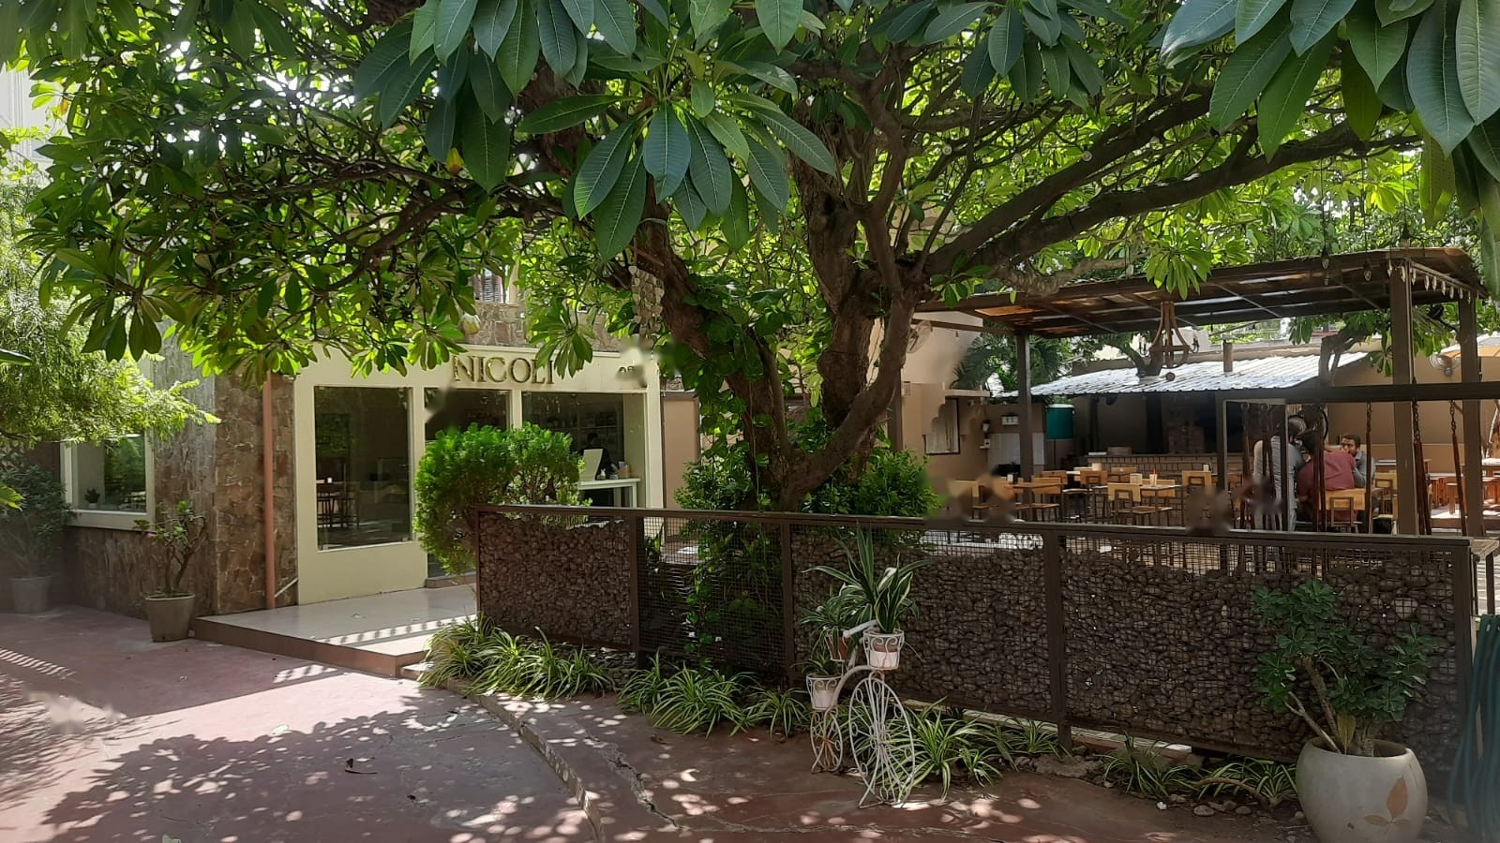
ZONE 03 // CENTRAL COURTYARD HUB
Courtyard Hub & Spatial Circulation
Multi-Zonal Organization and Biophilic Orientation
PHYSICAL & SPATIAL OBSERVATION
Sprawling frangipani canopy casting dappled shade across flagstones; stone-filled gabion wall separates outdoor dining from circulation. Direct sightlines connect the bakery door, swing seating, covered patio, and garden tables.
ENVIRONMENTAL PSYCHOLOGY & WAYFINDING
Acts as the primary orientation node ('Prospect and Refuge'). Visitors pause at the center to survey multiple micro-climates and seating modalities before committing to a table.
DESIGN CRITIQUE & RECOMMENDATION
The hub-and-spoke circulation is naturally intuitive; subtle paving color shifts could delineate the primary path to the pastry shop without needing intrusive directional signage.

Slide 6
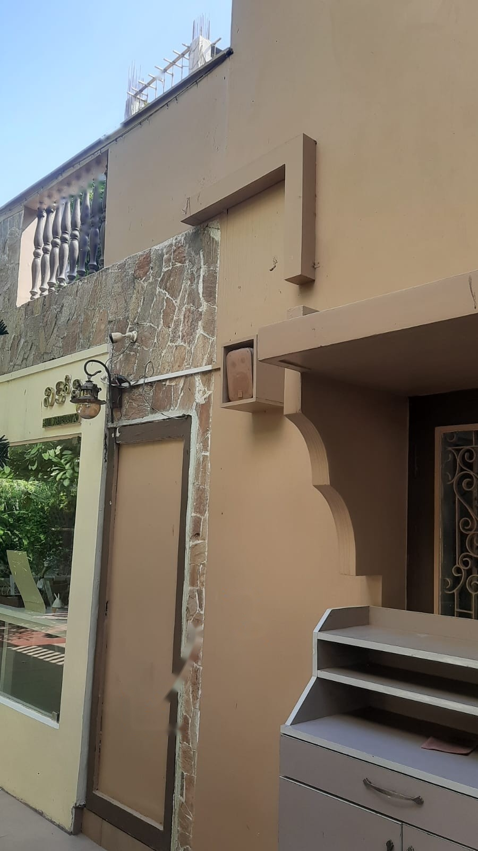
ZONE 03.1 // ACOUSTIC ENVIRONMENT
Auditory Ambiance & Acoustic Concealment
Balancing Environmental Noise with Dispersed Sound
PHYSICAL & SPATIAL OBSERVATION
Compact audio speaker housed discreetly within a recessed exterior wall alcove above the doorway, color-matched to the beige stucco and natural stone trim.
ENVIRONMENTAL PSYCHOLOGY & WAYFINDING
Generates a diffuse acoustic floor that softens street murmur while safeguarding conversation privacy. Concealed hardware maintains the authentic illusion of an organic domestic garden.
DESIGN CRITIQUE & RECOMMENDATION
Sound concealment prevents visual clutter and acoustic fatigue; decibel levels should dynamically calibrate between serene afternoon tea and bustling weekend gatherings.

Slide 7
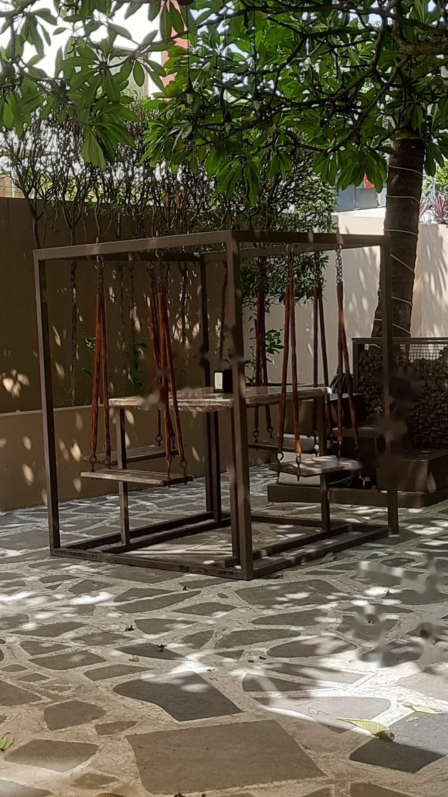
ZONE 03.2 // SEATING ERGONOMICS
Swing Seating: Playful Affordance vs. Posture
High-Novelty Magnet vs. Long-Stay Ergonomic Limits
PHYSICAL & SPATIAL OBSERVATION
Heavy structural steel box-frame suspending timber swing bench seats around an integrated stone table over rough-cut flagstone paving.
ENVIRONMENTAL PSYCHOLOGY & WAYFINDING
High visual affordance: immediately invites touch, playful interaction, and photography. However, lack of lumbar support and a fixed swing radius discourage long-dwell dining or laptop work.
DESIGN CRITIQUE & RECOMMENDATION
Functions brilliantly as a social focal point and photo magnet; must be strategically balanced with ergonomically cushioned banquettes elsewhere in the floor plan.

Slide 8
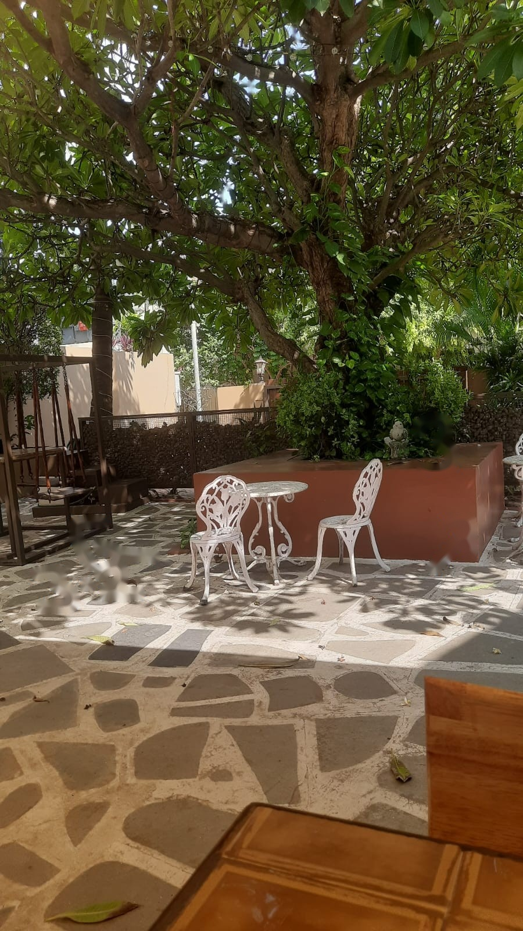
ZONE 03.3 // LIGHTING & ATMOSPHERE
Dappled Daylight & Garden Dining
Biophilic Lighting and Material Valence
PHYSICAL & SPATIAL OBSERVATION
Ornate white wrought-iron garden chairs and filigree table beneath the leafy canopy, adjacent to an earthy terracotta raised planter box.
ENVIRONMENTAL PSYCHOLOGY & WAYFINDING
Dappled sunlight filtering through natural leaves ('komorebi') triggers parasympathetic calming. The delicate white filigree stands out crisp and romantic against dark organic foliage.
DESIGN CRITIQUE & RECOMMENDATION
Hard unpadded iron creates physical pressure points after 25+ minutes; weather-resistant seat cushions would bridge the gap between visual romance and physical comfort.

Slide 9
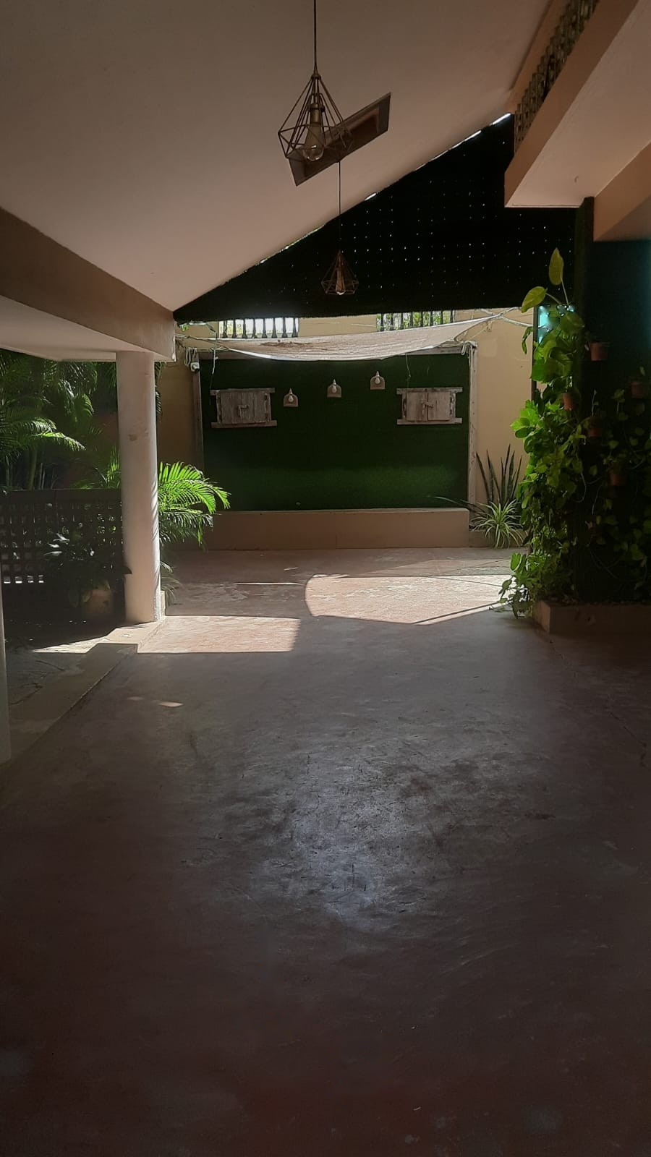
ZONE 03.4 // SPATIAL FLEXIBILITY
Covered Event Sub-Stage & Living Wall
Transitional Micro-Climates and Programmatic Adaptability
PHYSICAL & SPATIAL OBSERVATION
Deep sheltered patio framed by white structural columns, geometric wire pendant lights, smooth concrete flooring, and an artificial vertical hedge wall.
ENVIRONMENTAL PSYCHOLOGY & WAYFINDING
High psychological refuge: overhead roof provides intimacy and shade. The vertical green wall acts as an acoustic baffle and clean focal backdrop for private gatherings or performances.
DESIGN CRITIQUE & RECOMMENDATION
The transition from sunny courtyard to deep patio causes a steep drop in illumination; warm accent track lighting along ceiling beams is vital to avoid a sunken, shadowy feel.

Slide 10
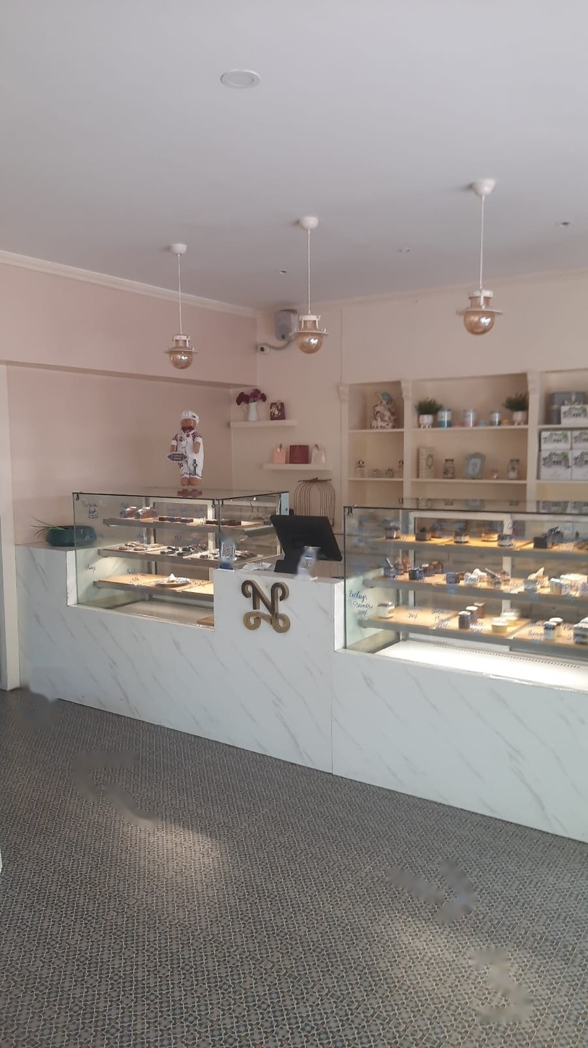
ZONE 04 // INTERIOR ORDERING COUNTER
Pastry Showcase & Merchandising Saliency
Visual Appetite Cues vs. Queueing Flow Ambiguity
PHYSICAL & SPATIAL OBSERVATION
L-shaped marble-clad counter with illuminated glass vitrines displaying artisanal pastries, central brass 'N' monogram, and POS terminal against soft pastel walls.
ENVIRONMENTAL PSYCHOLOGY & WAYFINDING
High visual saliency: brilliantly lit pastries act as irresistible appetite anchors. However, the counter provides no visual indicators for where the queue starts versus where orders are collected.
DESIGN CRITIQUE & RECOMMENDATION
Incorporate subtle architectural cues—such as a specific pendant light drop or floor inlay pattern—to guide intuitive ordering progression without tacky rope barriers.

Slide 11
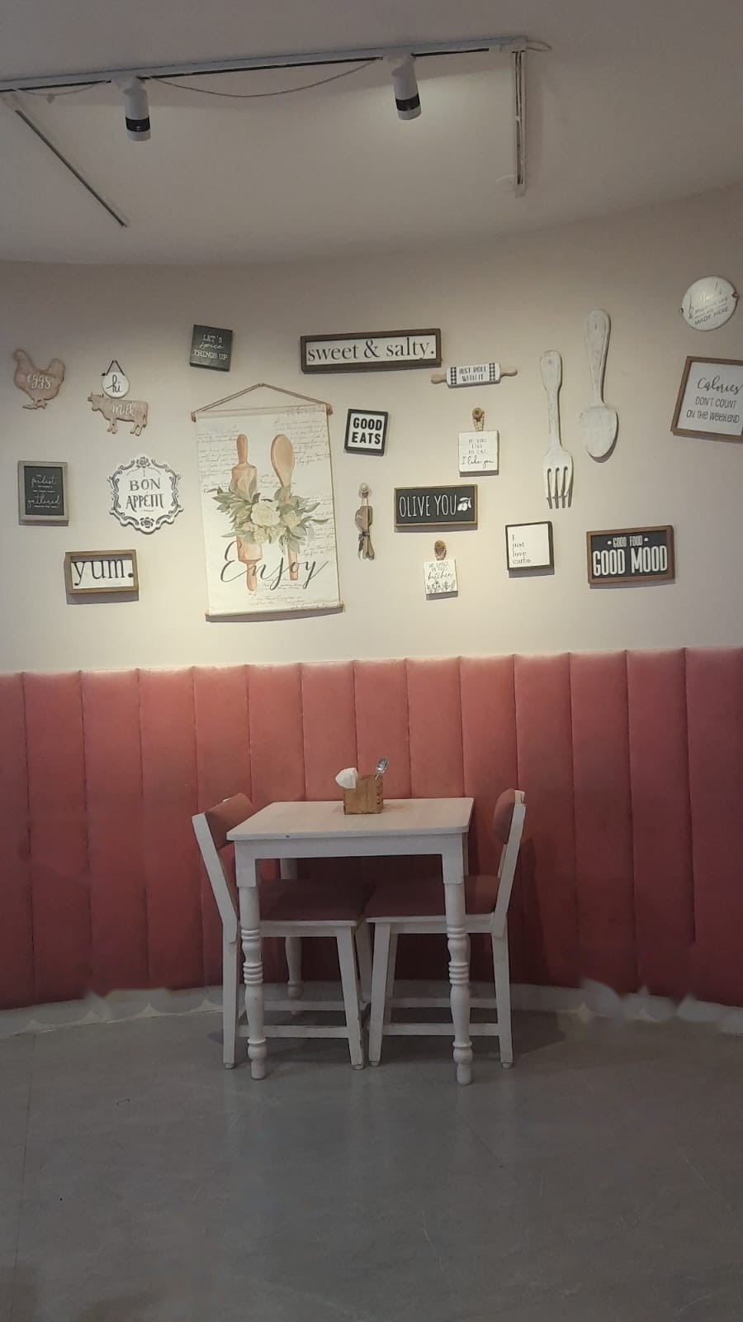
ZONE 05.1 // TACTILE COMFORT & BOOTH
Velvet Booth & Tactile Aesthetics
Acoustic Dampening and Photo-Ready Domestic Charm
PHYSICAL & SPATIAL OBSERVATION
Dusty-rose vertical channel-tufted upholstered wall banquette, white turned-leg table, and a curated culinary typographical gallery wall.
ENVIRONMENTAL PSYCHOLOGY & WAYFINDING
Velvet tufting absorbs acoustic reverberation and offers rich tactile warmth. High-back banquettes satisfy instinctual desires for territory and psychological refuge.
DESIGN CRITIQUE & RECOMMENDATION
Vertical upholstery successfully doubles as artistic accent and sound dampener, creating the most emotionally comforting, high-demand seating zone in the cafe.

Slide 12
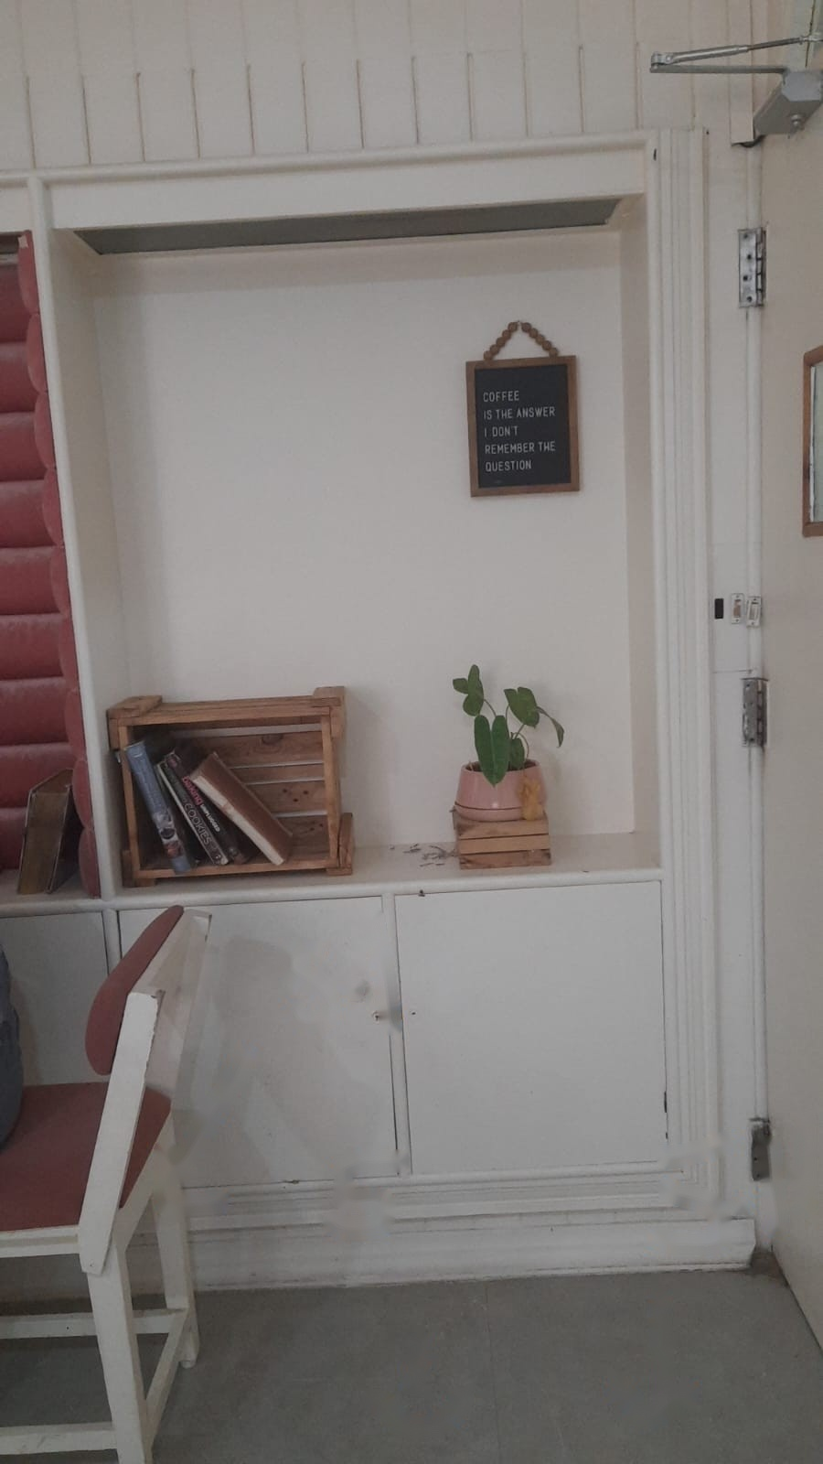
ZONE 05.2 // THIRD-PLACE PSYCHOLOGY
Domestic Cues & 'Third Place' Sanctuary
Fostering Belonging Through Residential Joinery
PHYSICAL & SPATIAL OBSERVATION
White built-in cabinetry featuring an open wooden crate bookshelf with real books, a potted houseplant, and a framed chalkboard coffee quote.
ENVIRONMENTAL PSYCHOLOGY & WAYFINDING
Directly embodies Ray Oldenburg's 'Third Place' theory: domestic architectural elements signal that leisurely dwelling, reading, and unhurried contemplation are welcomed.
DESIGN CRITIQUE & RECOMMENDATION
Residential styling humanizes commercial hospitality, building customer attachment and encouraging repeat visits over rapid transactional turnover.

Slide 13
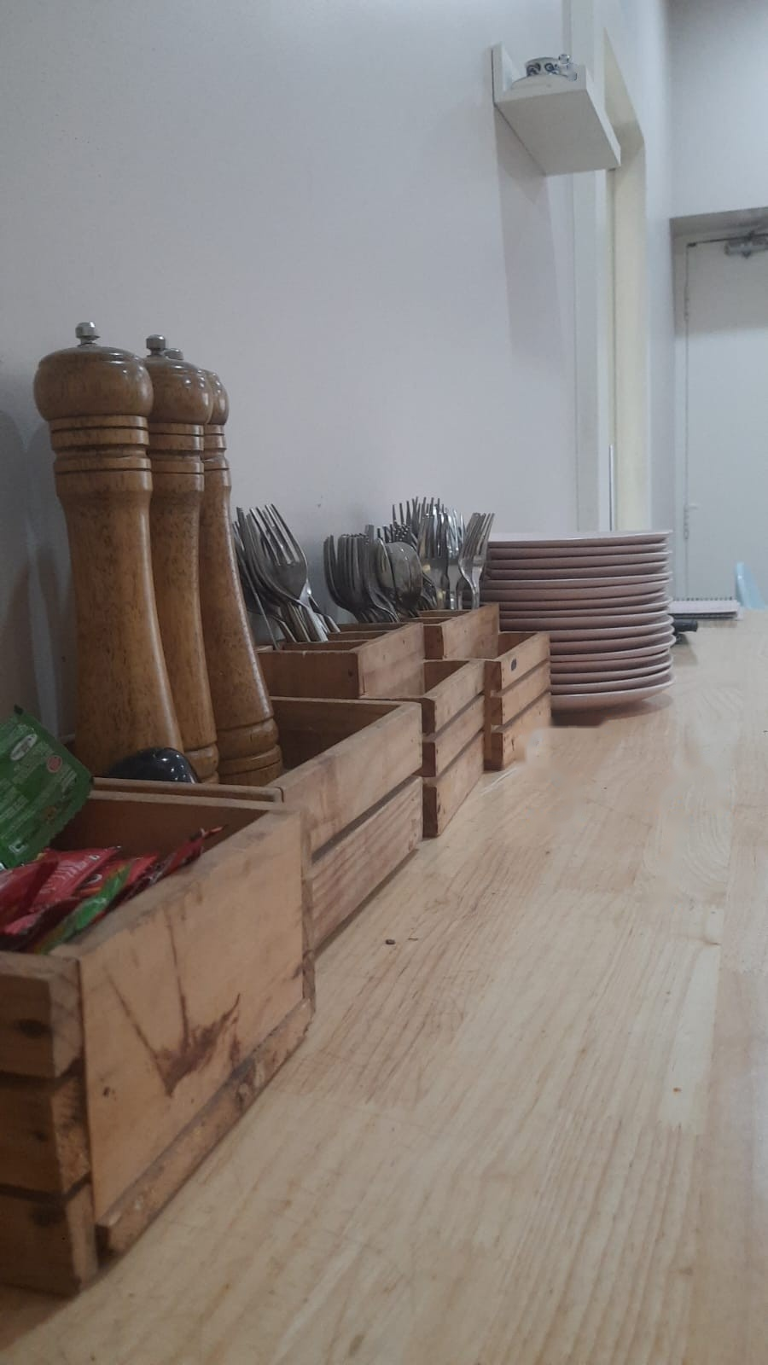
ZONE 05.3 // SELF-SERVICE & AUTONOMY
Tableware Station & Customer Agency
Perceived Affordance and Frictionless Self-Service
PHYSICAL & SPATIAL OBSERVATION
Solid timber side table arranged with rustic wooden crates containing condiment packets, tall pepper grinders, stainless steel cutlery, and stacked plates.
ENVIRONMENTAL PSYCHOLOGY & WAYFINDING
Immediate perceived affordance: necessities are categorized, exposed, and reachable. Empowers patrons with agency, avoiding awkward delays waiting for busy servers.
DESIGN CRITIQUE & RECOMMENDATION
Natural wood caddies reinforce handcrafted culinary values; keeping the station in plain sight from all indoor tables ensures frictionless customer autonomy.

Slide 14
SPATIAL SYNTHESIS & BEHAVIORAL MATRIX
Environmental Cues Across Spatial Zones at Nicoli
Spatial Zone | Lighting Environment | Acoustic Level | Dwell Time | Dominant Psychological Driver
Street Approach | Full Daylight / Sun | Urban Ambient / Low | 2 - 3 mins | Anticipation & Exploration
Entrance Threshold | Deep Canopy Shade | Sensory Airlock Filter | 1 - 2 mins | Boundary Crossing / Discovery
Courtyard Hub | Dappled Foliage Shade | Diffuse Background Music | 30 - 60 mins | Prospect & Refuge Dynamic
Covered Patio | Sheltered Sub-ambient | Baffled Green Wall | 20 - 45 mins | Spatial Intimacy / Event Focus
Pastry Counter | High-Lumen Showcase | Active Transactional | 3 - 5 mins | Visual Saliency / Appetite
Dining Banquette | Warm Diffuse Lighting | Upholstery Absorbed | 45 - 90 mins | Tactile Warmth & Sanctuary

Slide 15
ARCHITECTURAL TAKEAWAYS
Four Design Principles for Experiential Hospitality Spaces
01
Threshold Legibility
Balance the intrigue of foliage and mystery with illuminated low-glare twilight signifiers to prevent first-timer friction.
02
Ergonomic Diversity
Pair high-novelty magnets (like swing seating) with supportive, upholstered banquettes to cater across dwell times.
03
Intuitive Wayfinding
Delineate ordering, queuing, and circulation zones through architectural shifts in flooring and lighting rather than clunky signage.
04
Sensory 'Third Place'
Seamlessly integrate residential cues, biophilia, acoustic baffling, and customer autonomy to transform a cafe into a living sanctuary.

