Slide 1

The jBilling Open Source Advantage
The Enterprise Open Source Billing System

Slide 2
jBilling – Company Overview
jBilling was started in 2003, with the development of a billing framework using Java EE.
jBilling is not a software vendor, but a consulting company.
jBilling is small and distributed with consultants and developers in four continents.
jBilling has the largest installed base, with thousands of downloads per month.

Slide 3
jBilling – Company Overview
Customers include...
  Mobile phone operators - Ex: Spinbox - Sweden
  Internet services providers – Ex: Douglas FastNet – Oregon
  Application service providers – Ex: Pureplay.com – San Francisco
  Media – Ex: Stream The World - Canada

Slide 4
Why jBilling?
It has the functionality and features needed for enterprise level billing.
It is flexible: it can be configured and extended to meet your requirements.
It is open source: no licensing cost and full control of the billing solution remains with you.

Slide 5
jBilling
Features
Flexibility
Open Source

Slide 6
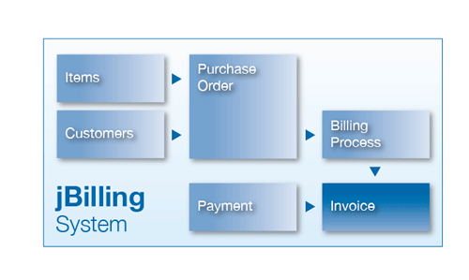
jBilling - Basics
Items are simple representations of your products and services
Customers buy items
Orders 'connect' items with customers
Invoices are only generated from orders
Payments reduce an invoice balance

Slide 7
Features – Billing process
The billing process runs periodically to select orders and generate invoices.
It can run on any period of days, weeks or months.
It can produce a review report to allow for the review of the invoices to be generated. Errors can be fixed before they make it to real invoices.
Fully automated invoices generation

Slide 8
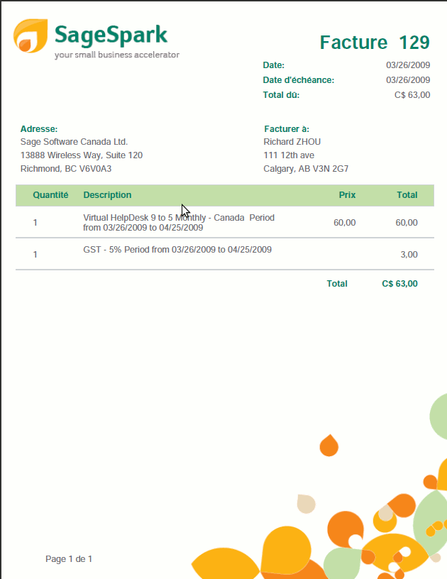
Features - Invoices
Invoice presentation if fully configurable with GUI
Customers can have any combination of recurring charges (subscriptions) and one-time charges.

Slide 9
Features – Payment processing
The billing process can request the payment of an invoice as soon as it is generated.
Automatic payment processing is done using plug-ins.
Plug-ins encapsulate the integration with the external payment gateways.
Asynchronous and parallel processing allow for unlimited scalability.

Slide 10
Features - Payments
Payment can be done with checks, credit cards and ACH.
A payment can pay multiple invoices
A payment can pay a fraction of an invoice
A payment can be automatically linked to an invoice when the invoice is generated or when the payment is entered.

Slide 11
Features - Notifications
Every event in the billing system is associated with a notification.
Each notifications has a template associated with it.
Templates are mostly text, with variables and logic embedded
Emails can be just text, or full html.
Dear $first_name, $last_name
This is to notify you that invoice $invoice.number is ready with the charges for your Gold subscription.
#if customer.state = 'FL then
Did you know that residents of Florida have access to additional storage? Please click ...
#endif

Slide 12
Features – Accounts Aging
The system tracks invoice balances
As a balance ages, the system can transition the customer status.
The aging steps are configurable: from “Active”, to “Deleted”.
Events are produced to alert other systems of a status change (for provisioning and other processes).

Slide 13
Features - Reports
A built-in reports engine is included
Reports can be saved and configured to extract any data from the system.
Additional reporting is common with Jasper Reports or Crystal Reports. This allows for scheduled reports and more formats.

Slide 14
Features - Integration
Every function of the server is exposed in the API
  User management: Create, Update, Delete
  Order management: Create, Update, Delete
  Queries, etc...
Available protocols are
  SOAP (web services), Hessian, Burlap, RMI
Plug-ins can listen to internal events, then make external calls

Slide 15
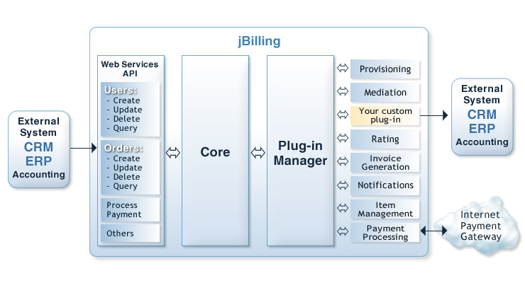
Features - Integration

Slide 16
Features - Mediation
The mediation module processes external records to translate them into billable items
Mediation can be batch (files or database) or real-time (API calls).
Full flexibility to accommodate for any CDR format.
Record splitting, grouping, error handling and record recycling is available.
High performance: several hundreds of records per second.

Slide 17
Features - Rating
Rating is done with a rules engine that is embedded in jBilling.
Any combination or condition can be expressed as a rules, without changing code in the billing system.
Discounts, taxes and special pricing are possible.

Slide 18
Features - Rating
Rates can be loaded from a spreadsheet or entered as explicit rules.

Slide 19
jBilling
Features
Flexibility
Open Source

Slide 20
Flexibility: Plug-ins
The core of the billing system is unaware of how specific processes are implemented.
Instead, it relies on plug-ins.
Hundreds of jBilling plug-ins are available for
  Invoice generation
  Payment processing
  Email notifications
  Etc.

Slide 21
Flexibility: Events
The core of the billing system publishes an event for most of its actions
A new invoices or a payment that failed are all internal billing events
A plug-in can listen to specific events to add custom logic to the system.

Slide 22
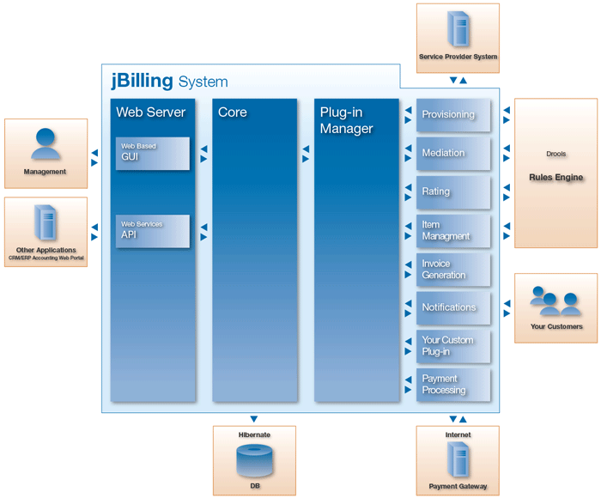
Flexibility: Events

Slide 23
Flexibility: Rules
jBilling adopted JBoss Rules as a rules engine an Business Rules Management System (BRMS)
In most cases, even the most complex requirement can be addressed with new rules in the BRMS, rather than with changes to the jBilling core or a new plug-in.

Slide 24
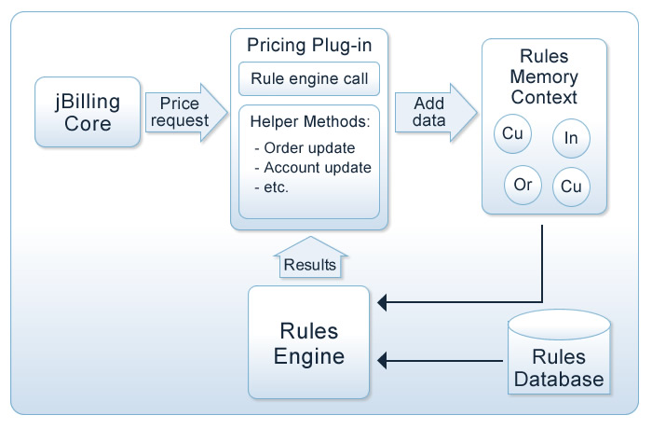
Flexibility: Rules

Slide 25
Example: business case
Offer pre-paid package of 1000 clicks for half price (5 cents, instead of 10).
The 1000 clicks have to be done within a month.
Anything above this limit would pay the standard rate.

Slide 26
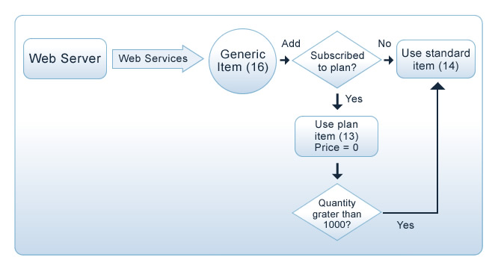
Example: implementation
The system provisioning the service (web server) should not be aware of the new promotion. It relies only one one generic item.

Slide 27
jBilling
Features
Flexibility
Open Source

Slide 28
Open Source
What is Open Source?
  Anybody can download, install and use the software for free.
  The source code is also freely available.
  Revenue is based on professional services.
Unmatched quality assurance.
Fast and accurate feedback for product development.
Rapid development with contributions from the community.

Slide 29
Open Source: cost
Immediate savings: no licensing fees
DIY: Leverage your internal resources to customize jBilling.
Choose your platform: jBilling runs on any database, operating system and application server.
Pick from open source or commercial vendors your best option: Oracle, MySQL, Linux, Solaris, Weblogic, Tomcat, etc...

Slide 30
Open Source: control
You choose when:
  A new feature is developed
  How to deploy the system
  When a bug is fixed
You can gain knowledge of jBilling overtime:
  Minimize your reliance on any vendor
  All the source code is there for you to examine
It is key to retain control of mission critical applications, such as billing.

