Slide 1
Developers & Databases
SQL, ORMs, MicroORMs, MVC, etc.

Slide 2
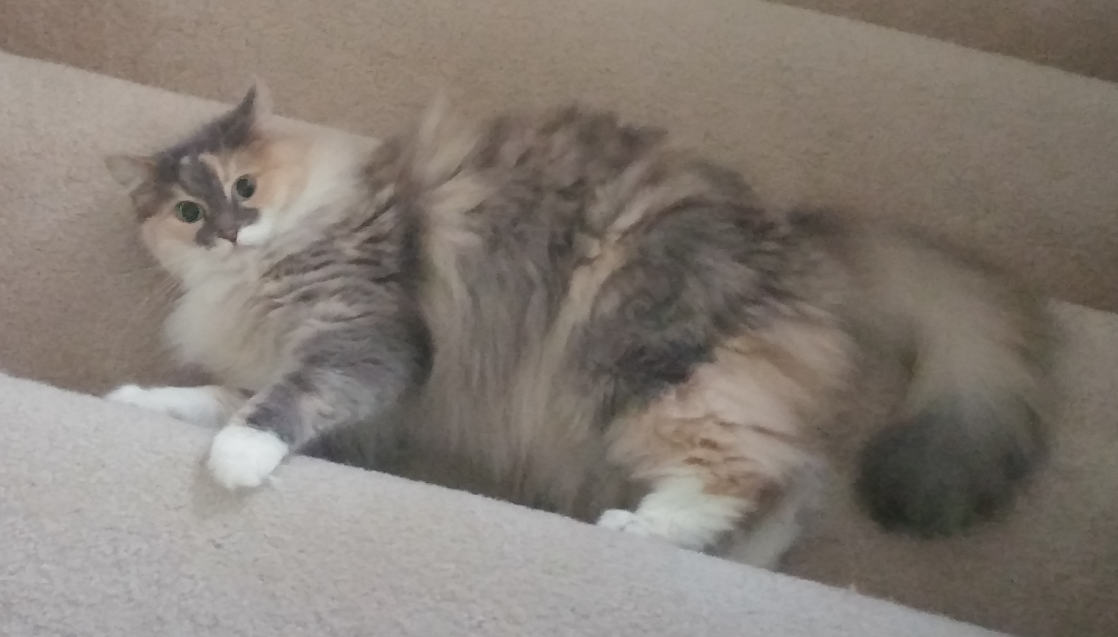

Introduction
Application developer, at the UI, for around 10 years now. 11-years total professional experience.
Web Developer, DBA, participates in some research on campus
Computational genomics, drug discovery, data/image mining, HPC
@thedarktrumpet

Slide 3
Overview
Goals of this presentation, and why it’s important
Definitions
A [brief] history of Application Development, related to databases
Useful Developer Tools
Discussion, Q&A

Slide 4
Definitions
Developer - Scope limited to web development, application development, anything touching a relational database.
Design Pattern - Given a recurring problem, this is a generalized solution.
MVC = Model View Controller (Design Pattern)
ORM - Object Relational Mapping

Slide 5
Brief History
10-12 Years Ago…and sometimes current…
<?php
$servername = "localhost";
$username = "username";
$password = "password";
$dbname = "myDB";
// Create connection
$conn = mysqli_connect($servername, $username, $password, $dbname);
// Check connection
if (!$conn) {
die("Connection failed: " . mysqli_connect_error());
}
$sql = "SELECT id, firstname, lastname FROM MyGuests";
$result = mysqli_query($conn, $sql);
if (mysqli_num_rows($result) > 0) {
// output data of each row
while($row = mysqli_fetch_assoc($result)) {
echo "id: " . $row["id"]. " - Name: " . $row["firstname"]. " " . $row["lastname"]. "<br>";
}
} else {
echo "0 results";
}
mysqli_close($conn);
?>

Slide 6
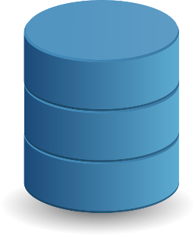


Brief History (cont…)
Greater than 5 years ago…
Library (Model)
Views (PHP/DSL)

Slide 7
Brief History (cont…)
Greater than 3-years ago
Library (Model/ORM)
Library (Model/ORM)
Controller (Switcher)
Views (DSL)

Slide 8
Brief History (cont..)
Recent
Model (EF/etc)
Framework (MVC/etc)
Application (API)
Web App (JS/Node/Etc)
Application (API)
Model (EF/etc)
Application (Console)
Framework (MVC/etc)

Slide 9
ORM Demos
First – F# with micro-orm-ish like option
Second – C# with a micro-orm (PETAPOCO)
Third – C# with Entity Framework

Slide 10
Tool Demos
Linqpad
DataGrip
Visual Studio (Database Project)
Git/Version Control

Slide 11
Useful Tools to show-off
SSIS – Cloning databases
SQL Server Profiler
SSMS
Stored Procedures/SQL/etc

