Slide 1
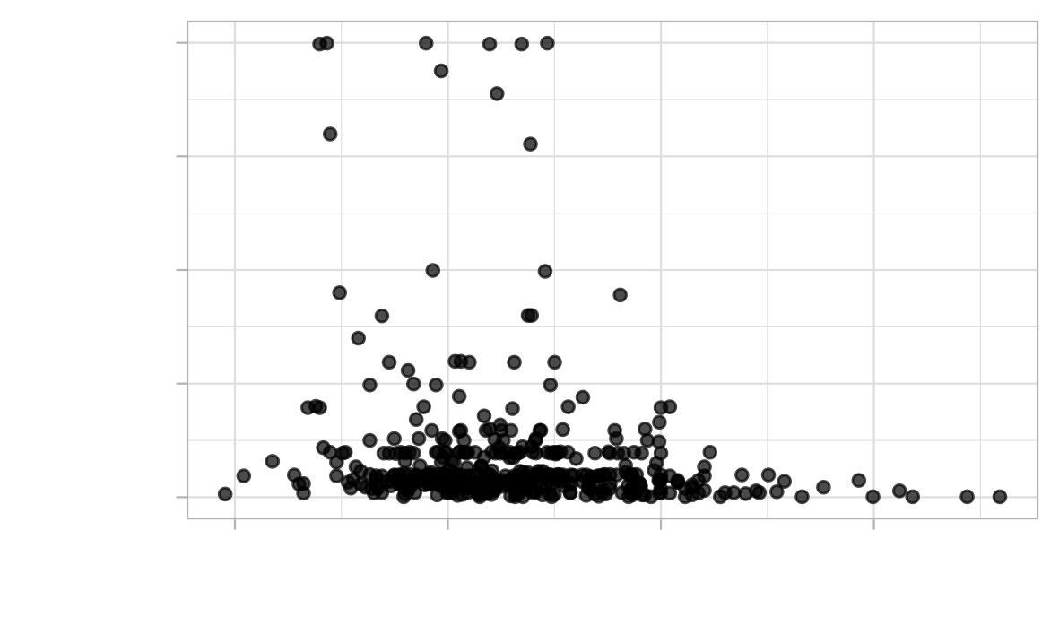


Slide 2

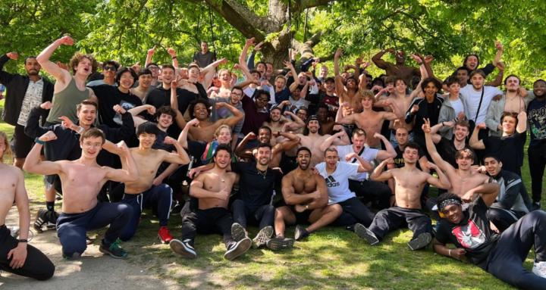
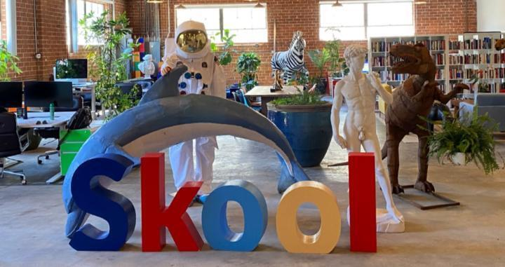
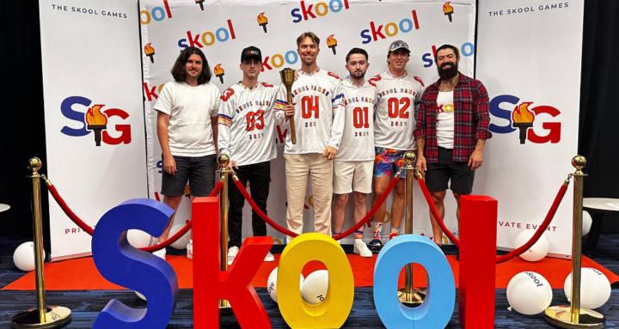

Max Business School™
#36 | Public | Free
161,500 Members
A community for anyone to learn
practical skills in their pursuit of
freedom, for free.
Adonis Gang
# 2 | Private | Free
137,400 Members
Men need brotherhood now more than ever. Join the largest self improvement
community!
Skool Community
#8 | Public | Paid
121,000 Members
Let's collaborate to make Skool better.
Share your feedback!
Skool Masterclass
#41 | Private | Free
63,800 Members
Learn how to make 💰 online with Skool.
Digital Wealth Academy
#7 | Private | Paid
60,700 Members
Welcome to the Digital Wealth Academy Online community. Here you will learn how to make money online with the Master Resell Rights business model.

Slide 3
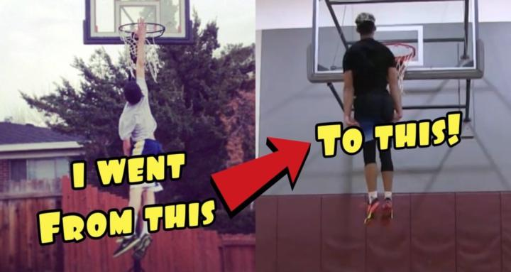
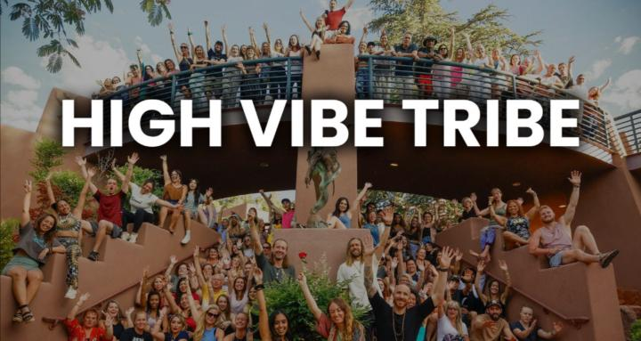
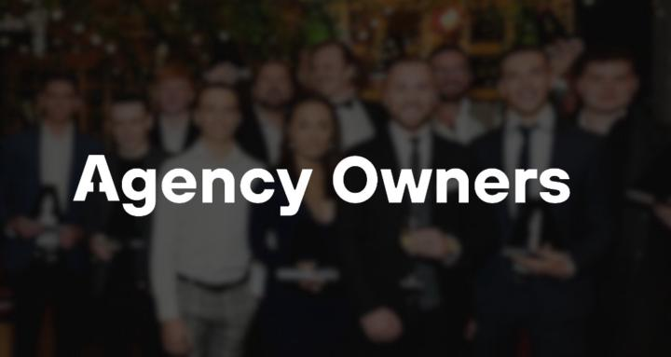


THP Jump Training
#40 | Private | Free
56,200 Members
This course will give you all the resources needed to get your first dunk and beyond!
High Vibe Tribe
#16 | Private | Free
42,300 Members
A community for those dedicated to raising
their vibration, healing, letting go of limitations and creating freedom in all areas of life!
Agency Owners
#60 | Private | $1/month
39,000 Members
Master your environment by surrounding yourself with other agency owners.
Social Media Business
# 86 | Private | Free
36,200 Members
A community for those interested in
making money online using the power
of social media.
Ultimate Branding Course
#29 | Private | Paid
36,100 Members
Welcome to the The Ultimate Branding Course & Community! Learn to build a powerful brand on
social media while making money with Master
Resell Rights.

Slide 4

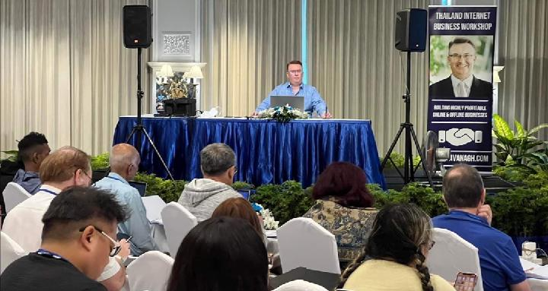
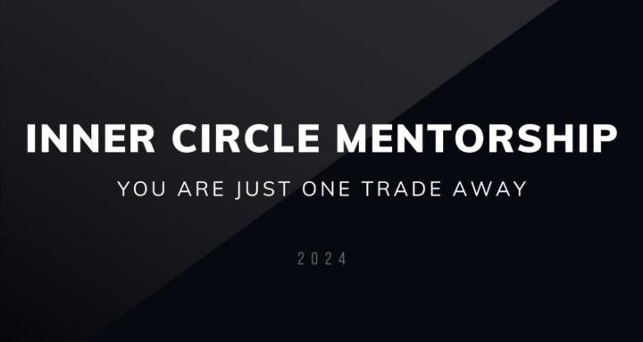

🏆 CHALLENGE 60 JOURS™
#420 | $999
79 Members
Transforme radicalement ton Mindset
en 60 jours pour devenir une nouvelle personne et libérer ton plein potentiel
Best Coaching Program
#461 | $999
293 Members
Best Coaching Program is the premier online coaching program by Internet Business Coach, David Cavanagh
DT Inner Circle provides you with the frameworks and guidance to get over 100K in funding in 90 days and become a consistently profitable trader.
DT Inner Circle™️
#866 | $999
27 Members
New Earth Health Coaches
# 706 | $999
108 Members
For HealthProfessionals, Experts and Coaches who are awakening to their life's purpose and building $50k/m Online Coaching Businesses

Slide 5

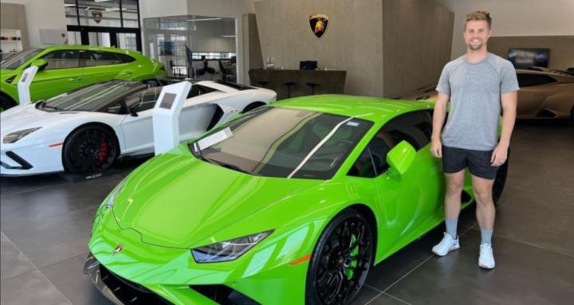
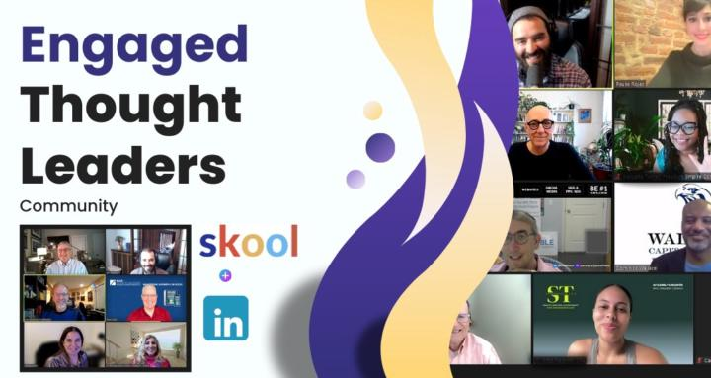
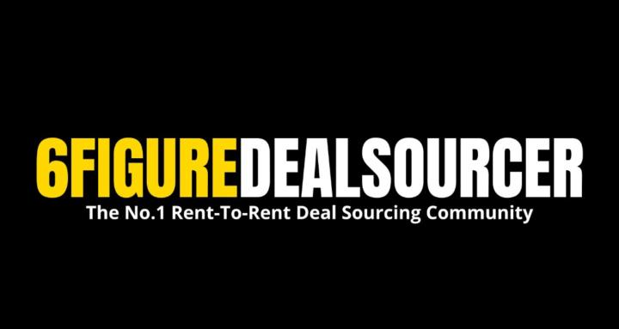
💸 YouTube Magnate = approaching YouTube like an entrepreneur, so you can make money creating videos about whatever you're interested in.
YouTube Magnates
# 561 | $997
157 Members
Sports Content Creators
#583 | $997
222 Members
The only community for independent sports content creators making 6 figures monthly using personal brands and faceless social media accounts.
Engaged Thought Leaders - 🤝
#613 | $997
25 Members
Join the Engaged Thought Leaders: Innovate, network, and lead in your field. Elevate your LinkedIn presence and make impactful connections 😎👌🤝
#6FigureDealSourcer (PREMIUM)
#969 | $938
93 Members
Helping Deal Sourcers make £10,000+ per MONTH by selling Rent-To-Rent deals to investors for £3,000 EACH using my FREE Facebook strategy 🔥

Slide 6
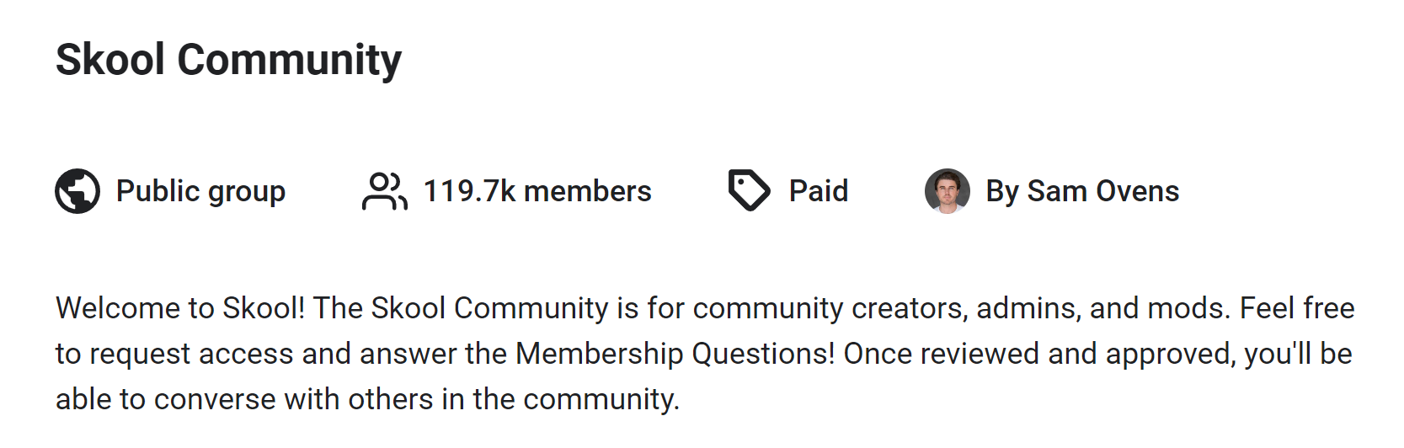
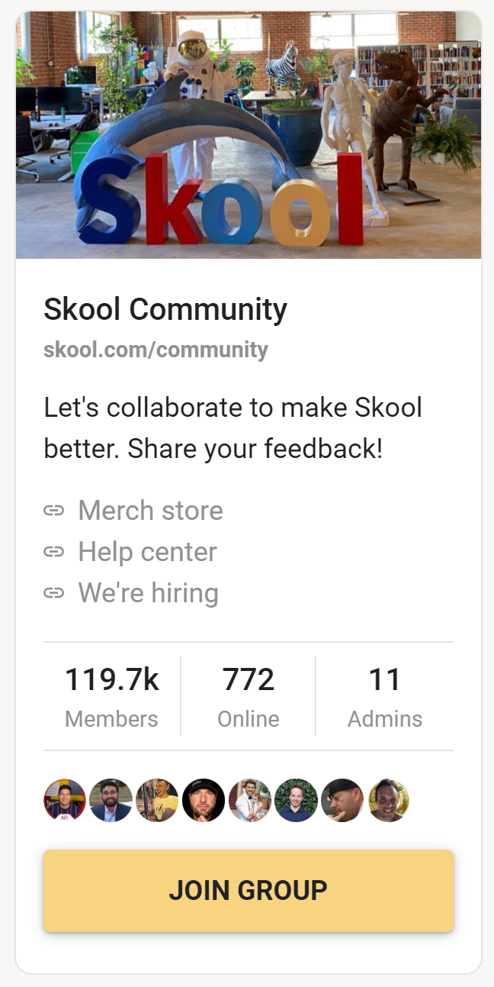
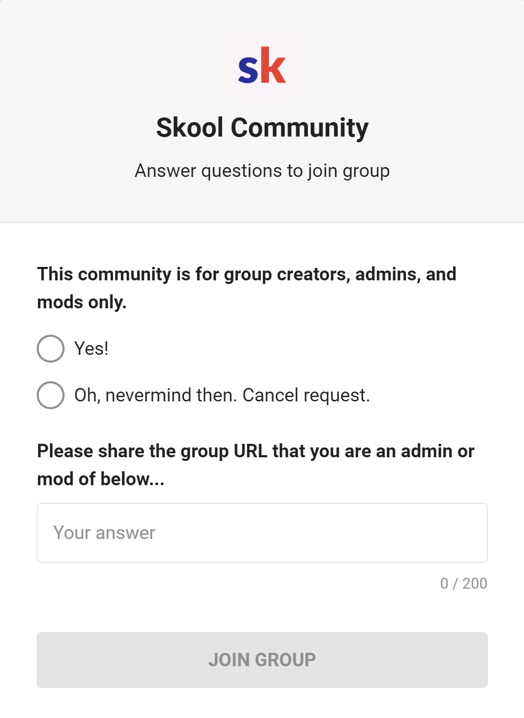
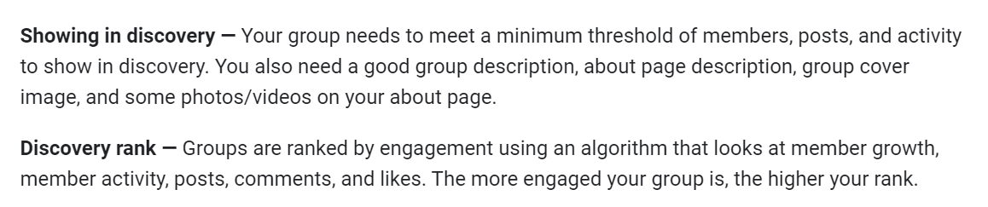
Notes:
After joining that community, link to my youtube video.

Slide 7
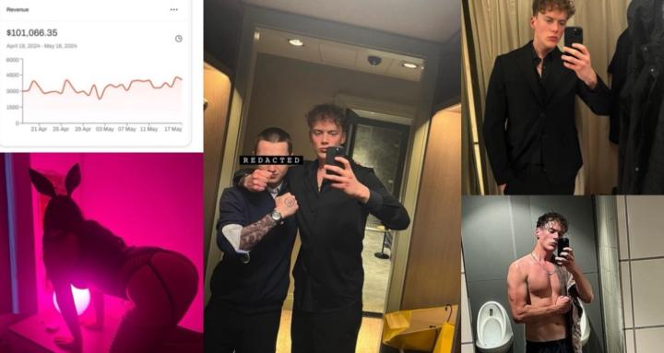
#356 | 🏆 CHALLENGE 60 JOURS™ | 84 | 999
Transforme radicalement ton Mindset en 60 jours pour devenir une nouvelle personne et libérer ton plein potentiel
Best Coaching Program is the premier online coaching program by Internet Business Coach, David Cavanagh
#488 | Best Coaching Program | 291 | 999
#718 | New Earth Health Coaches | 117 | 999
changed from 999 to 299
What they don't teach you in school, everything from: • Entrepreneurship • Sexual mastery • Attractiveness • Natural health mastery & more
#136 | The school of life | 84 | 999
changed from 999 to 50

Slide 8


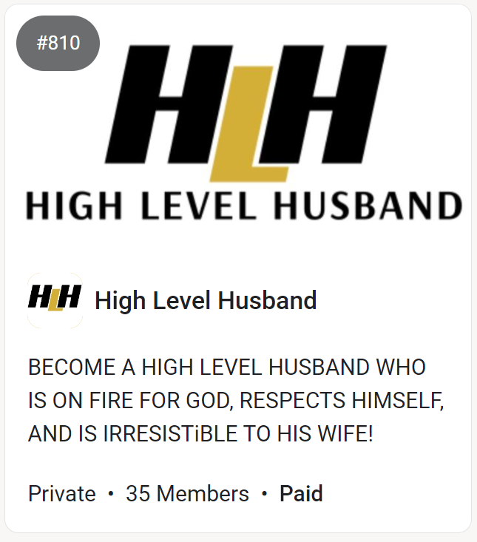
#990 | Growth Operating Masterclass | 125 | 999
Sign your first client(s). 🚀 Set up the systems. 📈 Become irreplaceable. 💰
Join the Engaged Thought Leaders: Innovate, network, and lead in your field. Elevate your LinkedIn presence and make impactful connections 😎👌🤝
#589 | Engaged Thought Leaders - 🤝 | 25 | 997
#727 | High Level Husband | 35 | 997
BECOME A HIGH LEVEL HUSBAND WHO IS
ON FIRE FOR GOD, RESPECTS HIMSELF,
AND IS IRRESISTiBLE TO HIS WIFE!
changed from 997 to PAID

Slide 9
#136 | The school of life | 84 | 999 | Private | What they don't teach you in school, everything from: • Entrepreneurship • Sexual mastery • Attractiveness • Natural health mastery & more
#356 | 🏆 CHALLENGE 60 JOURS™ | 84 | 999 | Private | Transforme radicalement ton Mindset en 60 jours pour devenir une nouvelle personne et libérer ton plein potentiel
#488 | Best Coaching Program | 291 | 999 | Private | Best Coaching Program is the premier online coaching program by Internet Business Coach, David Cavanagh
#718 | New Earth Health Coaches | 117 | 999 | Private | For HealthProfessionals, Experts and Coaches who are awakening to their life's purpose and building $50k/m Online Coaching Businesses
#990 | Growth Operating Masterclass | 125 | 999 | Private | Sign your first client(s). 🚀 Set up the systems. 📈 Become irreplaceable. 💰
#490 | YouTube Magnates | 198 | 997 | Private | 💸 YouTube Magnate = approaching YouTube like an entrepreneur, so you can make money creating videos about whatever you're interested in.
#589 | Engaged Thought Leaders - 🤝 | 25 | 997 | Private | Join the Engaged Thought Leaders: Innovate, network, and lead in your field. Elevate your LinkedIn presence and make impactful connections 😎👌🤝
#727 | High Level Husband | 35 | 997 | Private | BECOME A HIGH LEVEL HUSBAND WHO IS ON FIRE FOR GOD, RESPECTS HIMSELF, AND IS IRRESISTiBLE TO HIS WIFE!
#916 | #6FigureDealSourcer (PREMIUM) | 93 | 938 | Private | Helping Deal Sourcers make £10,000+ per MONTH by selling Rent-To-Rent deals to investors for £3,000 EACH using my FREE Facebook strategy 🔥
#357 | PODAZ Premium Membership | 244 | 777 | Private | PODAZ Premium là cộng đồng Training thực chiến về kinh doanh POD (Print On Demand) tại thị trường Âu Mỹ, dành cho Newbie 100% đến Seller $1M Anual
#745 | Righteous & Rich School | 78 | 499 | Private | Everything we've learned scaling our business from $0 to $3M+ (whilst not engaging in ANY haram alhamdulillah!)
#442 | The 4D Academy | 290 | 497 | Private | The online school that will teach you everything you need to become an outrageously paid copywriter ASAP.
#840 | AI OFM NZ & BELOV | 128 | 497 | Private | Seule, La Victoire Compte.

Slide 10
1 | #136 | The school of life | 84 | 999 | Private | https://assets.skool.com/f/173ec01b0aa9456ba1db1a36ec64a31c/abcd50f6a82e4092b79ec2608ead2c2d2a4cd4bda6b84a58bd180858ae337b31-md.jpg
2 | #356 | 🏆 CHALLENGE 60 JOURS™ | 84 | 999 | Private | https://assets.skool.com/f/3da71b603fea4ff1833cf4e5ecdc788e/078f2fef8a954012947e02b52b046421fe30df979d5243eaaaacc658c3d7219b-md.jpg
3 | #357 | PODAZ Premium Membership | 244 | 777 | Private | https://assets.skool.com/f/43eb08392e4241e8a525b288b6d581c4/8958320221754bf68eeb9be215adf2fe1721079ddeac4c8496396c4293d103ca-md.jpg
4 | #442 | The 4D Academy | 290 | 497 | Private | https://assets.skool.com/f/c0d7305289a649dfb0d48bd0fda121ca/73d2f50559db427d8a2410a2c1a6acd9deebffb6f3e74281a5e454b2669bc6bb-md.jpg
5 | #488 | Best Coaching Program | 291 | 999 | Private | https://assets.skool.com/f/ab919cd683a640099f5591d64482773e/2dc704b006c54ff6afdd269cbca50dbe9b177c888b4744428dca3b6f130699c8-md.jpg
6 | #490 | YouTube Magnates | 198 | 997 | Private | NA
7 | #589 | Engaged Thought Leaders - 🤝 | 25 | 997 | Private | https://assets.skool.com/f/d8526186ee344eaba84cf6531b06660d/ffbc5b32bc7447878f2f799512c845d43001fb2e47354a518af213a039e0e918-md.jpg
8 | #718 | New Earth Health Coaches | 117 | 999 | Private | https://assets.skool.com/f/c848ebab237f4a6690c48923cee9aae6/98d0d2788cd24c3ca516c48a5e61af91e7c429623ec54c879cdc76bc571be155-md.jpg
9 | #727 | High Level Husband | 35 | 997 | Private | https://assets.skool.com/f/725bfdaf4ccd4edaac37e1fe062980f6/be56464116ca46099a5829be0ab630e2087a5331995e4c74900612242e4f65d0-md.jpg
10 | #745 | Righteous & Rich School | 78 | 499 | Private | https://assets.skool.com/f/ad98b754fa50467fade84547644590f9/6e7368db85b84b8c9958b38533e67f43f669b33595cc4d5db45d19cac2cfd867-md.jpg
11 | #840 | AI OFM NZ & BELOV | 128 | 497 | Private | https://assets.skool.com/f/23a073b27a71417c93f993fa739185a2/00820cbbd5e049f3a27209786a8c08aed9bbbf861c1048eda5532ca0e515be5c-md.jpg
12 | #916 | #6FigureDealSourcer (PREMIUM) | 93 | 938 | Private | https://assets.skool.com/f/d480b19152b24fd399bc11a6d3aa0a44/d5901f92da1b42c4bc50656fd215102c1576d80d4991423fb150b38e8e83d64f-md.jpg
13 | #990 | Growth Operating Masterclass | 125 | 999 | Private | https://assets.skool.com/f/b70595b3d1b94a5187e5b649f03c96cd/d5161940f8cc4ab3b0d6b4e20f8f9fd4dc681100f36f401fa0862e3468274b95-md.jpg

Slide 11
Start your own community, Make 3 main posts (pinned)
!Snapshot of 6.8.2024, the order and numbers can change any day
Include # ranking so you can find them on those 34 pages
Most Members
Distribution of members
Highest Price
Distribution of prices
How often paid, free, price_disclosed
Scatterplot, log10 members, zoom in below $100
Topics (based on title) wordcloud
Title length (emojis)
Description length (emojis) wordcloud
languages
Search for Academy_webscraping 2.0 / 1000 in total, same for community and tribe.
Academy vs community comparison analysis
Word clouds! NO! make 3 more videos! show analysis and promote my group with progress!
Predict MMR?, Leaderboard? all time? added monthly increase
feed a model?
How I did the webscrpaing you can learn in my community.
Started yesterday and currently free and public.

Slide 12
1 | #37 | Max Business School™ | 160400 | Free | Public | https://assets.skool.com/f/9fed30752196495cbc84dcf7d93febd2/56758927e0ee481ba3acb64e9368d7f1bfce9562123a4e3f8f1a0661f180ca66-md.jpg | A community for anyone to learn practical skills in their pursuit of freedom, for free.
2 | #3 | Adonis Gang | 136000 | Free | Private | https://assets.skool.com/f/2d44feba1f75485794cdec132dd0b3ac/7f82b806efb447009db45857f01bbc4b981231da72a342b29fb7f3ccd6c67d85-md.jpg | Men need brotherhood now more than ever. Join the largest self improvement community!
3 | #15 | Skool Community | 119100 | Paid | Public | https://assets.skool.com/skool/a735cecd334b4e3ab85de80740fe7480.jpg | Let's collaborate to make Skool better. Share your feedback!
4 | #46 | Skool Masterclass (Free) | 63000 | Free | Private | https://assets.skool.com/f/f7b2fdd401e842049ec865fe4b29a8a4/67d7ca61c9f64b3c9b1493f3e7c397bc98ec35788397406bb1ef2c7bc94390a6-md.jpg | Learn how to make 💰 online with Skool.
5 | #8 | The Digital Wealth Academy | 59500 | Paid | Private | https://assets.skool.com/f/f0d0df517a7d42b896f1ab71ac0af4b7/759d1af73cbd49ae91fc7e7cb1c779b1aa7d9e7f3b7c41d4aa3cdde6f93cd917-md.jpg | Welcome to the Digital Wealth Academy Online community. Here you will learn how to make money online with the Master Resell Rights business model.
6 | #42 | THP Jump Training | 55700 | Free | Private | https://assets.skool.com/f/b429db95e796465ba8ebeaff34387492/dd3b95fc0d3c44d0a306880a98360e0201d92d518c95475d8f7815958f3c6032-md.jpg | This course will give you all the resources needed to get your first dunk and beyond!
7 | #16 | High Vibe Tribe | 41200 | Free | Private | https://assets.skool.com/f/c0319012afd142a2b237a4e4074e347d/ef56f1b7ad674d888dca380e66d272bcef034b5b080444b9bb5e411e6f37acd2-md.jpg | a community for those dedicated to raising their vibration, healing, letting go of limitations and creating freedom in all areas of life
8 | #61 | Agency Owners | 39100 | $1 /month | Private | https://assets.skool.com/f/381b2eecca5442df85c8ab8c6a264d8c/8e9288318e75445ca6ec11ec375edc300f42beaabdc242bf835f8fef595e996a-md.jpg | Master your environment by surrounding yourself with other agency owners.
9 | #86 | Social Media Business Free | 36000 | Free | Private | https://assets.skool.com/f/e97d222b29be418d8b0a3f35f65cd88c/b165d54bf1b545c69ca67acd3de453a0b7843dc57e274b8797b0fe37467c9b9d-md.jpg | A community for those interested in making money online using the power of social media.
10 | #26 | Ultimate Branding Course | 35400 | Paid | Private | https://assets.skool.com/f/61e74d7394cc4f8484dd3d62bef6df00/d4890082a63d4bec8480bbb87afa4f05c6998ef7cd9e48e5912a28625ce17941-md.jpg | Welcome to the The Ultimate Branding Course & Community! Learn to build a powerful brand on social media while making money with Master Resell Rights.

