Slide 1

Addressing the U.S. Opioid Epidemic with Visual Analytics
presented by
tri le

Slide 2



Sources: 1. 2019 National Survey on Drug Use and Health, 2020 2. National Center for Health Statistics, Data Brief No. 394, December 2020
Why Opioids?
10.1 million
people misused prescription opioids in 2019¹
1.6 million
people had an opioid use disorder in 2019¹
70,630+
people died from drug overdose in 2019²

Slide 3
Objective
Identify
which opioid contributes the most to overdose deaths
Determine
which U.S. states are affected most by the opioid epidemic
Explore
which age groups are more likely to overdose
Provide
insight to U.S. policymakers and local government to help inform opioid abuse prevention and treatment needs

Slide 4

Methodology
Dataset queried from CDC Wonder (online database of public health information)
Initial EDA performed in Microsoft Excel and Python + Pandas
Visualizations completed with Tableau Public
9807 unique data points
Features include year, state, gender, age group, type of opioid, etc.

Slide 5
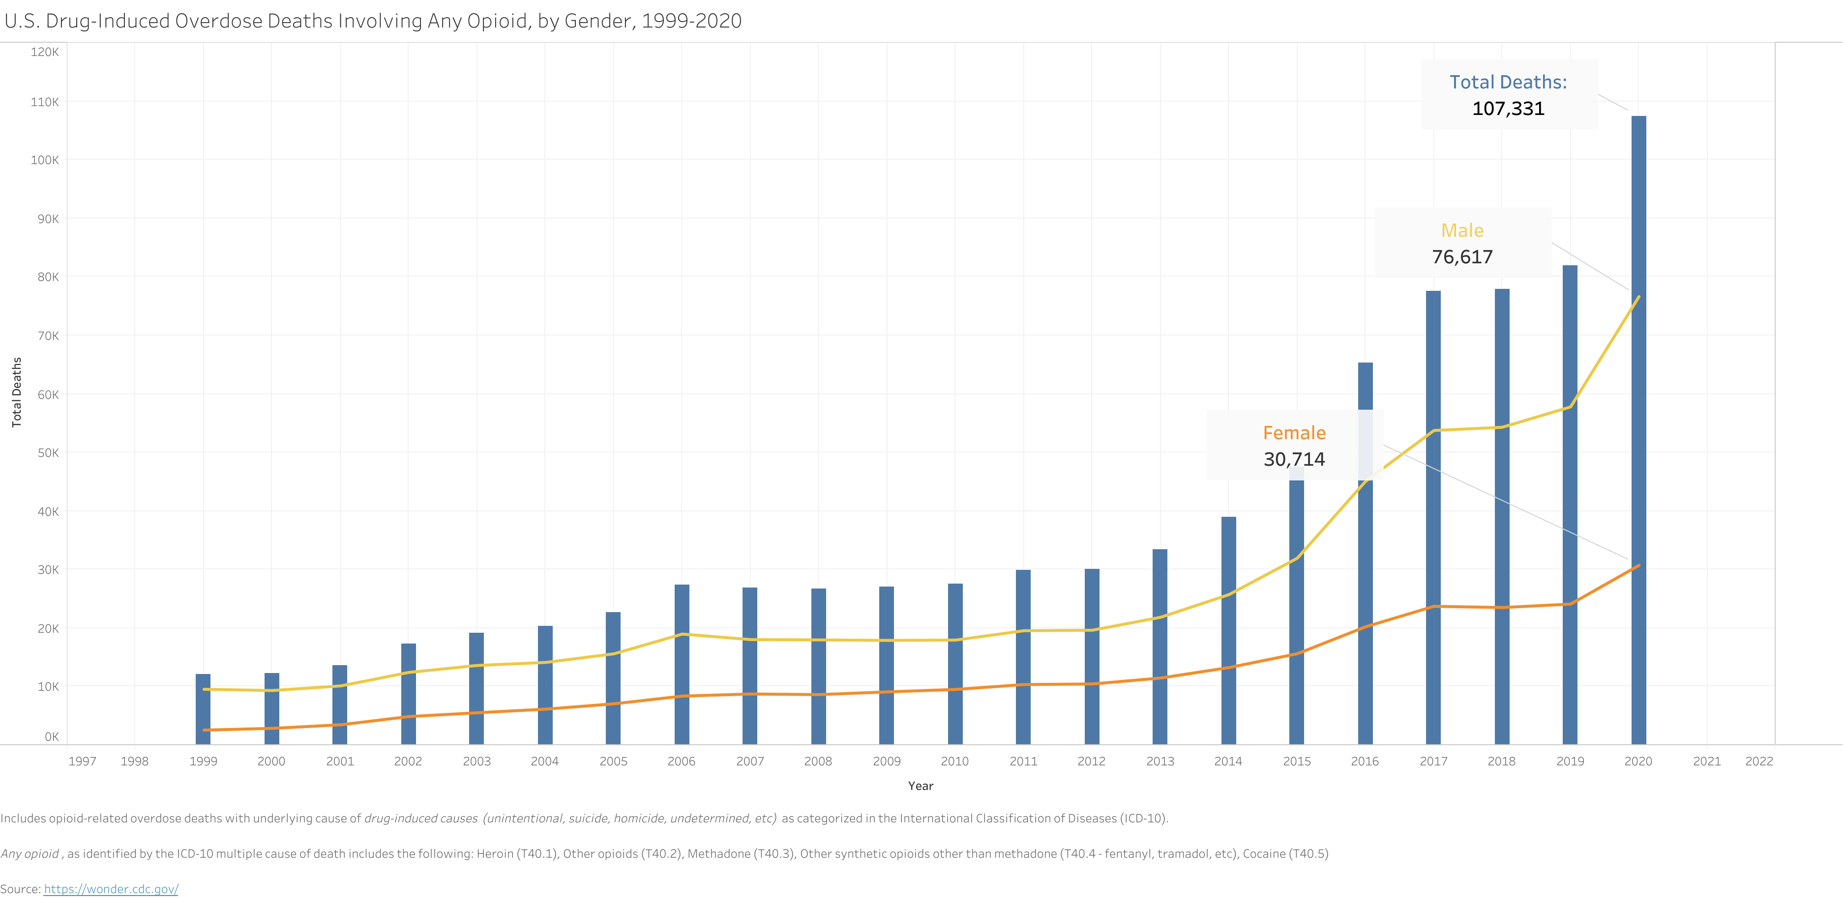
Findings and Results

Slide 6
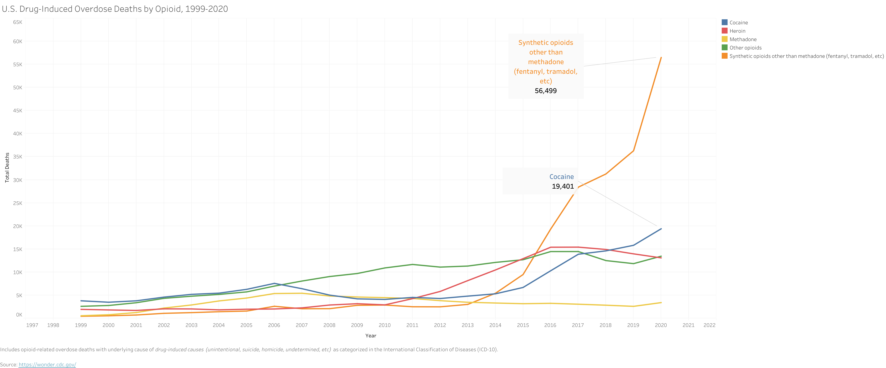
Findings and Results

Slide 7
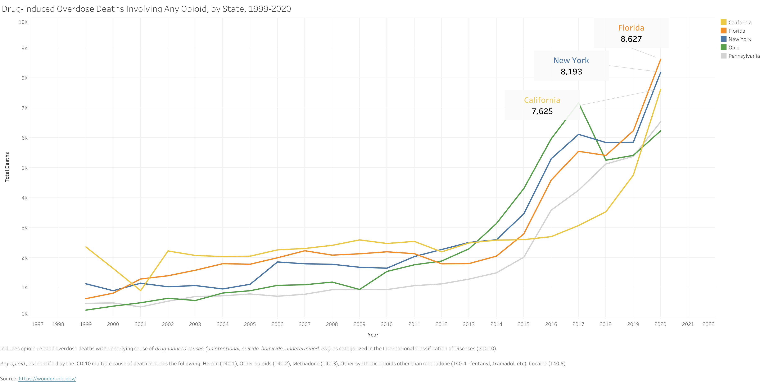
Findings and Results

Slide 8
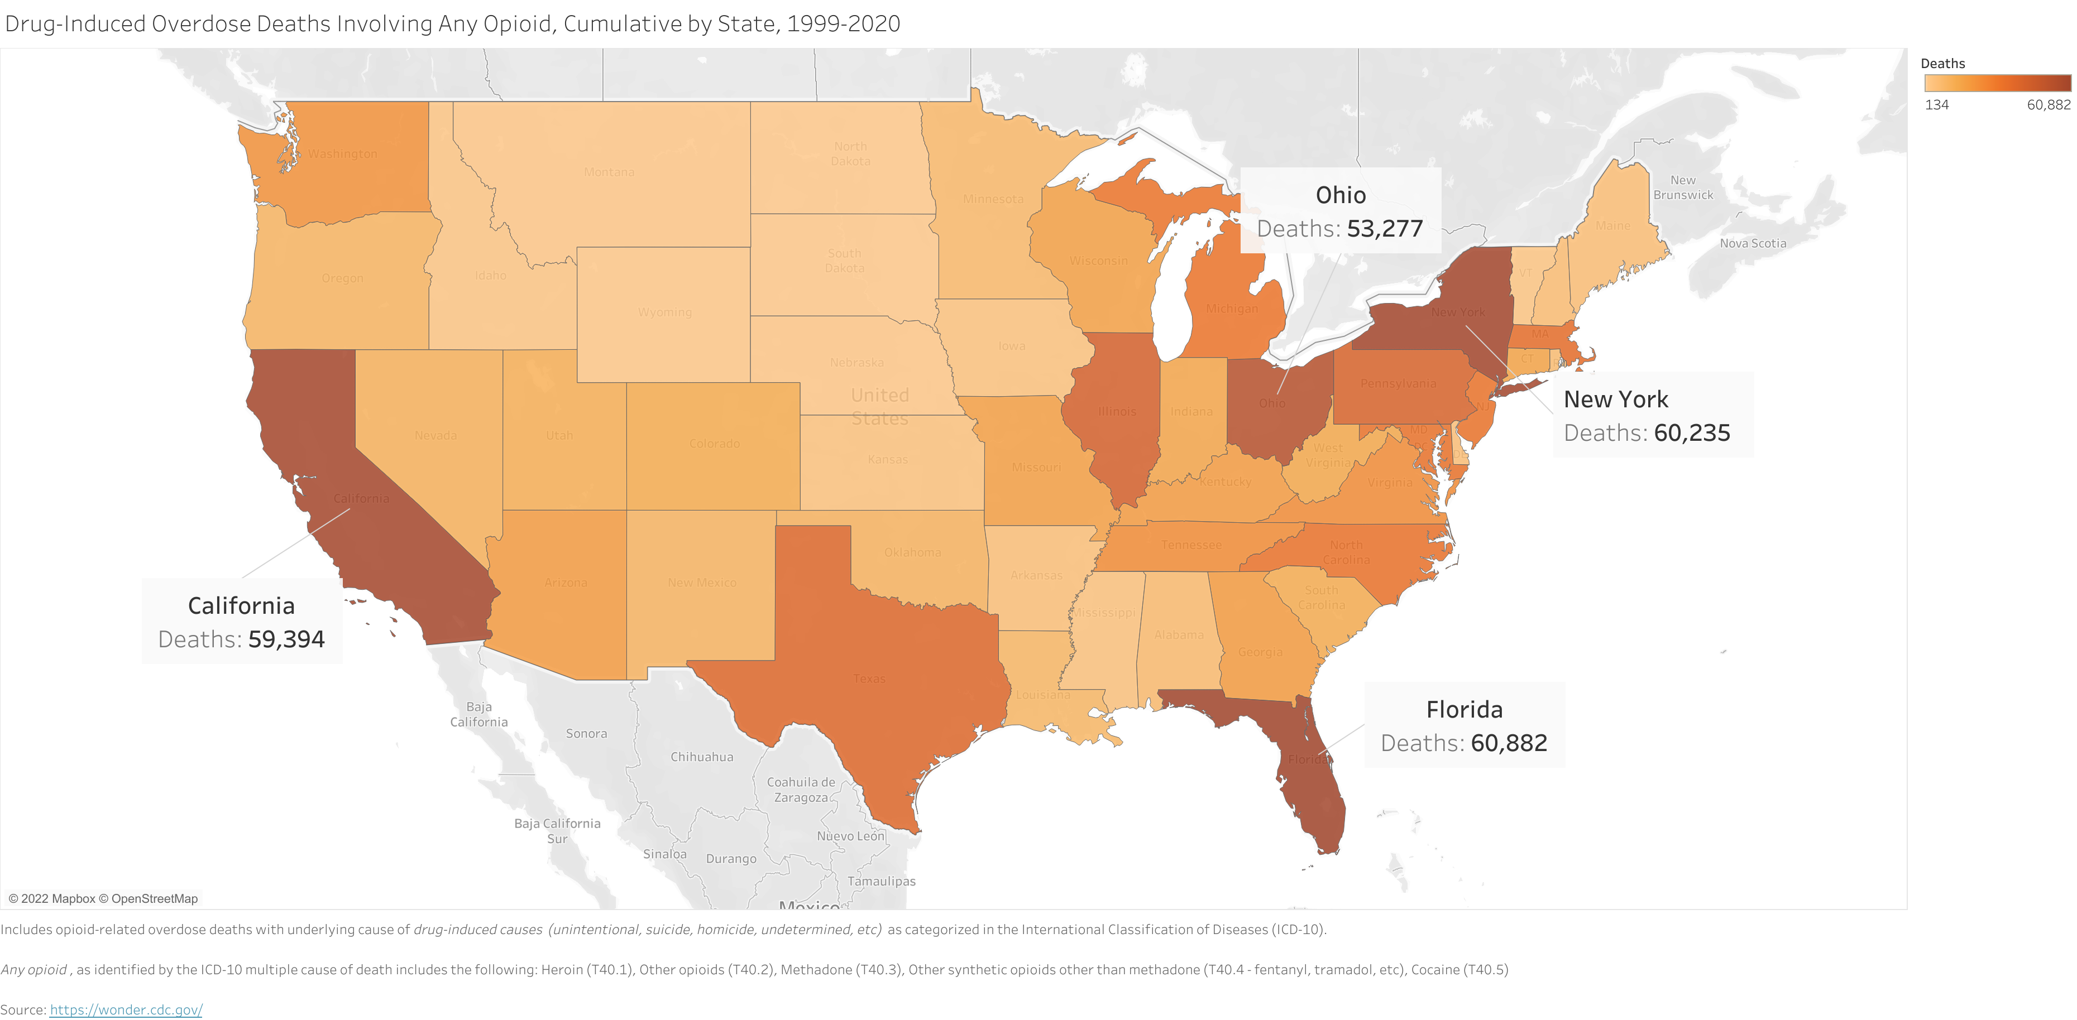
Findings and Results

Slide 9
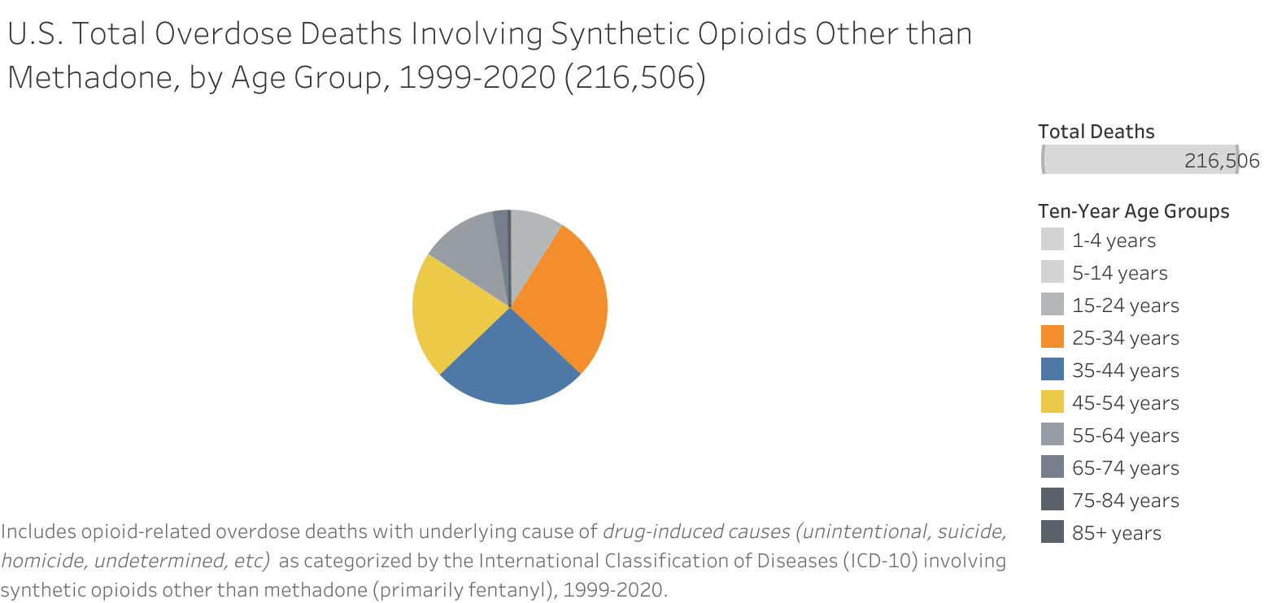
Findings and Results

Slide 10
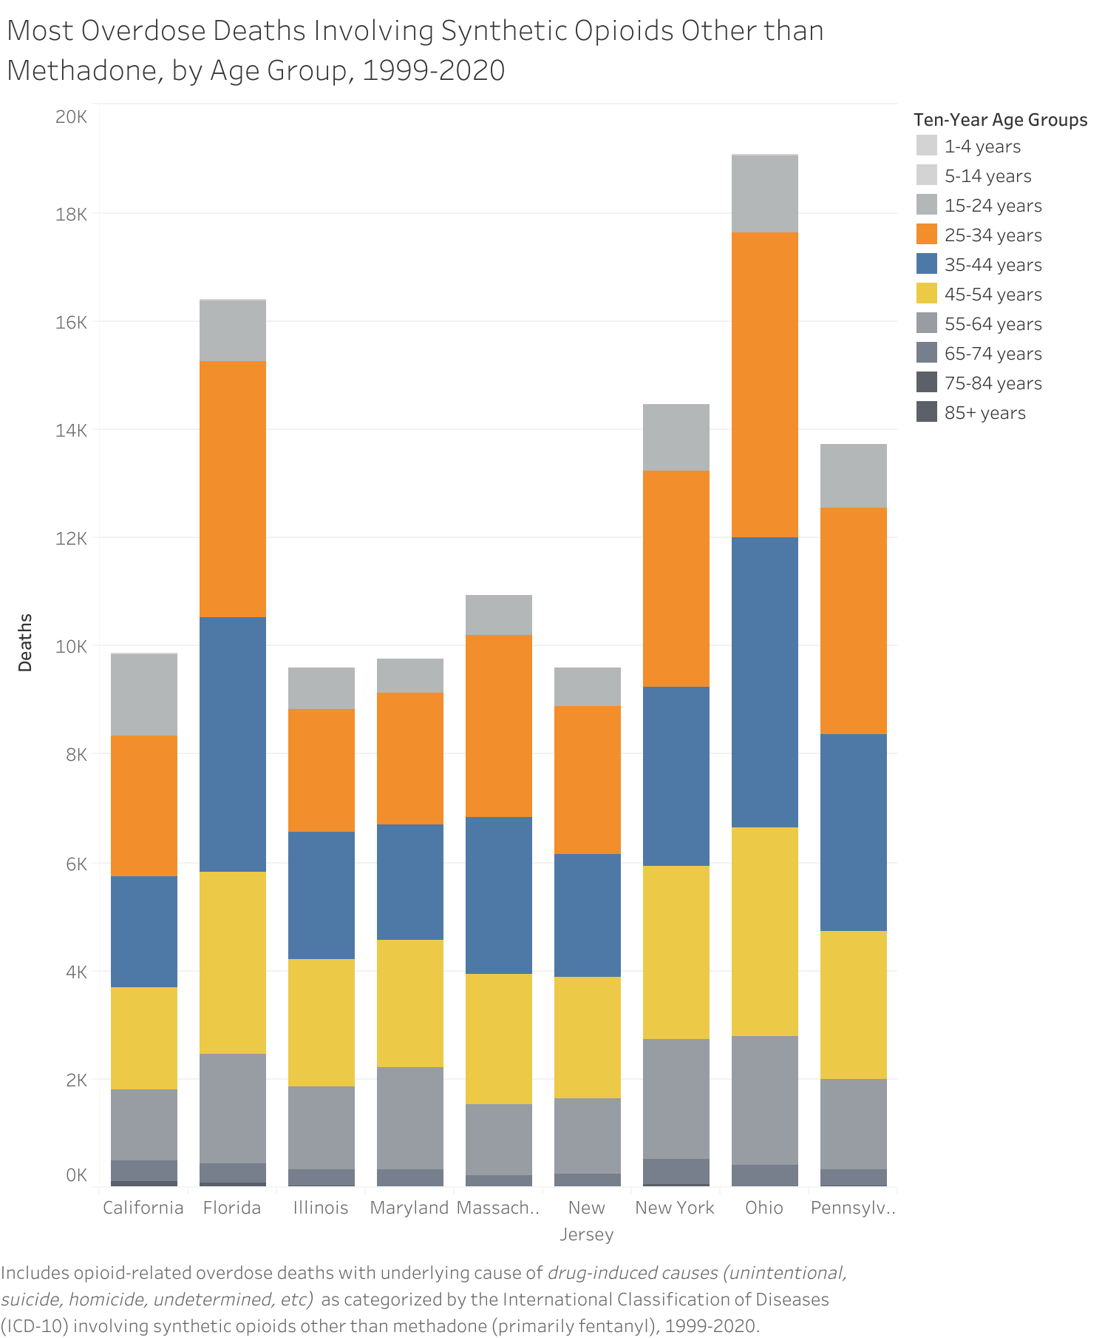
States with Most Overdose Deaths Involving Synthetic Opioids Other than Methadone, 1999-2020

Slide 11
Conclusion
Synthetic opioids (other than methadone) contribute to the most opioid overdose deaths in the U.S. and have increased over 1800% since 2013
Florida, New York, California, and Ohio have surged ahead with opioid overdose deaths in the last 10 years
Adults ages 25-54 make up more than 75% of all opioid-related deaths, while men are 2.5x more likely than women to overdose

Slide 12
Potential Future Work
Include population and demographic data from the U.S. Census for further potential analysis and insight
Perform a more detailed geographic analysis of opioid-related deaths by county
Construct an unsupervised learning model like clustering to identify which groups are more at risk of opioid overdose deaths

Slide 13
Questions?
metis business fundamentals
june 2022

Slide 14
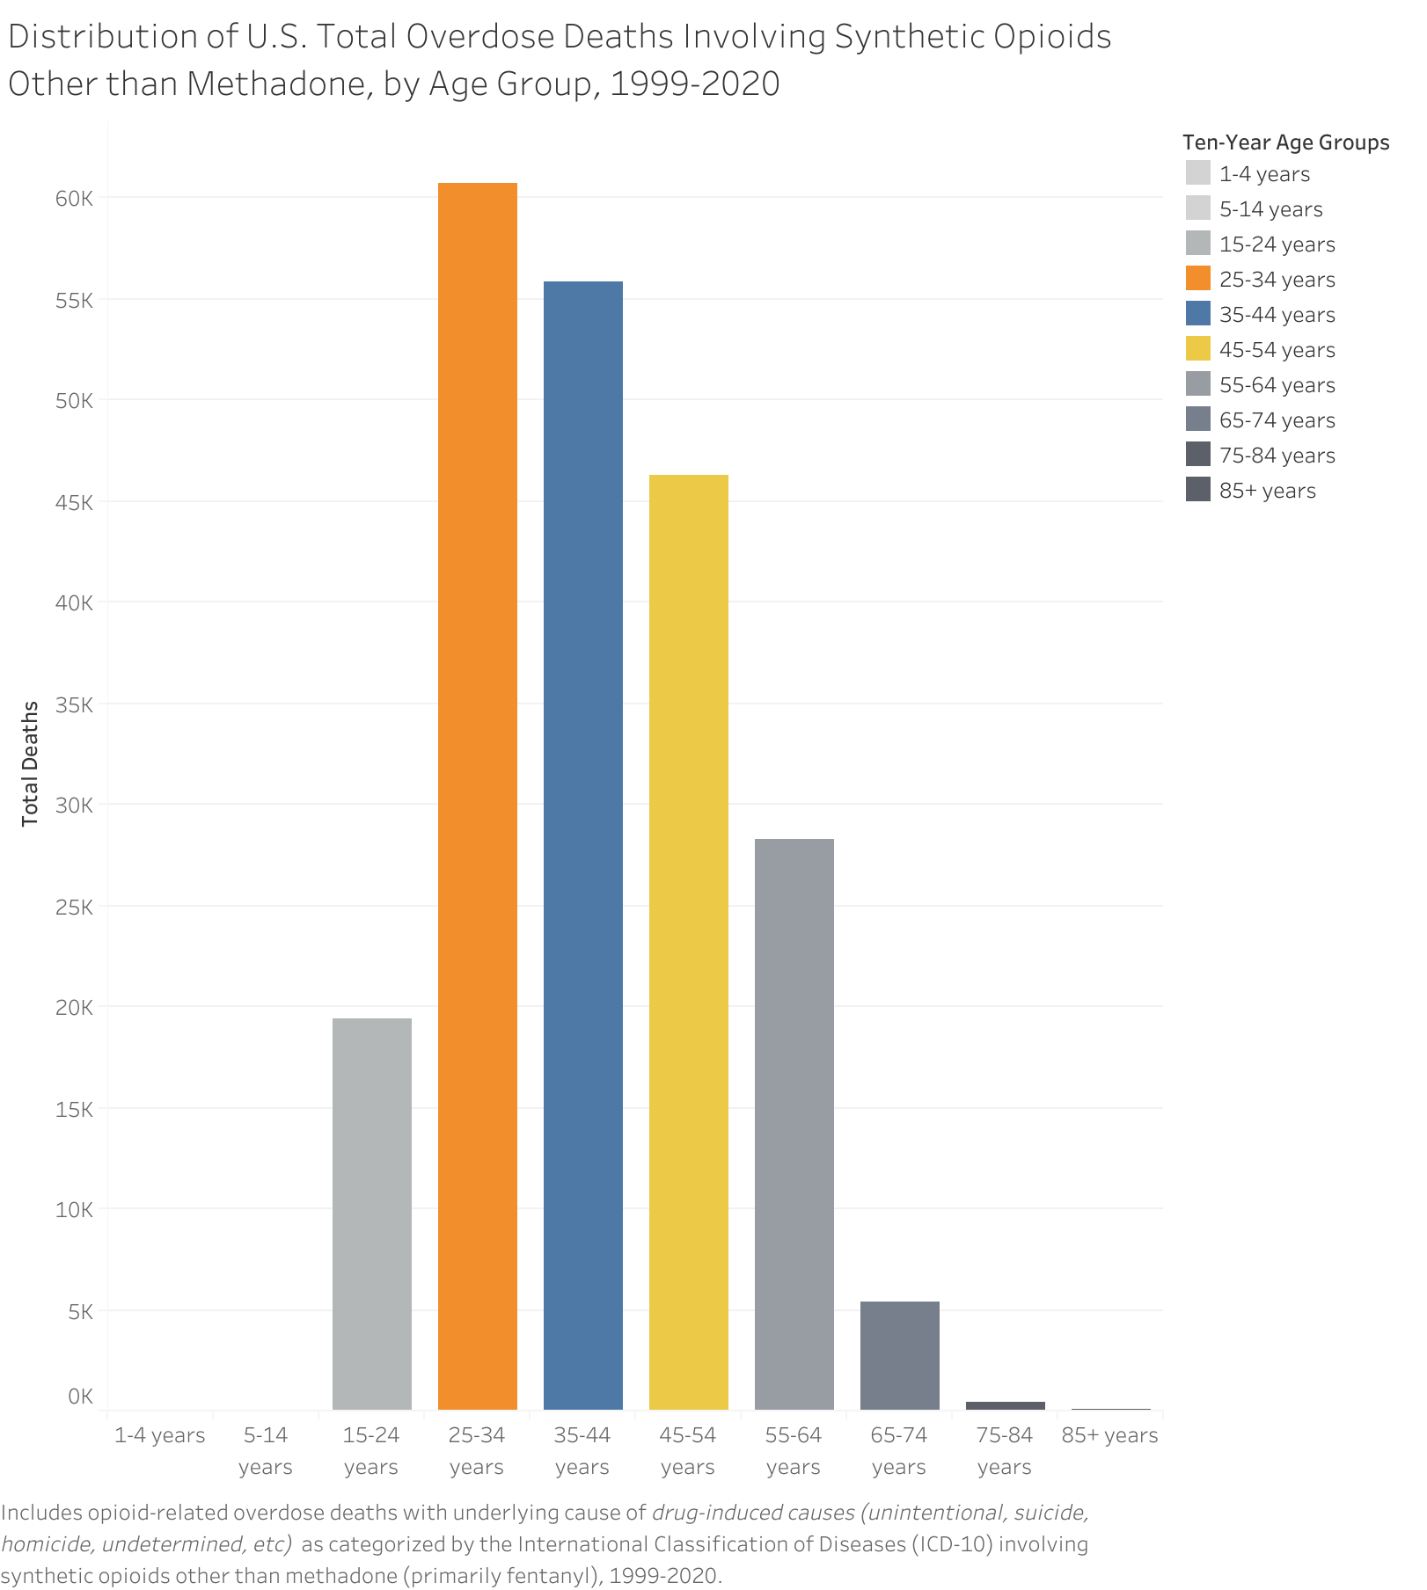
Appendix

Slide 15
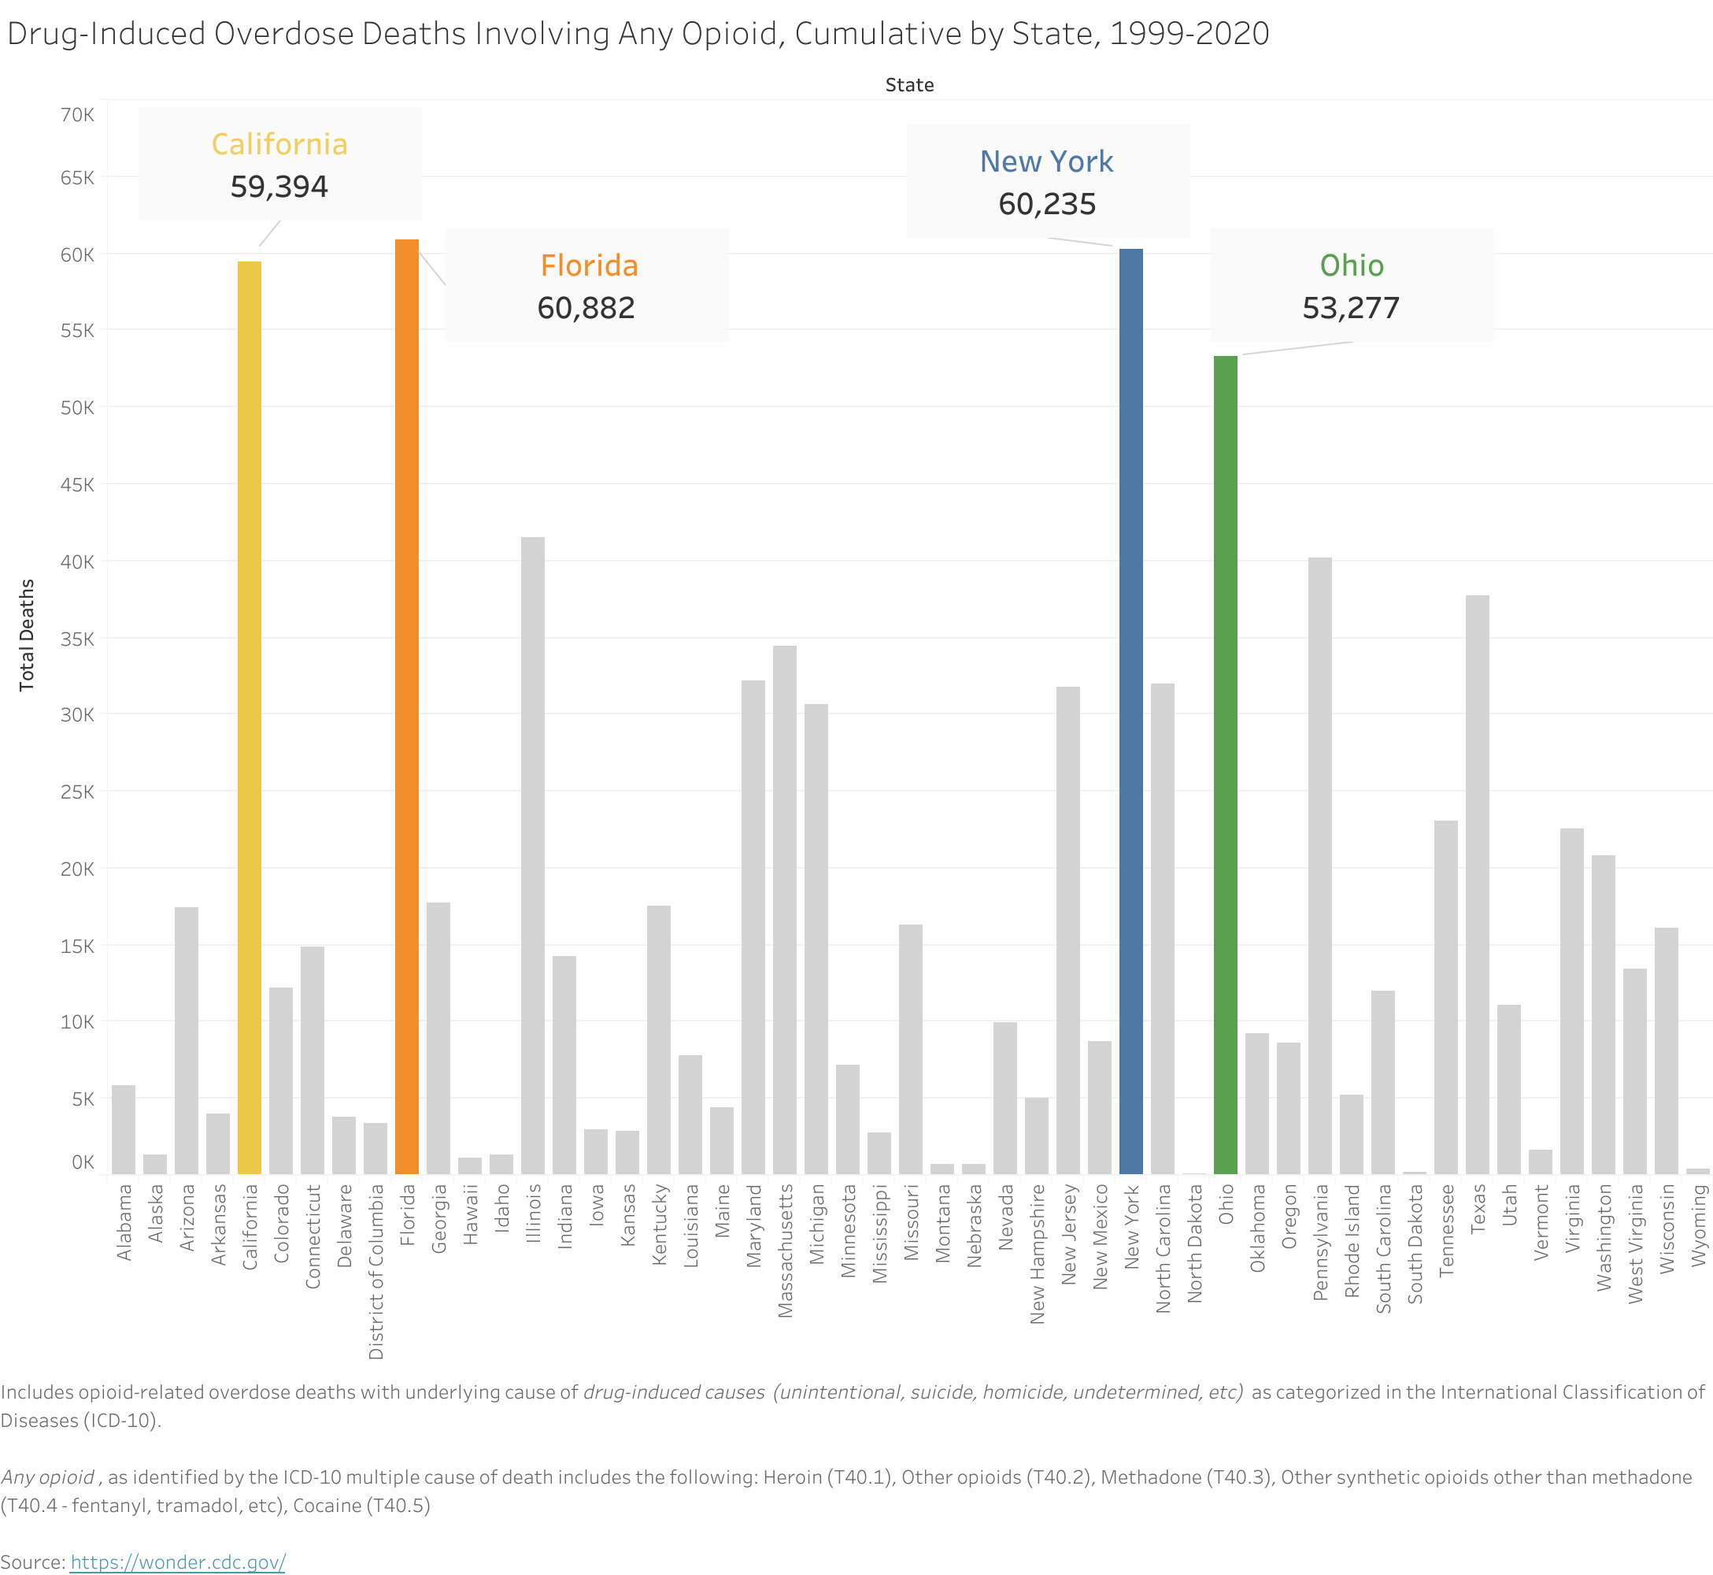
Appendix

