Slide 1

Analyzing Twitter
Climate Change Conversations:
Using Data Engineering, NLP, & Topic Modeling to uncover Global Warming Topics
Hello Metis.
6:00 PM • Oct 5, 2022
tri le

Slide 2

What’s in a Tweet?

Slide 3

Data Features
Tweet Unique ID
Tweet Location
Tweet Text
Twitter Username
Retweet Count
Follower Count
Favorites Count
Hashtags
Mentions
Etc.
900,000K+ Tweets

Slide 4
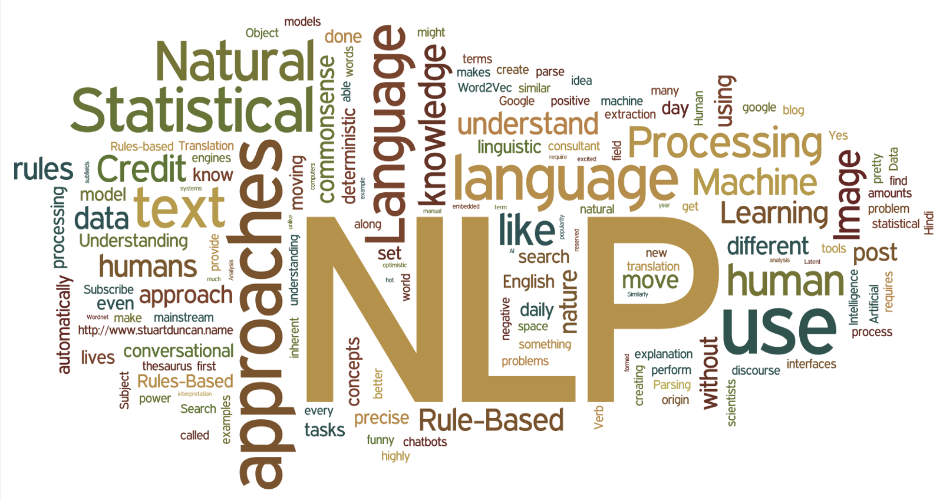
Objectives

Slide 5






Methodology
Text Processing
& Dimensionality Reduction
150,000+ words
4 Topics
? words

Slide 6

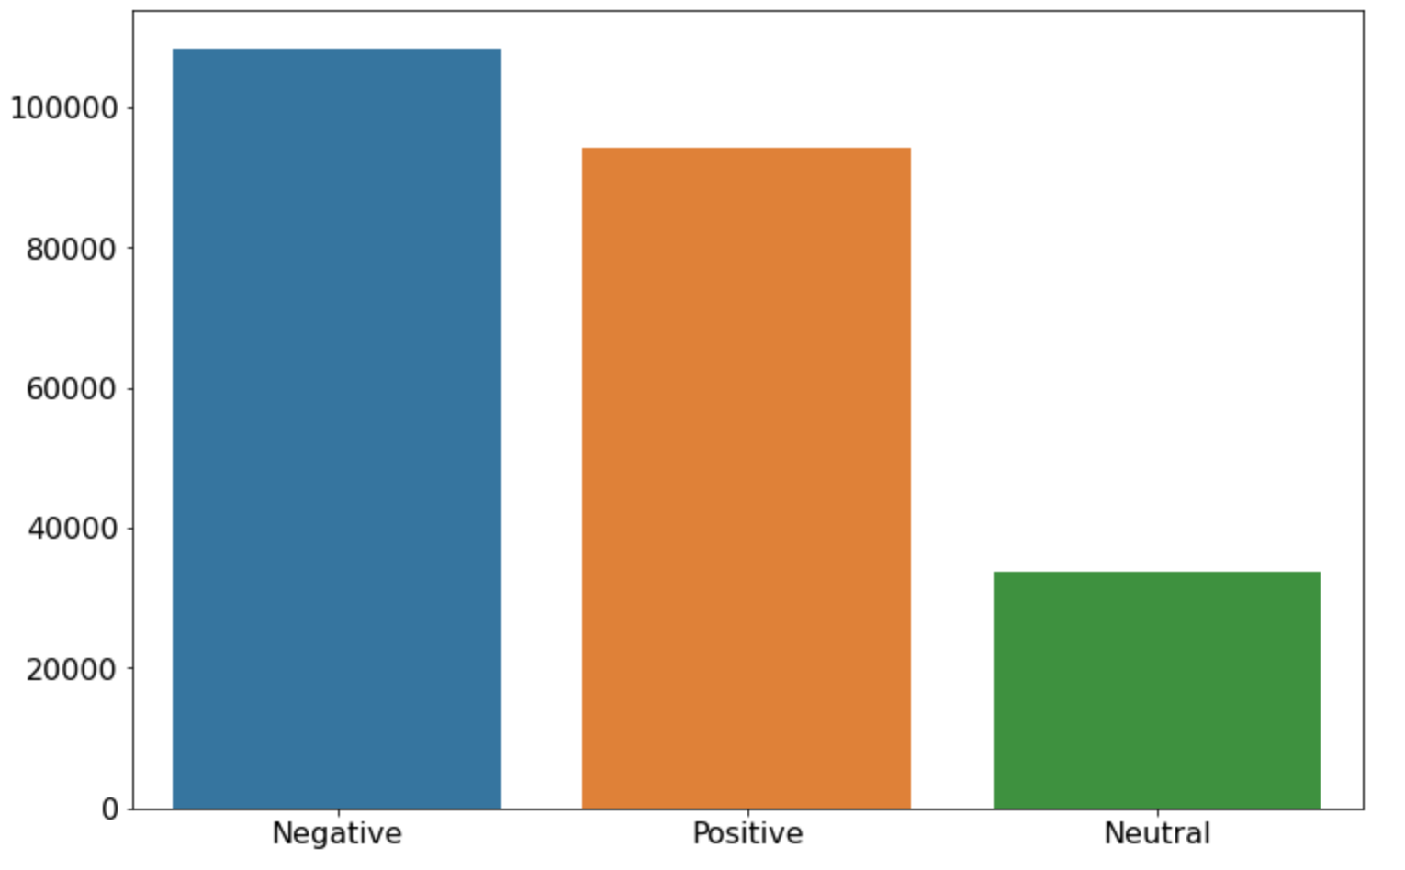
Sentiment Analysis

Slide 7
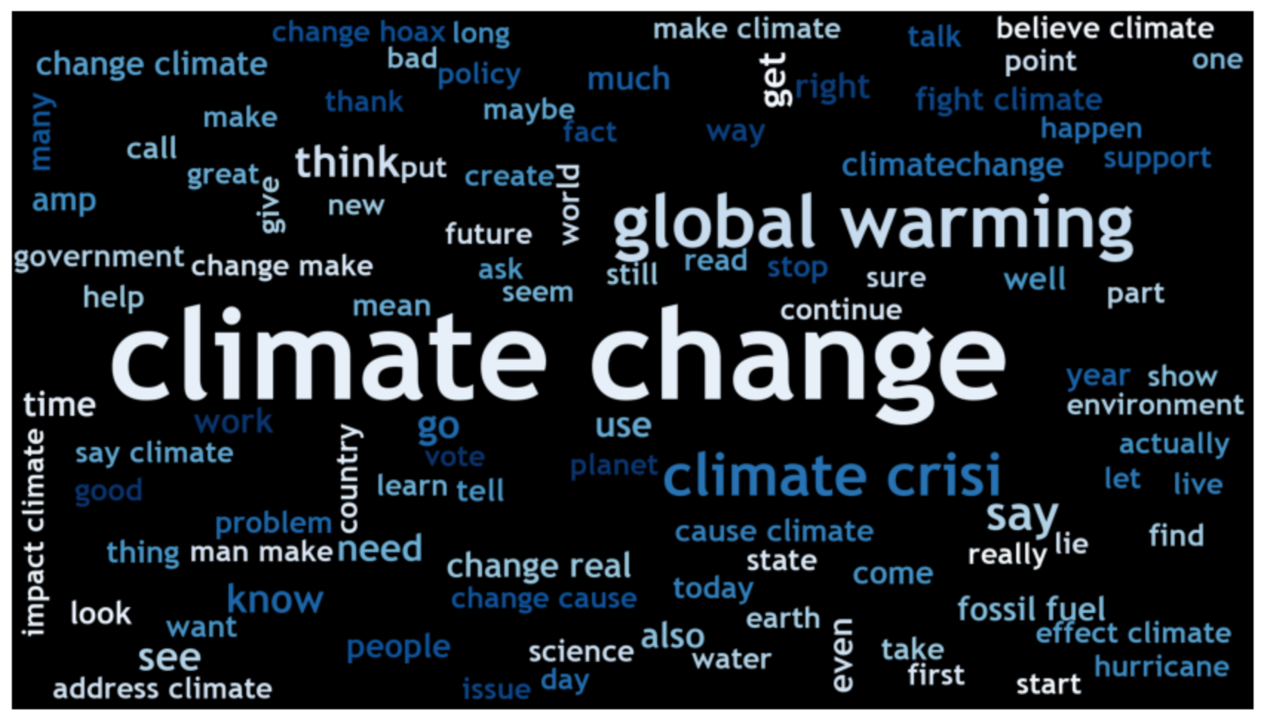
100 Most Common Words

Slide 8
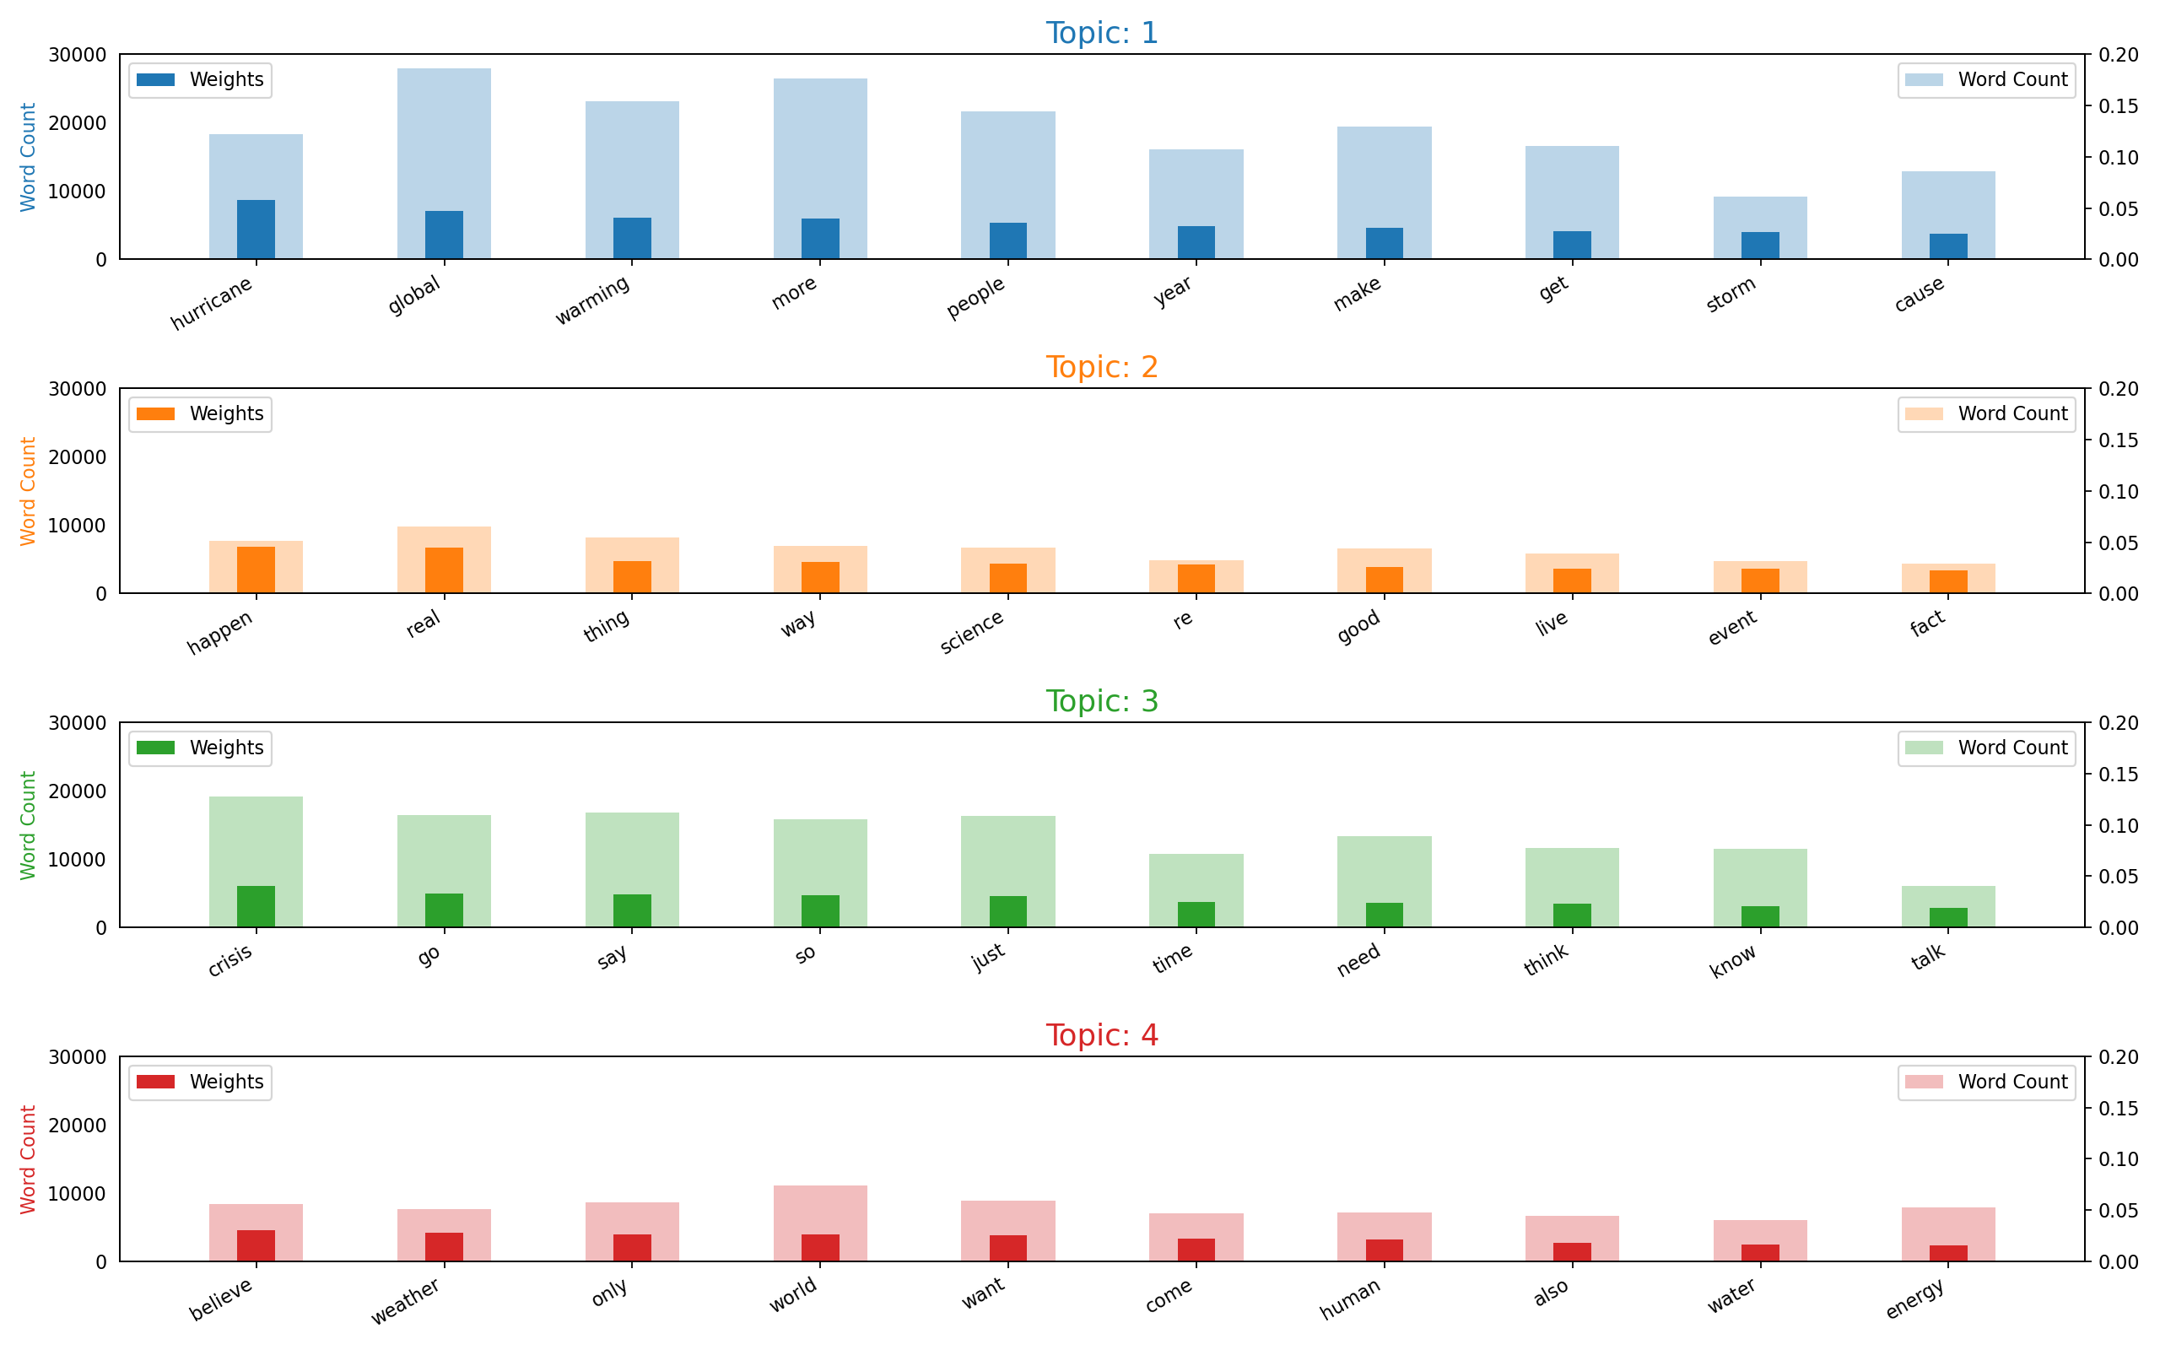
Findings: Topics

Slide 9
Conclusion
Topic 1:
Global warming is caused by people and results in “natural disasters”
Hurricane
Global Warming
People
Cause
Topic 2:
Climate Change is scientifically real and is happening
Happen
Real
Science
Fact
Topic 3:
Although Climate Change is a crisis, more time and discussion is required:
Crisis
Need
Time
Think
Topic 4:
Possibly, Climate Change is a believe to be caused by natural world weather:
Believe
Weather
World
Human
Key Topic Terms

Slide 10
Potential Future Work
Further Data Engineering:
AWS
MongoDB
Streamlit and/or Heroku
Further Analysis:
LSA & NMF
Social Network Analysis
Gelphi + NetworkX

Slide 11
Thank you!
Questions?
6:e0 PM • Oct 05, 2022
metis 2022 oct

