Slide 1
Waste Classification:
Using Neural Networks
tri le

Slide 2

Why Garbage?
292.4 million tons generated in 2018
146.1 million ended up in landfills
4.9 lbs generated per person
Up 33.8% from 3.3 lbs in 1980
Global issue – land, water, air pollution
Risk of contamination and toxins

Slide 3


What Can Be Done?
Motivation: Create a deep learning model environmental and waste management industries can leverage to improve recycling efforts
Waste Management & Republic Services
Goal: Identify whether an object is organic or recyclable
With high accuracy up from 67.5%

Slide 4
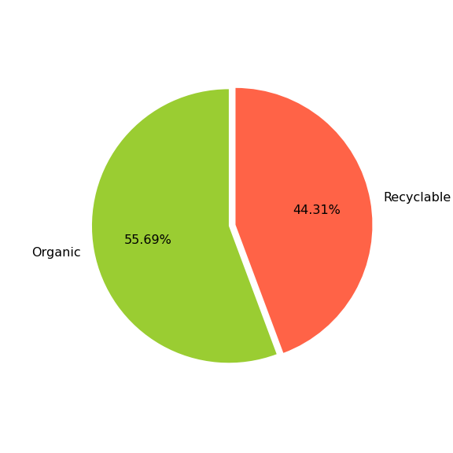
Data & Methodology
Organic vs Recyclable
25K+ Total Images
22K+ Training
2500+ Test
Various images & sizes
Width x Height x RGB

Slide 5
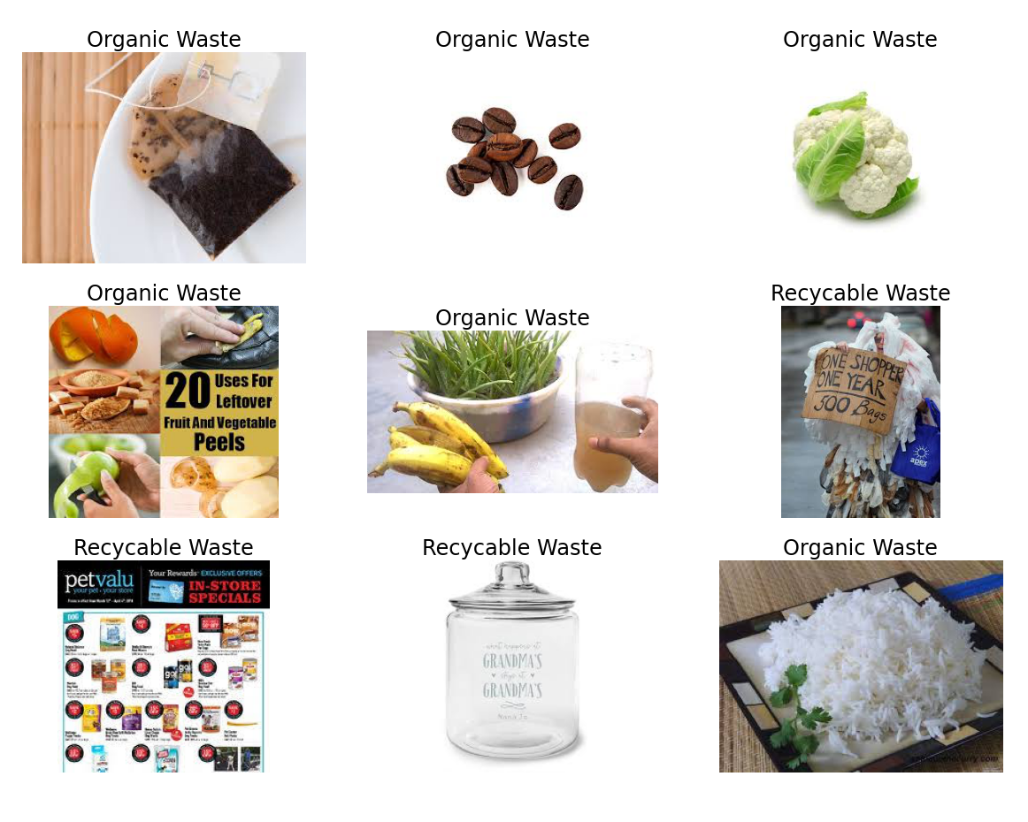
Data & Methodology
Image Augmentation
Rescale & Resize
Reshape Input Values
2D 1D
Train, Validation, Test
Datasets

Slide 6
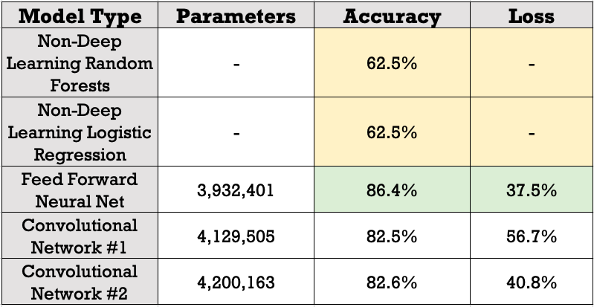
Findings & Results
Activation
ReLU & Sigmoid
Loss Function
Binary Cross-Entropy
Optimizer
Adam

Slide 7
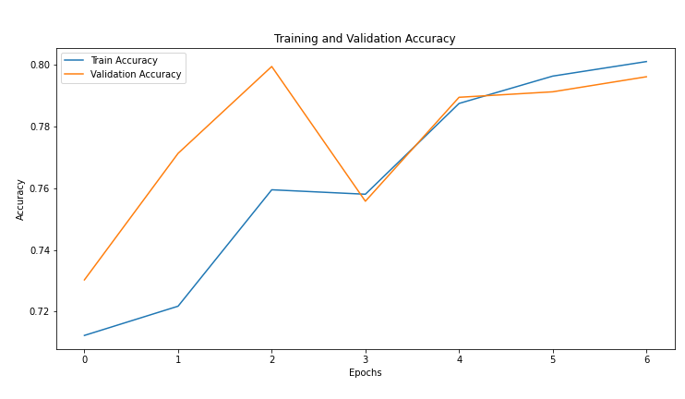
Findings & Results
Feed Forward Neural Network
Accuracy

Slide 8
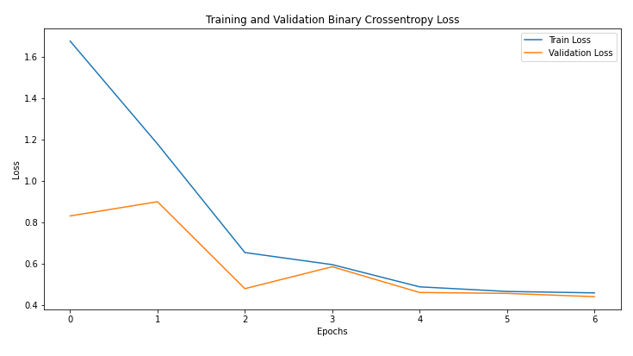
Findings & Results
Feed Forward Neural Network
Loss

Slide 9
Conclusion
Best performing model:
Feed Forward Neural Network
What does this mean?
Additional modeling required as CNNs are expected to perform better

Slide 10
Potential Future Work
CNN Optimization
VGG-16, Inception, ResNet
Transfer Learning
ImageNet
Autoencoders, Transformers, Reinforcement Learning, GANs

Slide 11
Thank You
Questions?
metis 2022 sep

Slide 12
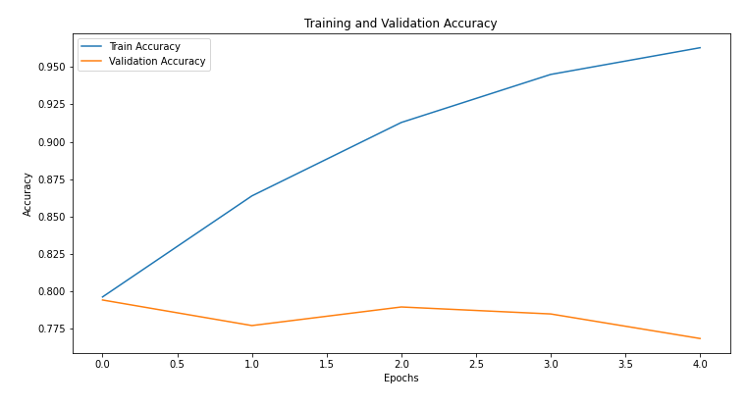
Appendix
CNN #1
Accuracy

Slide 13
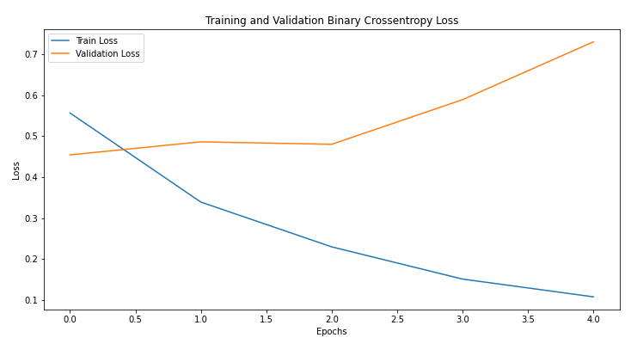
Appendix
CNN #1
Loss

Slide 14
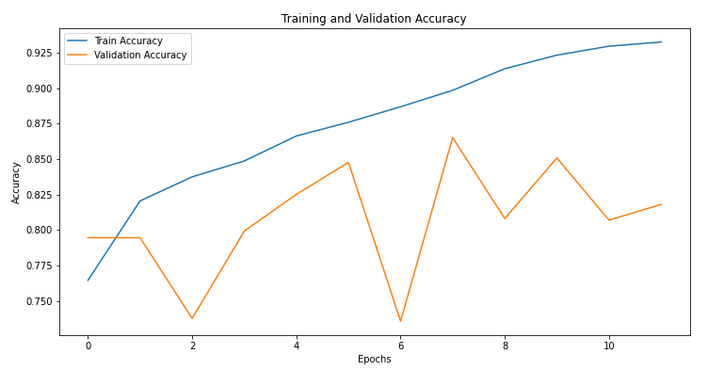
Appendix
CNN #2
Accuracy

Slide 15
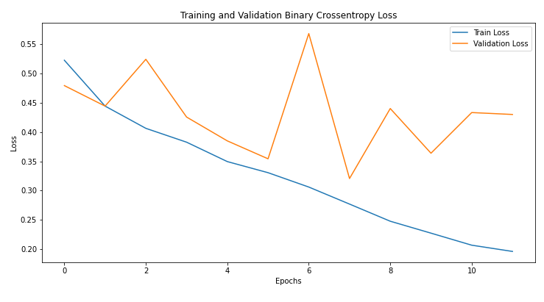
Appendix
CNN #2
Loss

