Slide 1
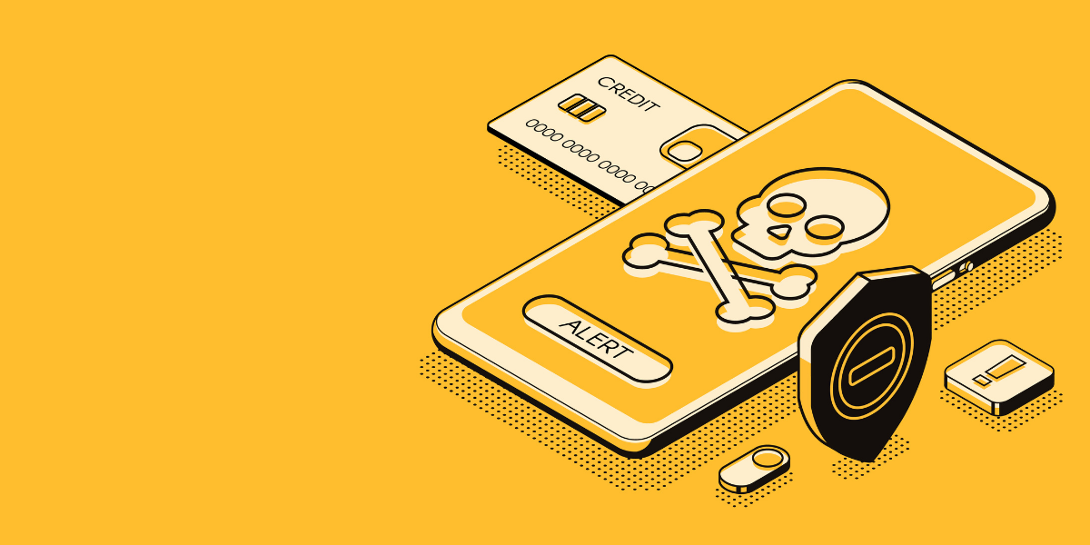
Detecting
Fraud
with Machine
Learning
Presented by:
Tri Le

Slide 2
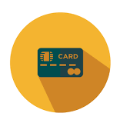

Sources:
1. https://www.prnewswire.com/news-releases/payment-card-fraud-losses-reach-27-85-billion-300963232.html
2. Fidelity National Information Services Inc.
Why credit card fraud?
$27.85 billion in fraud loss in 2018
and projected to rise to $40.63 billion in 10 years¹
U.S. companies incurred 33.99% of total fraud losses worldwide
despite generating only 21.54% of global card volume¹
35% increase in fraudulent transactions
in April 2020 from the previous year and expected to rise

Slide 3
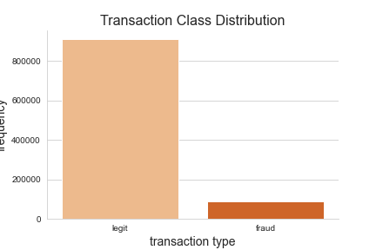
Transactions: legit or fraud?

Slide 4

The data
1 million observable datapoints
3 numerical features:
Distance from home
Distance from last transaction
Ratio to median purchase
4 categorical features:
Repeat retailer
Used chip
Used pin number
Online order

Slide 5
Methodology
1
EDA + Feature Engineering
2
Establish baseline
3
Try different models
4
Class Imbalance + Hyperparameter Tuning
5
Evaluate & select ideal model

Slide 6
Methodology
Credit Card Transactions
Split Data (Training & Testing)
kNN
Logistic Regression
Decision Tree
Random Forest
XGBoost
Select Ideal Model
Class Imbalance + Hyperparameter Tuning
Evaluate Scoring Metrics

Slide 7
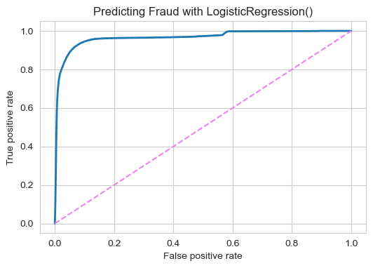
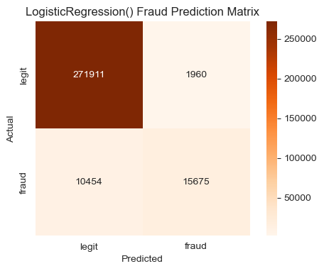
Findings: Baseline Metrics

Slide 8
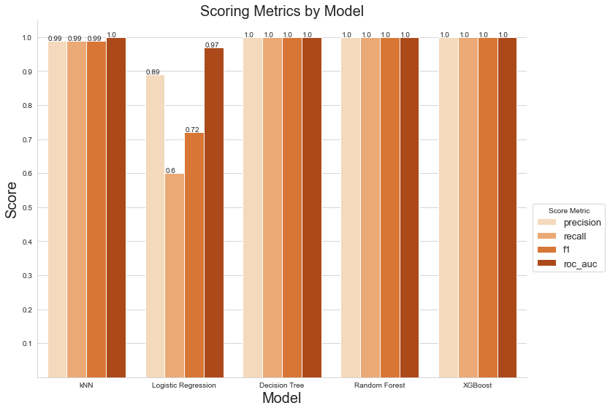
Findings: Baseline Metrics

Slide 9
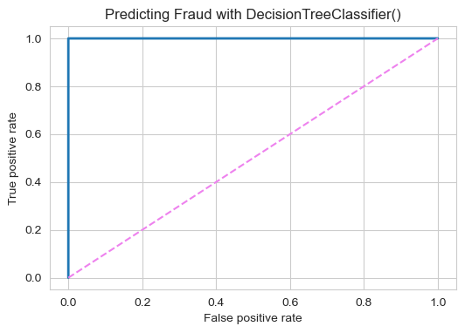
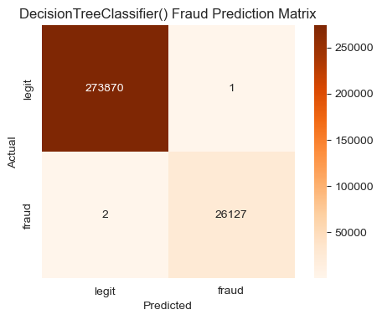
Ideal Model: Decision Tree

Slide 10
Decision Tree Evaluation
Optimal hyperparameters:
max_leaf_nodes = 39
min_samples_split = 3
Recall, Precision, F1 Score: 100%

Slide 11
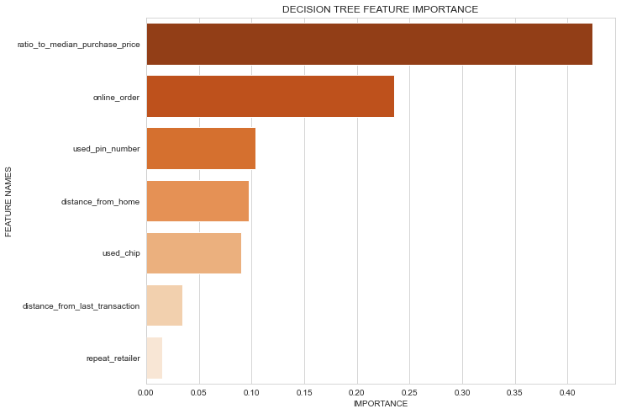
Final Model: Decision Tree

Slide 12
Conclusion
We can predict which transaction will be fraudulent with exceptionally perfect accuracy, precision, and recall at 100%
Because the model performed so well, there was no need to adjust class imbalance via over/under-sampling, weighting, or threshold adjustments
Which begs the question: Does this represent real-world data? Will our analysis benefit from the inclusion of additional data for further modeling?

Slide 13
Questions?
Metis
Classification
July 2020

Slide 14
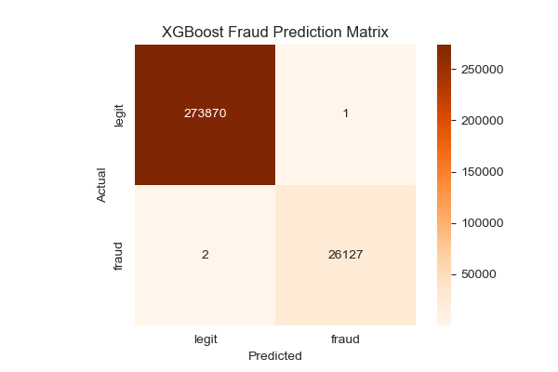

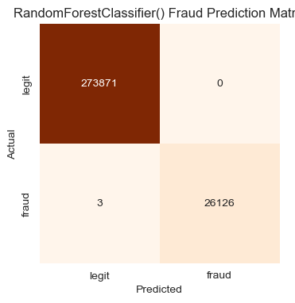
Appendix

Slide 15
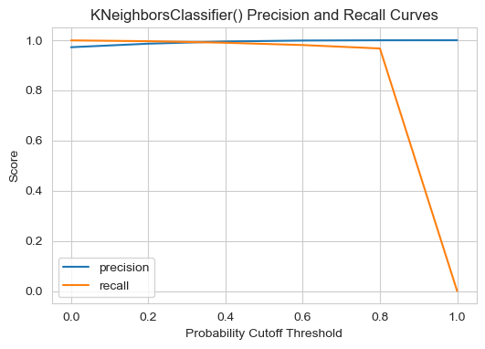
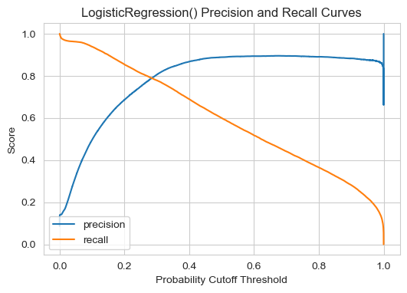
Appendix

Slide 16
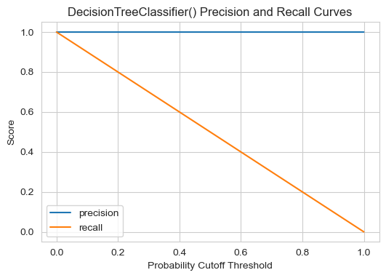
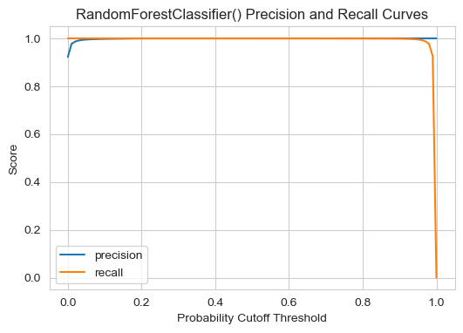
Appendix

Slide 17
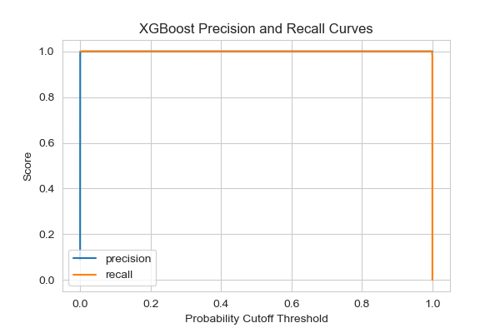
Appendix

Slide 18
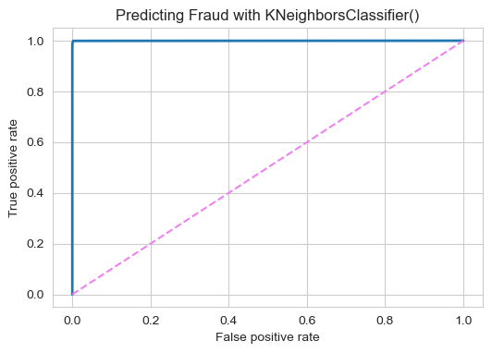
Appendix

Slide 19
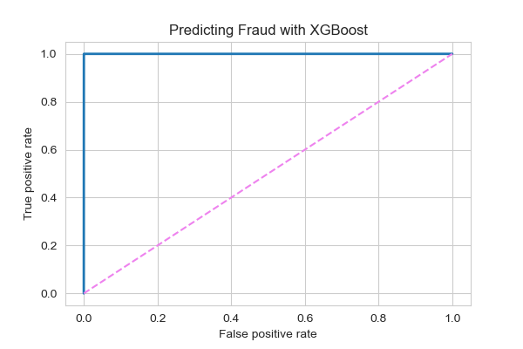
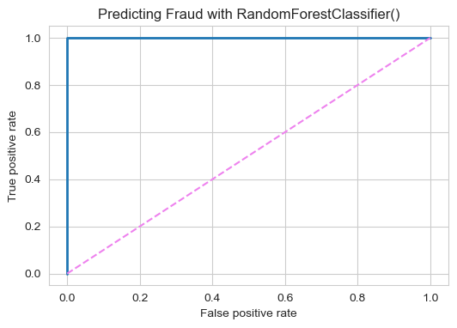
Appendix

