Slide 1

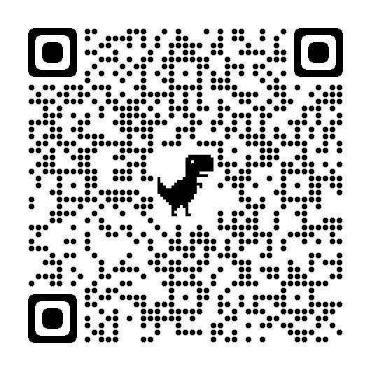
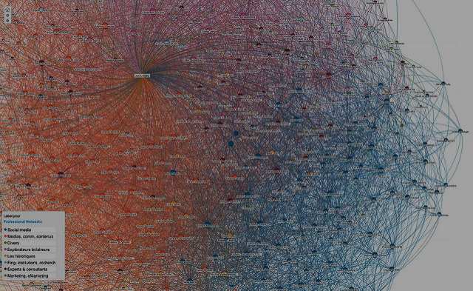

Formatting Example Poster (80 PT)
Insert Corporate Partner Logo Here
Student names in alphabetical order by last name.
NOTES TO DATA MINE STUDENTS
This is a 28 PT font Title
We encourage you to use a template from your Corporate Partner if possible. We would love to see 80 unique posters that are not all on this Purdue template.
Poster must be 24 x 36 inches (just like this poster)
Use images
Limit blocks of text and complete sentences
Purdue branding is located here if you plan to use this Purdue template or incorporate Purdue colors. https://marcom.purdue.edu/our-brand/
This list of text is 24 PT
See all guidelines here
This QR code is 3” x 3”
ADD PHOTOS/VISUALS
TO ENHANCE THE APPEAL
OF YOUR POSTER
This paragraph is size 20. This is the SMALLEST recommended size for text.
The first large-scale learning community for undergraduate and graduate students from all majors, focused on Data Science for All. Hillenbrand Hall, where many Data Mine students live, is filled with new learning communities of students preparing for the data-driven workforce of the 21st century.
Make sure to include bullet points.
Info should be brief
Bold text with keywords or numbers
THIS IS A 36 PT FONT TITLE
ADD PHOTOS/VISUALS
TO ENHANCE THE APPEAL
OF YOUR POSTER
This paragraph is size 24. This is the MOST recommended size for text.
The first large-scale learning community for undergraduate and graduate students from all majors, focused on Data Science for All. Hillenbrand Hall, where many Data Mine students live, is filled with new learning communities of students preparing for the data-driven workforce of the 21st century.
Make sure to include bullet points.
Info should be brief
Bold text with keywords or numbers
Font Size
This line of text is Calibri size 12
This line of text is Calibri size 14
This line of text is Calibri size 16
This line of text is Calibri size 18
This line of text is Calibri size 20
This line of text is Calibri size 24
This line of text is Calibri size 28
This line of text is Calibri size 32
This line of text is Calibri size 36
This line of text is Calibri size 40
This line of text is Calibri size 44
This line of text is Calibri size 48
This line of text is Calibri size 54
This line of text is Calibri size 60
This line of text is Times New Roman size 12
This line of text is Times New Roman size 14
This line of text is Times New Roman size 16
This line of text is Times New Roman size 18
This line of text is Times New Roman size 20
This line of text is Times New Roman size 24
This line of text is Times New Roman size 28
This line of text is Times New Roman size 32
This line of text is Times New Roman size 36
This line of text is Times New Roman size 40
This line of text is Times New Roman size 44
This line of text is Times New Roman size 48
This line of text is Times New Roman size 54
This line of text is Times New Roman size 60
ADD PHOTOS/VISUALS
TO ENHANCE THE APPEAL
OF YOUR POSTER
The Data Mine Corporate Partners Symposium 2023

