Slide 1
Summer Onboarding
Meeting #2
June 2024

Slide 2
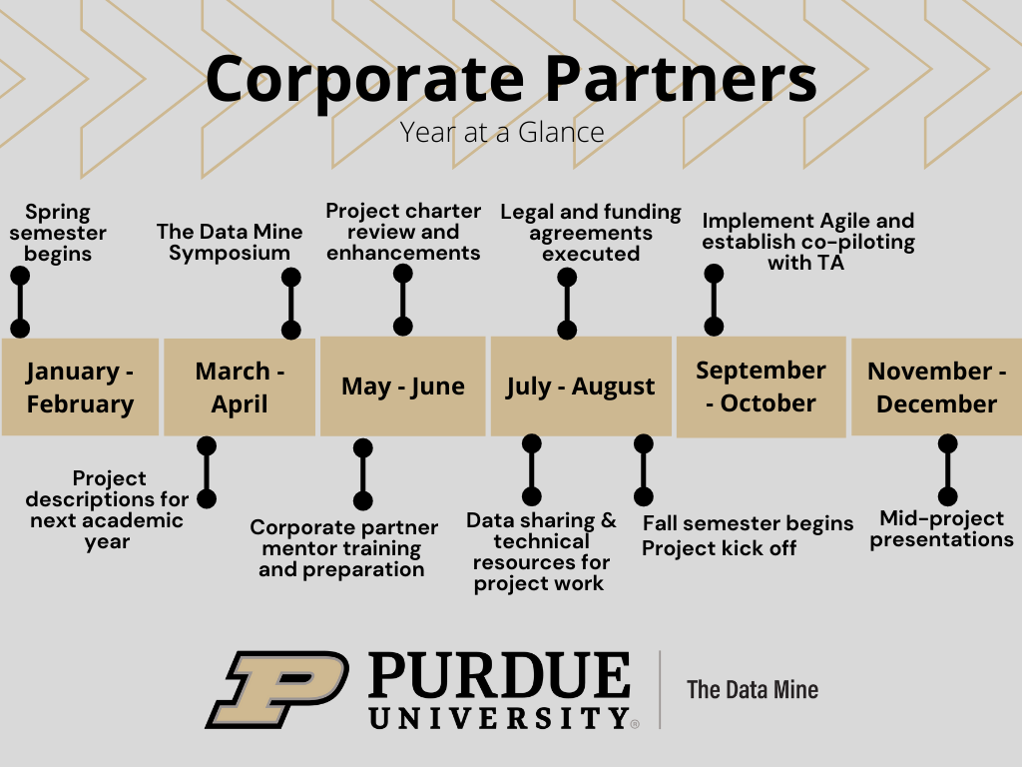
Year at a Glance
The Data Mine

Slide 3

Meeting Agenda
The Data Mine
Data Sharing
Agile
Community Building
Goals

Slide 4
Data Sharing
The Data Mine
It is important to consider how you would like to share data to the students.
Some of the ways to share data include:
Purdue Environment
The Data Mine utilizes a high performance computing cluster (HPC) on campus know as Anvil.
Anvil looks like a website that the students navigate on their computer. From there they choose the amount of resources and time required and launch a Jupyter Lab session. This gives the students access to all the code and data that’s stored on the HPC for their specific group project.
Mentors can receive access to Anvil to upload data.
To learn more about Anvil, please visit the Anvil information page.
Company Environment
In the past, companies have elected to provided their own equipment to students such as laptops or virtual machines (VMs).
The Data Mine staff can provide a roster with student names and email address in order for companies to create career accounts for each student on the project.

Slide 5
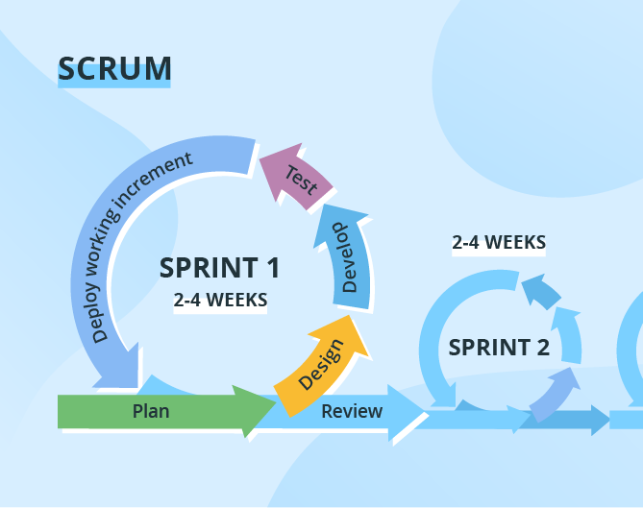
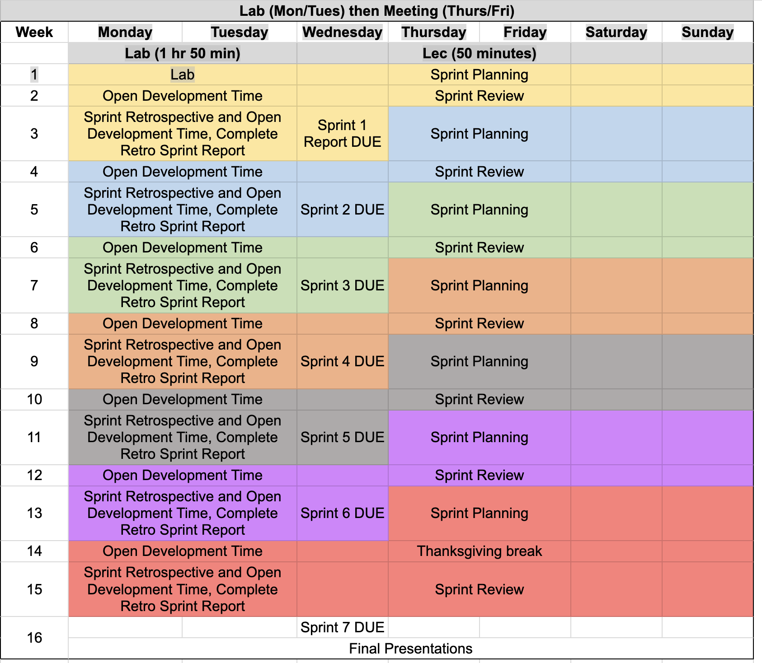
Agile
The Data Mine
https://the-examples-book.com/crp/agile/

Slide 6

Goals / Outcomes & Community Building
The Data Mine
What are three goals / outcomes that you would like to see from this academic year?
Regarding your professional career, what steps have you taken to create a strong community within a team while accomplishing a task or goal?

Slide 7
Meeting #3 Agenda
The Data Mine
TA Introductions
Expectations

Slide 8
Thank You
datamine@purdue.edu

