Slide 1
Welcome to The Data Mine!
Week 1 Lab Session

Slide 2
Week 1 Lab Schedule
Introductions, project/company information and logistics (15 mins)
Lego Agile activity instructions and set up (10 minutes)
Lego Agile activity (1 hour)
Presentation of final product (10 minutes)
Tear down and clean up (15 minutes)

Slide 3
NDA and IP Agreements

Slide 4
NDA and IP Agreements
The Data Mine is incredibly fortunate to work with our many corporate partners. A large reason we can coordinate these projects is because of the trustworthiness of our students. We place large amounts of trust in you to protect and secure all private company information.
Some companies will require a signed Non-Discloser Agreement (NDA) from all students. If your company assignment requires an NDA, you will receive the NDA to electronically sign (DocuSign) in your email. The NDA must be signed and submitted before you can access any confidential information from the company. If you choose not to sign the NDA for any reason, you will be transitioned to a new team that does not have an NDA requirement.
Some companies will also include an Intellectual Property (IP) Clause or a separate IP Agreement. If you choose not to sign the IP Agreement for any reason, you will be transitioned to a new team that does not have an IP Agreement requirement.
There may be legal consequences in the situation an NDA is violated.
The legal agreements are between you, as an individual, and your corporate partner. Therefore, Purdue and The Data Mine cannot provide legal counsel on these documents.
Thank you for your commitment to the security and confidentiality of our corporate partners’ information!

Slide 5
DATA MINE AGILE TRaining

Slide 6
What is Agile?
Customer is actively involved in planning and prioritizing work and provides frequent feedback
Agile is a method of customer-focused project management focused on incremental and iterative delivery
How teams complete work
Instead of just delivering a final product all at once there is a regular cadence of feature delivery
Notes:
Agile methodology is a project management approach that focuses on flexibility, collaboration, and continuous improvement. Instead of completing a project all at once, work is divided into smaller phases called sprints, allowing teams to regularly evaluate progress, gather feedback, and make adjustments as needed. Agile encourages frequent communication among team members and stakeholders, helping organizations respond more quickly to changing needs while delivering results more efficiently.

Slide 7
Roles in Agile
Product owner:
Represents the customer
Develops and prioritizes user stories (features the customer wants in the product)
Accepts and rejects work
Scrum Master:
Organizes work on the development team
Ensures communication between roles
Removes bureaucratic barriers
Developers:
Responsible for delivering features
Work cross-functionally with other members of the development team
Notes:
Product Owner: Represents the customer and is responsible for defining the project's goals, prioritizing tasks, and ensuring the team delivers the most valuable features.
Scrum Master: Serves as a facilitator and coach who helps the team follow Agile principles, removes obstacles, and supports effective communication and collaboration.
Developer: Designs, builds, tests, and delivers the product. Developers work collaboratively to complete the tasks identified during each sprint and continuously improve the product.

Slide 8
Sprint Cycles
Sprint Planning
Work with PO to determine work to be accomplished during the upcoming sprint
Sprint
Work time to deliver on the features identified during planning
Sprint Review
Present work accomplished during the sprint to the PO and get feedback
Retrospective
Review backlog
Review how the sprint went and how things can be improved in the future
* All Data Mine Corporate Partner projects will utilize an Agile framework this year; grades will be primarily based on your performance during sprints
Notes:
A sprint cycle is a short, structured period of work (typically one to four weeks) in which an Agile team completes a set of prioritized tasks. The cycle usually follows these steps:
Sprint planning: The team selects tasks from the product backlog and determines what can be completed during the sprint.
Daily stand-up meetings: Team members meet briefly each day to discuss progress, upcoming work, and any obstacles.
Sprint execution: Developers complete the planned work while collaborating and making adjustments as needed.
Sprint review: At the end of the sprint, the team presents the completed work to stakeholders and gathers feedback.
Sprint retrospective: The team reflects on what went well, what challenges arose, and how processes can be improved before the next sprint begins.
The cycle then repeats until the project is complete.

Slide 9
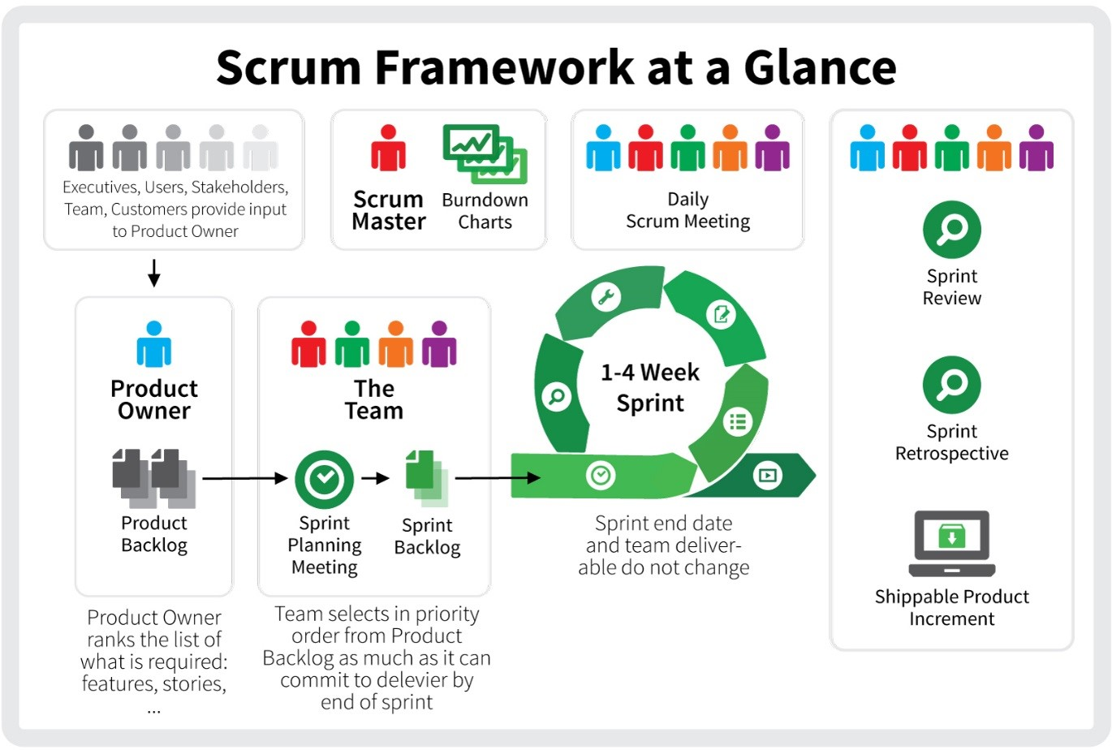
Agile Basics
Notes:
The Scrum framework is an Agile framework that helps teams organize and manage complex projects through short, iterative work cycles called sprints.

Slide 10
Lego agile activity

Slide 11
Task: Design and build
A new building for The Data Mine

Slide 12
Instructions
Roles
A Data Mine or MEM staff member will act as the product owner for this activity (we will be walking around).
All team members will act as developers.

Slide 13
Instructions
Product owners have developed a backlog of tasks. Your team will be responsible for allocating work in an Agile methodology and executing the tasks.
However, there are a few caveats…
Your team will need to identify and deliver the minimum viable product (MVP)
You will need to work with the product owner to clarify requests tasks in the backlog.
You may not be able to complete all of the tasks on the backlog with the time and materials provided (you will need to negotiate with the PO!).
Remember, product owners can also change their minds – you may need to be flexible if you build something and they don’t like it.
Creativity is encouraged! A Lego can represent anything as long as it is explained (and communication is a key part of Agile!)

Slide 14
Sprint Timeline
Sprint Planning (4 minutes)
Choosing what tasks to do during the sprint, estimating time/distributing work, and working with the product owner to clarify tasks.
Sprint (8 minutes)
Work time in which the product owner is not actively working with you.
Sprint Review (3 minutes)
Present work from the sprint to the product owner and get feedback.
Retrospective (2 minutes)
Discuss what went right, what went wrong, and how you can fix issues in the next sprint (e.g., how you collaborate, estimating time required for tasks, etc.)
Repeat! (3x)
Notes:
Product Backlog is the "everything we might do, in priority order" list, while the Sprint Backlog is the "what we're doing right now, and how" list — a focused slice pulled from the top of the Product Backlog for the current Sprint.

