Slide 1
Agile reflection

Slide 2

Sprint Review Kahoot (8 minutes)
Kahoot Link: https://create.kahoot.it/share/tdm-agile-review/2d89128e-9e57-4d18-8f67-4e8b703d7493

Slide 3

Sprint Retrospective (8 minutes)
What went well during Sprint #1? (Lego Activity, Mentor/Lab Meeting)
What didn’t go well during Sprint #1? (Lego Activity, Mentor/Lab Meeting)
How can we improve Sprint #2?
What are some questions you have regarding Spring #1?

Slide 4

Stand-up (5-10 minutes)
What have you been working on since the last meeting?
What are you currently working on?
Are there any blockers or barriers preventing you from doing your work?

Slide 5
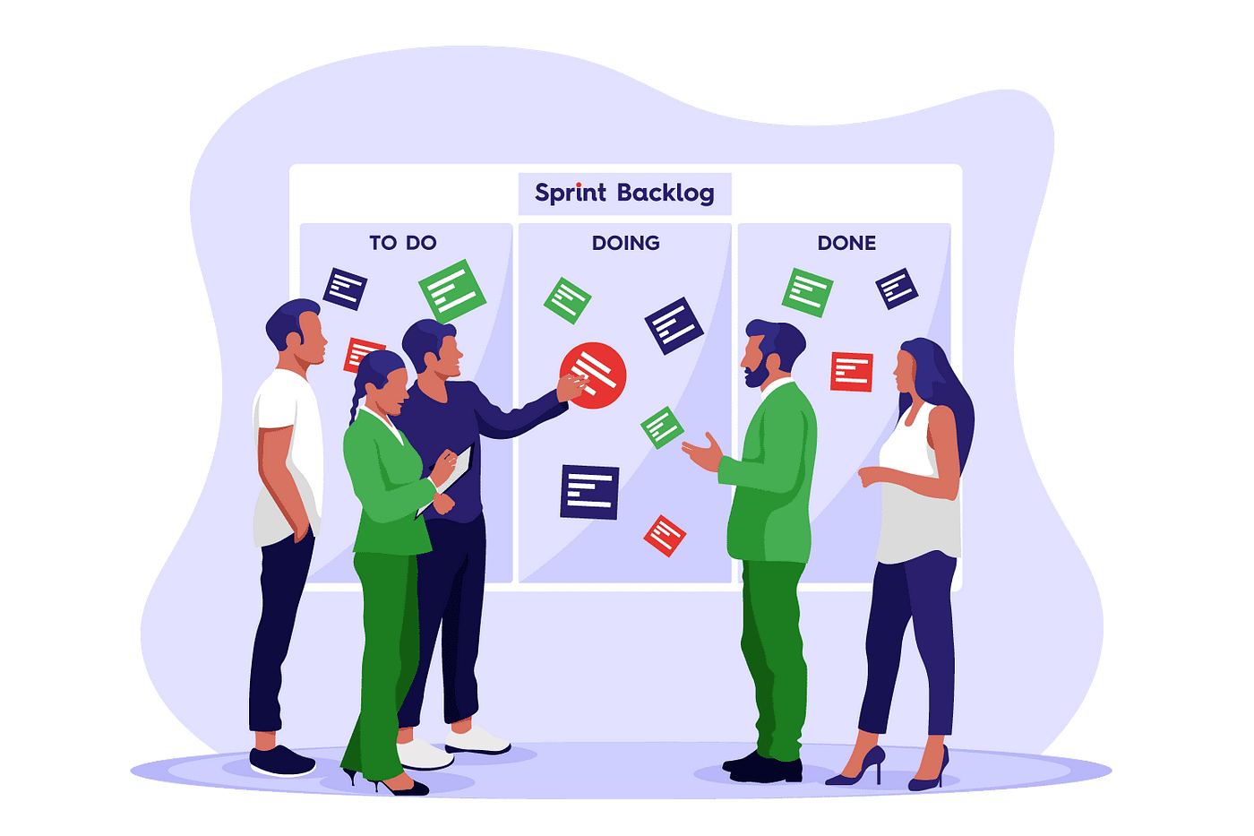
Sprint Planning
What are some task we want to focus on completing this sprint?
Who will work on these task(s)?
What will the final product of this task look like?

Slide 6

Github on Anvil
Github on Anvil Guide:
https://the-examples-book.com/starter-guides/tools-and-standards/git/github-anvil

Slide 7

Starter Guide & Literature Review
Starter guides: https://the-examples-book.com/starter-guides/introduction
Purdue literature review guide: https://guides.lib.purdue.edu/research_approaches/litreview

