Slide 1
Agile reflection

Slide 2
Sprint Retrospective
What went well?
What went less?
What do we want to try next?
What questions do we have?

Slide 3

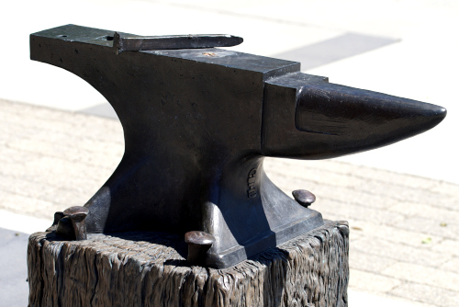
Setup Github on Anvil
Github on Anvil guide (https://the-examples-book.com/starter-guides/tools-and-standards/git/github-anvil)
Collaborate as a team to help each other set up Github on Anvil

