Slide 1
Summer Onboarding
Meeting #1
May 2024

Slide 2
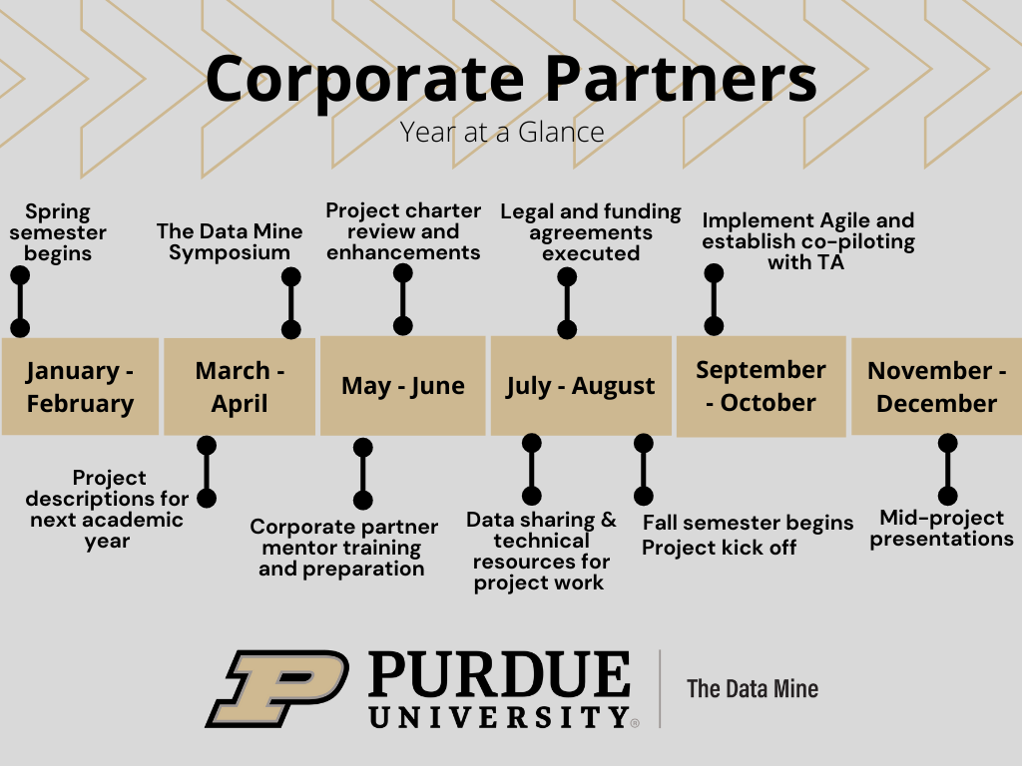
Year at a Glance
The Data Mine

Slide 3
Meeting Agenda
The Data Mine
Legal
Title IX Training
Project Charter

Slide 4
Legal
The Data Mine
Legal Documents
Sponsor Acknowledgement (SA)
[New Partners] Our industry partners sign this SA (click here to download full sponsor acknowledgement). The SA covers five years of partnership, but it does not obligate your company to five years of projects.
[Renewing] After executing the full SA, please renew each year with this addendum for years two through five. (click here to download addendum).
Nondisclosure Agreement (NDA)
Most companies require the students and Data Mine staff to sign an NDA at the start of the project
The NDA is provided by the company. If you do not have an NDA, here is a generic one provided by Purdue Legal Counsel. (click here to download NDA template).
The NDA must be between an individual (student and staff) and the company. Purdue will not sign an NDA on behalf of the students.
The Data Mine staff handles the logistics of getting the NDAs signed by students and staff. We return a zip file of all signed documents shortly after the fall semester starts.
Intellectual Property (IP)
At Purdue University, students retain their IP. Students can license their IP at no cost.
The IP Assignment Agreement is provided by the company. If you do not have an IP Assignment Agreement, (click here to download IP Assignment template).
Purdue faculty and staff cannot sign any agreement regarding IP for projects running under the SA. Faculty and staff can only sign an IP agreement under sponsored research contracts.

Slide 5
Title IX Training
All corporate partner mentors must complete the Title IX Mandatory Reporter Annual Certification.
Link to access the training: https://rise.articulate.com/share/iZxLOkuhvguWRDgucVLEsmTU2QgV2kwg?_ga=2.226536212.864048274.1715024650-1658901526.1704904023#/
Once training is complete, you’ll receive a confirmation email. Please forward that email to your corporate partner liaison.
The Data Mine

Slide 6
Project Charter
The Data Mine
The Purpose of the project charter is the inform the students what they are working towards and why it is important
With clear guidance and motivation, the students will take ownership and use their creativity to work on the project

Slide 7
Project Charter
The Data Mine
A Project Charter builds upon the project description by adding additional details to help guide the students during the academic year.
Project charters formats can consist of a word document or slide deck.
What to include in the project charter
Information about the company
What does your company do?
History
What is your team’s role in relation to the company?
Information about the mentor
Title & Job responsibilities
Contact Information
Availability
Project Description
A bit more detailed version of the initial project description
What is the motivation?
Who are the stakeholders?
What is the purpose?
Objective
Contextualize the project
What are the main goals?
What is the projected product?
What are the expected outcomes for the end of the academic year?
https://the-examples-book.com/crp/mentors/projectcharter

Slide 8
Project Charter
The Data Mine
What to include in the project charter (continued…)
About the Data
What data is being used and why is it important to the project?
How will the students access the data?
Any preprocessing done prior to students receiving the data?
How is is currently used?
How was it collected?
Goals / Milestones
Fall Semester Goals
Sprint Goals (7 Sprints)
Spring Semester Goals
Sprint Goals (7 Sprints)
Team Roles
Mentor (Project Owner)
TA (Scrum Master)
Students (Developers)
Sub teams?
Reviewing Materials
Videos
Literature
Articles
News
Project Examples
Required Tools
https://the-examples-book.com/crp/mentors/projectcharter

Slide 9
Fall 2024 Schedule
The Data Mine
Sprint | Lab (Mon/Tues) then Meeting (Thurs/Fri) | Meeting (Mon/Tues) then Lab (Thurs/Fri) | Details | Due Date | Submission
1 | Start: Mon 8/19 End: Wed 9/4 | Start: Mon 8/19 End: Sun 9/1 | Monday, 8/19: First day of Fall 2024 classes
 |  |  | Corporate Partners Syllabus Quiz due | Wed, 9/4 by 11:59 PM ET | Gradescope
 |  |  | Agile Training & Quiz due | Wed, 9/4 by 11:59 PM ET | Gradescope
 |  |  | Sprint #1 Report due | Wed, 9/4 by 11:59 PM ET | Gradescope
2 | Start: Thurs 9/5 End: Wed 9/18 | Start: Mon 9/2 End: Sun 9/15 | Monday, 9/2: Labor Day (no CRP meetings/classes)
 |  |  | Sprint #2 Report due | Wed, 9/18 by 11:59 PM ET | Gradescope
3 | Start: Thurs 9/19 End: Wed 10/2 | Start: Mon 9/16 End: Sun 9/29 | Sprint #3 Report due | Wed, 10/2 by 11:59 PM ET | Gradescope
4 | Start: Thurs 10/3 End: Wed 10/16 | Start: Mon 9/30 End: Sun 10/13 | Monday, 10/7 & Tuesday, 10/8: Fall Break – No Classes
 |  |  | Sprint #4 Report due | Wed, 10/16 by 11:59 PM ET | Gradescope
5 | Start: Thurs 10/17 End: Wed 10/30 | Start: Mon 10/14 End: Sun 10/27 | Sprint #5 Report due | Wed, 10/30 by 11:59 PM ET | Gradescope
6 | Start: Thurs 10/31 End: Wed 11/13 | Start: Mon 10/28 End: Sun 11/10 | Sprint #6 Report due | Wed, 11/13 by 11:59 PM ET | Gradescope
 |  |  | Final presentation draft materials due | Wed, 11/13 by 11:59 PM ET | your TA will submit the draft
7 | Start: Thurs 11/14 End: Wed 11/27 | Start: Mon 11/11 End: Sun 11/24 | Data Mine Staff returns feedback on presentations during your lab time
 |  |  | Final Presentation Practice Sessions and Revisions during your lab time
 |  |  | Wednesday, 11/27 – Friday, 11/30: Thanksgiving break – No Classes
 |  |  | Sprint #7 Report due | Sun, 12/1 by 11:59 PM ET | Gradescope
 | Monday, 12/2 – Friday 12/6 Last week of fall 2022 classes |  | Final team presentations during your regularly scheduled 50-minute team meeting.
 |  |  | Saturday, 12/6: Last day of fall 2024 classes.
 | Mon 12/9 – Sat 12/14 |  | Final Exam Week – no meetings in Corporate Partners and nothing is due for this course. There are no final exams in Corporate Partners.
 | Tuesday, 12/17 |  | Fall 2024 grades are submitted to Registrar’s Office by 5 PM ET

Slide 10

Meeting #2 Agenda
The Data Mine
Data Sharing
Agile
Community Building
Goals

Slide 11
Thank You
datamine@purdue.edu

