Slide 1
Summer Onboarding
Meeting #2
June 2024

Slide 2
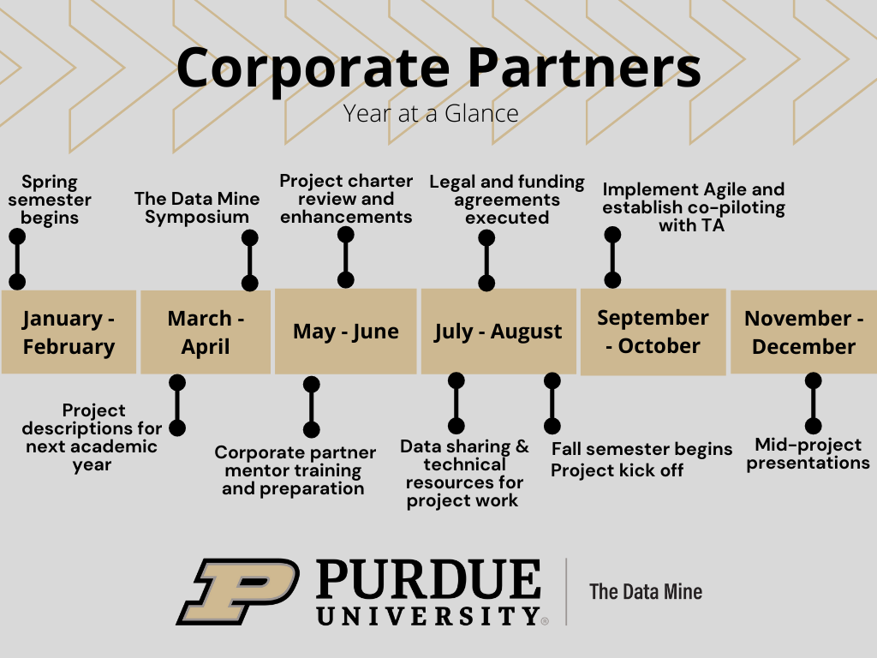
Year at a Glance
The Data Mine

Slide 3

Meeting Agenda
The Data Mine
Data Sharing
Agile
Community Building
Goals

Slide 4
Data Sharing
The Data Mine
It is important to consider the following questions:
What data are you using?
How will the students access the data?
Some of the ways to share data include:
Purdue Environment
The Data Mine utilizes a high performance computing cluster (HPC) on campus know as Anvil.
Anvil looks like a website that the students navigate on their computer. From there they choose the number of resources and time required and launch a Jupyter Lab session. This gives the students access to all the code and data that’s stored on the HPC for their specific group project.
Mentors can receive access to Anvil to upload data.
To learn more about Anvil, please visit the Anvil information page.
Company Environment
Company laptops, virtual machines (VMs), etc.

Slide 5
Agile
The Data Mine
Product Owner
Corporate Partner Mentor
The expert of the project, has a focused understanding of consumer needs, domain application, and business specifications
Scrum Master
Teaching Assistant (TA)
The Bridge between the mentor and the students. They are the project managers, and they establish agile management to the students
Developers
Students
The primary contributors to the project and perform the actions necessary to work towards the project goal

Slide 6
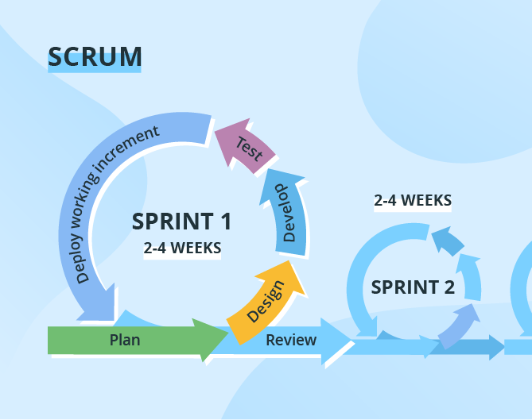
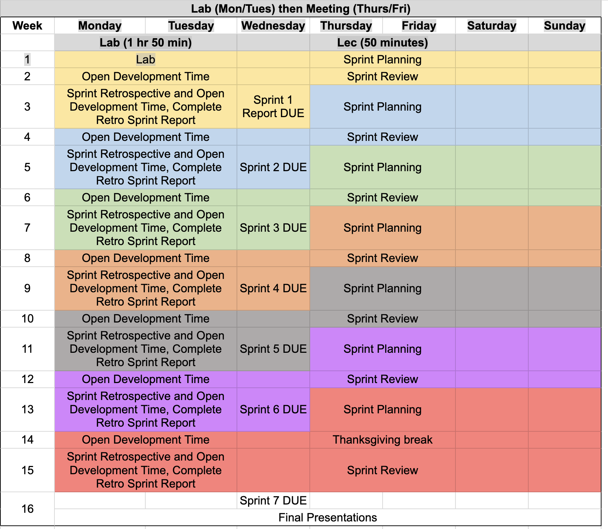
Agile
The Data Mine
https://the-examples-book.com/crp/agile/

Slide 7
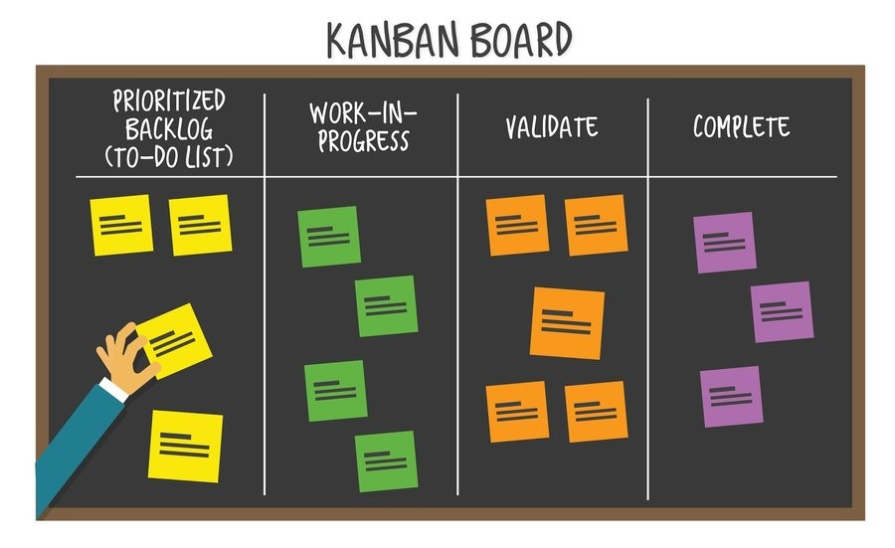
Agile
The Data Mine

Slide 8

Goals / Outcomes & Community Building
The Data Mine
What are three goals / outcomes that you would like to see from this academic year?
Regarding your professional career, what steps have you taken to create a strong community within a team while accomplishing a task or goal?

Slide 9
Meeting #3 Agenda
The Data Mine
TA Introductions
Expectations

Slide 10
Thank You
datamine@purdue.edu

