Slide 1
Summer Onboarding
Meeting #3
June/July 2024

Slide 2
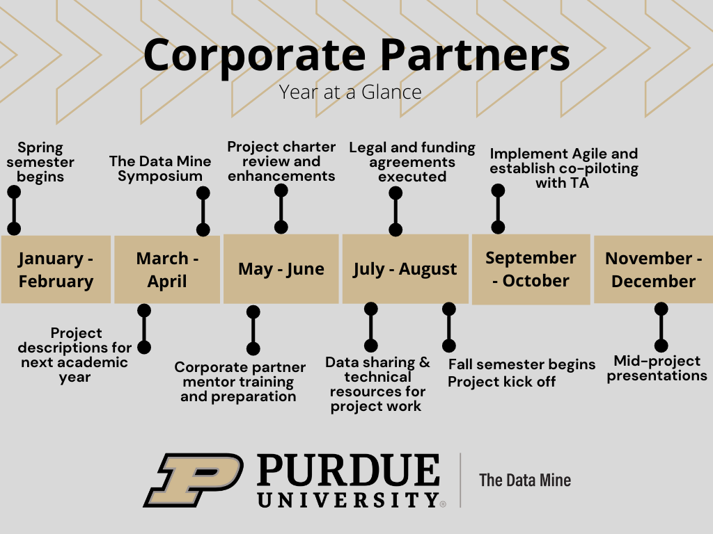
Year at a Glance
The Data Mine

Slide 3
Meeting #3 Agenda
The Data Mine
TA Introductions
Expectations

Slide 4
TA Introduction
The Data Mine
Name
Role at organization and how many years at company
TA: Major and Year
Prior TDM experience if applicable
What is one thing that you are looking forward to this fall?

Slide 5
Setting Expectations
What specific responsibilities do you want the TA to focus on for the project?
Are there any materials for the TA to review prior to the start of the academic year?
What from the company can you train the TA on so they can pass their learnings to the team? (i.e., Company Culture, Technical Skills, Internal Documentation)
How can the TA create a bridge from the student team to the corporate partner mentors?
How do you, as the mentor, want to communicate to the team outside the weekly meetings? (Email, MS Teams, etc.)
The Data Mine

Slide 6
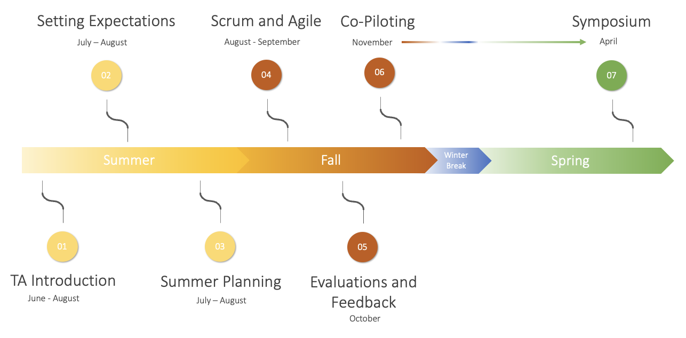
Setting Expectations
The Data Mine
It is encouraged that mentors and TAs use the summer months to prepare for the academic year.
During the summer months, mentors and TAs should consider planning all components of the project charter:
Semester and Project Goals
Project Schedule and Checkpoints
Team Composition and Roles
Preparatory Readings and Exercises
Tools and Software
Data Sharing and Access
Scrum and Agile Trainings
Co-Piloting
The ultimate goal of the mentor and TA relationship should be, what we call co-piloting. By November, the student team, mentor, TA will ideally be comfortable with the project, agile, and The Data Mine course.
TAs and Mentors will then Co-Pilot the project where the project management should feel consistent and scheduled

Slide 7
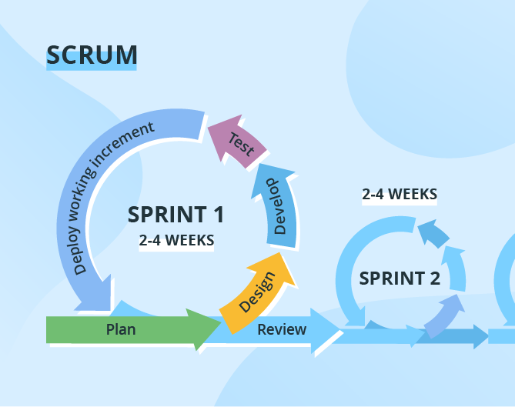
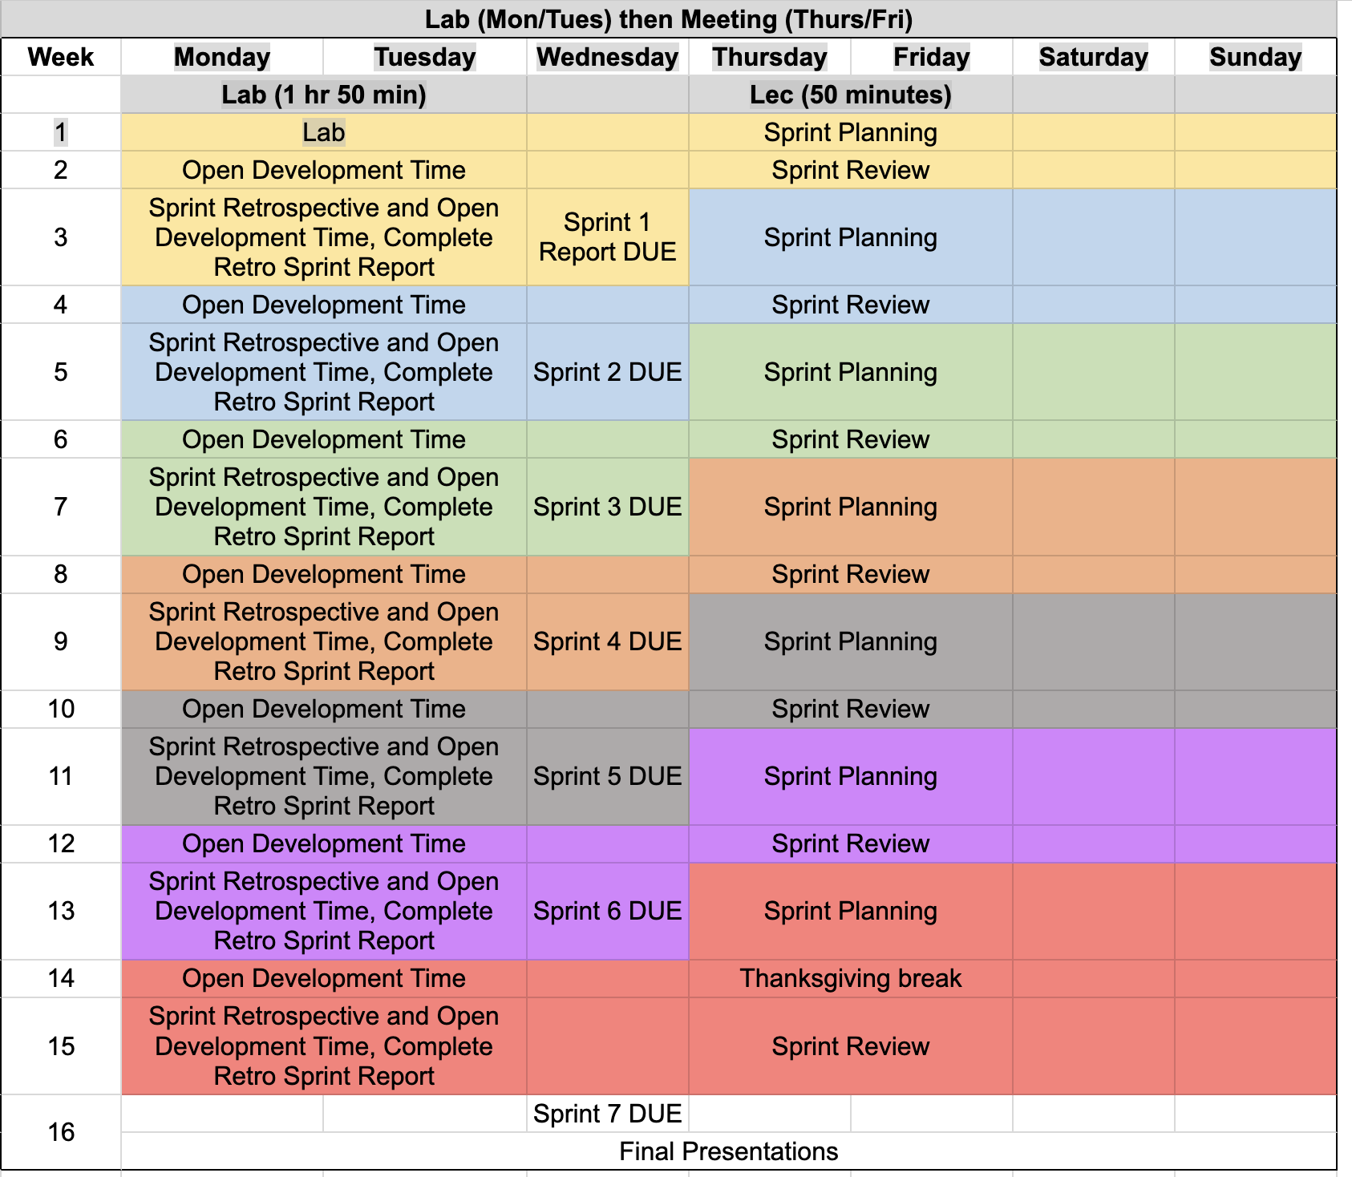
Agile
The Data Mine
https://the-examples-book.com/crp/agile/

Slide 8

Meeting #4 Meeting Agenda
The Data Mine
Project Charter Review

Slide 9
Thank You
datamine@purdue.edu

