Slide 1
Functions

Slide 2
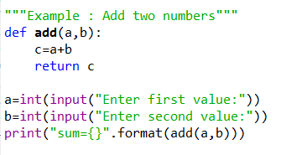
Functions
Functions are blocks of reusable code.
Syntax:
def func_name(arguments):
statements
return some_value
Example:
Def:
a , b = arguments
add() = function name
c = local variable created to store & return
result

Slide 3
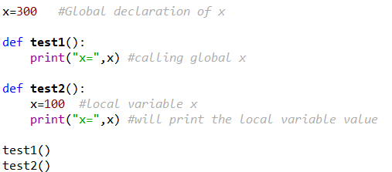
Variable Scope
Variable scope: it determines the visibility of the variable
2 types:
Local Variable: Visible only in the function where it’s declared
Global Variable: Declared once in program and visible to all the functions
Example:

Slide 4
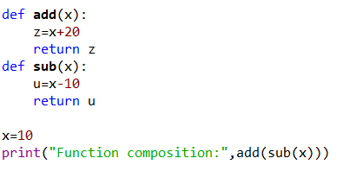
Function Composition
f(g(x))
Syntax:
def f(x):
statement1
return something
def g(x):
statement2
return something
call f(g(x)) #main function
Example:

Slide 5
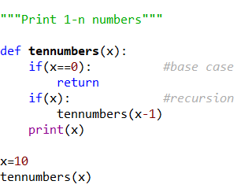
Recursion
Function calling itself until it reaches a base condition is recursion.
Syntax:
def func1():
base case statements
return func1()
print(func()) #main function
Example:

Slide 6
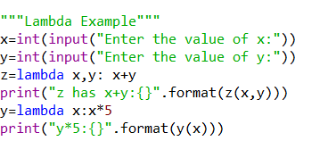
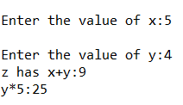
Lambda
Syntax:
Variable=lambda list_of_arguments: expression
Result:

Slide 7
Use Functions
Find cube of any number
Find diameter, circumference and area of circle .
Find maximum and minimum between two numbers using functions.
A number is even or odd using functions.
A number is prime, Armstrong or perfect number using functions.
All prime numbers between given interval using functions.
All strong numbers between given interval using functions.
All Armstrong numbers between given interval using functions.
All perfect numbers between given interval using functions.

Slide 8
Use Recursion
Find sum of digits of the number using Recursive Function.
Find power of any number using recursion.
Print all natural numbers between 1 to n using recursion.
Print all even or odd numbers in given range using recursion.
Find sum of digits of a given number using recursion.
Write a C program to find factorial of any number using recursion.
Write a C program to generate nth Fibonacci term using recursion.
Write a C program to find GCD (HCF) of two numbers using recursion.
Write a C program to find LCM of two numbers using recursion.
Write a C program to check whether a number is palindrome or not using recursion
Write a C program to display all array elements using recursion.
Write a C program to find sum of elements of array using recursion.
Write a C program to find maximum and minimum elements in array using recursion.
Write a C program to find sum of all natural numbers between 1 to n using recursion.
Write a C program to find sum of all even or odd numbers in given range using recursion.
Write a C program to find reverse of any number and string using recursion.
Prime or Composite

