Slide 1
TitelFolie
Hier muss noch was hin

Slide 2
Overview
Project Scope
DataSource
System Architecture
Data Processign
ML-Model
ML-Model as Service
Monitoring and Reliability
Challenges and Constraints
Results, Conclusion & Reproducibility

Slide 3
Project Scope
Develop a system that:
  Collects / sends sensor data continuously
  Detects anomalies using machine learning
  Exposes predictions through a REST API

Slide 4
Design Overview / Key Ideas / Workflow
Sensor Data
Sensor Data should be collected and send to an API, which then uses an ML Model to make a prediction. The Predictions and the Sensor Data then should be logged and Monitored.
REST API
Anomaly Detection Model
Prediction Result
Logging and Monitoring

Slide 5
Design in Detail
Kafka – Event streaming platform
Data Validation Service (API)
Data Storage
Monitoring
Prediction by ML as Service (API)
Isolation Forest (ML Model)

Slide 6
Kafka – Event Streaming Platform
Receives real-time events from sensors
Publishes events to Kafka topic
Buffers and distributes data to subscribed services
Enables scalable, asynchronous communication

Slide 7
Data Validation Service (API)
Subscribes to Kafka topics.
Validates incoming event structure and data quality.
Filters out invalid or incomplete records and sends them to storage
Forwards valid events to the prediction service

Slide 8
Prediction by ML as Service (API)
Receives validated events
Calls the trained Isolation Forest model Returns an anomaly score or anomaly label
Stores prediction results for later analysis

Slide 9
solation Forest (ML Model)
Detects anomalies in incoming data.
Uses patterns learned during training.
Produces anomaly predictions without requiring labeled data.
Returns the prediction to the ML service.

Slide 10
Data Storage
Stores validated events.
Stores prediction results and anomaly scores.
Provides historical data for retraining and analysis.
Serves as the data source for monitoring dashboard

Slide 11
Monitoring
Visualizes incoming events and predictions.
Displays anomaly trends and system health.
Tracks model performance over time.
Generates alerts when abnormal behavior is detected.

Slide 12
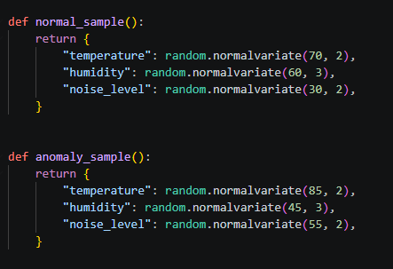
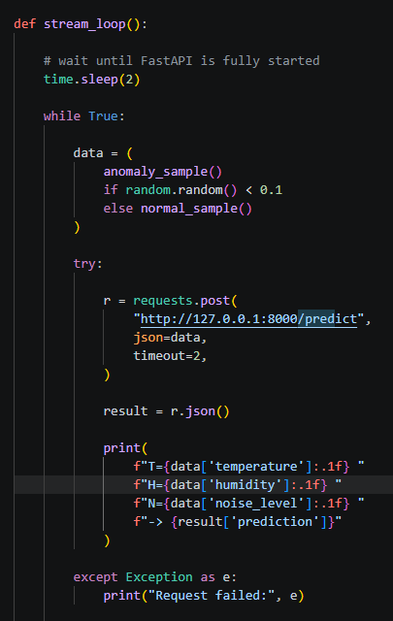
Sensor Data as Stream and Data Validation
Constant stream of data with a 10% probabilty of data beeing anomalies as long as stream_loop runs
Streams directly to FastAPI endpoint
Data Validation already done at that point

Slide 13
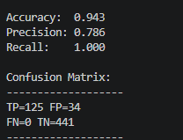
ML Model
Isolation Forest
  detects anomalies by randomly partitioning data
  unusual points are isolated faster with fewer splits, making them easier to identify as outliers
  Needs to be trained first
  Needs no labels for training
Training with 300 Sampels and Testing on 600 Datapoints

Slide 14
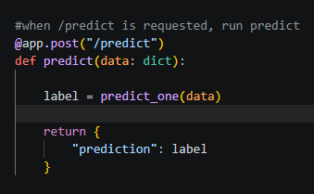
Model as a Service
Each request of /predict triggers predict(predict_one)
=> Each data send to the /predict endpoint triggers the ML Model

