Slide 1


Major Tom (NASADataCopilot)
Your AI copilot for NASA data analysis
Meritxell Cordon
Sneyder Murillo
Uzziel Perez
Manel Cerezo
David Larrosa

Slide 2

Problem
DATA ML Pipeline require human Expert manual validation
expert knowledge
cost of time and resources
No tools available for non professionals
Low explainability for the results and exponential growth of astronomical data

Slide 3

Solution
User-friendly and interactive AI-based tool that delivers:
Fast and automated validations
Clear and human-readable explanations
Scalable design adaptable to the user´s level of expertise

Slide 4

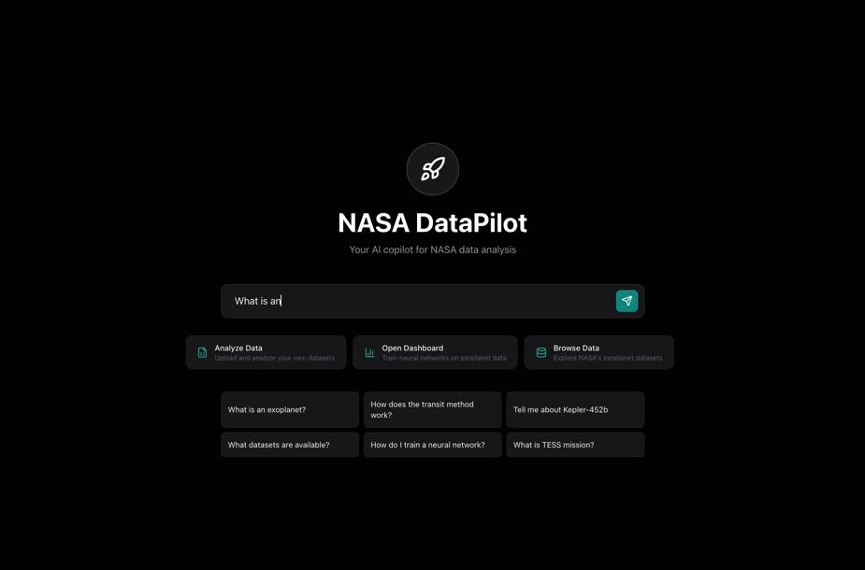
The Project

Slide 5
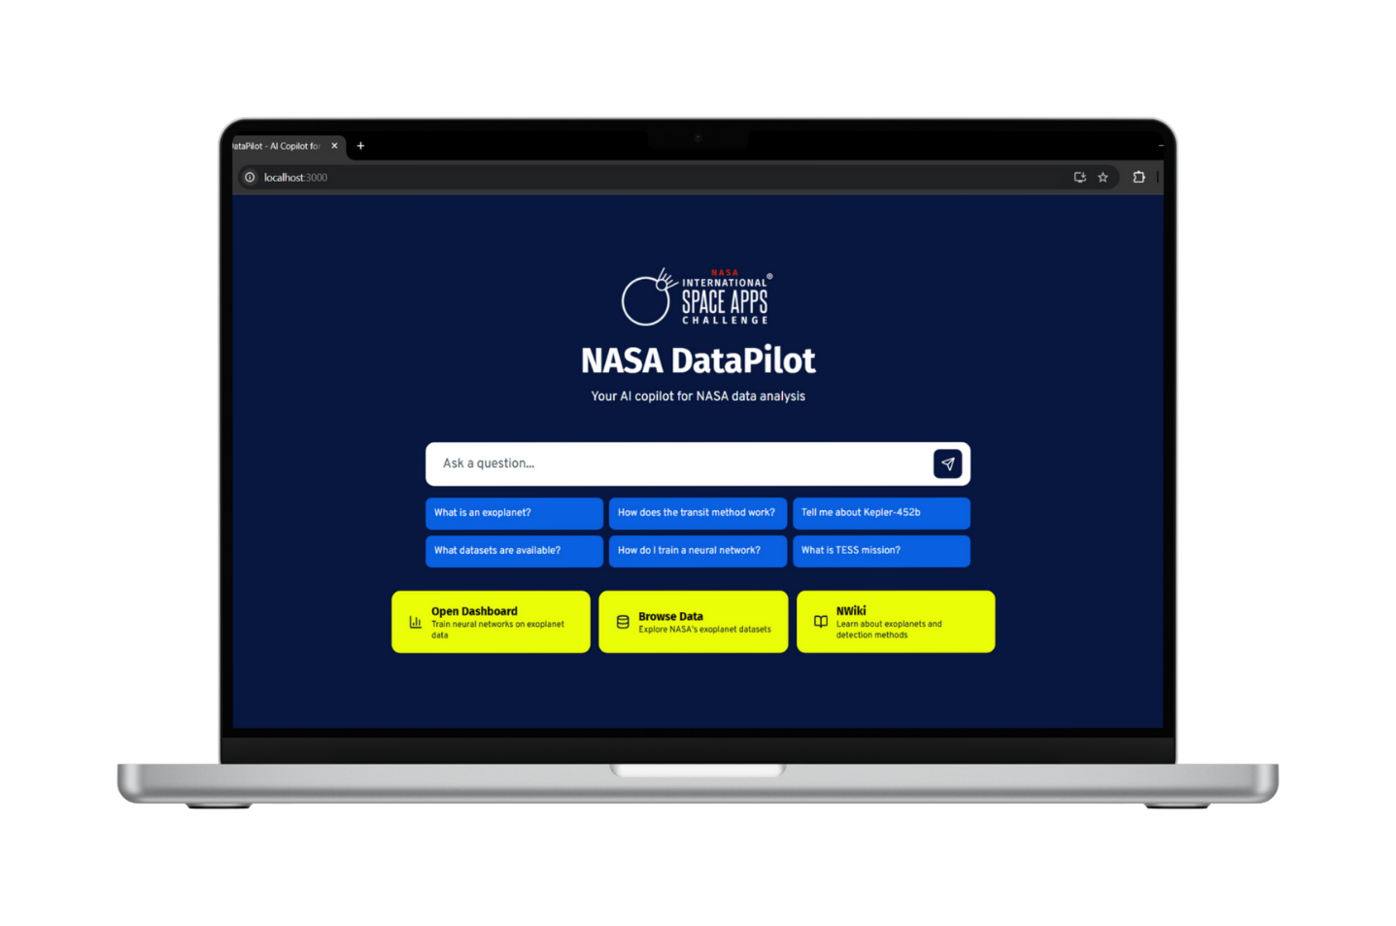
The Project

Slide 6
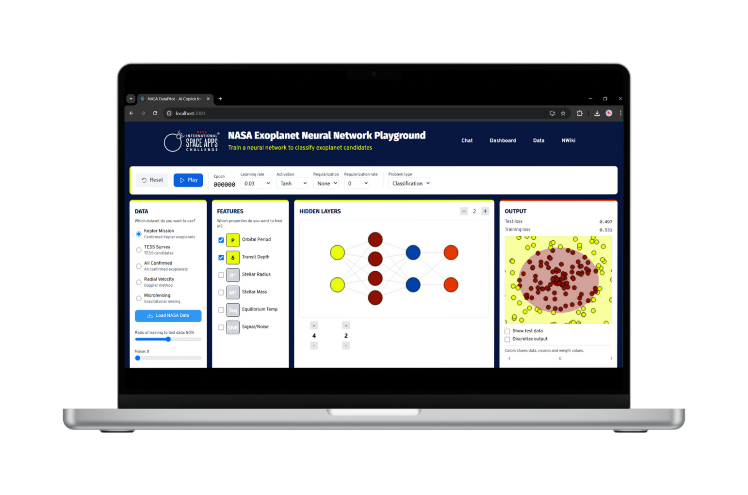
The Project

Slide 7

Value proposition
Easy interaction with Language Model that creates a user-friendly experience
Prepared for easy installation on local and Cloud using containers
Lets users experiment with new data

Slide 8

Target
Educational systems(Science schools, PhD students...)
Researchers
Astrophysics
Afficionados
Private agencies based on space
Public administrations

Slide 9
Outcome
Rapid, automated assurance
Efficiency and reliability
Effortless adoption, intuitive design
Ease of use and broad appeal
Deploy anywhere, start instantly
Speed of adoption and flexibility
Transparent, explainable results
Trust and clarity
Scalable design for everyone
Growth and universal value, bring science closer to people

