Slide 1



CI/CD Fundamentals
Introduction to Python Software Development on GitHub
Lyda Hill Department of Bioinformatics
UT Southwestern Medical Center
https://about.codecov.io/blog/common-steps-in-a-complete-continuous-integration-workflow/

Slide 2
What does CI/CD stand for?
Continuous Integration
Continuous Delivery
Continuous Deployment

Slide 3
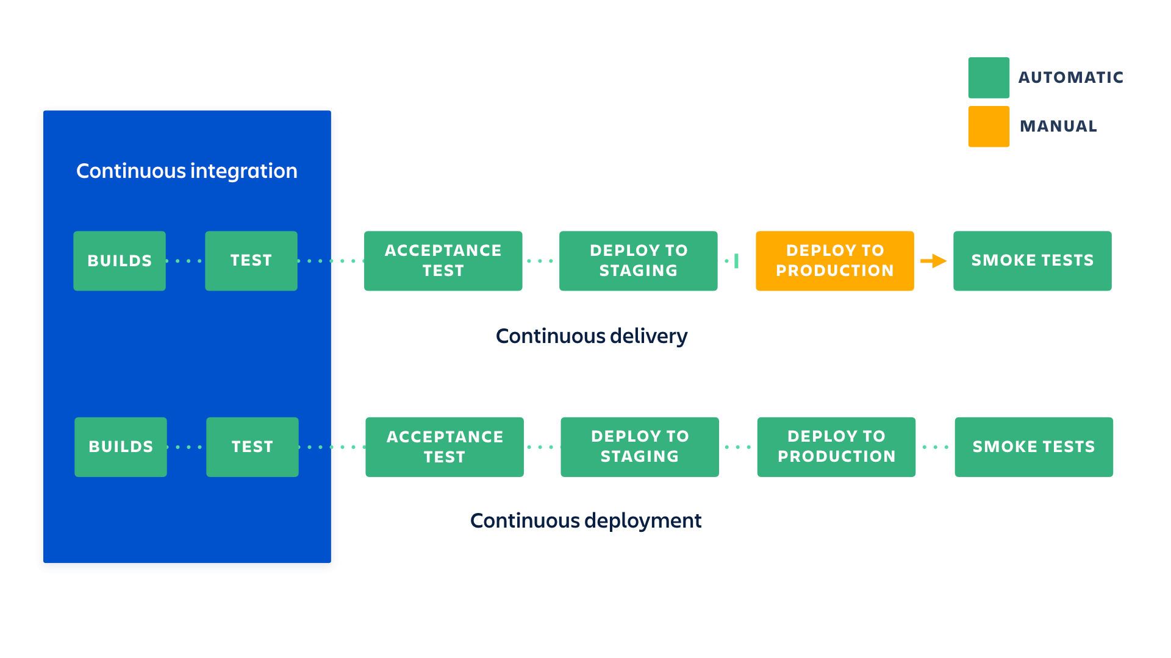
https://www.atlassian.com/continuous-delivery/principles/continuous-integration-vs-delivery-vs-deployment
Notes:
In Lessons Learned in Software Testing, Cem Kaner, James Bach, and Brett Pettichord provided the origin of the term: "The phrase smoke test comes from electronic hardware testing. You plug in a new board and turn on the power. If you see smoke coming from the board, turn off the power. You don't have to do any more testing."

Slide 4
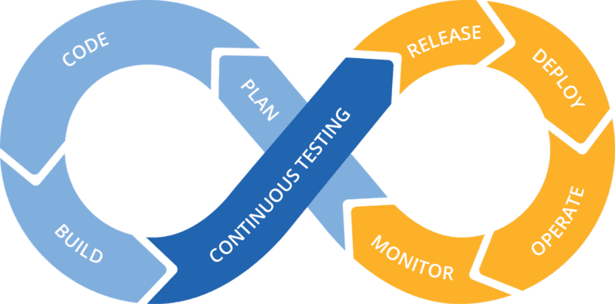
https://deploybot.com/blog/continuous-development

Slide 5
Vocabulary
Build

Slide 6
Vocabulary
Build – Convert source code files into a standalone software that anyone can run on their machine.

Slide 7
Vocabulary
Build – Convert source code files into a standalone software that anyone can run on their machine.
Test

Slide 8
Vocabulary
Build – Convert source code files into a standalone software that anyone can run on their machine.
Test – Evaluate and verify software can do what it is supposed to do.

Slide 9
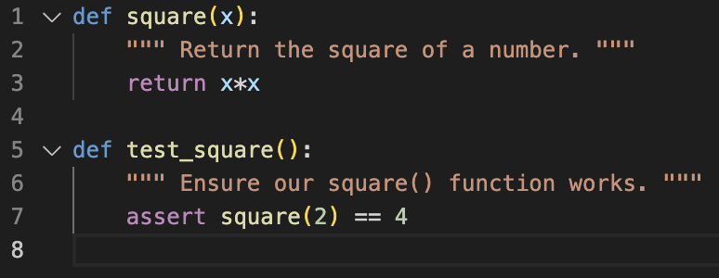
How do we know this function works?

Slide 10
We check it with a unit test

Slide 11
Test subgroups
Acceptance test – A group of unit tests that ensure the software meets specifications e.g. of a contract.
Smoke test – A group of unit tests that act as a sanity check for severe failures. If you run the software, does smoke come out of the computer?

Slide 12
Vocabulary
Build – Convert source code files into a standalone software that anyone can run on their machine.
Test – Evaluate and verify software can do what it is supposed to do.
Release

Slide 13
Vocabulary
Build – Convert source code files into a standalone software that anyone can run on their machine.
Test – Evaluate and verify software can do what it is supposed to do.
Release – A build that is a new or upgraded version of the software.

Slide 14
Vocabulary
Build – Convert source code files into a standalone software that anyone can run on their machine.
Test – Evaluate and verify software can do what it is supposed to do.
Release – A build that is a new or upgraded version of the software.
Deploy

Slide 15
Vocabulary
Build – Convert source code files into a standalone software that anyone can run on their machine.
Test – Evaluate and verify software can do what it is supposed to do.
Release – A build that is a new or upgraded version of the software.
Deploy – Make the software available for use.

Slide 16
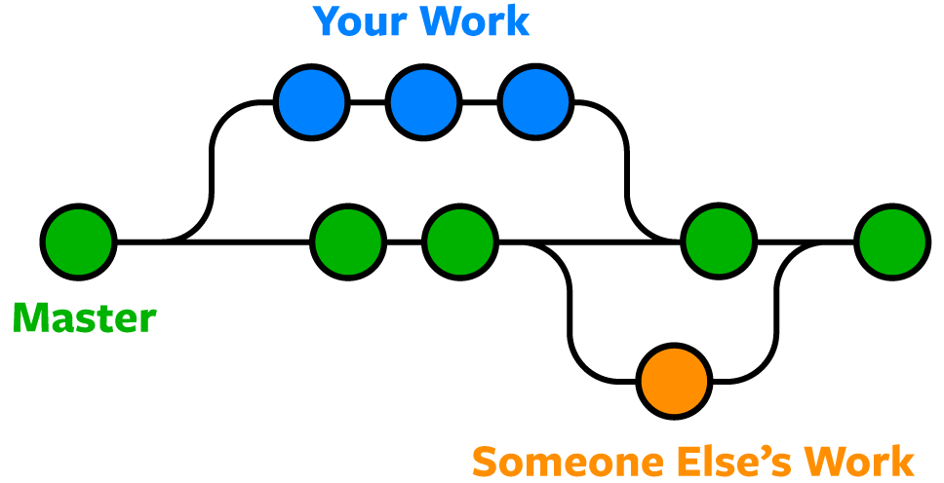
The goal of CI/CD is to ensure developments do not stray far from the main branch
New Feature
v0
v1
v1.1
Main
Bugfix
https://www.nobledesktop.com/learn/git/git-branches

Slide 17
Why is CI/CD useful?
Ensures disparate parts of the code base work together throughout development, preventing integration challenges.
Protects against release of broken software.
Allows for fast feedback from users and fast fixes from developers.

Slide 18
How do we implement CI/CD in practice?
Version control (git)
Automatic testing (pytest)
Automatic building (setuptools, pyproject.toml)
Automatic deployment (twine, PyPI)

Slide 19
Additional CI/CD tools in the workflow
Code quality (linter such as ruff, code formatter such as black)
Test coverage check (codecov)
Documentation (sphinx, numpydoc)
Security checks (CodeQL)

Slide 20
Local CI/CD workflows
Can run some tools, such as the linter and code formatter, before pushing code to the repository
Can automatically run some actions using pre-commit

Slide 21
Running the CI/CD workflow
Need a continuous integration tool
Bitbucket (https://bitbucket.org/product/features/pipelines)
Jenkins (https://jenkins.io)
AWS CodePipeline (https://aws.amazon.com/codepipeline)
CircleCI (https://circleci.com)
Azure (https://azure.microsoft.com/)
Gitlab (https://about.gitlab.com/)
GitHub (https://github.com/)
Etc.
These tools use a YAML file (or similar) to describe a series of actions that make up a workflow.

Slide 22
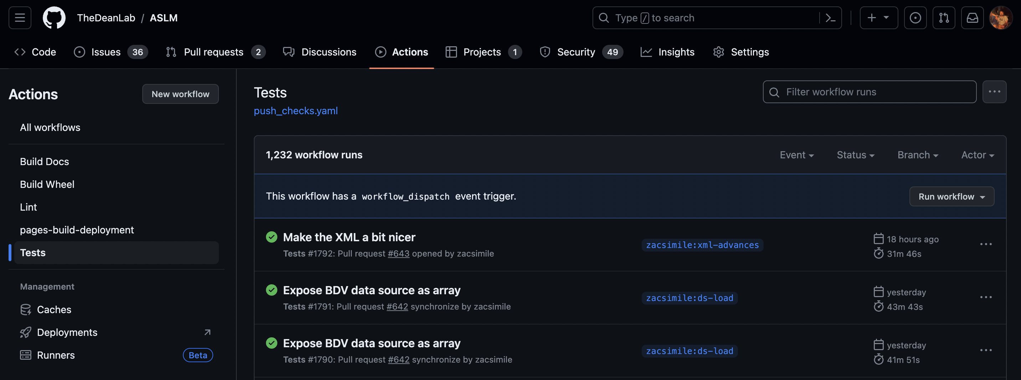
GitHub Actions Dashboard

Slide 23
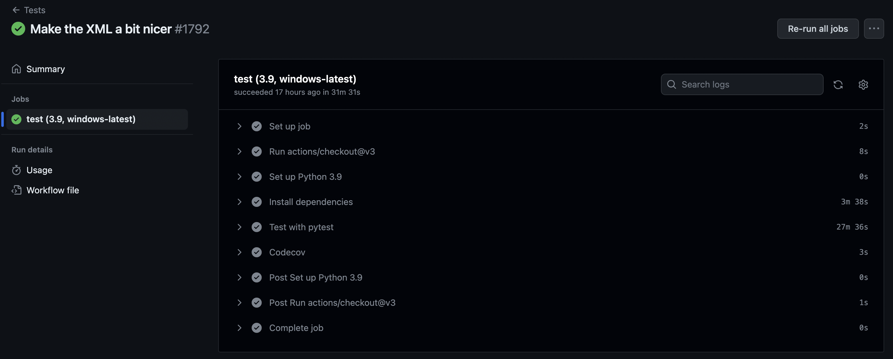
GitHub Actions Workflow Example

Slide 24
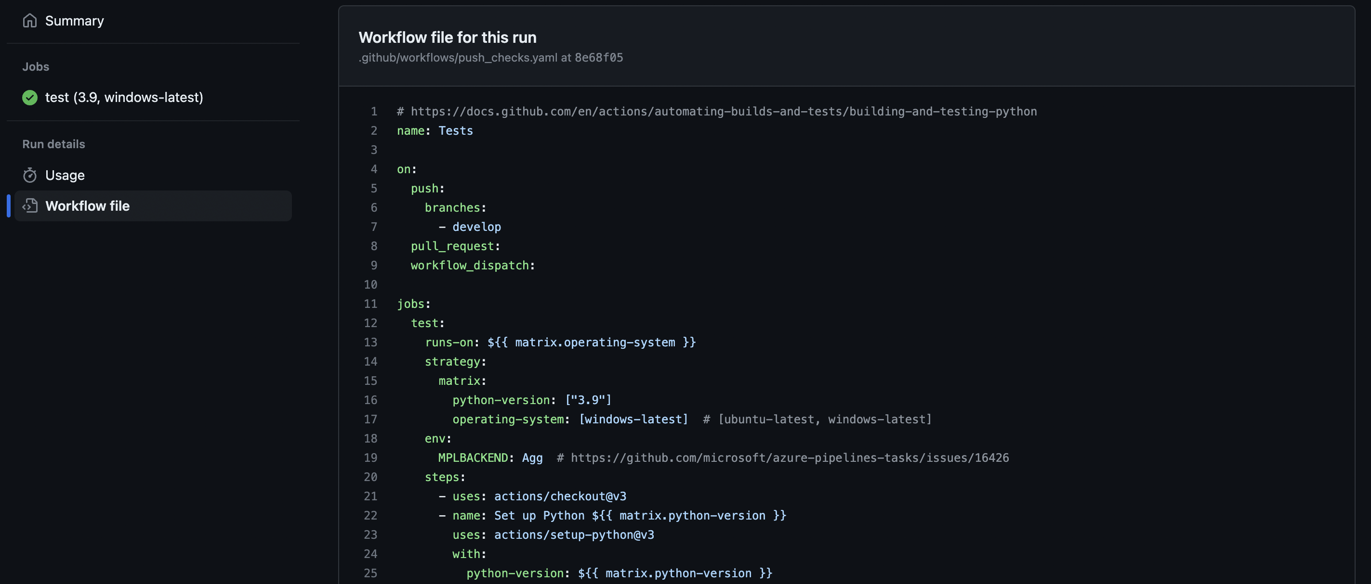
GitHub Actions Workflow Example

