Slide 1
Unit Testing and Test Driven Development
Conor McFadden
Continuous Integration with Python Nanocourse 2023

Slide 2
Unit Testing overview
Importance of unit testing in software development.
Writing effective unit tests using python's testing frameworks.
Incorporating test-driven development principles

Slide 3
Software Review Overview
Verification: Formal proof that a program is correct.
Tedious to do by hand, and automated tool support for verification is still an active area of research.
Code review: Having somebody else carefully read your code, and reason informally about it, can be a good way to uncover bugs. It’s much like having somebody else proofread an essay you have written.
Testing: Running the program on carefully selected inputs and checking the results.
User Inputs? Logic errors? Hardware bugs?

Slide 4
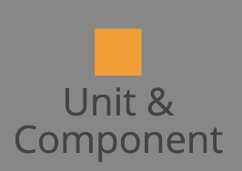
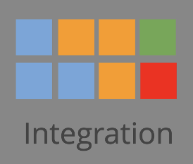
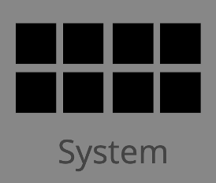
Types of Tests
Unit Test: Isolated method, function or component.
Integration Test: Combined Unit Tests tested as a group.
System (Smoke) Testing: Tests the entire system as a whole to verify that critical functionalities work.

Slide 5
Python Testing Frameworks
unittest: A testing framework included in the Python standard library. It provides a basic set of tools for writing and executing tests.
pytest: A popular and powerful third-party testing framework. It encourages test-driven development (TDD) and provides features like fixtures and parameterized testing.
doctest: A testing framework that allows you to embed tests within docstrings, making it useful for creating documentation that also serves as executable test cases.

Slide 6
Writing a Unit Test
Arrange: prepare for test, preparing objects, starting or killing services, entering records.
Act: action that we would like to test, function or process.
Assert: checking the result state to see if it matches expectations. Look at output and make judgment
Cleanup: cleanup tests so other downstream tests aren’t influenced by results or attributes.

Slide 7
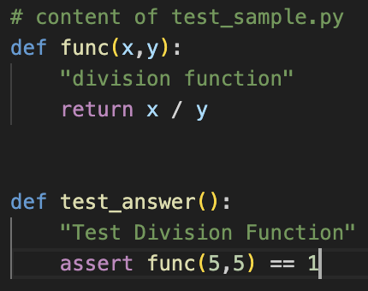
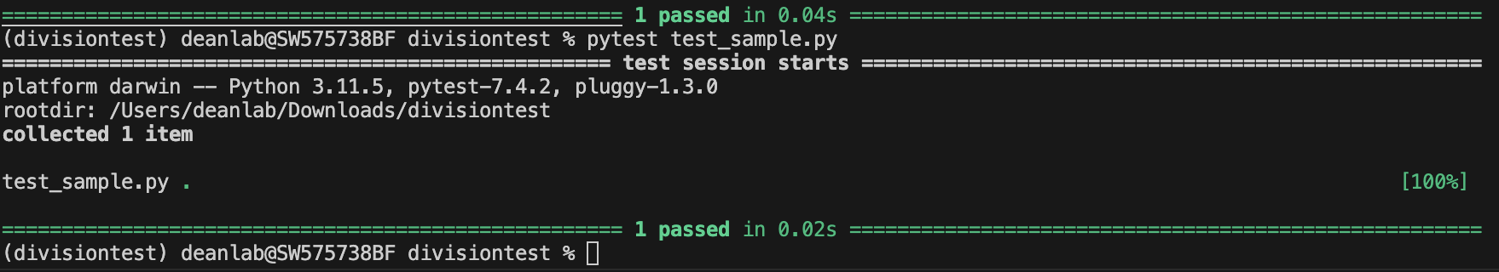
Running pytest
Just type >> pytest in prompt
Assert is True, the test passes!

Slide 8
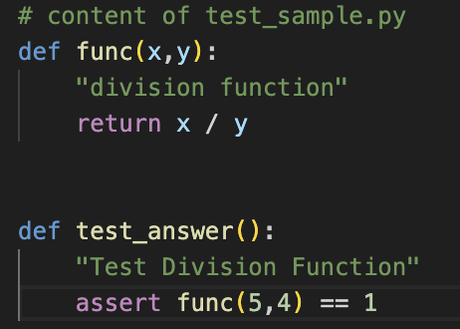
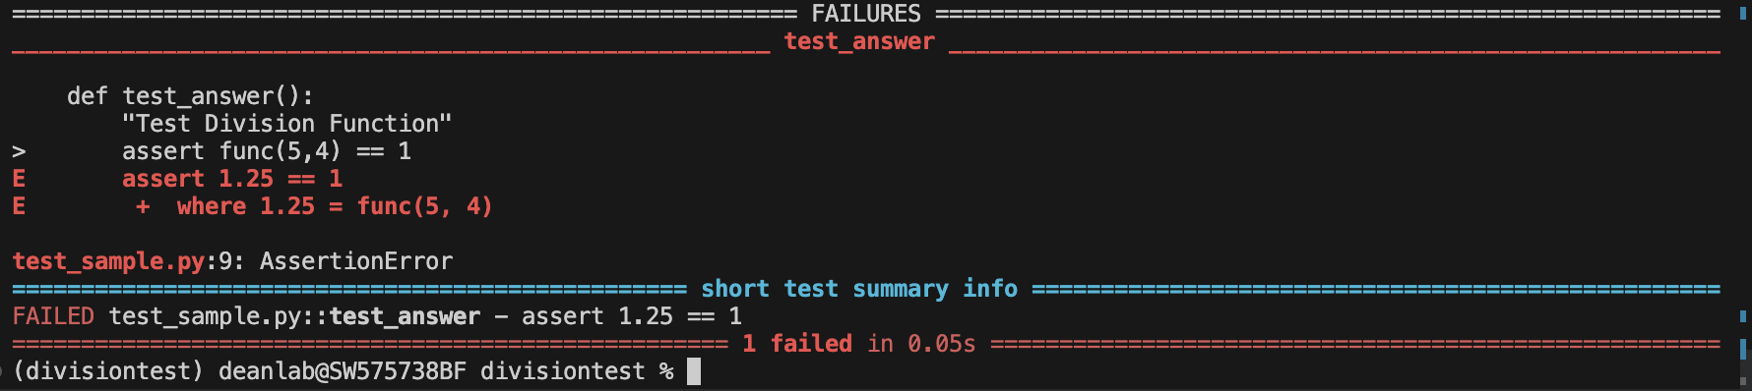
Running pytest
Assert is False, the test fails!

Slide 9
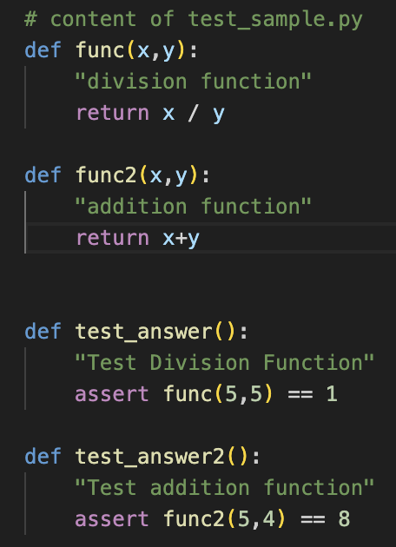
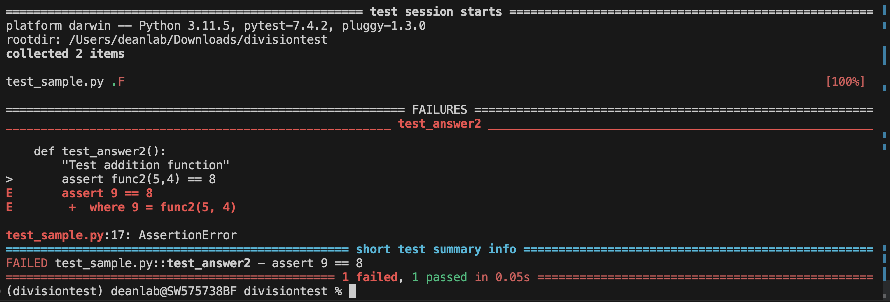
Any “test_” function will be recognized by pytest automatically

Slide 10
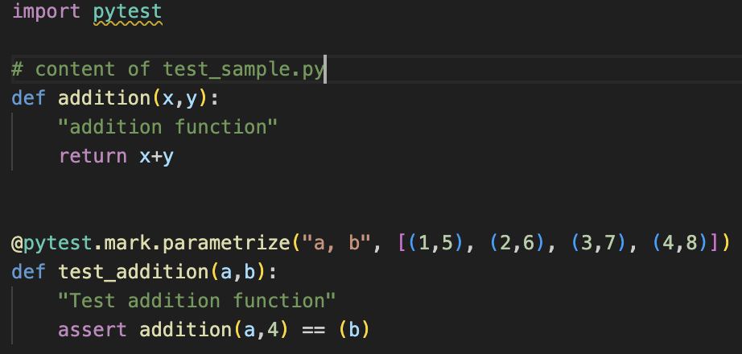
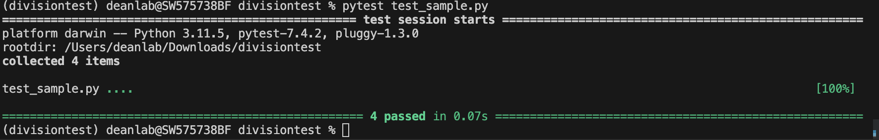
Parameterization in tests
Test multiple parameters at once using pytest parameterize

Slide 11
Fixtures in pytest
A way to set up and clean up things before and after running tests.
They help avoid repeating setup code in multiple tests.
Why Use Fixtures?
Avoid duplicating setup code in every test.
Keep test files clean and readable.
Automatically clean up after tests run.

Slide 12
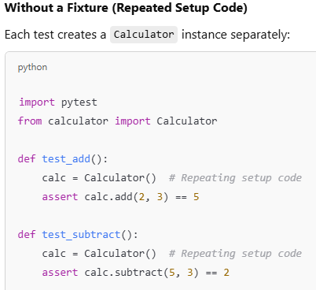
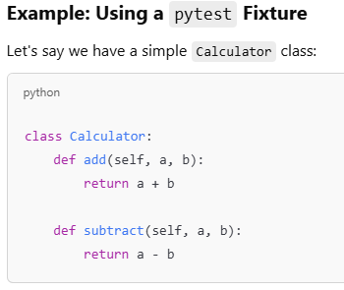
Fixtures in pytest

Slide 13
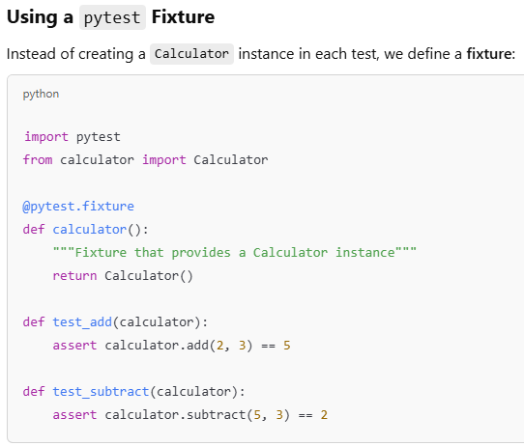
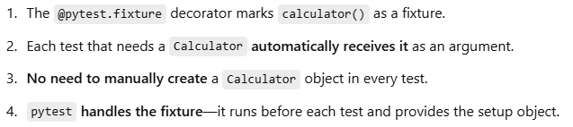
Fixtures in pytest

Slide 14
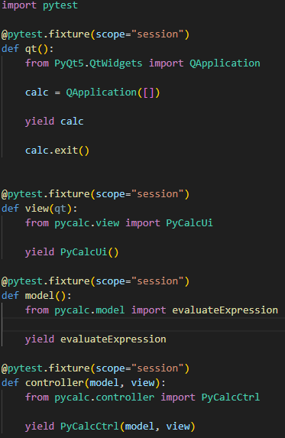
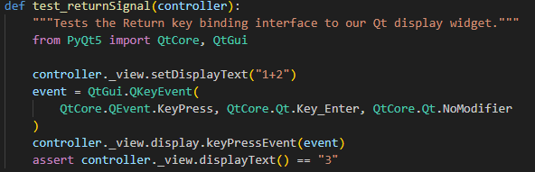
Key Binding Test in PyCalc Exercise
conftest.py
test_controller.py
Fixtures → conftest.py
Yield keyword to free resources after test.

Slide 15
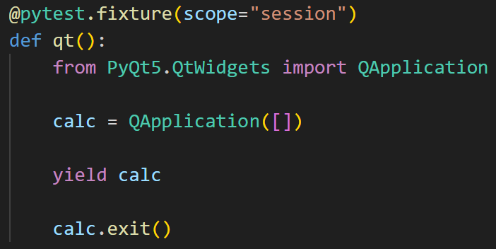
What is yield doing?
SETUP: prepare resources
YIELD: give it to your tests
TEARDOWN: free your resources

Slide 16
Unit Testing Best Practices
Unit test cases should be independent.
Test only one code or component at a time.
Clear and consistent naming conventions.
Fix bugs before moving on!
“Test as you code” → Write you tests while the idea is still fresh.

Slide 17
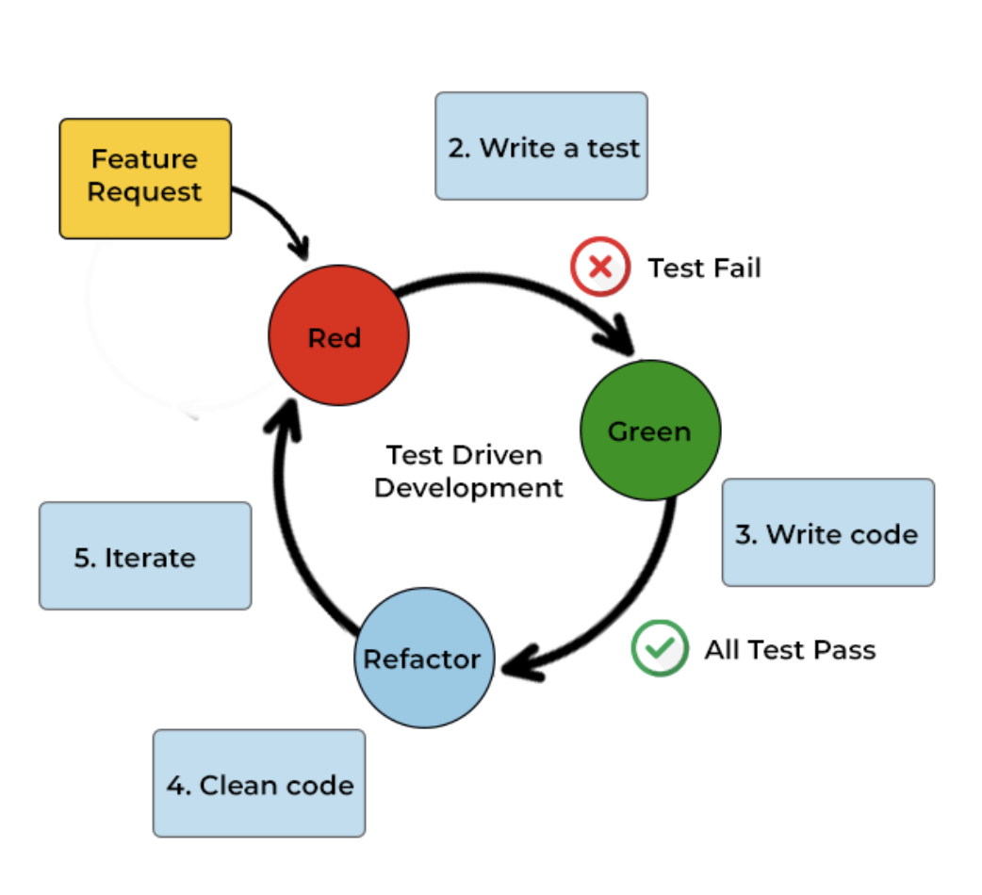
Testing-Driven Development/Deployment

Slide 18
Conclusions
Writing tests are useful for making sure code is functioning properly and removing bugs during development
Pytest is a useful framework for setting up tests

Slide 19
Exercise
Install pytest in environment using pyproject.toml
pip install –e .[dev] or pip install –e “.[dev]” on Mac
Write a unit test to test _calculateResult function in controller.py
If time is remaining, parameterize the test for _calculateResult

