Slide 1
Regular Expression Application FastContext Lecture 3
Aug 25th / 2023

Slide 2
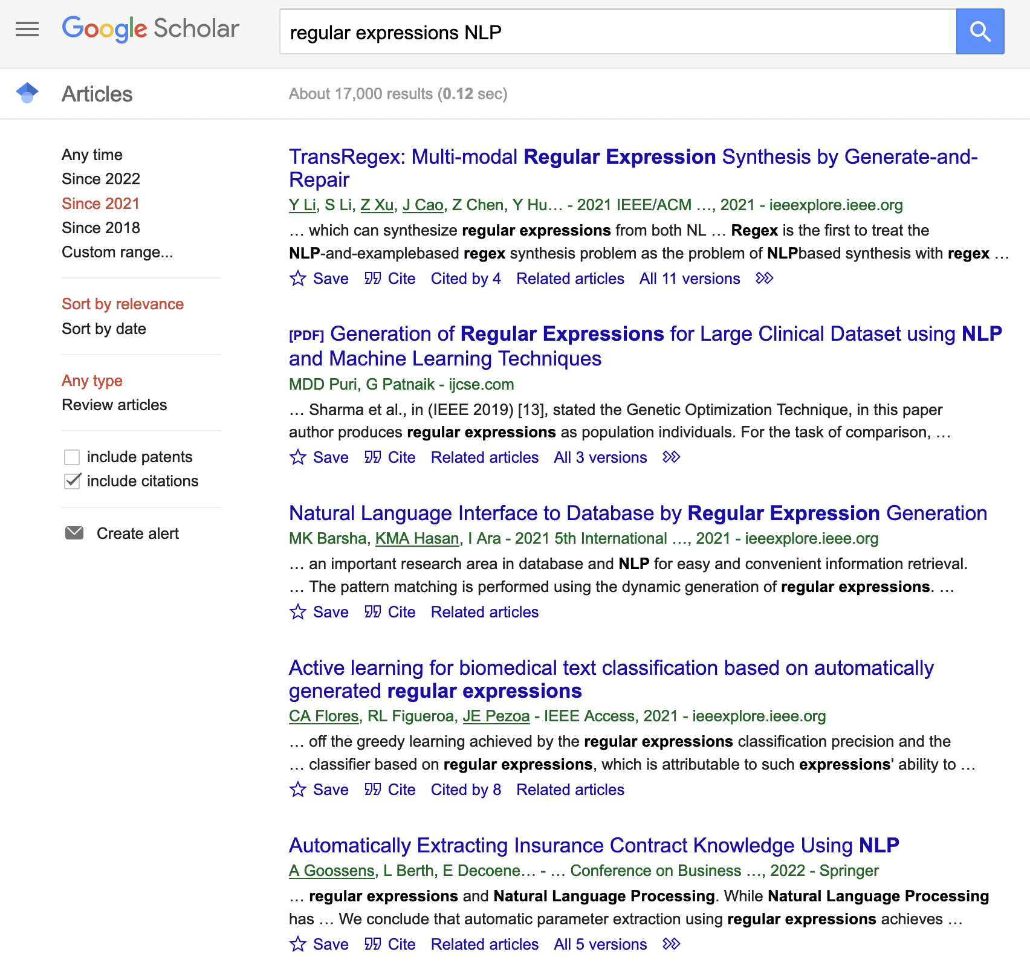
Regular Expressions in NLP Applications
Still widely used for many (most?) NLP applications
Even pure machine learning approaches often incorporate regular expressions, even if it is just to clean their data set
Often at the main component of “rule-based” NLP systems
Note: Google Scholar is a great source for finding papers to present to class
Notes:
Generation of Regex Rules, Code generation, ChatGPT finds it easier to use existing software sometimes…

Slide 3
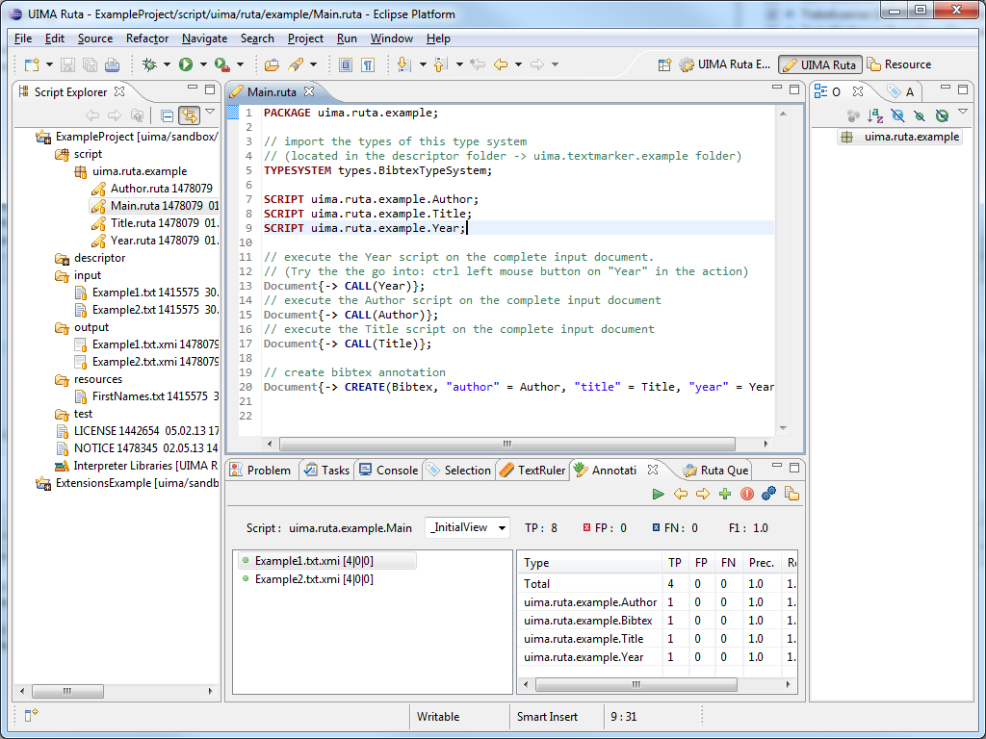
Toolkits
Various toolkits and applications have been built to make the generation of regular expressions easier
Apache UIMA RUTA is one such tool
There are many others...

Slide 4
FastContext: an efficient and scalable implementation of the ConText algorithm
Problem
Context Information
Context information is information associated with a particular concepts
Could be considered a subset of conceptual relations
Negation
Negative for melanoma
Experiencer
There is a family history of colon cancer.
Experiencer is not the patient
Temporality
In 2018 the patient was diagnosed and successfully treated for non-hodgkin's lymphoma
Past event
Shi, Jianlin, and John F. Hurdle. "FastContext: an efficient and scalable implementation of the ConText algorithm." arXiv preprint arXiv:1905.00079 (2019).

Slide 5
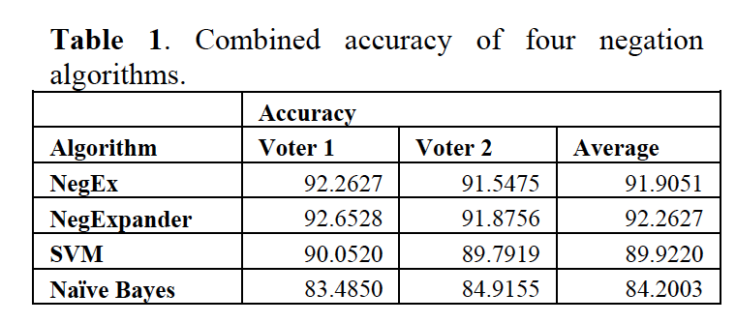
Regular Expressions – Still Relevant?
Rule-based Negation Finding Software
Comparison vs ML approaches
NegExpander
Applies negation to conjunction
Negfinder
Has “terminators” to scope negation
Can not handle pseudo negation like double negation
NegEx and Context
Have pseudo triggers to deal with this scenario
Goryachev, Sergey, Margarita Sordo, Qing T. Zeng, and Long Ngo. "Implementation and evaluation of four different methods of negation detection." Boston, MA: DSG (2006).
Notes:
Haven’t seen more recent clinical results with Deep Learning

Slide 6
Algorithm
ConText
Loops through all the rules for each word
FastContext
Hashing to process rules simultaneously
First - constructs nested-map structure from the rules
Top level is a single map, where the keys are the first word in each ConText rule
Value associated with a top-level key is a child map which keys consist of the second words of all the rules starting with that first word
Rest of the words in the rules will be included in the subsequent descendent maps
Allows processing of all rules without looping
Notes:
Context O(wr)
FastContext hash construction+some words + some rules

Slide 7
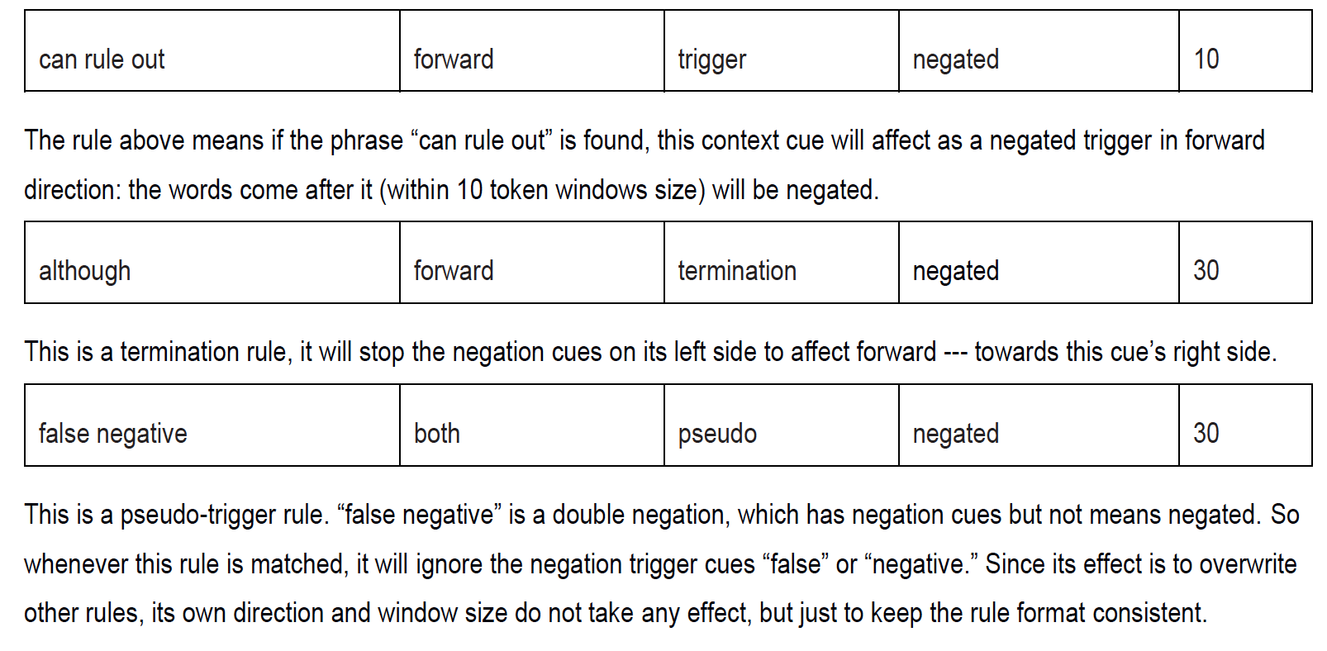

Slide 8
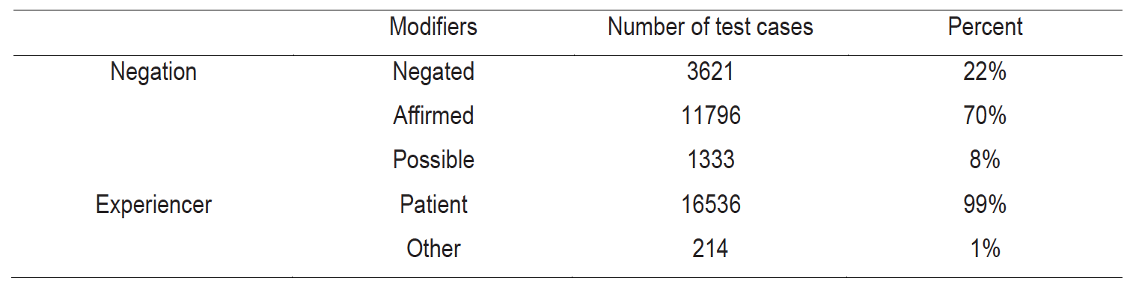
Data set: SemEval 2015 Task 14

Slide 9
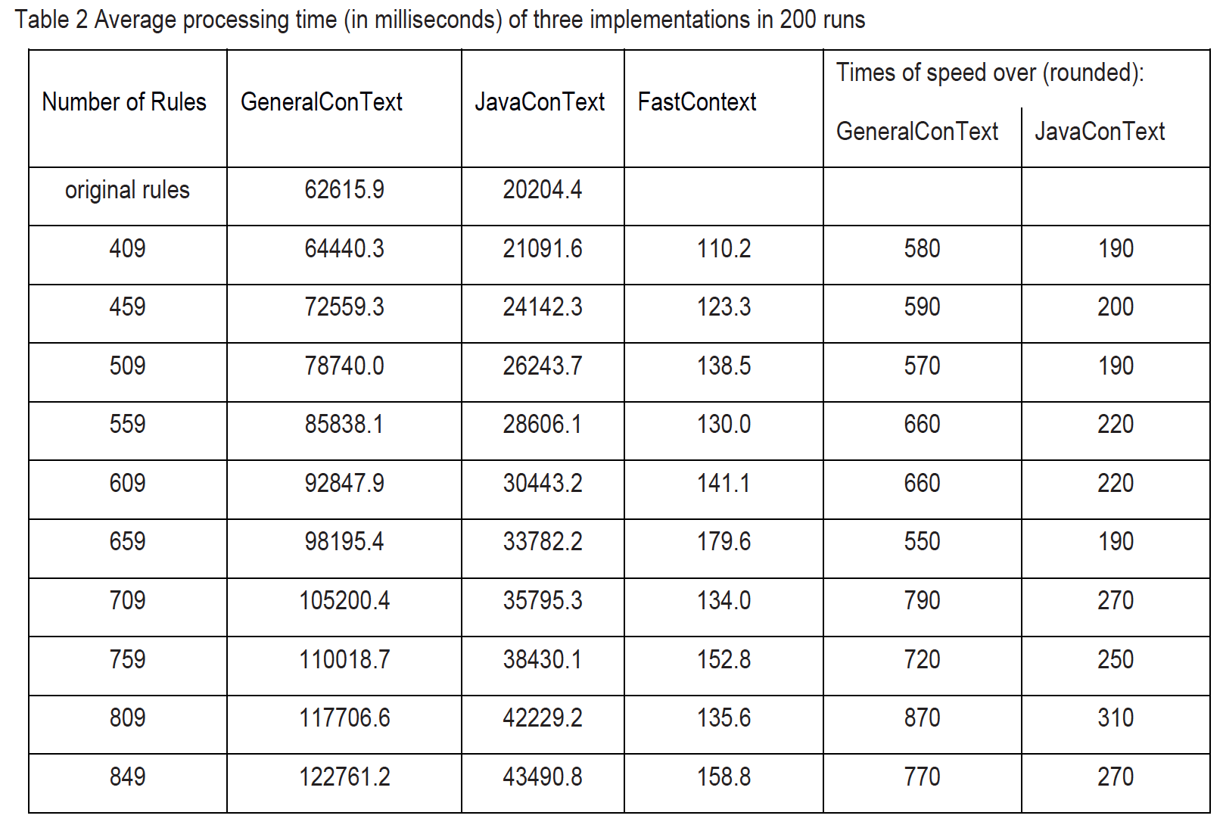

Slide 10
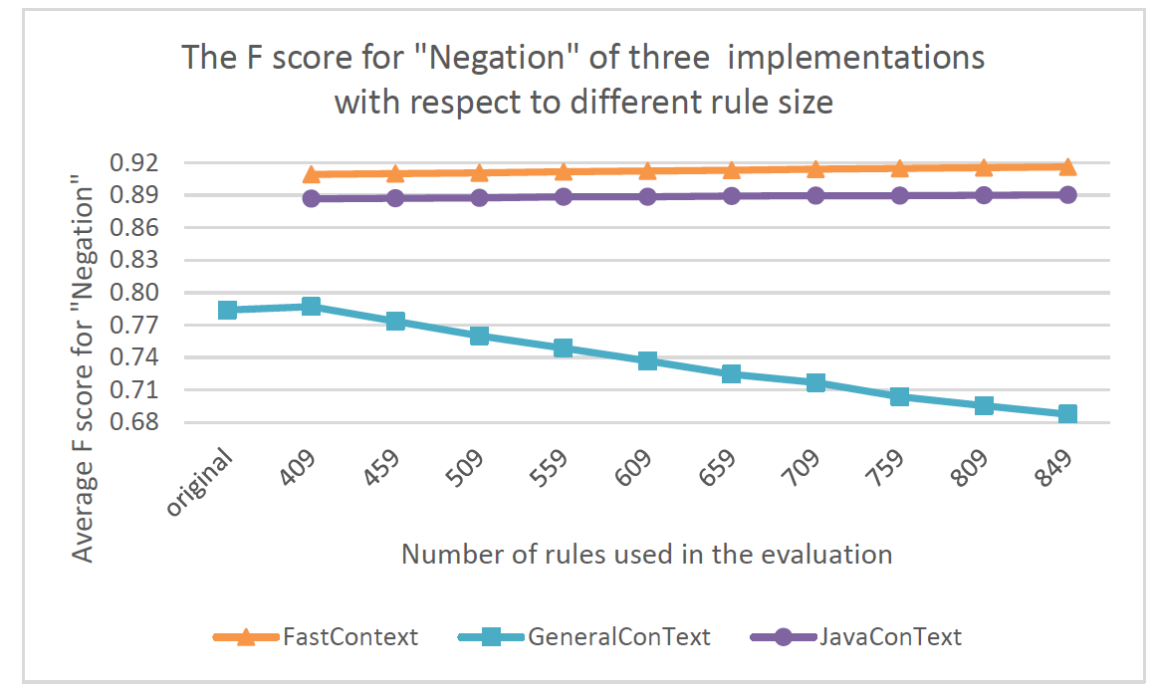

Slide 11
Advantages of Regular Expressions
Terse!
Often (not always) easier to understand than a set of commands
Short means quicker to code and develop
Interpretable
Relative to machine learning approaches it is easier to understand why a piece of text was identified by a particular regular expression
Widespread language and library support and education
Speed (usually…)

Slide 12
Disadvantages
Discover some of them yourself on the next assignment…

