Slide 1
Lecture 4 Edit Distance and Dynamic Programming
Aug 28th / 2023

Slide 2
Lecture Overview
Things to start…
Discuss Assessment
Remaining Edit distance textbook notes
Edit distance and other string metrics
Memoization in Dynamic Programming
Assignment #1
Language Modelling
If time

Slide 3
Things to start…
Cheaha
https://docs.uabgrid.uab.edu/wiki/Cheaha_GettingStarted
Try rc.uab.edu
Textbook
https://web.stanford.edu/~jurafsky/slp3/
Pytorch Tutorial
https://pytorch.org/tutorials/beginner/basics/intro.html

Slide 4
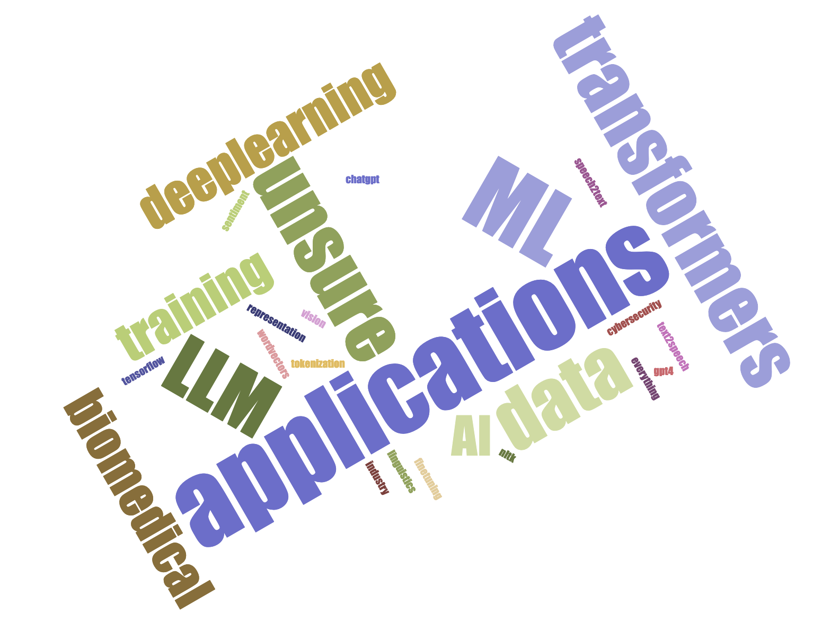
Assessment 2023
https://www.jasondavies.com/wordcloud/
Notes:
Disappointed – Text to Speech / Speech to Text
Tensorflow – No, Pytorch Yes
Happy people: Unsure, biomedical, applications, ML, transformers, deeplearning, training, AI, ML, data

Slide 5
Assessment Questions
Tensor
Multi-dimensional array
6 correct answers
Parse Tree
2 student (was only 1 last year)
Norms (L1 and L2)
4 students
Dynamic Programming
7 students
Not a dynamic language
Notes:
Tensor – n-dimensional matrix. (makes things interesting, vision and language have converged and are using the same toolkits now), not a TPU
Norms – L1 / Euclidean = 5, L2 Norm is Manhattan (3)
Dynamic programming – solve subproblem, use result to solve next subproblem until you reach goal, yes it is an optimization technique
Parse tree - leftmost derivation, at each step the leftmost nonterminal is replaced

Slide 6
Edit Distance
https://web.stanford.edu/~jurafsky/slp3/slides/2_EditDistance.pdf
Other Lecture available online
http://www.cs.jhu.edu/~langmea/resources/lecture_notes/dp_and_edit_dist.pdf
http://spring2015.cs-114.org/wp-content/uploads/2016/01/EditDistance.pdf
93 pages….

Slide 7
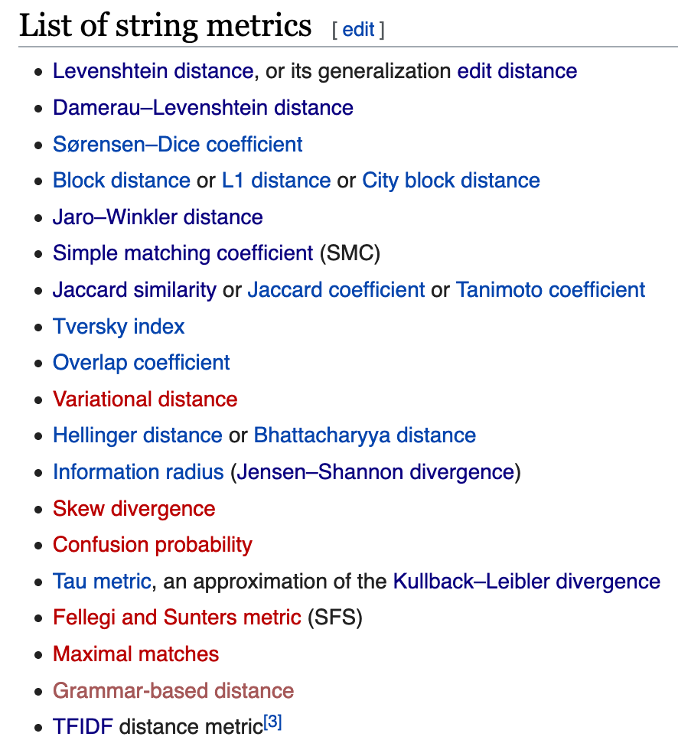
Other String Metrics or Distances

Slide 8
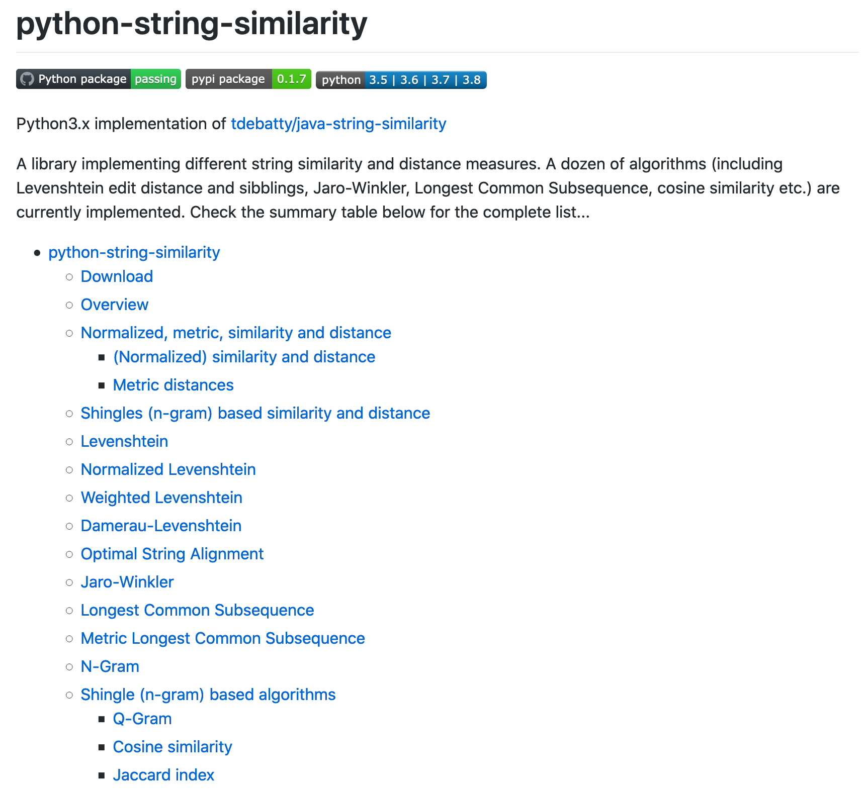
Python String Similarity Library
Python 3.x implementation of Thibault DeBatty’s Java Code
Mostly up tp date with java version (except Ratcliff-Obershelp)
May be useful project resource
https://github.com/luozhouyang/python-string-similarity

Slide 9
Dynamic Programming (Exp vs Poly)
https://www.hackerearth.com/practice/algorithms/dynamic-programming/introduction-to-dynamic-programming-1/tutorial/
Notes:
Point is to show cost savings

Slide 10
https://www.hackerearth.com/practice/algorithms/dynamic-programming/introduction-to-dynamic-programming-1/tutorial/

Slide 11
https://www.hackerearth.com/practice/algorithms/dynamic-programming/introduction-to-dynamic-programming-1/tutorial/
Notes:
Memoization – to remember
Tradeoff is what? Speed for space.

Slide 12
Assignment #1

