Slide 1
Lecture 6 Naïve Bayes
Sept 1st, 2023

Slide 2
Overview
Finish Language Modeling
LaPlace / +1 Smoothing
Backoff
Text Classification and Naïve Bayes (modified slides)

Slide 3
Language Modeling
Interpolation and Subword Regularization

Slide 4
The intuition of smoothing (from Dan Klein)
When we have sparse statistics:
Steal probability mass to generalize better
P(w | denied the)
3 allegations
2 reports
1 claims
1 request
7 total
allegations
attack
man
reports
outcome
…
claims
request
P(w | denied the)
2.5 allegations
1.5 reports
0.5 claims
0.5 request
2 other
7 total
allegations
allegations
attack
man
outcome
reports
…
claims
request

Slide 5
Add-one estimation
Also called Laplace smoothing
Pretend we saw each word one more time than we did
Just add one to all the counts!
MLE estimate:
Add-1 estimate:
Notes:
What is V?

Slide 6
Maximum Likelihood Estimates
The maximum likelihood estimate
of some parameter of a model M from a training set T
maximizes the likelihood of the training set T given the model M
Suppose the word “bagel” occurs 400 times in a corpus of a million words
What is the probability that a random word from some other text will be “bagel”?
MLE estimate is 400/1,000,000 = .0004
This may be a bad estimate for some other corpus
But it is the estimate that makes it most likely that “bagel” will occur 400 times in a million word corpus.

Slide 7
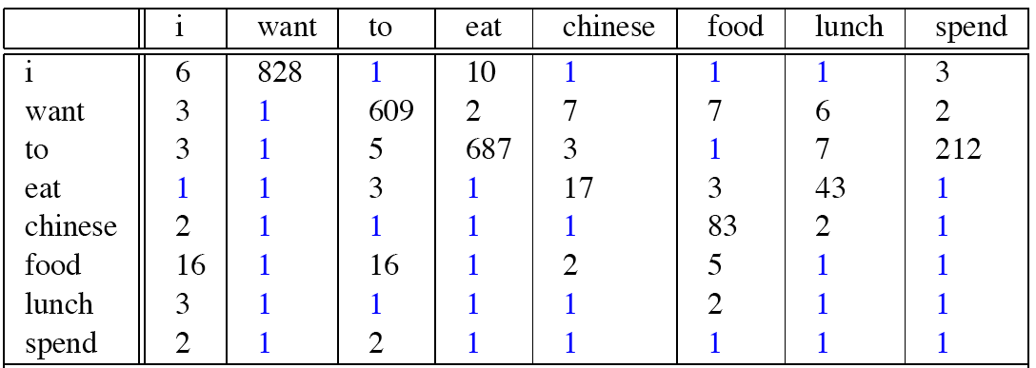
Berkeley Restaurant Corpus: Laplace smoothed bigram counts
Notes:
Everything adds 1, ”I want” used to be 827

Slide 8

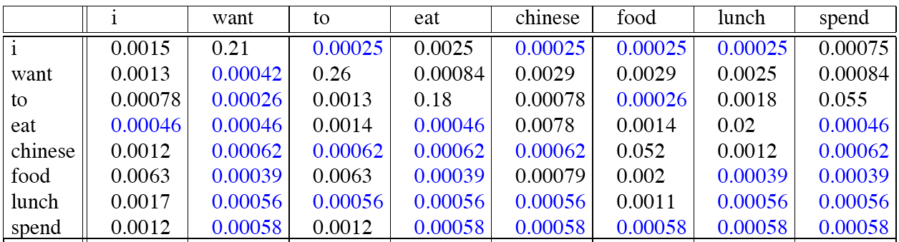
Laplace-smoothed bigrams
Notes:
Only a subset of corpus, don’t expect probabilities in this table to add up to 1
Other words can come after i besides the ones shown here

Slide 9
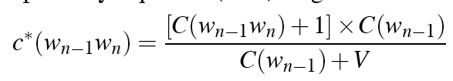
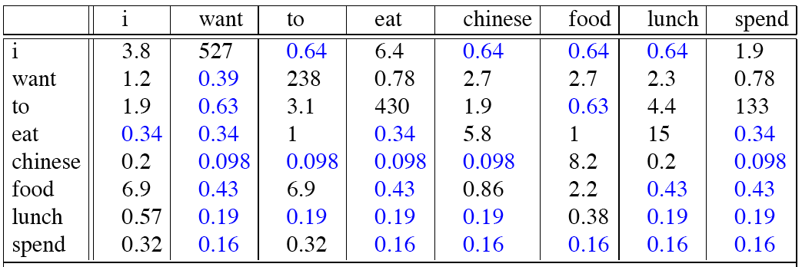
Reconstituted counts
Notes:
Generate our new count estimates for the corpus after smoothing, cell i want was 827, +1 to get 828, now 527?
Why reduced?
Why are zeroes not the same?
Just like old slide, expect now we are multiplying by C(wn-1) which is the old count

Slide 10
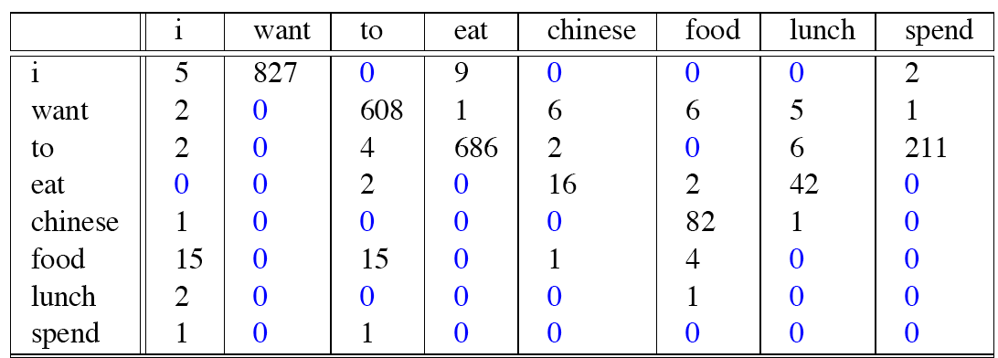
Compare with raw bigram counts
Notes:
C(want to) went from 608 to 238, P(to|want) from .66 to .26!
Discount d= c*/c
d for “chinese food” =.10!!! A 10x reduction. Why so much? (Chinese very common prefix for food, “Chinese food” was bigger proportion of #)

Slide 11
Add-1 estimation is a blunt instrument
So add-1 isn’t used for N-grams:
We’ll see better methods
But add-1 is used to smooth other NLP models
For text classification
In domains where the number of zeros isn’t so huge.

Slide 12
Regularization: Backoff and Interpolation
Language models are generated from some corpus of text
Do not want to “overfit” your language model, you want it to work in a variety of different contexts / domains
Sometimes it helps to use less context
Condition on less context for contexts you haven’t learned much about
Backoff:
use trigram if you have good evidence,
otherwise bigram, otherwise unigram
Interpolation:
mix unigram, bigram, trigram
Interpolation works better

Slide 13
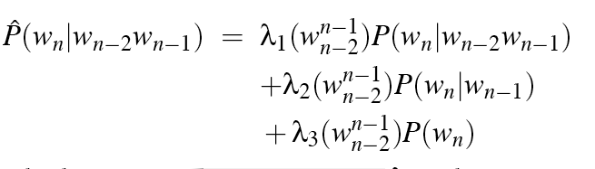
Linear Interpolation
Simple interpolation
Lambdas conditional on context:

Slide 14
How to set the lambdas?
Use a held-out corpus
Choose λs to maximize the probability of held-out data:
Fix the N-gram probabilities (on the training data)
Then search for λs that give largest probability to held-out set:
Training Data
Held-Out Data
Test
Data

Slide 15
Unknown words: Open versus closed vocabulary tasks
Language models not based on n-grams (almost all models now?) use subword models
Byte-Pair Encoding (BPE) (Sennrich et al., 2016)
Unigram language modeling tokenization (Kudo, 2018)
WordPiece (Schuster and Nakajima, 2012)
If we know all the words in advanced
Vocabulary V is fixed
Closed vocabulary task
Often we don’t know this
Out Of Vocabulary = OOV words
Open vocabulary task
Instead: create an unknown word token <UNK>
Training of <UNK> probabilities
Create a fixed lexicon L of size V
At text normalization phase, any training word not in L changed to <UNK>
Now we train its probabilities like a normal word
At decoding time
If text input: Use UNK probabilities for any word not in training

Slide 16
END

