Slide 1
Text Classification and Naïve Bayes
The Task of Text Classification
https://web.stanford.edu/~jurafsky/slp3/slides/4_NB_Apr_4_2021.pptx
Notes:
Modified slides – good intro to ML in NLP

Slide 2
Is this spam?
Notes:
Probably - look at link versus who it is from

Slide 3
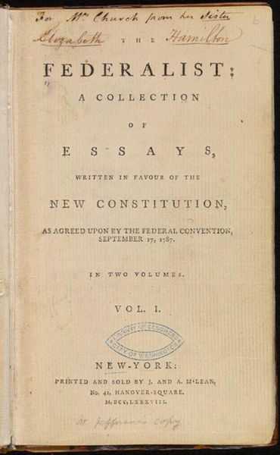
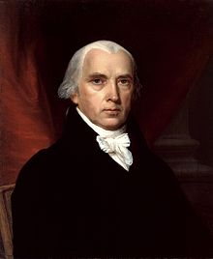
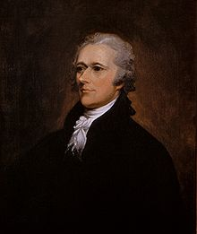
Who wrote which Federalist papers?
1787-8: anonymous essays try to convince New York to ratify U.S Constitution: Jay, Madison, Hamilton.
Authorship of 12 of the letters in dispute
1963: solved by Mosteller and Wallace using Bayesian methods
James Madison
Alexander Hamilton

Slide 4
Male or female author?
By 1925 present-day Vietnam was divided into three parts under French colonial rule. The southern region embracing Saigon and the Mekong delta was the colony of Cochin-China; the central area with its imperial capital at Hue was the protectorate of Annam…
Clara never failed to be astonished by the extraordinary felicity of her own name. She found it hard to trust herself to the mercy of fate, which had managed over the years to convert her greatest shame into one of her greatest assets…
S. Argamon, M. Koppel, J. Fine, A. R. Shimoni, 2003. “Gender, Genre, and Writing Style in Formal Written Texts,” Text, volume 23, number 3, pp. 321–346
Notes:
Gender stereotypical... need better example
#1: Saigon. Grey, Anthony
#2: Jerusalem the Golden. Drabble, Margaret
From shlomo argamon

Slide 5
Male or female author?
The cTAKES builds on existing open-source technologies—the Unstructured Information Management Architecture framework and OpenNLP natural language processing toolkit. Its components, specifically trained for the clinical domain, create rich linguistic and semantic annotations
Competitive challenges for information extraction from clinical text, along with the availability of annotated clinical text corpora, and further improvements in system performance are important factors to stimulate advances in this field and to increase the acceptance and usage of these systems in concrete clinical and biomedical research contexts.
Notes:
Guergana Savova
Stephane Meystre
Abstracts from 2010 to 2008

Slide 6


Positive or negative movie review?
unbelievably disappointing
Full of zany characters and richly applied satire, and some great plot twists
this is the greatest screwball comedy ever filmed
It was pathetic. The worst part about it was the boxing scenes.

Slide 7
What is the subject of this article?
MEDLINE Article
MeSH Subject Category Hierarchy
Antagonists and Inhibitors
Blood Supply
Chemistry
Drug Therapy
Embryology
Epidemiology
…
?

Slide 8
Text Classification
Assigning subject categories, topics, or genres
Spam detection
Authorship identification
Age/gender identification
Language Identification
Sentiment analysis
…

Slide 9
Text Classification: definition
Input:
a document d
a fixed set of classes C = {c₁, c₂,…, c_{J}}
Output: a predicted class c ∈ C

Slide 10
Classification Methods: Hand-coded rules
Rules based on combinations of words or other features
spam: black-list-address OR (“dollars” AND “have been selected”)
Accuracy can be high
If rules carefully refined by expert
But building and maintaining these rules is expensive

Slide 11
Classification Methods: Supervised Machine Learning
Input:
a document d
a fixed set of classes C = {c₁, c₂,…, c_{J}}
A training set of m hand-labeled documents (d₁,c₁),....,(d_{m},c_{m})
Output:
a learned classifier γ: d → c

Slide 12
Classification Methods: Supervised Machine Learning
Any kind of classifier
Naïve Bayes
Logistic regression
Support-vector machines
k-Nearest Neighbors
…
Notes:
Not k-nearest neighbors is NOT k-means!
Any other classifier? Conditional Random Field?
Decision trees? Random forests? Gradient Boosting?

Slide 13
Text Classification and Naïve Bayes
Naïve Bayes (I)

Slide 14
Naïve Bayes Intuition
Simple (“naïve”) classification method based on Bayes rule
Relies on very simple representation of document
Bag of words

Slide 15
The Bag of Words Representation
Notes:
Often used as baseline
Often replaced with “Bag of X” where X is some feature..

Slide 16
The bag of words representation
seen | 2
sweet | 1
whimsical | 1
recommend | 1
happy | 1
... | ...
γ(
)=c
Notes:
Looking for changes (delta?) in the bag of words representation between classes

Slide 17
Text Classification and Naïve Bayes
Formalizing the Naïve Bayes Classifier

Slide 18
Bayes’ Rule Applied to Documents and Classes
For a document d and a class c
Notes:
Classic Bayes Rule, trying to find the probability of it belonging to a class c (like positive movie review, female author, etc...) given an input document
P(c|d) is the posterior probability
P(d|c) likelihood , since P(d|c) = likelihood (c|d)

Slide 19
Naïve Bayes Classifier (I)
MAP is “maximum a posteriori” = most likely class
Bayes Rule
Dropping the denominator
Notes:
Why drop the denominator? P(d) is the same for all classes. Input document is a given.

Slide 20
Naïve Bayes Classifier (II)
Document d represented as features x1..xn
Notes:
Ask students, why do we break down document into features?
-why not label encode documents?
-no comparison would be possible, all documents in own class

Slide 21
Naïve Bayes Classifier (IV)
O(|X|^{n}•|C|) parameters
How often does this class occur?
Could only be estimated if a very, very large number of training examples was available.
We can just count the relative frequencies in a corpus
Notes:
Huge order for parameters
Curse of dimensionality..

Slide 22
Multinomial Naïve Bayes Independence Assumptions
Bag of Words assumption: Assume position doesn’t matter
Conditional Independence: Assume the feature probabilities P(x_{i}|c_{j}) are independent given the class c.
Notes:
Bag of words assumption – true? What about negation?
Only true that middle character positions in words don’t matter to the human brain
Conditional independence - true enough usually, this is the Naïve Baye assumption.

Slide 23
Applying Multinomial Naive Bayes Classifiers to Text Classification
positions ← all word positions in test document
Notes:
Why positions?
Likely just iterating through all words, except maybe not stop words (if using), maybe using character n-grams (especially authorship attribution) which is why they used positions instead of words (probably, not a mind reader…)

Slide 24
Problems with multiplying lots of probs
There's a problem with this:
Multiplying lots of probabilities can result in floating-point underflow!
.0006 * .0007 * .0009 * .01 * .5 * .000008….
Idea: Use logs, because log(ab) = log(a) + log(b)
We'll sum logs of probabilities instead of multiplying probabilities!

Slide 25
We actually do everything in log space
Instead of this:
This:
Notes:
1) Taking log doesn't change the ranking of classes!
The class with highest probability also has highest log probability!
2) It's a linear model:
Just a max of a sum of weights: a linear function of the inputs
So naive bayes is a linear classifier

Slide 26
Text Classification and Naïve Bayes
Naïve Bayes: Learning

Slide 27
Learning the Multinomial Naïve Bayes Model
Sec.13.3
First attempt: maximum likelihood estimates
simply use the frequencies in the data
Notes:
Make sure students understand what is meant by multinomial
Have students translate formulas into English
Probability of class based on class frequency
Probability of word in a given class is the count of the word in that class, divided by all words in that class

Slide 28
Parameter estimation
fraction of times word w_{i} appears
among all words in documents of topic c_{j}
Create mega-document for topic j by concatenating all docs in this topic
Use frequency of w in mega-document
Notes:
Don’t really have to create a mega-document, just iterate.

Slide 29
Problem with Maximum Likelihood
Sec.13.3
What if we have seen no training documents with the word fantastic and classified in the topic positive (thumbs-up)?
Zero probabilities cannot be conditioned away, no matter the other evidence!
Notes:
MAP = maximum a posteriori probability

Slide 30
Laplace (add-1) smoothing for Naïve Bayes
Notes:
Same as language modelling

Slide 31
Multinomial Naïve Bayes: Learning
From training corpus, extract Vocabulary
Calculate P(c_{j}) terms
For each c_{j} in C do
docs_{j} ← all docs with class =c_{j}
Calculate P(w_{k} | c_{j}) terms
Text_{j} ← single doc containing all docs_{j}
For each word w_{k} in Vocabulary
n_{k} ← # of occurrences of w_{k} in Text_{j}
_{k}
Notes:
-Calculation of 2 terms from Naïve Bayes after we dropped denominator
-what is your intuition about why we need P(cj)?
-note the alpha parameter – what is this? -> hyperparameter (could use 1, could do hyper-parameter tuning…)

Slide 32
Unknown words
What about unknown words hat appear in our test data but not in our training data or vocabulary?
We ignore them
Remove them from the test document!
Pretend they weren't there!
Don't include any probability for them at all!
Why don't we build an unknown word model?
It doesn't help: knowing which class has more unknown words is not generally helpful!
Notes:
This is different problem from fantastic not appearing in the positive class as discussed earlier

Slide 33
Stop words
Some systems ignore stop words
Stop words: very frequent words like the and a.
Sort the vocabulary by word frequency in training set
Call the top 10 or 50 words the stopword list.
Remove all stop words from both training and test sets
As if they were never there!
But removing stop words doesn't usually help
So in practice most NB algorithms use all words and don't use stopword lists

Slide 34
Text Classification and Naïve Bayes
Naïve Bayes: Relationship to Language Modeling

Slide 35
Generative Model for Multinomial Naïve Bayes
c=China
X₁=Shanghai
X₂=and
X₃=Shenzhen
X₄=issue
X₅=bonds
Notes:
A class of documents (for example a country like China) can generate text so if some constraints are true, it is a language model

Slide 36
Naïve Bayes and Language Modeling
Naïve bayes classifiers can use any sort of feature
URL, email address, dictionaries, network features
But if, as in the previous slides
We use only word features
we use all of the words in the text (not a subset)
Then
Naïve bayes has an important similarity to language modeling.
Notes:
-most often will use other features than just words, and probably not used ALL the words (remove stop words)

Slide 37
Each class = a unigram language model
Sec.13.2.1
Assigning each word: P(word | c)
Assigning each sentence: P(s|c)=Π P(word|c)
Class pos
0.1 I
0.1 love
0.01 this
0.05 fun
0.1 film
…
I
love
this
fun
film
0.1
0.1
.01
0.05
0.1
P(s | pos) = 0.0000005
Notes:
So here you are getting the probability of a series of words, so language model

Slide 38
Naïve Bayes as a Language Model
Sec.13.2.1
Which class assigns the higher probability to s?
Model pos
Model neg
0.2 I
0.001 love
0.01 this
0.005 fun
0.1 film
0.1 I
0.1 love
0.01 this
0.05 fun
0.1 film
I
love
this
fun
film
0.1
0.1
0.01
0.05
0.1
0.2
0.001
0.01
0.005
0.1
P(s|pos) > P(s|neg)

Slide 39
Text Classification and Naïve Bayes
Multinomial Naïve Bayes: A Worked Example

Slide 40
 | Doc | Words | Class
Training | 1 | Chinese Beijing Chinese | c
 | 2 | Chinese Chinese Shanghai | c
 | 3 | Chinese Macao | c
 | 4 | Tokyo Japan Chinese | j
Test | 5 | Chinese Chinese Chinese Tokyo Japan | ?
+1
+|V|
Priors:
P(c)=
P(j)=
3
4
1
Choosing a class:
P(c|d5)
P(j|d5)
4
3/4 * (3/7)³ * 1/14 * 1/14
≈ 0.0003
Conditional Probabilities:
P(Chinese|c) =
P(Tokyo|c) =
P(Japan|c) =
P(Chinese|j) =
P(Tokyo|j) =
P(Japan|j) =
(5+1) / (8+6) = 6/14 = 3/7
(0+1) / (8+6) = 1/14
1/4 * (2/9)³ * 2/9 * 2/9
≈ 0.0001
(0+1) / (8+6) = 1/14
(1+1) / (3+6) = 2/9
(1+1) / (3+6) = 2/9
(1+1) / (3+6) = 2/9
Notes:
8 Tokens (words) in Chinese mega-document
3 tokens in Japanesse
Chinese, Beijing, Shanghai, Macao,
Tokyo, Japan

Slide 41
Naïve Bayes in Spam Filtering – Not Just Words
SpamAssassin Features:
Mentions Generic Viagra
Online Pharmacy
Mentions millions of (dollar) ((dollar) NN,NNN,NNN.NN)
Phrase: impress ... girl
From: starts with many numbers
Subject is all capitals
HTML has a low ratio of text to image area
One hundred percent guaranteed
Claims you can be removed from the list
'Prestigious Non-Accredited Universities'
http://spamassassin.apache.org/tests_3_3_x.html
Notes:
Can we just use words now with Deep Learning?
Maybe? Size of corpus, model, etc...

Slide 42
Summary: Naive Bayes is Not So Naive
Very Fast, low storage requirements
Robust to Irrelevant Features
Irrelevant Features cancel each other without affecting results
Very good in domains with many equally important features
Decision Trees suffer from fragmentation in such cases – especially if little data
Optimal if the independence assumptions hold: If assumed independence is correct, then it is the Bayes Optimal Classifier for problem
A good dependable baseline for text classification
But we will see other classifiers that give better accuracy

Slide 43
Text Classification and Naïve Bayes
Precision, Recall, and the F measure

Slide 44
The 2-by-2 Contingency Table
 | Correct | Not Correct
Selected | TP | FP
Not Selected | FN | TN
Notes:
Correct vs Not Correct – where do they come from?
-human annotators / gold standard / ground truth
Selected and Not Selected – where do they from?
-your system
-Definition False Positive, etc… (ask students for example with movie reviews)

Slide 45
Precision and Recall
Precision: % of selected items that are correct Recall: % of correct items that are selected
 | Correct | Not Correct
Selected | TP | FP
Not Selected | FN | TN
Notes:
Precision P = tp/(tp + fp)
Recall R = tp/(tp + fn)
Mention precision recall tradeoff.
precision, recall, f-measure [many have seen before]
precision: what proportion of your guesses are correct?
recall: what proportion of true entities did you get right?
[note that there is typically a trade-off between precision and recall!]
[to get high precision, be very reluctant to make guesses – but then you may have poor recall]
[to get high recall, be very promiscuous in making guesses – but then you may have poor precision]

Slide 46
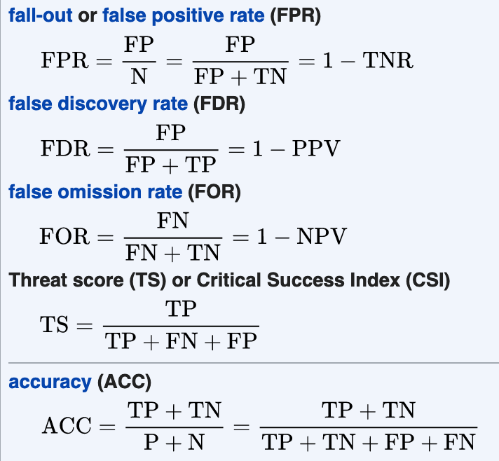
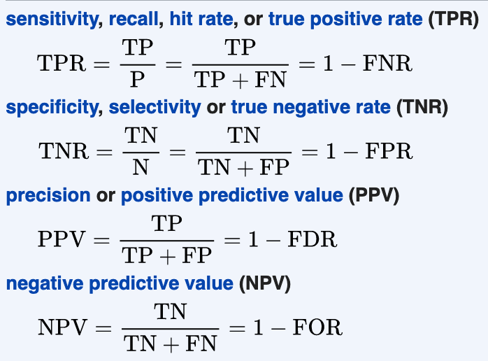
Wikipedia – Related terms
https://en.wikipedia.org/wiki/Precision_and_recall
Notes:
ASK STUDENTS HERE ABOUT WHY NOT TO USE ACCURACY
-when class is unbalanced, results are misleading… (if TP >> TN or vice versa)

Slide 47
A combined measure: F
A combined measure that assesses the P/R tradeoff is F measure (weighted harmonic mean):
Why weighted mean?
People usually use balanced F1 measure
i.e., with β = 1 (that is, α = ½): F = 2PR/(P+R)
Why harmonic mean?
Very conservative average (least of the 3 Pythagorean means)
Notes:
a combined measure: F-measure: weighted harmonic mean between precision and recall (formula below with alpha)
-multiply numerator and denominator by 2PR
[why weighted? in some applications you may care more about P or R]
[why harmonic? it's conservative -- lower than arith or geo mean]
[if P and R are far apart, F tends to be near lower value]
[in order to do well on F1, need to do well on BOTH P and R]
[this way, can't beat the system by being either too reluctant or too promiscuous]
Values of b > 1 favor recall, while
values of b < 1 favor precision.
Comment: when ppl say f-measure w/o specifying beta, they mean balanced, and this is by far the most common way of doing it

Slide 48
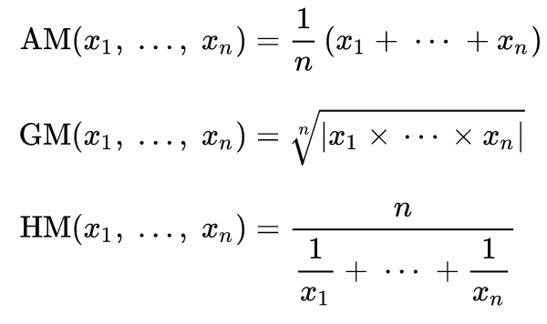
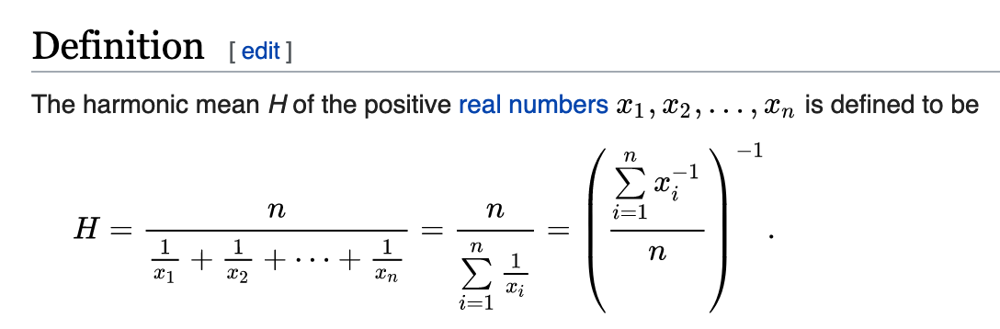
Harmonic Mean
https://en.wikipedia.org/wiki/Harmonic_mean
Notes:
Our x1 and x2 are what? Precision and Recall
Hardest to game, will be lower than AM or GM for unequal value pairs, try plugging in different values for precision and recall and see

Slide 49
Text Classification and Naïve Bayes
Text Classification: Evaluation

Slide 50
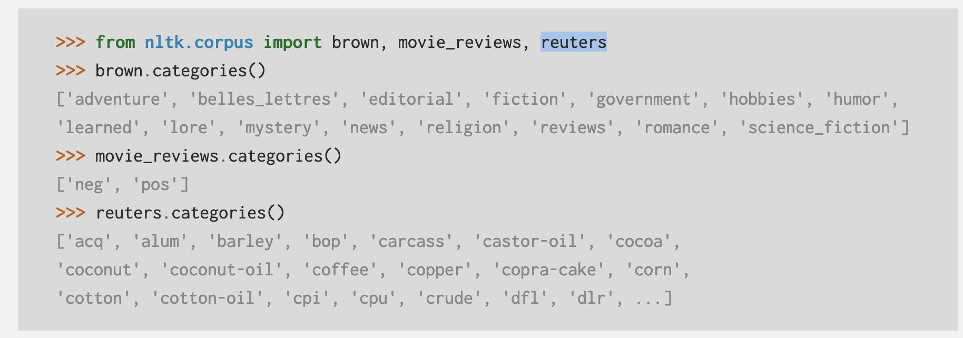
Evaluation: Classic Reuters-21578 Data Set
Sec. 15.2.4
Most (over)used data set, 21,578 docs (each 90 types, 200 tokens)
9603 training, 3299 test articles (ModApte/Lewis split)
118 categories
An article can be in more than one category
Learn 118 binary category distinctions
Average document (with at least one category) has 1.24 classes
Only about 10 out of 118 categories are large
Earn (2877, 1087)
Acquisitions (1650, 179)
Money-fx (538, 179)
Grain (433, 149)
Crude (389, 189)
Trade (369,119)
Interest (347, 131)
Ship (197, 89)
Wheat (212, 71)
Corn (182, 56)
Common categories
(#train, #test)

Slide 51
Reuters Text Categorization data set (Reuters-21578) document
Sec. 15.2.4
<REUTERS TOPICS="YES" LEWISSPLIT="TRAIN" CGISPLIT="TRAINING-SET" OLDID="12981" NEWID="798">
<DATE> 2-MAR-1987 16:51:43.42</DATE>
<TOPICS><D>livestock</D><D>hog</D></TOPICS>
<TITLE>AMERICAN PORK CONGRESS KICKS OFF TOMORROW</TITLE>
<DATELINE> CHICAGO, March 2 - </DATELINE><BODY>The American Pork Congress kicks off tomorrow, March 3, in Indianapolis with 160 of the nations pork producers from 44 member states determining industry positions on a number of issues, according to the National Pork Producers Council, NPPC.
Delegates to the three day Congress will be considering 26 resolutions concerning various issues, including the future direction of farm policy and the tax law as it applies to the agriculture sector. The delegates will also debate whether to endorse concepts of a national PRV (pseudorabies virus) control and eradication program, the NPPC said.
A large trade show, in conjunction with the congress, will feature the latest in technology in all areas of the industry, the NPPC added. Reuter
&#3;</BODY></TEXT></REUTERS>
Notes:
Multi-value classification – livestock and hogs

Slide 52
Confusion matrix c
For each pair of classes <c₁,c₂> how many documents from c₁ were incorrectly assigned to c₂?
c_{3,2}: 90 wheat documents incorrectly assigned to poultry
Docs in test set | Assigned UK | Assigned poultry | Assigned wheat | Assigned coffee | Assigned interest | Assigned trade
True UK | 95 | 1 | 13 | 0 | 1 | 0
True poultry | 0 | 1 | 0 | 0 | 0 | 0
True wheat | 10 | 90 | 0 | 1 | 0 | 0
True coffee | 0 | 0 | 0 | 34 | 3 | 7
True interest | - | 1 | 2 | 13 | 26 | 5
True trade | 0 | 0 | 2 | 14 | 5 | 10
Notes:
Why assigning poultry to wheat? Investigate…

Slide 53
Micro- vs. Macro-Averaging
Sec. 15.2.4
If we have more than one class, how do we combine multiple performance measures into one quantity?
Macroaveraging: Compute performance for each class, then average.
Microaveraging: Collect decisions for all classes, compute contingency table, evaluate.

Slide 54
Micro- vs. Macro-Averaging: Example
Sec. 15.2.4
Class 1
Class 2
Micro Ave. Table
 | Truth: yes | Truth: no
Classifier: yes | 10 | 10
Classifier: no | 10 | 970
 | Truth: yes | Truth: no
Classifier: yes | 90 | 10
Classifier: no | 10 | 890
 | Truth: yes | Truth: no
Classifier: yes | 100 | 20
Classifier: no | 20 | 1860
Macroaveraged precision: (0.5 + 0.9)/2 = 0.7
Microaveraged precision: 100/120 = .83
Microaveraged score is dominated by score on common classes
Notes:
Because f1 ignores true negs and its magnitude is mostly determined by the number of true positives, large classes dominate small classes in microaverage.

