Slide 1
Subterfuge RPG
Final Presentation
GAT212 Spring 2015—Travis Moore © 2015 DigiPen Institute of Technology

Slide 2
Game SYSTEM
Description
Subterfuge RPG is a spy-fiction game set in the year 2015. This era is in an unstable state sitting at the brink of what could be a truly devastating world war. Governments take secret actions in order to stay safe not to implicate themselves in events that might be seen as acts of war.
Unique Features
Push your luck dice mechanic that allows players to push their spies to the limits of their abilities.
For example: Your Spy has a Melee Combat ability of 10. You roll a D6 and get a 5. You can choose to keep rolling and increase your score up to your ability of 10. If you go over your ability, then you bust and only get half of your last score.
GAT212 Spring 2015—Travis Moore © 2015 DigiPen Institute of Technology

Slide 3
Player & Game Master GUIDE
Welcome to Subterfuge RPG
What is a Roleplaying Game (RPG)?
Game Theme and Genre
Components
Attributes & Skills
Character Generation
Creating your Character
Determining Attributes/Skills/Health
Determining Class Type and Abilities
Provisioning Gear
Level Progression
How to Play
Taking Your Turn
Movement/Terrain
Non-combat Actions
Combat Actions
Combat
Melee Combat
Ranged Combat
Life/Death Checks
Character Sheets
Pre-made Captain
Pre-made Assassin
Pre-made Saboteur
Pre-made Analyst
Running a Game Session
Providing Information
Narration
Attribute & Skill Checks
Attribute Checks
Skill Checks
Awards/Rewards/Incentives
Experience & Leveling
Combat
Melee Combat
Ranged Combat
Live/Death Checks
How to Play an Enemy in Combat
GAT212 Spring 2015—Travis Moore © 2015 DigiPen Institute of Technology

Slide 4
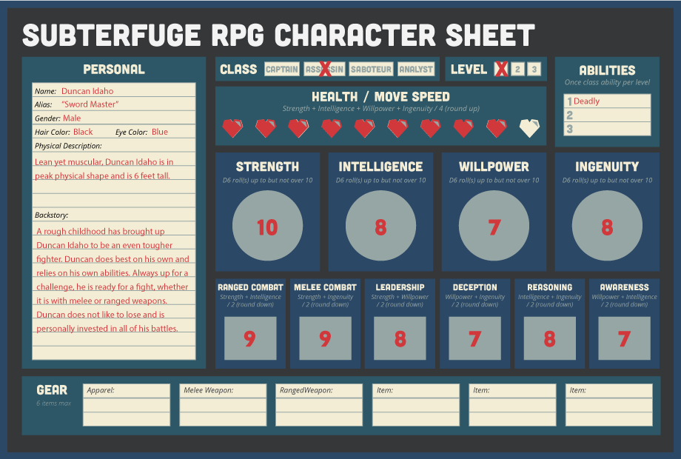
Character Generation
Roll a D6 using the Push Your Luck Mechanic to get Attributes:
Strength
Intelligence
Willpower
Ingenuity
Combine Attribute values and divide by two (round down) to get Skills:
Ranged Combat
Melee Combat
Leadership
Deception
Reasoning
Awareness
GAT212 Spring 2015—Travis Moore © 2015 DigiPen Institute of Technology

Slide 5
Classes & Abilities
Captain
The Captain class uses their Willpower attribute to the fullest, especially because this attribute combines to create the Leadership and Awareness skills.
Abilities
Inspire: Once per mission you can allow a teammate to reroll any type of Skill Check.
Intimidate: Once per mission you can force the Game Master to undo an action taken by an enemy and force a different outcome.
Sacrifice: Once per mission you can take a failed Deathblow from an ally, saving them, and attempt to take the damage instead (roll to pass a Deathblow Check if applicable).
Assassin
The Assassin class uses their Strength attribute to the fullest, especially when this attribute is combined into the Ranged Combat and Melee Combat skills.
Abilities
Assassinate: Once per mission you can instantly kill any enemy that is not the main villain.
Deadly: Once per mission you can reroll a failed Ranged Combat and also a failed Melee Combat roll.
Quick: Once per mission you can perform both Melee Combat and Ranged Combat in the same turn against multiple enemies.
Saboteur
The Saboteur class uses their Ingenuity attributes to the fullest, especially as this attribute is combined into the Deception and Awareness skills.
Abilities
Creative: Once per mission you suggest an alternate means of solving a non-combat problem that would utilize a Skill Check of your choice.
Stealth: Once per mission you guarantee not getting caught/tripping an alarm/being seen for any situation.
Trickery: Once per mission you can fool an enemy, except the main villain, into thinking you are on their team and have them do something for you.
Analyst
The Analyst class uses their Intelligence attribute to the fullest, especially as this attribute combines to make the Reasoning and Awareness skill.
Abilities
Medicine: Twice per mission you can roll a D6 and heal any member of your team (including yourself).
Surveillance: Once per mission you can privately talk to the Game Master to find out what major event/problem is coming up next.
Unbelievable Science: Once per mission you can make a compelling, but most likely fake, scientific argument against a current situation to completely disregard and change the outcome (including the death of an ally).
GAT212 Spring 2015—Travis Moore © 2015 DigiPen Institute of Technology

Slide 6
Mission Module
Briefing / Provisioning Gear
Main Objective: Discover which company(ies) are involved in a potential arms deal with a foreign nation and obtain evidence proving so.
Sub Objective: Prevent any further weapons deals with foreign nations.
Sub Objective: Find our missing field agent, Niccolo Kristov.
Chapter 1: Charity Event
Players explore their surroundings, learn who the big players are at the event and search for clues. Players can start to go off in their own directions based on how they feel like playing the game.
Chapter 2: The Big Game
One or more of the players can experience the big Blackjack game/simulation and try to get more information out of the two main suspects in the game.
Chapter 3: The Action
Combat breaks out in the wine cellar of the estate. The players have an opportunity to find the missing the agent here, as well. The big showdown with the Korean spies and the arms dealer takes place.
Optional Ending: Epic Finale
If the Game master feels that the players would like a bigger ending the game can throw move combat and puzzles at the player in the form of chasing down the last Korean spy to an offshore submarine where they must prevent him from stealing the submarine and launching missiles.
GAT212 Spring 2015—Travis Moore © 2015 DigiPen Institute of Technology

Slide 7
Playtesting / Lessons Learned
Playtesting
Players liked the personalities of the NPCs, including their cheesy bad-guy names.
The Optional Ending was seen as a good idea.
The story works well with a variety of things for different player types.
The adventure guide was missing explaining how experience was earned during the mission.
Minor typographical errors.
Lessons Learned
There’s quite a lot to consider when making an RPG.
Do anything and everything you can do to help your Game Master because the success of the game hinges on their ability to parse through the information, understand it, and make it their own.
GAT212 Spring 2015—Travis Moore © 2015 DigiPen Institute of Technology

Slide 8
The end
Rough Draft Presentation
GAT212 Spring 2015—Travis Moore © 2015 DigiPen Institute of Technology

