Slide 1
Subterfuge RPG
Rough Draft Presentation
GAT212 Spring 2015—Travis Moore © 2015 DigiPen Institute of Technology

Slide 2
Player Guide
Welcome to Subterfuge RPG
What is a Roleplaying Game (RPG)?
Game Theme and Genre
Components List
Character Generation
Creating Your Character
Determining Attributes, Health, and Skills
Choosing a Class and Abilities
Character Sheet
Attributes Breakdown
Strength, Intelligence, Willpower, Ingenuity
Skills Breakdown
Melee, Ranged, Leadership, Deception, Reasoning, Awareness
Level Progression
Leveling Up
Improving Attributes
Combat
Combat Sequence
Rounds
Turns
Movement, Non-Combat Actions, Combat Actions
Melee Combat
Ranged Combat
Life/Death
NOT COMPLETED:
Provisioning Gear, How To Play, Example Play, Movement/Terrain, NonCombat, and Exploration.
GAT212 Spring 2015—Travis Moore © 2015 DigiPen Institute of Technology

Slide 3
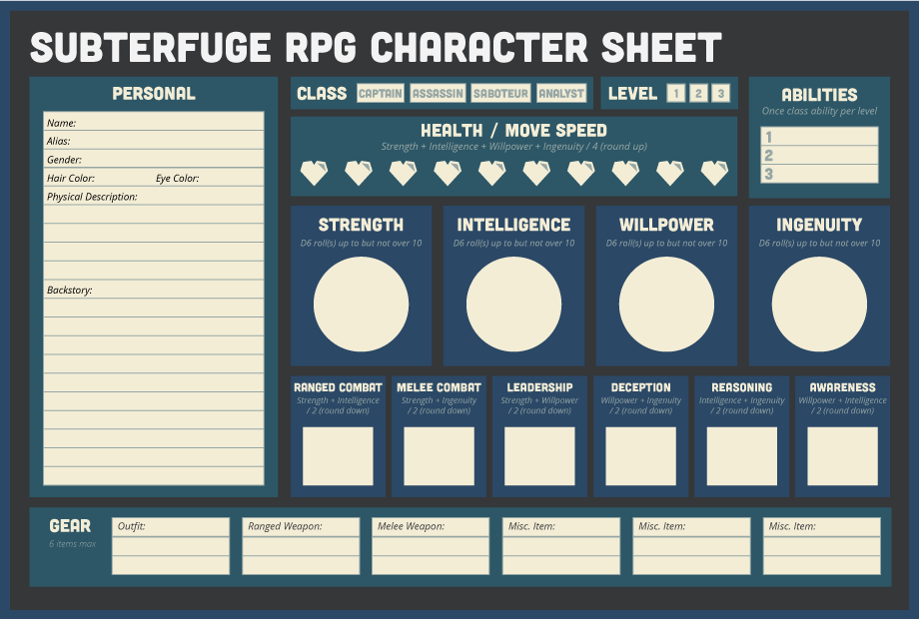
Character sheet
GAT212 Spring 2015—Travis Moore © 2015 DigiPen Institute of Technology

Slide 4
Game master Guide
COMPLETED:
Nothing, woo!
NOT COMPLETED:
Running a Play Session
Combat
Non-Combat
Attribute / Skill Checks
Live / Death Checks
Running a Campaign
Awards / Rewards / Incentives
Game Narrative / Motivating Players
Non-Player Characters (NPCs)
Friendly NPCs
Enemies
Main Villain
GAT212 Spring 2015—Travis Moore © 2015 DigiPen Institute of Technology

Slide 5
Mission module
COMPLETED:
Nothing, woo!
NOT COMPLETED:
Mission Briefing
Mission Goals
Mission Map
Player Known Information
Game Master Only Information
Major Events in the Mission
Class Specific Events
Story Specific Events
Non-Player Characters (NPCs)
Friendly NPCs
Enemies
Main Villain
GAT212 Spring 2015—Travis Moore © 2015 DigiPen Institute of Technology

Slide 6
The end
Rough Draft Presentation
GAT212 Spring 2015—Travis Moore © 2015 DigiPen Institute of Technology

