Slide 1
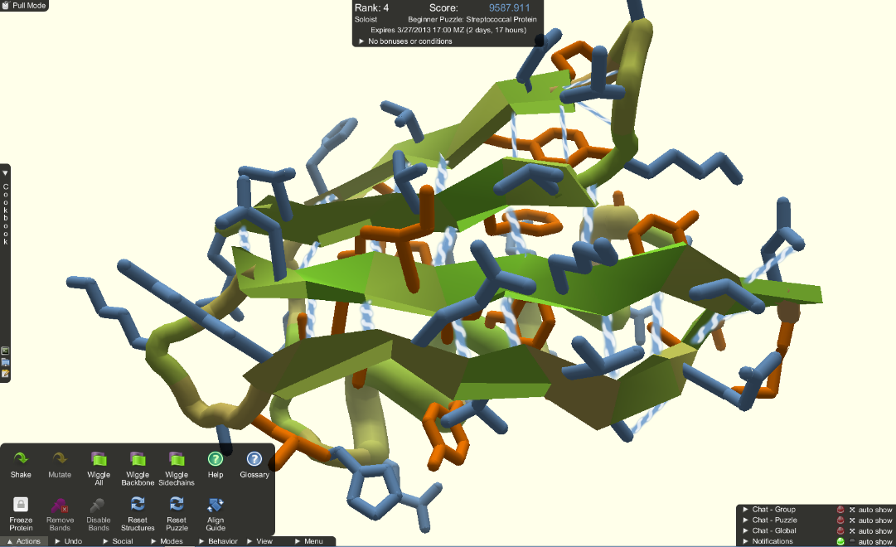
Foldit
Student: Travis Moore
Simulation: Foldit
Publisher: Foldit is developed by the Center for Game Science at University of Washington in collaboration with UW Department of Biochemistry.
Website: http://fold.it/portal/

Slide 2
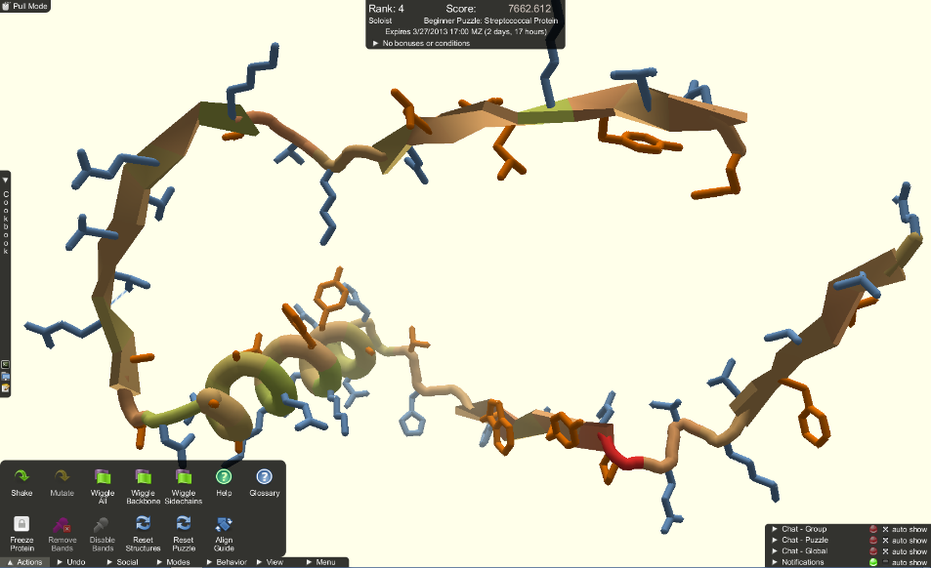
Foldit
Platform: Foldit is digital game that can be played downloaded for free on windows, mac, and linux computers.
Genre / Audience: Foldit is a puzzle game intended for those who want to participate to important scientific research. There are many degrees of freedom a protein can fold into. Foldit attempts to predict the structure of a protein by taking advantage of humans' puzzle-solving intuitions and having people play competitively to fold the best proteins.

