Slide 1
2D Graphics and Sprites

Slide 2

Sprites
Standard Image
2d Arrays of Pixels
Each Pixel Multiple Channels
Each channel usually a byte

Slide 3
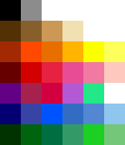
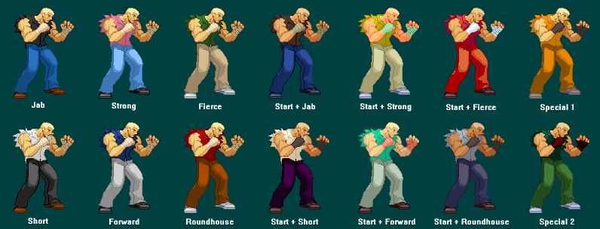
Palettes
Palette Image
2d Array of palette indices
Palette stores pixel colors
Palette Swaps can be used to change costume highlights or simple animations
Much smaller in memory

Slide 4
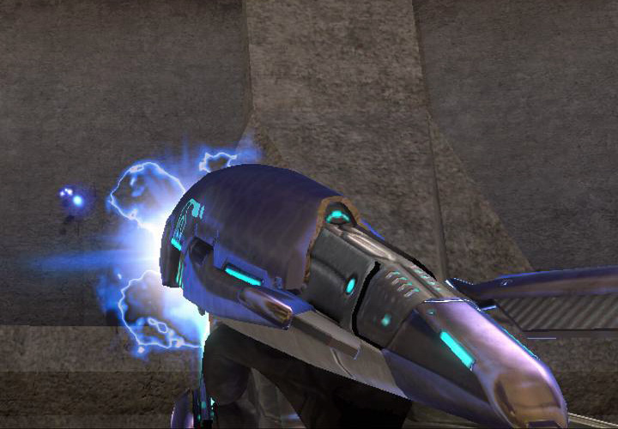
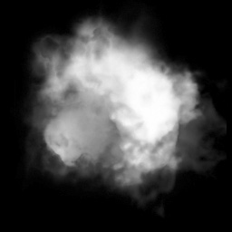
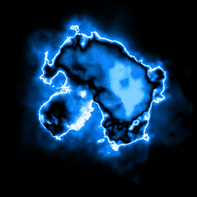
Plasma Rifle Muzzle Flash
Copyright © Microsoft Corp. All rights reserved.

Slide 5

Sprite Animation
Sprites are animated by drawing slightly different frames at a frame rate (usually 30, 24, 12)
Large about of memory needed for many frame animation

Slide 6

Multi Part Animation
Each element is a sprite
Sprite will change frames
Sprite will also rotate and translation to generate animation
Flash is best example
Can create animations quickly
Similar to 3d
Copyright © Nintendo Corp. All rights reserved.

Slide 7
Hardware

Slide 8

Texture Filtering
Textures need to appear at many different sizes due to perspective scaling
Need a efficient way of resizing sprites and filtering them

Slide 9
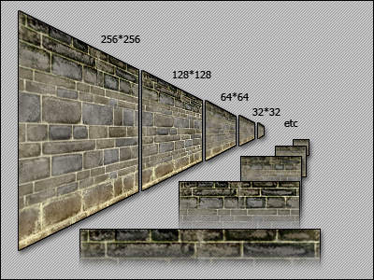
Texture Mip Maps
Array of bitmaps with mip levels
Each level is half the size of previous level
Mip mapping allows for high quality smooth texture filtering with distance

Slide 10
Sprite Mapping?
Should each sprite be its own texture?
Should each frame be its own texture?
What works best on modern hardware?

Slide 11
Draw Calls
Number of Draw has a disproportional effect on performance (DrawPrims)
Overhead of Hardware layer
Communication to GPU
State Management
Context switches expensive
Changing textures or shaders
Changing draw modes

Slide 12
Batching
Place as many sprites as possible on one texture (Atlas)
Sort by layer and then in each layer sort by texture used
Transform each sprite filling a vertex buffer with the 4 verts
When the buffer is full or a different texture is used flush the buffer

Slide 13
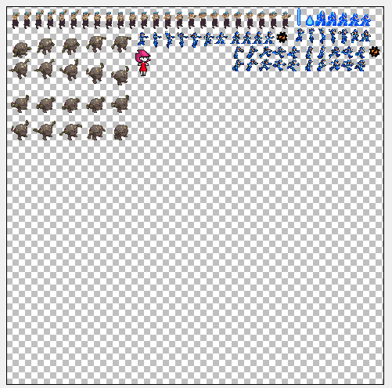
Generated Sprite Sheet

Slide 14
Batching
Ideally group background tiles on one large texture so it can be draw all at once
Can precache the background into pieces for every faster drawing

Slide 15
Batching In Zero
Done automatically
Can manually optimize atlases if necessary

Slide 16
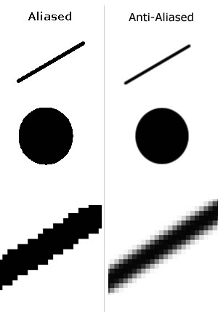
Aliasing Anti Aliasing
Aliasing is the jagged edges on polygons
Make lines appear smooth
Can be baked into sprite Alpha
GPU will do resampling
But…

Slide 17
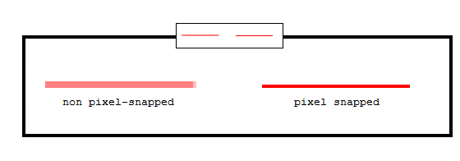
Pixel Snapping
With tile maps a visual artifact can occur when images are drawn half a pixel off
Object blurs and un blurs
Same artifact shows up when scaling
In 3d sometimes called screen door effect

Slide 18
Pixel Snapping
Be careful when drawing objects at near the same resolution as screen
Mip mapping can create additional artifacts on edges
Interpolation in general can create artifacts

Slide 19
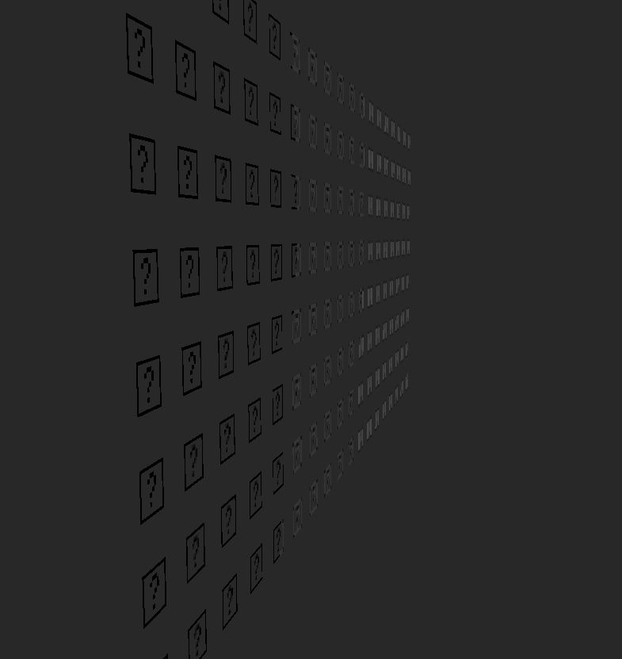

Slide 20
Color Bleeding
Color can leak in during filtering
Colors from other mip levels can leak during minification (shrinking)
Can also bleed into neighboring sprites
Limit zooming in and out on sprites
Magnification is not a problem

Slide 21
Pre multiplied Alpha
Alpha can be premultiped
Fixed filtering artifacts
Solves some mip mappings issues
Allows more flexible sorting
Premultiplied alpha - Shawn Hargreaves

Slide 22
Fill Rate
Overdraw – Drawing the same pixel over and over again
Alpha Blending – Increases per pixel cost
Try to avoid massive amounts of overdraw and disable alpha blending when not needed.
Huge particles system in front of the camera
Large amount of background layers

Slide 23
Blend Modes
Alpha Blending – Traditional compositing.
Pixel = Source * Alpha + Dest * (1 – Alpha)
Additive Blending – Object color is added onto the background. Fire, sparks, etc.
Pixel = Source + Dest
Multiply Blending – Burn effects tinting etc.
Pixel = Src * Dest

Slide 24
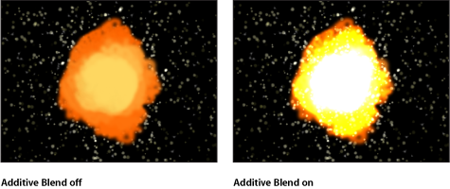

Slide 25
Sorting
Due to alpha blending sprites must be drawn back to front
The Zbuffer can not be used to solve depth issues
Sort By Z?
Sort By Layers?

Slide 26
Questions?

