Slide 1
Probability in Simulation

Slide 2
Random
Which is more random?
8346718737466518133325234234
0341767833551615246446221847
5104683297087413925673486592

Slide 3
Random
Not really enough data to tell
What is randomness anyways?
8346718737466518163325234234
Mashing Keyboard
0341767833551615246446221847
Python Random Number Generator
5104683297087413925673486592
Python Deck Random

Slide 4
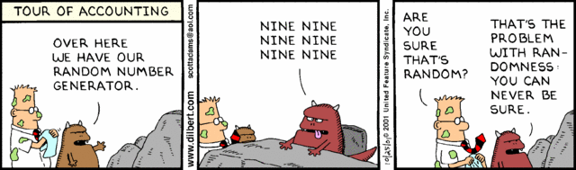

Slide 5
Random
Light Switch Question
Two rooms
One with a person flipping a coin to determine flipping a light switch.
The other with a person deciding when to flip the light switch themselves
Can you tell the difference?

Slide 6
Random
Yes we Can
In a true random distribution every sequence should be equally likely (given a large enough sample)
Humans do not like a long runs in an effort to make things more random they make them less

Slide 7
Random
What is more likely?
Heads, Heads, Heads, Heads, Heads
Heads, Heads, Tails, Heads, Tails

Slide 8
Random
What is more likely?
Heads, Heads, Heads, Heads, Heads
Heads, Heads, Tails, Heads, Tails
They are the same probability
This is the gambler’s fallacy

Slide 9
Random
Humans suck at probability
Humans like patterns
Humans believe that a number or roll should be up
Terrible at evaluating risk (Plane vs Car)
Are terrible at prediction mostly because we like seeing patterns so much

Slide 10
Random Numbers Generators
Pseudo random
What you get in most libraries
Performance vs distribution
Real random
Read from large table
Thermal noise in the CPU
Environmental noise

Slide 11
Pseudo Random Generator
The generator algorithm is seeded with a value, usually an integer
The same seed generates the same set of numbers
Every time a number is generated the seed is updated
Eventually the sequence will loop (seed back to start) this is know at the period of the sequence

Slide 12
Pseudo Random
To duplicate the same sequence random numbers use the same seed
Can by synced in network games
Used to generate different worlds in a predictive fashion or dungeons (See: Minecraft)
This also allows the game to ensure determinism

Slide 13
Generators
Different Generators have different probabilities, periods, and speed.
Check the library you are using
Can have fast random for particles etc.
Also useful to have different random objects so effects and non-game effecting random generator does not effect gameplay

Slide 14
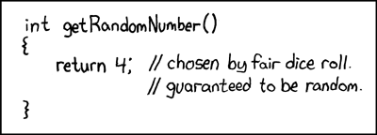

Slide 15
Random is not fun
It is frustrating
It makes your experience unpredictable
Random drops
So how do we prevent these issues?

Slide 16
Dice
Why throw two dice?
Gives better distribution.

Slide 17
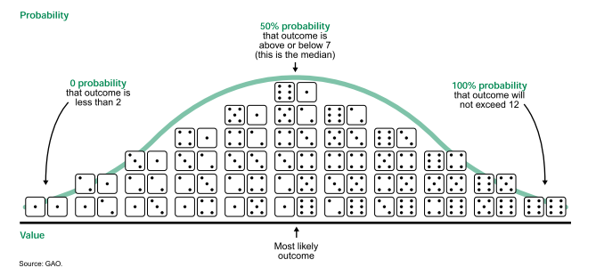

Slide 18
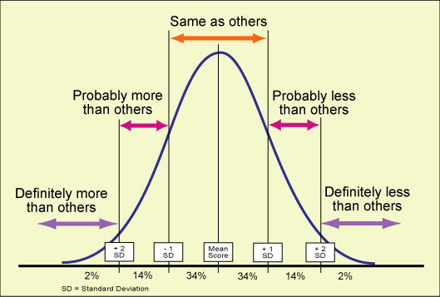
Bell Curve

Slide 19
Distribution
With a basic random generator the distribution is always linear
Can use multiple samples to create different distributions
Most things in Zero use the concept of base value and variance

Slide 20
Basic Probability and Time
Probability of a event vs a test against random number generator (Probability between zero and one)
The likeliness of the event is greatly effected by the frequency of the polling for the probability
In WOW one in a million is tomorrow

Slide 21
Deck Random
Take all number in range and place them in a list
Shuffle the list
Each a number is request draw pop from the front
When the deck is empty generate another deck

Slide 22
Deck Random
Gives equal distribution
Matches human perception
Can add more of elements that need to be more common
Expanding the number of decks in the shuffle allow for more duplicates in a row

Slide 23
Modified Deck Random
Can also combine decks
Generate a low variance count
Draw from common deck that number of times
Then draw from rare deck
Repeat
Add in elements that the player prefers or based on their class
Different drop tables etc

Slide 24
Making your number up
Store a value on the player that increase the chance of getting a rare
When they get a rare reset the value if they do not increase the value
Bias the chance of getting a rare by the value
Also great for criticals and random attack effects
http://dota2.gamepedia.com/Pseudo-random_distribution

Slide 25
Tools
Normal Random
Deck Random
Random Variance(Takes a base value and a +/- amount of variance)
Probability function (0 to 1) return true / false

Slide 26
Questions?

