Slide 1
Beatrix Lycanthorn
Curse of the Werewolf
Tragedy Search Corporation
Preston Lowery—Travis Moore—Kellie Pelton

Slide 2
High Concept
Beatrix Lycanthorn is a 2D platform adventure set in a stylized, melancholy medieval Europe. Beatrix hungers like the wolf…for vegetables.

Slide 3
Genre
Adventure
Platforming
Puzzle

Slide 4
Theme
Werewolf curse
Supernatural
Medieval Europe

Slide 5
Mechanics
Win: Collect all the clues and cure the werewolf curse
Lose: Let the hunger meter drop to zero as a werewolf
Lose in a level: Attract too much attention as a werewolf and be chased out of town
  Forces level restart
As a werewolf, hunger meter slowly drops when not eating vegetables
Hunger meter also dips when being attacked (acts like a health meter)
Object collection
Differing abilities and mechanics between the human and the werewolf
Can transform into werewolf at will, but you stay the werewolf until a timer ticks down

Slide 6
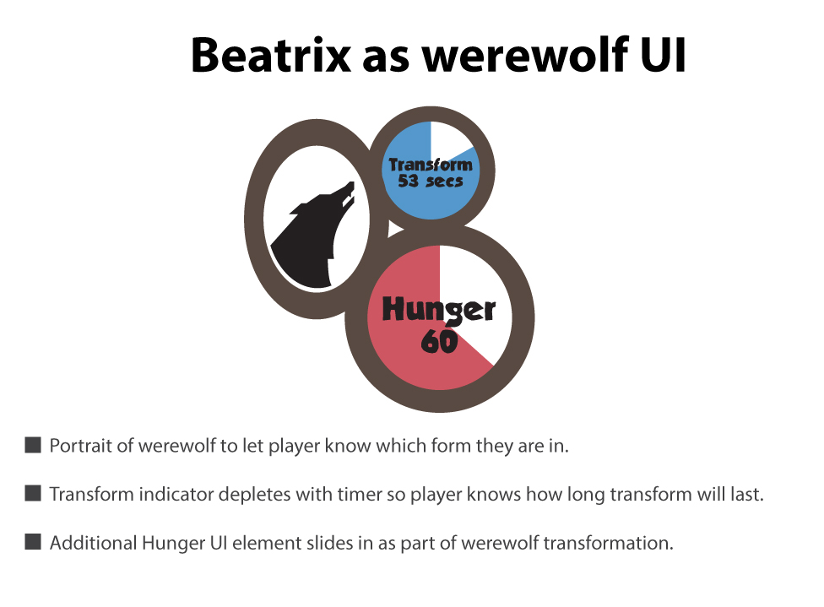
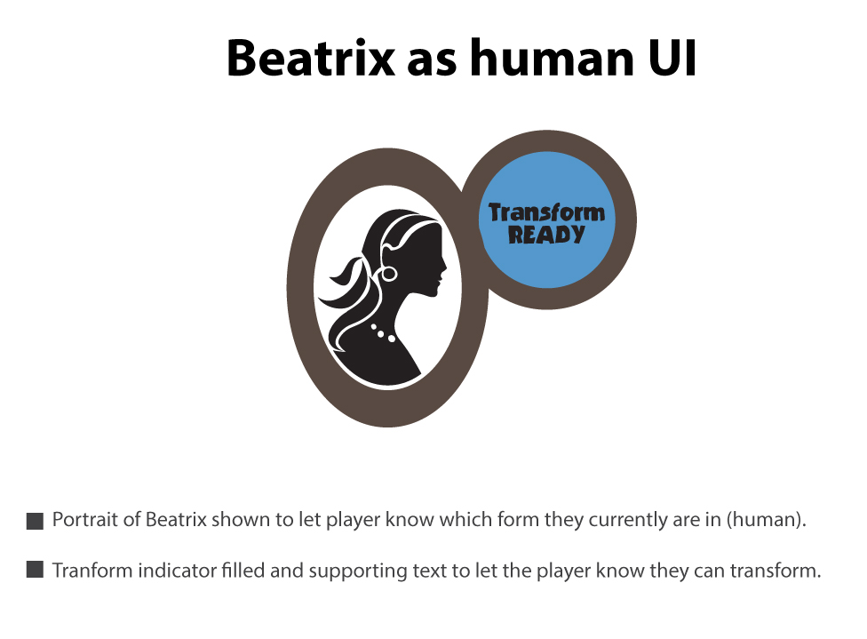
Mechanics (UI)

Slide 7
Mechanics
Differences | Human | Werewolf
Movement | Normal speed, left and right, jump and crouch | Advanced speed, left and right, wall jump
Abilities | Use items | Break things, dig in certain places
Jump | Basic jump | Basic jump and wall jump
Health | Any damage will cause a level restart | Tanky, based on value left in hunger meter
Goals | Explore for ingredients for cure to curse, cure the curse | Eat to survive
Physical | Small (can fit in places the werewolf can’t) Can crouch and crawl | Large (cannot fit in certain areas) Cannot crouch nor crawl

Slide 8
Characters
Beatrix Lycanthorne:
  Main character, movement by player input
  English woman of common appearance for medieval century women trying to break the curse of the werewolf
  Hopes to revert to past life and return to family
Countrymen and women, guards
  AI controlled enemies/NPCs tending their fields and attacking when the werewolf draws too much attention
  Pace back and forth in the background, are not touchable when the player is human

Slide 9
Environment
Backdrop of several medieval countries that require the player to platform through them
UI shows current state (human or werewolf) and hunger meter when in wolf form. The UI is shown in upper left corner
Some levels require obstacles (barrels, etc…) to be broken or dirt to be dug through to reveal passages

Slide 10
Summary
2D side-scrolling platformer puzzle game
Ability to change into a powerful vegetarian werewolf that needs to eat and can be chased out of town
Set in medieval England as the hub world
  Levels include other medieval European countries each with an appropriate feel

