Slide 1



Project name: Project from Facade Project manager: IKSANOV Aleksandr Last Updated: 01-Jun-20
Schedule | Scope | Quality | Cost
RED | YELLOW | RED | GREEN
Summary title Summary title Summary title Summary title Summary title
DR1
DR2
DR2
DR2
DR2
DR2
DR2
DR3
DR3
DR3
G
Committed * Actual / Forecast
11-Apr-20 10-Apr-20
15-Apr-20 15-Apr-20
15-Apr-20 15-Apr-20
15-Apr-20 15-Apr-20
15-Apr-20 15-Apr-20
15-Apr-20 15-Apr-20
15-Apr-20 15-Apr-20
19-Apr-20 19-Apr-20
19-Apr-20 19-Apr-20
19-Apr-20 19-Apr-20
* Committed dates are DR1 baseline dates
Status | Previous 08-Jan-19 | Current 15-Apr-20 | Comment
Overall Project Status | R | G | Overall comment
Schedule | Y | R | Schedule comment
Scope | G | Y | Scope comment
Quality | G | R | Quality comment
Cost | R | G | Cost comment
Alcatel-Lucent Enterprise - Confidential Solely for authorized persons having a need to know Proprietary - Use pursuant to Company Instruction
Page 1

Slide 2
Project name: Project from Facade Project manager: IKSANOV Aleksandr Last Updated: 01-Jun-20
Summary title Summary title Summary title Summary title Summary title
That`s all, folks!
Red Flag
That`s all, folks!
Yellow Flag
\n" + "1PowerPoint documents are made up of a tree of records. A record may contain either other records (in which case it is a Container), or data (in which case it's an Atom). A record can't hold both. PowerPoint documents don't have one overall container record. Instead, there are a number of different container records to be found at the top level. Any numbers or strings stored in the records are always stored in Little Endian format (least important bytes first). This is the case no matter what platform the file was written on - be that a Little Endian or a Big Endian system. PowerPoint may have Escher (DDF) records embedded in it. These are always held as the children of a PPDrawing record (record type 1036). Escher records have the same format as PowerPoint records. Hello mate! Hello mate! Hello mate! Hello mate! Hello mate! Hello mate! Hello mate! Hello mate! Hello mate! This is bold and underscore and both and not true false PowerPoint documents are made up of a tree of records. A record may contain either other records (in which case it is a Container), or data (in which case it's an Atom). A record can't hold both. PowerPoint documents don't have one overall container record. Instead, there are a number of different container records to be found at the top level. Any numbers or strings stored in the records are always stored in Little Endian format (least important bytes first). This is the case no matter what platform the file was written on - be that a Little Endian or a Big Endian system. PowerPoint may have Escher (DDF) records embedded in it. These are always held as the children of a PPDrawing record (record type 1036). Escher records have the same format as PowerPoint records. A record may contain either other records (in which case it is a Container), or data (in which case it's an Atom). A record can't hold both. PowerPoint documents don't have one overall container record PowerPoint documents are made up of a tree of records. A record may contain either other records (in which case it is a Container), or data (in which case it's an Atom). A record can't hold both. PowerPoint documents don't have one overall container record. Instead, there are a number of different container records to be found at the top level. Any numbers or strings stored in the records are always stored in Little Endian format (least important bytes first). This is the case no matter what platform the file was written on - be that a Little Endian or a Big Endian system. PowerPoint may have Escher (DDF) records embedded in it. These are always held as the children of a PPDrawing record (record type 1036). Escher records have the same format as PowerPoint records. Hello mate! Hello mate! Hello mate! Hello mate! Hello mate! Hello mate! Hello mate! Hello mate! Hello mate! This is bold and underscore and both and not true false PowerPoint documents are made up of a tree of records. A record may contain either other records (in which case it is a Container), or data (in which case it's an Atom). A record can't hold both. PowerPoint documents don't have one overall container record. Instead, there are a number of different container records to be found at the top level. Any numbers or strings stored in the records are always stored in Little Endian format (least important bytes first). This is the case no matter what platform the file was written on - be that a Little Endian or a Big Endian system. PowerPoint may have Escher (DDF) records embedded in it. These are always held as the children of a PPDrawing record (record type 1036). Escher records have the same format as PowerPoint records. Hello mate! Hello mate! Hello mate! Hello mate! Hello mate! Hello mate! Hello mate! Hello mate! Hello mate! This is bold and underscore and both and not true false PowerPoint documents are made up of a tree of records. A record may contain either other records (in which case it is a Container), or data (in which case it's an Atom). A record can't hold both. PowerPoint documents don't have one overall container record documents don't have one overall container record. Instead, there are a number of different container records to be found at the top level. Any numbers or strings stored in the records are always stored in Little Endian format (least important bytes first). This is the case no matter what platform the file was written on - be that a Little Endian or a Big Endian system. PowerPoint may have Escher (DDF) records embedded in it. These are always held as the children of a PPDrawing record (record type 1036). " + "
Alcatel-Lucent Enterprise - Confidential Solely for authorized persons having a need to know Proprietary - Use pursuant to Company Instruction
Page 2

Slide 3
Project name: Project from Facade Project manager: IKSANOV Aleksandr Last Updated: 01-Jun-20
Summary title Summary title Summary title Summary title Summary title
2Escher records have the same format as PowerPoint records. Hello mate! Hello mate! Hello mate! Hello mate! Hello mate! Hello mate! Hello mate! Hello mate! Hello mate! This is bold and underscore and both and not true false PowerPoint documents are made up of a tree of records. A record may contain either other records (in which case it is a Container), or data (in which case it's an Atom). A record can't hold both. PowerPoint documents don't have one overall container record. Instead, there are a number of different container records to be found at the top level. Any numbers or strings stored in the records are always stored in Little Endian format (least important bytes first). This is the case no matter what platform the file was written on - be that a Little Endian or a Big Endian system. PowerPoint may have Escher (DDF) records embedded in it. These are always held as the children of a PPDrawing record (record type 1036). Escher records have the same format as PowerPoint records. Hello mate! Hello mate! Hello mate! Hello mate! Hello mate! Hello mate! Hello mate! Hello mate! Hello mate! This is bold and underscore and both and not true false PowerPoint documents are made up of a tree of records. A record may contain either other records (in which case it is a Container), or data (in which case it's an Atom). A record can't hold both. PowerPoint documents don't have one overall container record\n" + "3Escher records have the same format as PowerPoint records. Hello mate! Hello mate! Hello mate! Hello mate! Hello mate! Hello mate! Hello mate! Hello mate! Hello mate! This is bold and underscore and both and not true false PowerPoint documents are made up of a tree of records. A record may contain either other records (in which case it is a Container), or data (in which case it's an Atom). A record can't hold both. PowerPoint documents don't have one overall container record. Instead, there are a number of different container records to be found at the top level. Any numbers or strings stored in the records are always stored in Little Endian format (least important bytes first). This is the case no matter what platform the file was written on - be that a Little Endian or a Big Endian system. PowerPoint may have Escher (DDF) records embedded in it. These are always held as the children of a PPDrawing record (record type 1036). Escher records have the same format as PowerPoint records. Hello mate! Hello mate! Hello mate! Hello mate! Hello mate! Hello mate! Hello mate! Hello mate! Hello mate! This is bold and underscore and both and not true false PowerPoint documents are made up of a tree of records. A record may contain either other records (in which case it is a Container), or data (in which case it's an Atom). A record can't hold both. PowerPoint documents don't have one overall container record\n" + "4Escher records have the same format as PowerPoint records. Hello mate! Hello mate! Hello mate! Hello mate! Hello mate! Hello mate! Hello mate! Hello mate! Hello mate! This is bold and underscore and both and not true false PowerPoint documents are made up of a tree of records. A record may contain either other records (in which case it is a Container), or data (in which case it's an Atom). A record can't hold both. PowerPoint documents don't have one overall container record. Instead, there are a number of different container records to be found at the top level. Any numbers or strings stored in the records are always stored in Little Endian format (least important bytes first). This is the case no matter what platform the file was written on - be that a Little Endian or a Big Endian system. PowerPoint may have Escher (DDF) records embedded in it. These are always held as the children of a PPDrawing record (record type 1036). Escher records have the same format as PowerPoint records. Hello mate! Hello mate! Hello mate! Hello mate! Hello mate! Hello mate! Hello mate! Hello mate! Hello mate! This is bold and underscore and both and not true false PowerPoint documents are made up of a tree of records. A record may contain either other records (in which case it is a Container), or data (in which case it's an Atom). A record can't hold both. PowerPoint documents don't have one overall container record\n" + "
Green Flag
That`s all, folks!
Alcatel-Lucent Enterprise - Confidential Solely for authorized persons having a need to know Proprietary - Use pursuant to Company Instruction
Page 3

Slide 4
Project name: Project from Facade Project manager: IKSANOV Aleksandr Last Updated: 01-Jun-20
Risks
High Risks
Risk: Description High Description: Impact High Mitigation Plan: Mitigation High
Risk: Description High Description: Impact High Mitigation Plan: Mitigation High
Moderate Risks
Risk: Description Moderate Description: Impact Moderate Mitigation Plan: Mitigation Moderate
Risk: Description Moderate Description: Impact Moderate Mitigation Plan: Mitigation Moderate
Low Risks
Risk: Description Low Description: Impact Low Mitigation Plan: Mitigation Low
Risk: Description Low Description: Impact Low Mitigation Plan: Mitigation Low
Alcatel-Lucent Enterprise - Confidential Solely for authorized persons having a need to know Proprietary - Use pursuant to Company Instruction
Page 4

Slide 5
Project name: Project from Facade Project manager: IKSANOV Aleksandr Last Updated: 01-Jun-20
Scope Definition
SuperId1: Hreadline Status: Done
SuperId2222: Hreadline Status: Done
SuperId1: Hreadline Status: Done
SuperId2222: Hreadline Status: Done
SuperId1: Hreadline Status: Done
SuperId2222: Hreadline Status: Done
SuperId1: Hreadline Status: Done
SuperId2222: Hreadline Status: Done
SuperId1: Hreadline Status: Done
SuperId2222: Hreadline Status: Done
SuperId1: Hreadline Status: Done
SuperId2222: Hreadline Status: Done
Alcatel-Lucent Enterprise - Confidential Solely for authorized persons having a need to know Proprietary - Use pursuant to Company Instruction
Page 5

Slide 6
Project name: Project from Facade Project manager: IKSANOV Aleksandr Last Updated: 01-Jun-20
Other Information
Current Project Details
\n" + "1PowerPoint documents are made up of a tree of records. A record may contain either other records (in which case it is a Container), or data (in which case it's an Atom). A record can't hold both. PowerPoint documents don't have one overall container record. Instead, there are a number of different container records to be found at the top level. Any numbers or strings stored in the records are always stored in Little Endian format (least important bytes first). This is the case no matter what platform the file was written on - be that a Little Endian or a Big Endian system. PowerPoint may have Escher (DDF) records embedded in it. These are always held as the children of a PPDrawing record (record type 1036). Escher records have the same format as PowerPoint records. Hello mate! Hello mate! Hello mate! Hello mate! Hello mate! Hello mate! Hello mate! Hello mate! Hello mate! This is bold and underscore and both and not true false PowerPoint documents are made up of a tree of records. A record may contain either other records (in which case it is a Container), or data (in which case it's an Atom). A record can't hold both. PowerPoint documents don't have one overall container record. Instead, there are a number of different container records to be found at the top level. Any numbers or strings stored in the records are always stored in Little Endian format (least important bytes first). This is the case no matter what platform the file was written on - be that a Little Endian or a Big Endian system. PowerPoint may have Escher (DDF) records embedded in it. These are always held as the children of a PPDrawing record (record type 1036). Escher records have the same format as PowerPoint records. A record may contain either other records (in which case it is a Container), or data (in which case it's an Atom). A record can't hold both. PowerPoint documents don't have one overall container record PowerPoint documents are made up of a tree of records. A record may contain either other records (in which case it is a Container), or data (in which case it's an Atom). A record can't hold both. PowerPoint documents don't have one overall container record. Instead, there are a number of different container records to be found at the top level. Any numbers or strings stored in the records are always stored in Little Endian format (least important bytes first). This is the case no matter what platform the file was written on - be that a Little Endian or a Big Endian system. PowerPoint may have Escher (DDF) records embedded in it. These are always held as the children of a PPDrawing record (record type 1036). Escher records have the same format as PowerPoint records. Hello mate! Hello mate! Hello mate! Hello mate! Hello mate! Hello mate! Hello mate! Hello mate! Hello mate! This is bold and underscore and both and not true false PowerPoint documents are made up of a tree of records. A record may contain either other records (in which case it is a Container), or data (in which case it's an Atom). A record can't hold both. PowerPoint documents don't have one overall container record. Instead, there are a number of different container records to be found at the top level. Any numbers or strings stored in the records are always stored in Little Endian format (least important bytes first). This is the case no matter what platform the file was written on - be that a Little Endian or a Big Endian system. PowerPoint may have Escher (DDF) records embedded in it. These are always held as the children of a PPDrawing record (record type 1036). Escher records have the same format as PowerPoint records. Hello mate! Hello mate! Hello mate! Hello mate! Hello mate! Hello mate! Hello mate! Hello mate! Hello mate! This is bold and underscore and both and not true false PowerPoint documents are made up of a tree of records. A record may contain either other records (in which case it is a Container), or data (in which case it's an Atom). A record can't hold both. PowerPoint documents don't have one overall container record documents don't have one overall container record. Instead, there are a number of different container records to be found at the top level. Any numbers or strings stored in the records are always stored in Little Endian format (least important bytes first). This is the case no matter what platform the file was written on - be that a Little Endian or a Big Endian system. PowerPoint may have Escher (DDF) records embedded in it. These are always held as the children of a PPDrawing record (record type 1036). " + "
Alcatel-Lucent Enterprise - Confidential Solely for authorized persons having a need to know Proprietary - Use pursuant to Company Instruction
Page 6

Slide 7
Project name: Project from Facade Project manager: IKSANOV Aleksandr Last Updated: 01-Jun-20
Other Information
2Escher records have the same format as PowerPoint records. Hello mate! Hello mate! Hello mate! Hello mate! Hello mate! Hello mate! Hello mate! Hello mate! Hello mate! This is bold and underscore and both and not true false PowerPoint documents are made up of a tree of records. A record may contain either other records (in which case it is a Container), or data (in which case it's an Atom). A record can't hold both. PowerPoint documents don't have one overall container record. Instead, there are a number of different container records to be found at the top level. Any numbers or strings stored in the records are always stored in Little Endian format (least important bytes first). This is the case no matter what platform the file was written on - be that a Little Endian or a Big Endian system. PowerPoint may have Escher (DDF) records embedded in it. These are always held as the children of a PPDrawing record (record type 1036). Escher records have the same format as PowerPoint records. Hello mate! Hello mate! Hello mate! Hello mate! Hello mate! Hello mate! Hello mate! Hello mate! Hello mate! This is bold and underscore and both and not true false PowerPoint documents are made up of a tree of records. A record may contain either other records (in which case it is a Container), or data (in which case it's an Atom). A record can't hold both. PowerPoint documents don't have one overall container record\n" + "3Escher records have the same format as PowerPoint records. Hello mate! Hello mate! Hello mate! Hello mate! Hello mate! Hello mate! Hello mate! Hello mate! Hello mate! This is bold and underscore and both and not true false PowerPoint documents are made up of a tree of records. A record may contain either other records (in which case it is a Container), or data (in which case it's an Atom). A record can't hold both. PowerPoint documents don't have one overall container record. Instead, there are a number of different container records to be found at the top level. Any numbers or strings stored in the records are always stored in Little Endian format (least important bytes first). This is the case no matter what platform the file was written on - be that a Little Endian or a Big Endian system. PowerPoint may have Escher (DDF) records embedded in it. These are always held as the children of a PPDrawing record (record type 1036). Escher records have the same format as PowerPoint records. Hello mate! Hello mate! Hello mate! Hello mate! Hello mate! Hello mate! Hello mate! Hello mate! Hello mate! This is bold and underscore and both and not true false PowerPoint documents are made up of a tree of records. A record may contain either other records (in which case it is a Container), or data (in which case it's an Atom). A record can't hold both. PowerPoint documents don't have one overall container record\n" + "4Escher records have the same format as PowerPoint records. Hello mate! Hello mate! Hello mate! Hello mate! Hello mate! Hello mate! Hello mate! Hello mate! Hello mate! This is bold and underscore and both and not true false PowerPoint documents are made up of a tree of records. A record may contain either other records (in which case it is a Container), or data (in which case it's an Atom). A record can't hold both. PowerPoint documents don't have one overall container record. Instead, there are a number of different container records to be found at the top level. Any numbers or strings stored in the records are always stored in Little Endian format (least important bytes first). This is the case no matter what platform the file was written on - be that a Little Endian or a Big Endian system. PowerPoint may have Escher (DDF) records embedded in it. These are always held as the children of a PPDrawing record (record type 1036). Escher records have the same format as PowerPoint records. Hello mate! Hello mate! Hello mate! Hello mate! Hello mate! Hello mate! Hello mate! Hello mate! Hello mate! This is bold and underscore and both and not true false PowerPoint documents are made up of a tree of records. A record may contain either other records (in which case it is a Container), or data (in which case it's an Atom). A record can't hold both. PowerPoint documents don't have one overall container record\n" + "
Alcatel-Lucent Enterprise - Confidential Solely for authorized persons having a need to know Proprietary - Use pursuant to Company Instruction
Page 7

Slide 8
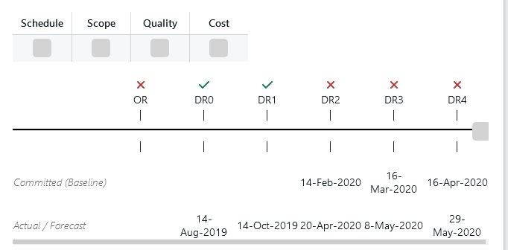
Project name: Project from Facade Project manager: IKSANOV Aleksandr Last Updated: 01-Jun-20
Alcatel-Lucent Enterprise - Confidential Solely for authorized persons having a need to know Proprietary - Use pursuant to Company Instruction
Page 8

Slide 9
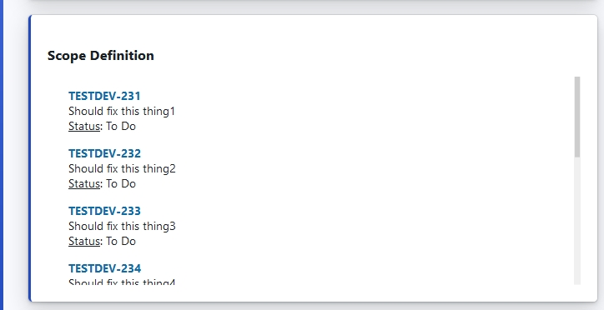
Project name: Project from Facade Project manager: IKSANOV Aleksandr Last Updated: 01-Jun-20
Alcatel-Lucent Enterprise - Confidential Solely for authorized persons having a need to know Proprietary - Use pursuant to Company Instruction
Page 9

Slide 10
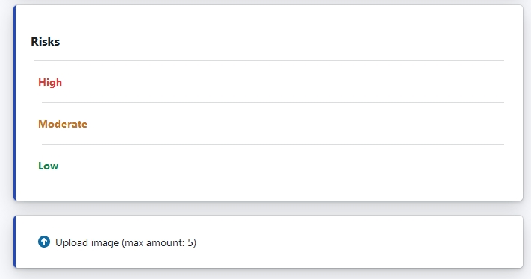
Project name: Project from Facade Project manager: IKSANOV Aleksandr Last Updated: 01-Jun-20
Alcatel-Lucent Enterprise - Confidential Solely for authorized persons having a need to know Proprietary - Use pursuant to Company Instruction
Page 10

Slide 11
Project name: Project from Facade Project manager: IKSANOV Aleksandr Last Updated: 01-Jun-20
Alcatel-Lucent Enterprise - Confidential Solely for authorized persons having a need to know Proprietary - Use pursuant to Company Instruction
Page 11

Slide 12
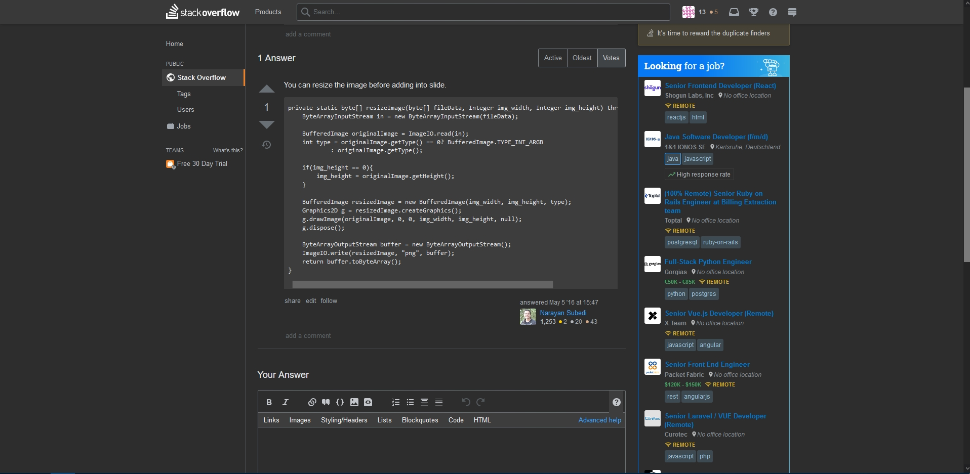
Project name: Project from Facade Project manager: IKSANOV Aleksandr Last Updated: 01-Jun-20
Alcatel-Lucent Enterprise - Confidential Solely for authorized persons having a need to know Proprietary - Use pursuant to Company Instruction
Page 12

