Slide 1

NUCLEAR WASTE: STORAGE AND DISPOSAL
Santa Rosa Junior College
Physics 4D, Spring 2006
Presented by : Philip Mutunga and Michael Serem
Date: May 11, 2006

Slide 2
SOURCES OF NUCLEAR WASTE
The increasing amount of excess military plutonium worldwide (as warheads are dismantled, plutonium is a left over).
The increasing amount of civilian plutonium from nuclear power plants.
The increasing amount of separated plutonium from the reprocessing of spent nuclear fuel.
Material left from nuclear research reactors.

Slide 3
CATEGORIES OF NUCLEAR WASTE
Very Low Level Waste (VLLW)
-Covers wastes with very low concentrations of radioactivity.
-Sources including hospitals and industry in general. Because
-VLLW contains little total radioactivity, it can be disposed of safely with domestic refuse either directly at landfill sites or indirectly after incineration.
Low Level Waste (LLW)
-Includes metals, soil, building rubble and organic materials which arise principally as lightly contaminated miscellaneous scrap.
- Organic materials are mainly in the form of paper towels, clothing and laboratory equipment that have been used in areas where radioactive materials are used - such as hospitals, research establishments and industry.

Slide 4
CATEGORIES OF NUCLEAR WASTE
Intermediate Level Waste (ILW)
-This is waste with radioactivity levels exceeding the upper boundaries for LLW but which does not need heating to be taken into account in the design of storage or disposal facilities.
-ILW arises mainly from the reprocessing of spent fuel, and from general operations and maintenance of radioactive plant.
-The major components of ILW are metals and organic materials, with smaller quantities of cement, graphite, glass and ceramics.
High Level Waste (HLW)
-High level Waste (HLW) is heat generating waste that has accumulated since the early 1950s primarily from the reprocessing of spent nuclear fuel.
-The temperature in HLW may rise significantly, so this factor has to be taken into account in designing storage or disposal facilities. As with ILW, there is currently no final management strategy for HLW.

Slide 5
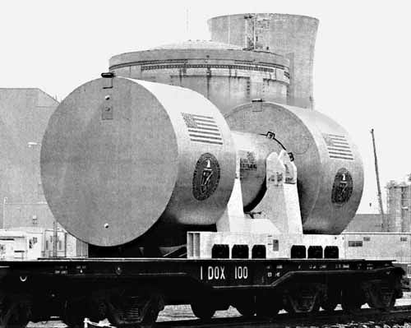
STORAGE METHODS.
Above Ground Storage.
ILW
Advantage –easy access to future generations. Disadvantages:
-radiological burden to future generations.
-space consumption.
A dry-cask storage apparatus.

Slide 6
STORAGE METHODS.
2.Disposal at Sea.
-Used in the past but no longer legal.
3.Sub-Seabed Disposal.
-Disposal in empty off shore oil and gas fields.
-Usually used for disposal of HLW

Slide 7
STORAGE METHODS.
4. Outer Space
-Too many rocket launches required-not economically feasible.
-Potential for catastrophic launch failure.
5. Ice sheets
For disposal of HLW.
Considered unacceptable because of lack of confidence in these wastes.

Slide 8
STORAGE METHODS.
6. Partitioning and Transmutation (P&T)
-Partitioning is the separation of long lived radio nuclides from waste into short lived nuclides.(by chemical means)
-Transmutation is the transformation of these nuclides into shorter lives or stable nuclides. (in a reactor or particle acc.)
Practical Difficulties:
-Requires re-handling of waste and thus further exposure to workers to radioactivity.
-Requires building of additional activities close to source of waste –added expense.
-Works only for certain short lived particles.
Technology still under-developed

Slide 9
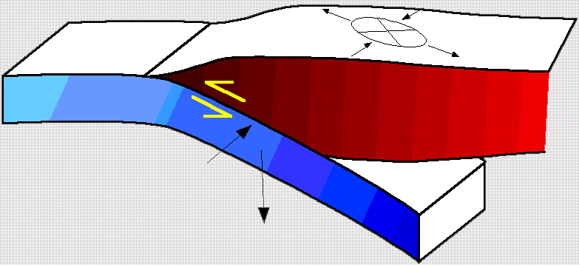
STORAGE METHODS.
7.Subduction Zones.
Most viable storage method proposed.
-Subduction zones are areas both above land and beneath ocean floors
Subduction refers to a process in which one tectonic plate slides beneath another at rate of about 6 cm annually, while being reabsorbed into the Earth's mantle.

Slide 10
STORAGE METHODS.
The idea is that the waste is removed from the biosphere faster than it can return.
As the plate is reabsorbed, the waste will be absorbed along with the plate where it will be dispersed through the mantle.
The plate moves slowly so that any fractures over a repository would be sealed at the contact point between the overriding plate and the subducting plate.

Slide 11
STORAGE METHODS.
Once the waste is carried into the interior of the Earth, it would take many millions of years "for the waste to circulate through the Earth's mantle.
It could re-emerge in a diluted, chemically and physically altered form at an oceanic ridge.

Slide 12
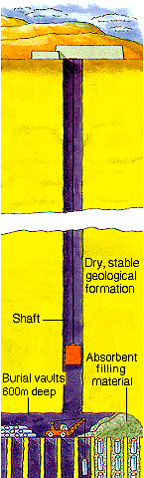
STORAGE METHODS.
8. Underground Storage.
Nuclear material buried in dried stable geological formation (eg salt mines)
1500 feet below ground level.

Slide 13
STORAGE METHODS.
Layers Of Protection.
The principal barriers are:
Locate deep underground in a stable rock structure.
Immobilise waste in an insoluble matrix, eg borosilicate glass, Synroc (or leave them as uranium oxide fuel pellets - a ceramic)
Seal inside a corrosion-resistant container, eg stainless steel
In wet rock: surround containers with bentonite clay to inhibit groundwater movement

Slide 14
STORAGE METHODS.
After being buried for about 1,000 years most of the radioactivity will have decayed. The amount of radioactivity then remaining would be similar to that of the naturally-occurring uranium ore from which the fuel originated, though it would be more concentrated.
Site the repository in a remote location. (eg of proposed site in the US- Yucca mountain in Nevada)

Slide 15
STORAGE METHODS.
Disadvantages of Underground Storage:
high-level waste from nuclear reactors may may contain reactor-grade plutonium ( a mixture of ²³⁹Pu and ²⁴⁰Pu)
- ²⁴⁰Pu : an undesirable contaminant and highly radioactive
- ²³⁹Pu: highly suitable for building weapons.
²⁴⁰Pu decays faster than the ²³⁹Pu, and thus the quality of the bomb material increases with time [although its quantity decreases].(Half life: ²⁴⁰Pu is 6,560 years and ²³⁹Pu is 24,110)

Slide 16
STORAGE METHODS.
Disadvantages of Underground Storage:
These deep storage areas have the potential to become "plutonium mines", from which material for nuclear weapons can be acquired with relatively little difficulty.
Critics of the latter idea point out that the relative enrichment of one isotope to the other with time occurs with a half-life of 9,000 years.
That is, it takes 9000 years for the quantity of ²⁴⁰Pu in a sample of plutonium to spontaneously decrease by half.

Slide 17
STORAGE METHODS.
This implies that "weapons grade plutonium mines" would be a problem for the very far future, and there yet remains a great deal of time for technology to advance to solve the problem, before it becomes acute.
One solution to this problem is to recycle the plutonium and use it as a fuel e.g. in fast reactors. In pyrometallurgical fast reactors, the waste generated is an actinide compound that cannot be used for nuclear weapons.

Slide 18
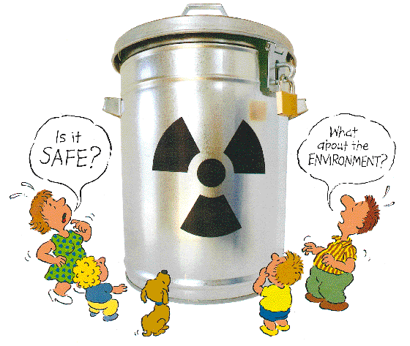
The End.

Slide 19
STORAGE METHODS
WORKS CITED
http://en.wikipedia.org/wiki/Radioactive_waste)
http://en.wikipedia.org/wiki/integral_Fast _Reactor
http://www.dti.gov.uk/nuclearcleanup/tl/tlnwr.htm#sources
http://www.etsu.edu/writing/3120f99/zctb3/nuclear2.htm
http://www.epa.gov/radiation/docs/radwaste/index. Htm
http://www.uic.com.au/wast.htm

