Slide 1
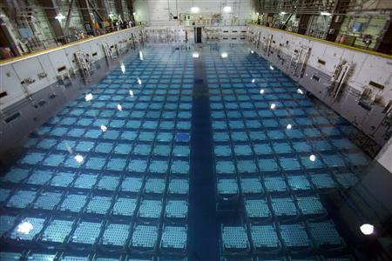
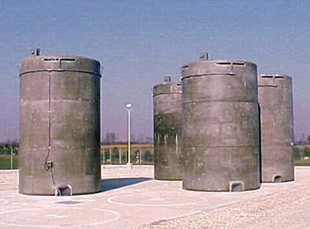
Spent Power Reactor Fuel: Pre-Disposal Issues
Robert Alvarez
Institute for Policy Studies
March 6, 2017

Slide 2
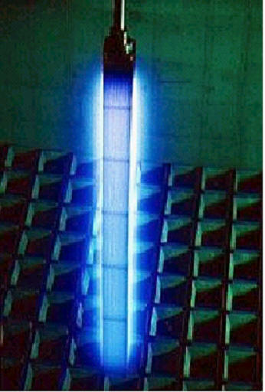
Spent nuclear power fuel is bound up in more than 244,000 long rectangular assemblies containing tens of millions of fuel rods. The rods, in turn, contain trillions of small, irradiated uranium pellets.
After bombardment with neutrons in the reactor core, about 5 to 6 percent of the pellets are converted to a myriad of radioactive elements, with half-lives ranging from seconds to millions of years. Standing within a meter of a typical spent nuclear fuel assembly guarantees a lethal radiation dose in minutes.
Heat from the radioactive decay in spent nuclear fuel is also a principal safety concern. A few hours after a full reactor core is offloaded, it can initially give off enough heat from radioactive decay to match the energy capacity of a steel mill furnace. This is hot enough to melt and ignite the fuel’s reactive zirconium cladding and destabilize a geological disposal site it is placed in.
By 100 years, decay heat and radioactivity drop substantially but still remain dangerous. For these reasons, the US Government Accountability Office informed Congress that spent nuclear fuel is “considered one of the most hazardous substances on Earth.”

Slide 3
US nuclear power plants are major radioactive waste
sites storing concentrations of radioactivity that dwarf
those generated by the country's nuclear weapons program.
There are 244,005
spent nuclear fuel
assemblies generated
as of 2013 .
They contain approximately:
(1) 23 billion curies (8.51E+20 Bq)
of long-lived radioactivity (>30 times more than generated by the U.S. nuclear weapons program).
(2) About 9.2 billion curies (3.4E+20Bq)
of cesium-137(350 times more than
released by all atmospheric nuclear
weapons tests); and
(3) About 700 metric tons of plutonium
(about 3 times more than used for weapons
throughout the world).
70,406
Assemblies
(29%)
Sources: DOE GC 859 data (2013), NWTRB (2016)

Slide 4
comparison of cesium-137 inventories
curies

Slide 5
High Burnup Spent Nuclear Fuel Problems
US commercial nuclear power plants use uranium fuel that has had the percentage of its key fissionable isotope—uranium 235—increased, or enriched, from what is found in most natural uranium ore deposits. In the early decades of commercial operation, the level of enrichment allowed US nuclear power plants to operate for approximately 12 months between refueling. In recent years, however, US utilities have begun using what is called high-burnup fuel. This fuel generally contains a higher percentage of uranium 235, allowing reactor operators to effectively double the amount of time the fuel can be used, reducing the frequency of costly refueling outages.
Research shows that under high-burnup conditions, cladding that of the fuel rods may not be relied upon as a key barrier to prevent the escape of radioactivity, especially during prolonged storage in the "dry casks" that are the preferred method of temporary storage for spent fuel.
High-burnup waste reduces the fuel cladding thickness and a hydrogen-based rust forms on the zirconium metal used for the cladding, which can cause the cladding to become brittle and fail. In addition, under high-burnup conditions, increased pressure between the uranium fuel pellets in a fuel assembly and the inner wall of the cladding that encloses them causes the cladding to thin and elongate. And the same research has shown that high burnup fuel temperatures make the used fuel more vulnerable to damage from handling and transport; cladding can fail when used fuel assemblies are removed from cooling pools, when they are vacuum dried, and when they are placed in storage canisters.

Slide 6
High Burnup Spent Nuclear Fuel Problems (cont)
High burnup spent nuclear fuel is proving to be an impediment to the safe storage and disposal of spent nuclear fuel. For more than a decade, evidence of the negative impacts on fuel cladding and pellets from high burnup has increased, while resolution of these problems remains elusive. For instance:
The NRC admits, “there is limited data to show that the cladding of spent fuel with burnups greater than 45,000 MWd/MTU will remain undamaged during the licensing period.” There is little to no data to support dry storage and transport for spent fuel with burnups greater than 35 gigawatt days per metric ton of uranium.
“The technical basis for the spent fuel currently being discharged (high utilization, burnup fuels) is not well established,”
“Insufficient information is available yet on high- burnup fuels to allow reliable predictions of degradation processes during extended dry storage.”
“What can go wrong? For example, what degradation of [high burn-up fuel] cladding might occur, leading to an unsafe condition ( e.g. high burn-up fuel] cladding rupture and release of radioactive material)?”
“Experimental data over the last twenty years suggest that fuel utilizations as low as 30,000 MWd/t can present performance issues including cladding embrittlement under accident conditions as well as normal operations.”

Slide 7
SNF Assemblies
Spent Nuclear Fuel Assembly Burnups (2013)
Source DOE GC 859 data (2013)

Slide 8
NRC allows a few high burnup assemblies, with higher decay heat to be mixed with lower burnup assemblies in a storage canister.
NRC’s current regulatory guidance concedes that “data is not currently available” supporting the safe transportation of high burnup spent nuclear fuel.
Owners of the shuttered Maine Yankee and Zion reactors are not taking a chance and have packaged high burnup spent fuel as it were damaged goods, stored in double-shell containers instead of single-shell, to allow for safer transport.
8 percent of
spent nuclear fuel
in dry casks has burnups
>45 GWd/MTU.

Slide 9
Spent Fuel Pool Storage (2013)
92 percent of SNF with
>45GWd/MTU is stored
in pools.
Source DOE GC 859 data (2013)

Slide 10
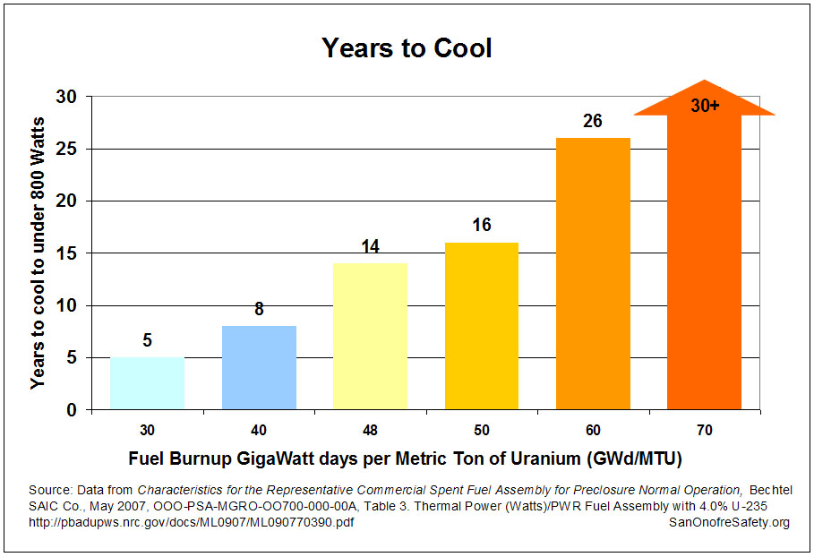
Also, the cooling pools at US commercial reactors are rapidly filling, with more than 70 percent of the nation's 77,000 metric tons of spent fuel in reactor pools, of which roughly a fourth is high burnup.
So far, a small percentage of high-burnup used fuel assemblies are sprinkled amid lower burnup fuel in dry casks at reactor sites.
But by 2048—the Energy Department's date for opening a permanent geologic disposal site—the amount of spent fuel could double, with high burnup waste accounting for as much as 60 percent of the inventory.

Slide 11
Estimated radioactivity in a
U.S. spent nuclear fuel assembly
Curies
* 41,200 MWd/MTHM
**50,000 MWd/MTHM
***72,000 MWd/MTHM
Sources DOE EIS-0250, Appendix A, http://energy.gov/sites/prod/files/EIS-0250-FEIS-01-2002_0.pdf
SAND2004-2757 (2004)

Slide 12
Interim Spent Nuclear Fuel Consolidated Storage
The DOE’ s proposed schedule for establishing a pilot interim storage site has slipped. By the time a centralized interim storage site may be available, there could be a “wave” of reactor shutdowns that could clog transport and impact the schedule for a centralized storage operation. Among the uncertainties identified by DOE include:
Transportation infrastructures at or near reactor sites are variable and changing;
Each spent nuclear fuel canister system has unique challenges. For instance, the CGS has some dry casks that are licensed for storage only and not for transport.
There are at least 10 different alternatives for a future storage facility that has yet to be selected.
The requirements for a geological repository are unknown. Constraint on decay heat from spent nuclear fuel can impact the timing of shipping.
The pickup and transportation order of spent fuel has yet to be determined. It has been assumed that the oldest would have priority, leaving sites with fresher and thermally hotter fuel that may be “trapped” at sites for to cool down.
Packaging of transport containers could have a major impact. As many as 11, 800 disposal canisters may have to be reopened.
.

Slide 13
Under the Nuclear Waste Policy Act, which sets forth the process for disposal of high-level radioactive wastes, the U.S. Government cannot accept title to spent nuclear fuel until it is received at an open repository site.
Legislative efforts are underway to have the DOE assume title of spent Nuclear Fuel for a “pilot” storage site for “stranded” wastes.
The U.S. Government Accountability Office reported in 2014: “per DOE, under provisions of the standard contract, the agency does not consider spent nuclear fuel in canisters to be an acceptable form for waste it will receive. This may require utilities to remove the spent nuclear fuel already packaged in dry storage canisters”

Slide 14
Total=45,569 assemblies/13,717 MT

Slide 15
Diablo Canyon 1&2
Sources: (a) ]EnergySolutions - TO11 - Final Report_1.pdf – Curie,
Tables ES-4 & 6-32; and (b) DOE GC 859 SNF Data (2013)

Slide 16
Spent nuclear fuel at stranded and future stranded reactors
Source DOE GC 859 data (2013)

Slide 17
Spent Nuclear Fuel Repackaging
The current generation of dry casks was intended for short-term on site storage, and not for direct disposal in a geological repository. NRC has licensed 51 different designs for dry cask storage, 13 which are for storage only. None of the dry casks storing spent nuclear fuel are licensed for disposal.
By the time, DOE expects to open a repository in 2048, the number of large dry casks currently deployed is expected to increase from 1,900 to 12,000. Repackaging for disposal may require approximately 80,000
“small” canisters.
Existing large canisters can place a major burden on a geological repository –such as: handling, emplacement and post closure of cumbersome packages with higher heat loads, radioactivity and fissile materials.
Repackaging expenses rely of the transportability of the canisters, but more importantly on the compatibility of the canister with heat loading requirement for disposal. In terms of geologic disposal, decay heat, over thousands of years, can cause waste containers to corrode, negatively impact the geological stability of the disposal site and enhance the migration of the wastes. Peak temperatures in the repository of 100 degrees C (212F) can extend beyond 300 years after centuries of decay and active ventilation.”
Robert H. Jones Jr., Dry Storage Cask Inventory Assessment, U.S Department of Energy, Nuclear Fuel Storage and Transportation Planning Project, FCRD-NFST-2014-000602, Rev. 1, August 2015, P. 55. http://energy.gov/sites/prod/files/2016/10/f33/FCRD-NFST-2014-000602,%20Dry%20Cask%20Assessment,%20Rev%201.pdf
R. Wigeland, T.Taiwo, M. Todosow, W. Halsey, J. Gehin, Options Study – Phase II, Department of Energy, Idaho National Laboratory, INL/EXT-10-20439, September 2010.

Slide 18
Repackaging Costs
The costs of repackaging at centralized storage site are large. The estimates in this study are based on a small (9 assemblies), medium (32 assemblies) and large (44 assemblies) standardized transportation and disposal canister (STAD) for a boiling water reactor. When applied to the Columbia Generating Station, assuming it will operate until 2043, and could involve cutting open 120 dry casks and repacking approximately 8,160 spent fuel assemblies into casks suitable for disposal. The additional costs range from $ 272 million to $915 million. A decision on the type of geologic repository will determine the size of the repackaged canisters.
Based on the Energy Department’s strategic plan to open a repository by the year 2048,
the per assembly cost would be approximately $33,400 (large STAD) to ($112,000 (small STAD) in 2015 dollars. The estimated cost of managing low-level radioactive waste from removing spent fuel to new canisters is estimated by the DOE at $9,500 per assembly and could be more than the cost to load the assembly in any canister.
U.S. Department of Energy, Office of Nuclear Energy, Task Order 21: Operational Requirements for Standardized Dry Fuel Canister Systems Updated Final Report, June 19, 2015. http://energy.gov/sites/prod/files/2016/10/f33/energysolutions-task-order-21-updated-final-report-61915_1.pdf

Slide 19
Estimated costs for repackaging spent nuclear fuel generated
by the Columbia Generating Station for disposal
16 large STADS (44 assemblies) | Canister | $127,361,640.00
 | Overpack | $64,618,818.00
 | transfer cask $726,560.00
 | Subtotal -Cask system | $192,776,215.00
 | total -loading cost | $2,295,470
 | Low-level waste | $77,520,000.00
 | Grand Total | $272,591,685.00
255 Medium STADS (32 assemblies) | Canister | $126,988,215.00
 | Overpack | $80,886,765.000
 | transfer cask | $725,560.00
 | Subtotal Cask System | $208,601,540.00
 | Loading Cost | $2,765,272
 | Low-level waste | $77,520,000.00
 | Grand Total | $288, 886,812.00
907 small STADS 9 assemblies | Canister | $508,139,494.00
 | Overpack | $326,520,000.00
 | Subtotal - cask system Loading Cost | $834,659,494.00 $3,083,969.00
 | Low-level waste | $ 77,520,000.00
 | Grand Total | $915,263,918.00
Sources: DOE: Task Order 21: Operational Requirements for Standardized Dry Fuel Canister Systems, (2015) Tables 7.5 and 7-6.,& DOE-NWTRB, June 2015, DOE GC 859, Energy Northwest (personal communication)

Slide 20
Conclusion
The basic approach undertaken in this country for the storage and disposal of spent nuclear fuel needs to be fundamentally revamped.
Instead of waiting for problems to arise, the NRC and the Energy Department need to develop a transparent and comprehensive road map identifying the key elements of—and especially the unknowns associated with—interim storage, transportation, repackaging, and final disposal of all nuclear fuel, including the high-burnup variety.
Otherwise, the United States will remain dependent on leaps of faith in regard to nuclear waste storage—leaps that are setting the stage for large, unfunded radioactive waste “balloon mortgage” payments in the future.

