Slide 1
NUCLEAR ENERGY
Morgan Windram
Duane Castaldi
Matt Pickett
Lauren Ziatyk

Slide 2
The Dawn of Time
The word atomos meaning invisible comes from Ancient Greek philosophers who first developed the idea that all matter is composed of invisible particles—atoms.
Physicists knew by 1900 that atoms contained much energy.
Wilhelm Rontgen discovered ionizing radiation in 1895; he passed an electric current through an evacuated glass tube to produce continuous X-rays.
1896 Henri Becquerel found that pitchblende caused a photographic plate to darken, due to emission of beta radiation (electrons) and alpha particles (helium nuclei).
Villard found a third type of radiation from pitchblende: gamma rays, similar to X-rays.
1896 Pierre and Marie Curie named this phenomenon 'radioactivity,’ and in 1898 isolated polonium and radium from the pitchblende.
British physicist Ernest Rutherford(1902 Ernest Rutherford emitted an alpha or beta particle from the nucleus creating a different element. In 1919 he fired alpha particles from a radium source into nitrogen to find that nuclear rearrangement was occurring as oxygen formed).--Father of nuclear science because of his contributions to the theory of atomic structure. In 1904 he wrote:
“If it were ever possible to control at will the rate of
disintegration of the radio elements, an enormous amount of
energy could be obtained from a small amount of matter.”

Slide 3
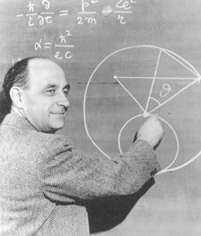
Modern Historical Notes
Albert Einstein developed his theory of the relationship between mass and energy in 1905. E=mc2, or "energy equals mass times the speed of light squared.“
1942 Enrico Fermi used uranium to produce first controlled chain reaction

Slide 4
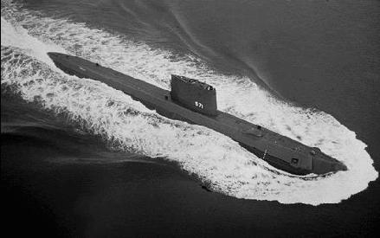

More History
December 1942-world's first nuclear reactor tested on the floor of an abandoned handball court beneath the University of Chicago.
July 1945-Enriched Uranium used in first nuclear explosion in Alamagordo, New Mexico.
August 1945-Truman signs Atomic Energy Act. Atomic Energy Commission is est.
December 1952-Eisenhower, ‘Atoms for Peace.’
January 1954-First Nuclear powered sub; USS Nautilus.
December 1957-First Nuclear power plant begins operation; Shippingport Pa.

Slide 5
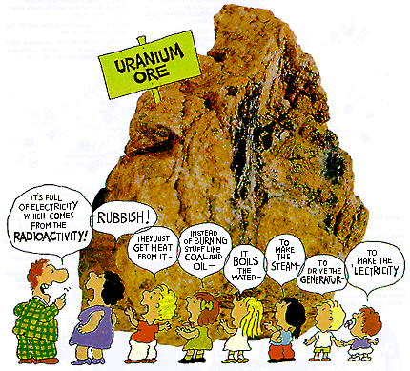
How Does it Work?

Slide 6
Basics of Uranium
It occurs in most rocks in concentrations of 2 to 4 parts per million
common in the earth's crust as tin, tungsten and molybdenum. It occurs in seawater.
High density
discovered in 1789 by Martin Klaproth, a German chemist, in the mineral called pitchblende.

Slide 7
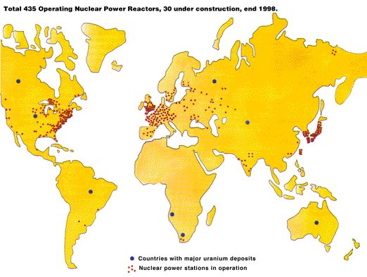
Uranium Deposits

Slide 8

Understanding Uranium Atoms
Heaviest of all naturally occurring elements
16 isotopes
Natural Uranium as U-235 and U-238
U-235 fissile; 92 protons and 143 neutrons (92 + 143 = 235).
Nucleus of a U-235 atom captures a neutron splitting it in two (fissions) and releases some energy in the form of heat (two or three additional neutrons are thrown off).
If enough of these expelled neutrons cause the nuclei of other U-235 resulting in a chain reaction. When this happens many millions of times, a very large amount of heat is produced.

Slide 9
So what Does U-238 Do?
U-235 is 'fissile', U-238 is said to be 'fertile'.
Is bombarded by neutrons and by a (nonfission reaction) is turned into Plutonium-239, (which is fissile).
Pu-239 fissions like U-235 and also yielding a lot of energy.

Slide 10
How do we recover it?
Mined
-OPEN CUT
Miners exposed to the orebody. Excess radon release and radiation because the ore is not in solution; much dust.
  Expensive to operate because large amounts of rock have to be broken up and removed. There are also longer lead times to production, (slower to produce an end product). Solid Waste products result. Expensive to build because of necessity of shafts, tunnels, crushers (other infrastructure). Large ground disturbance. Rehabilitation required because of ground disturbance. Not as easy to return to natural state.
-IN SITU
Using the in situ leach mining process uranium extracted by injecting a solution of water (containing dissolved oxygen and sodium bicarbonate) into a uranium-bearing rock formation. The solution strips/dissolves, the uranium from the parent rock. The resulting uranium-laden solution is pumped to the surface for separation and refining of the uranium into ‘yellowcake’ - raw material used to make power plant fuel.
End product = U₃O₈

Slide 11
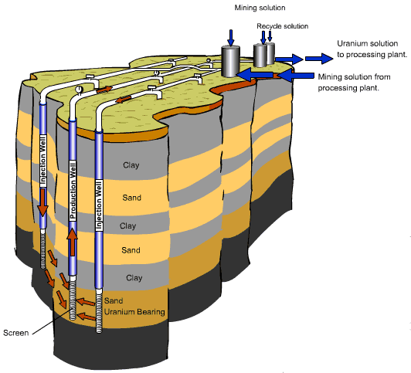
In Situ

Slide 12
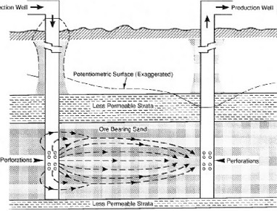
In Situ

Slide 13
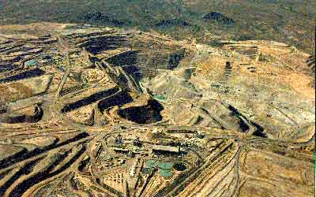
Open Pit
http://www.mineraldiscovery.com/pages/open_pit_viewpoint.htm

Slide 14
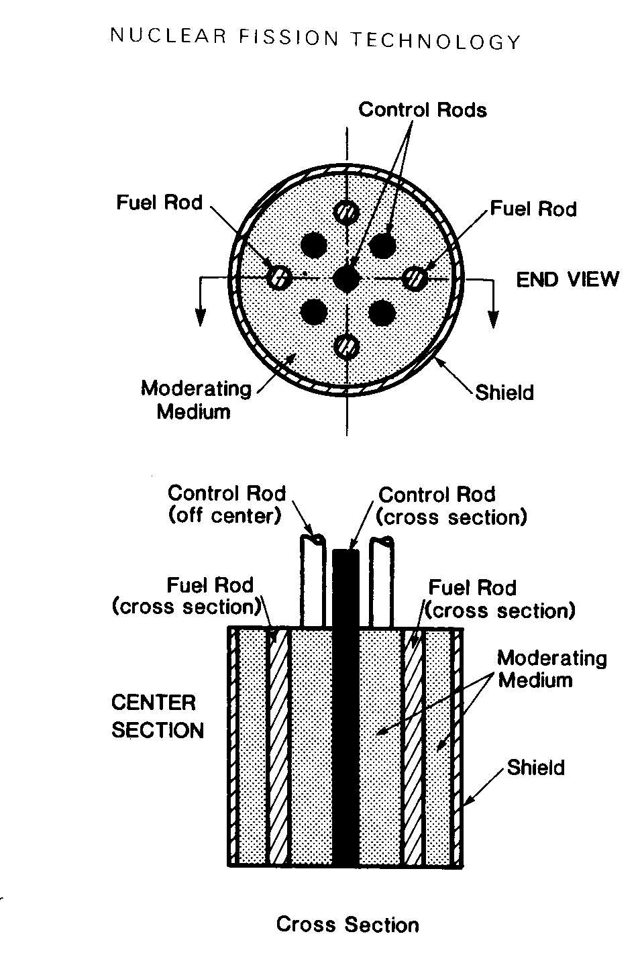
Convert it to energy?
Convert uranium oxide into a gas, uranium hexafluoride (UF6), which enables it to be enriched. Enrichment increases the proportion of the uranium-235 isotope from its natural level of 0.7% to 3 - 4%.
After enrichment, the UF6 gas is converted to uranium dioxide (UO2) which is formed into fuel pellets. These fuel pellets are placed inside thin metal tubes which are assembled in bundles to become the fuel elements for the core of the reactor.

Slide 15
Next Step: Making a Useable Fuel
Convert the uranium oxide into a gas, uranium hexafluoride
Enrichment increases the proportion of the uranium-235 isotope from its natural level of 0.7% to 3 - 4%, resulting in greater technical efficiency in reactor design/operation, also allows the use of ordinary water as a moderator.
After enrichment, the UF6 gas is converted to uranium dioxide (UO2) which is formed into fuel pellets. These fuel pellets are placed inside thin metal tubes which are assembled in bundles to become the fuel elements for the core of the reactor.
For reactors which use natural uranium as their fuel (and hence which require graphite or heavy water as a moderator) the U3O8 concentrate simply needs to be refined and converted directly to uranium dioxide.
Spent reactor fuel is removed, stored, and then either reprocessed or disposed of underground

Slide 16
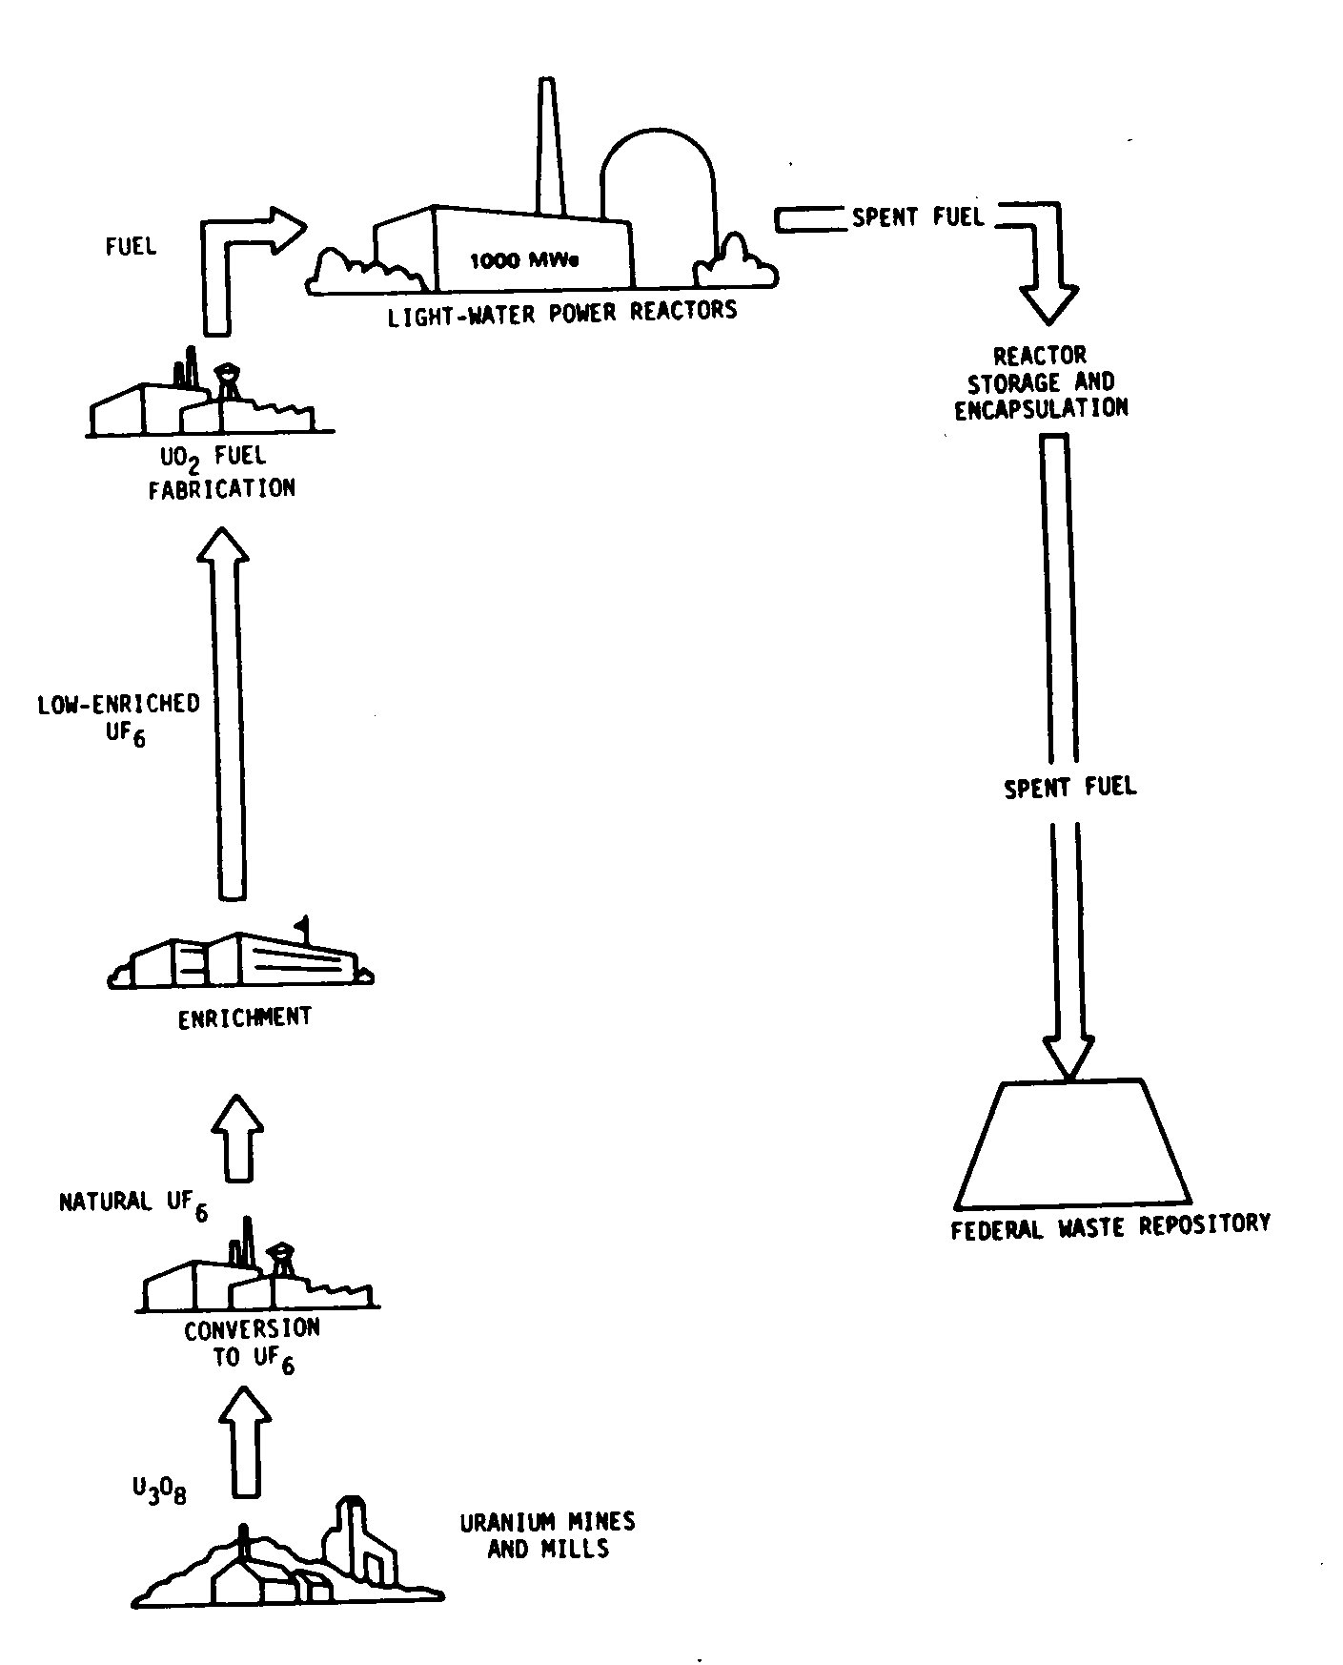
From Start to Finish

Slide 17

Neutron Bomb

Slide 18
Sources:
http://www.world-nuclear.org/education/uran.htm
http://nova.nuc.umr.edu/nuclear_facts/history/history.htm
http://www.aboutnuclear.org
http://www.altenergy.org/2/nonrenewables/nuclear/nuclear.html
http://www.sric.org/uranium/CUPstat.html
http://www.ne.doe.gov/uranium/history.html

Slide 19
“Using nuclear power to boil water is like using a chainsaw to cut butter.”—Alternative Energy Institute
December 2, 1942, the world's first nuclear reactor was tested on the floor of an abandoned handball court beneath the University of Chicago. At 3:25 that afternoon, the fission chain reaction inside what was known as Chicago Pile-1 became self-sustaining and the possibility of powering cities from the energy locked safely inside the atom became a reality (1). Thus opened the optimistic age when electric companies, in their eagerness to promote this new resource, assured the public that power would be so cheap to produce that there would be no need to even meter it. This optimism and excitement was soon tarnished, however, as the hazards, environmental costs, and the dangers of what was released along with energy from inside the uranium atom became apparent.

Slide 20
Environmental Benefits of Nuclear Energy
The information from supporters of nuclear energy.

Slide 21
Environmental Benefits
Little or no harmful emissions
Requires less fuel to produce same amount of energy
Less land area to produce same amount of energy
Waste isolation
Zero risk of large scale oil spills
Protection of Salmon Habitat

Slide 22
Environmental effects of fossil fuels compared to nuclear
Fossil fuels
  Global climate change
  Air quality degradation (coal, oil)
  Lake acidification and forest damage (coal, oil)
  Toxic waste contamination (coal ash and slag, abatement residues)
  Groundwater contamination
  Marine and coastal pollution (oil)
  Land disturbance
  Large fuel and transport requirements
  Resource depletion
Hydroelectric
  Population displacement
  Land loss and change in use
  Ecosystem changes and health effects
  Loss of biodiversity
  Dam failure
  Decommissioning
Renewables
(solar, wind, geothermal, biomass)
  Air quality degradation (geothermal, biomass)
  Extensive land use
  Ecosystem changes
  Fabrication impact (solar photovoltaic cells)
  Noise pollution (wind)
Nuclear (full energy chain)
  Severe reactor accident release
  Waste repository release

Slide 23
Produces little or no harmful emissions
Air-gaseous releases
Water-liquid releases
Solid Releases
Annual emissions avoided--in 2001 US nuclear power plants prevented 4.18 millions t sulfur dioxide, 2.03 million t nitrogen oxide, 177 million t carbon
Other facts and figures

Slide 24


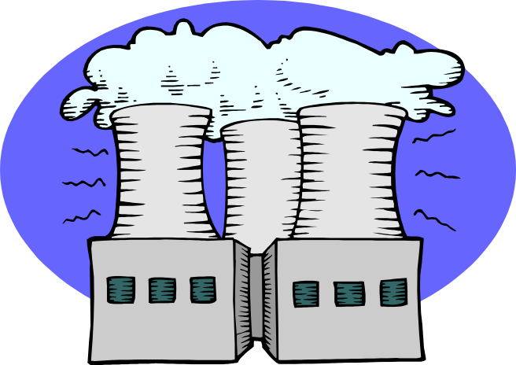
Fuel for Energy
Quantity of Electricity per 1 kg fuel:
1 kg firewood: 1 kW·h
1 kg coal: 3 kW·h
1 kg oil: 4 kW·h
1 kg uranium: 50 000 kW·h
(3 500 000 kW·h with reprocessing)
Tonnes of fuel required for 1000MW plant:
2 600 000 t coal: 2000 train cars
(1300 t each)
2 000 000 t oil: 10 supertankers
30 t uranium: reactor core
(10 cubic metres)

Slide 25
Less land area disturbed
Compared to other renewable resources, nuclear energy uses the least land area.
Land area required for 1000MW electricity production:
Fossil and nuclear sites: 1–4 km²
  Solar thermal or photovoltaic (PV) parks: 20–50 km²
  (a small city)
Wind fields: 50–150 km²
Biomass plantations: 4000–6000 km²(a
province)

Slide 26
The “Problem” of Nuclear Waste
The entire nuclear power industry generates approximately 2,000 tons of solid waste annually in the United States. All technical and safety issues have been resolved in creation of a high-level waste repository in the United States; politics are the only reason we do not have one. In comparison, coal fired power produces 100,000,000 tons of ash and sludge annually, and this ash is laced with poisons such as mercury and nitric oxide. Industry generates 36,000,000 tons of hazardous waste
Some solutions:
    Sub-seabed Solution
    Yucca Mountain Repository
    WIPP, Waste Isolation Pilot Plant

Slide 27
Sub-Seabed Solution
Charles Hollister, a geologist and senior scientist at the Woods Hole Oceanographic Institution, found the area
Area 4 times the size of Texas, 600 miles north of Hawaii
Area has been tranquil for 65 million years, undisturbed by volcanic activity or by shifting of the earth's tectonic plates
Faces much opposition
Henry Kendall -- a Nobel laureate in physics, a professor at the Massachusetts Institute of Technology, and the chairman of the Union of Concerned Scientists -- calls sub-seabed disposal a "sweet solution" and a "winner," labeling it the best of the alternatives from a technical standpoint.
Research funds cut off by DOE in 1986

Slide 28

Yucca Mountain
The site is located in Nye County, Nevada, about 100 miles northwest of Las Vegas. It is federally owned land on the western edge of the Department of Energy’s Nevada Test Site. The repository would be approximately 1,000 feet below the top of the mountain and 1,000 feet above the ground water.
Sits above an aquifer that can be used for drinking water
Spent nuclear fuel and high-level radioactive waste make up most of the material to be disposed at Yucca Mountain. About 90% of this waste is from commercial nuclear power plants; the remaining is from defense programs. This waste is currently stored at facilities in 43 states.
Could open by 2010 as long as all of the legislation is approved by everyone—Secretary of Energy, the President, then Congress, the NRC, the EPA, and DOE.
Source: http://www.epa.gov/radiation/yucca/about.htm

Slide 29
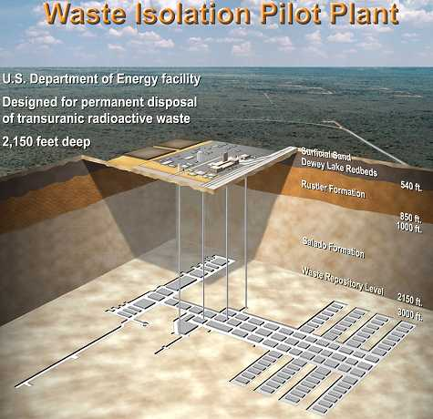
WIPP-Waste Isolation Pilot Plant
The world's first fully licensed deep geologic repository for nuclear waste, owned and operated by the US government.
Used as a research facility
Storage at 2,150 feet underground
Source: http://www.wipp.ws/index.htm

Slide 30


WIPP
The WIPP Site Holds Promise as an Ideal Source of Renewable Energy
Encompassing 16 square miles of open Chihuahuan desert with abundant sunshine and minimal surface roughness, the WIPP site can be used for either solar- or wind-generated electricity production, demonstration or testing.
Solar power production potential at WIPP is in the top 10% of the nation
Wind power production at or near WIPP is already a reality, with a generating capacity of over 60MW in the region.

Slide 31
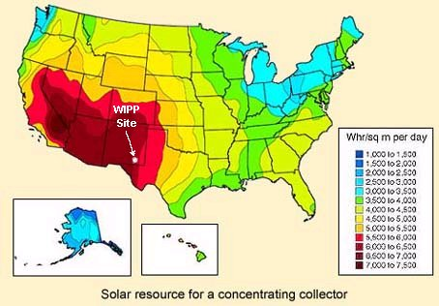
Solar Power at WIPP
As the accompanying map of New Mexico shows, the WIPP site enjoys abundant year-round sunshine. With an average solar power production potential of 6-7 kWh/sq meter per day, one exciting project being studied for location at WIPP is a 30-50 MW Solar Power Tower:

Slide 32
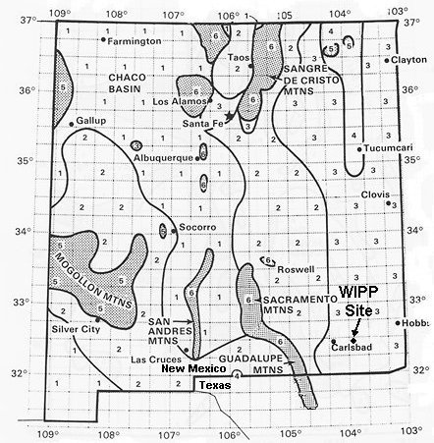
Wind Energy at WIPP
As the accompanying map of New Mexico shows, the best wind power generation potential near WIPP is along the Delaware Mountain ridge line of the southern Guadalupe Mountains, about 50-60 miles southwest. The numeric grid values indicate wind potential, with a range from 1 (poor) to 7 (superb). Just inside Texas in the southern Guadalupe Mountains, the Delaware Mountain Wind Power Facility in Culbertson County, Texas currently generates over 30 MW, and could be expanded to a 250 MW station.

Slide 33
Other environmental benefits
Zero Risk of Large Scale Oil Spills
  Also, lose our dependence on oil
  EXXON Valdez oil spill still not fully cleaned up
Protection of Salmon Habitats
  Salmon runs threatened and destroyed by hydroelectric dams

Slide 34
Sustainability
Even if Uranium mining were stopped today, the use of breeder reactors (which create more fuel than they use) would permit us to continue generating electricity at present levels for over a thousand years into the future. The Integral Fast Reactor, developed by Argonne National Laboratory, would have had this feature in addition to on-site fuel recycling, thus avoiding transport of spent fuel.
Breeder Reactor
    A nuclear reactor that is able to convert moret than one atom of fertile material into fissile material for every fission.
Fissile Material
  An isotope that will readily fission. The most important are Uranium-235, Plutonium-239, and Uranium-233.
Fertile Material
  An isotope that will readily become a fissile material by absorbing a neutron and undergoing a series of radioactive decays. The most important are Uranium-238 and Thorium-232.

Slide 35
View of Nuclear Power from the Opposition
Safety—Three Mile Island, Chernobyl
Terrorism—nuclear technology in the wrong hands
Hazardous Waste, storage, and transport
Expensive (maybe, the jury’s still out on that one)

Slide 36
Nuclear Power Economics
Matt Pickett

Slide 37
Economics Overview
Monetarily quantifiable costs
  Research/development
  Construction
  Maintenance
  Fuel
  Disposal
External costs
  Public safety
  Possible pollution
Each incurred and expected cost adds price to final product: the kWh
Method of economic efficiency comparison: price/kWh

Slide 38
Capital and Operations/Management Costs
Captial costs include plant construction and decommissioning costs
Actual costs depend on reactor type, age of plant, and region
Total 2001 average in U.S. (Fuel+O&M+Capital)
  3.73 cents/kWh for Nuclear
  3.27 cents/kWh for Coal
Capital Costs
  55% of cost for Nuclear
  45% for Coal
  16% for Gas
Data based on resource 1

Slide 39
Fuel Costs
Raw Ore – Includes mining/transportation
  $200 /kg fuel*
Conversion – Yellowcake to UF6
  $38 /kg fuel
Enrichment – Separation of isotopes
  $452 /kg fuel
Fuel fabrication – Enriched UF6 to reactor fuel rods
  $240 /kg fuel
Total cost per kg of fuel in 2000: $930
Total energy per kg: 3400 GJ
.3 cents/kWh
*Year 2000 statistics¹

Slide 40
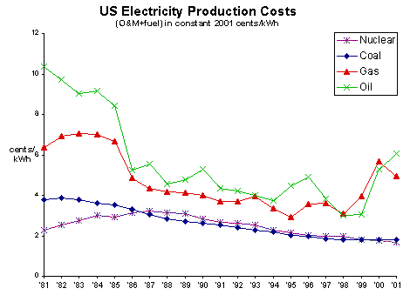
Fuel + Operations and Management Costs
From source 1

Slide 41
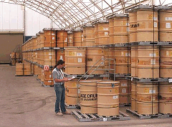
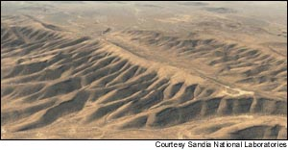
Disposal Costs
Currently stored onsite in U.S.
Yucca mountain estimated by DOE to cost $34.7 billion³

Slide 42
Investment economics
Old US propaganda led citizens to believe nuclear power would be economical:
“It is not too much to expect that our children will enjoy in their homes electrical energy too cheap to meter” – Lewis Strauss, 1954²
However, economics not originally driving force: cold war supremacy was
“the relations of the U.S. with every other country ... could be seriously damaged if Russia were to build an atomic power station for peacetime use ahead of us. The possibility that Russia might demonstrate her ‘peaceful’ intentions in the field of atomic energy while we are still concentrating on atomic weapons, could be a major blow to our position in the world.”
- Chairman of the Congressional JCAE, 1953²

Slide 43
External Costs
“The World Health Organization has estimated that worldwide the use of pesticides cause some 15 000 human lives and more than a million cases of poisoning each year! We must assume that these casualties are ignored and tolerated by the public because of the great economic importance of pesticides. We don't reason the same way about nuclear power although its casualties are few and it provides the world with about 17% of its electricity. It is true that radioactive contamination may have rather long-lasting effects. But the use of pesticides sometimes leads to mercury pollution which requires that lakes be black-listed for fishing.”
– Hans Blix, IAEA Director General, 21 May 1992⁴

Slide 44
External Costs
Plant Safety
Plant Security
Pollution
Typically accounted for by increase in capital costs
Nuclear industry required to account for externalities

Slide 45
References
http://www.uic.com.au/nip08.htm
Young, Warren. Atomic Energy Costing. Boston: Kluwer Academic Publishers, 1998
http://www.state.nv.us/nucwaste/yucca/loux05.htm
www.iaea.or.at/worldatom/Press/Statements/FormerDG/dgsp1992n12.htm

Slide 46
A Closer Look
At Nuclear Power in Pennsylvania

Slide 47
Electricity Production
36% of Pennsylvania’s electricity is provided by nuclear energy according to the Nuclear Energy Institute.
Nationally, 20% of the countries electricity is supplied by nuclear energy.

Slide 48
Energy Consumption in 1999
Petroleum 1,385.3 trillion BTU’s
Coal 1,142.7 trillion BTU’s
Nuclear 755.5 trillion BTU’s
Natural Gas 696.2 trillion BTU’s
Wood and Waste 94.5 trillion BTU’s
Hydroelectricity 15.6 trillion BTU’s
Other 1 trillion BTU’s
Source: June of 2002. Energy Policy for Pennsylvania. Report of the Task Force on 21st Century Energy Policy for Pennsylvania.

Slide 49
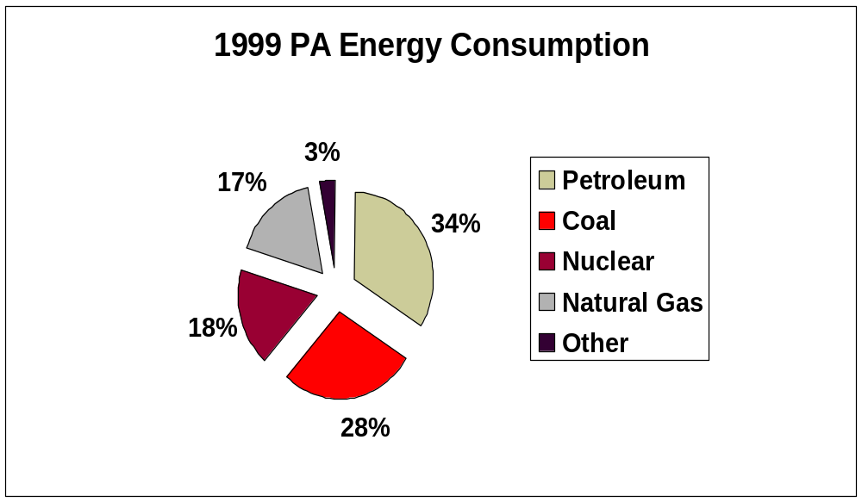
Energy Consumption in 1999

Slide 50
Clean Nuclear Power
Nuclear Power does not emit harmful emissions.
The Nuclear Energy Institute estimates that Pennsylvania’s nuclear power generation cut emissions by:
402,000 tons of SO₂
196,000 tons of NO_{x}
17,000,000 tons of C

Slide 51
Nuclear Units in Pennsylvania
Nine units statewide:
  Beaver Valley 1 and 2
  Limerick 1 and 2
  Peach Bottom 2 and 3
  Susquehanna 1 and 2
  Three Mile Island 1

Slide 52
Beaver Valley
Located in Shippingport, Pa.
Consists of 2 units.
Combined can produce 13 billion kilowatt hours of electricity.
A blackout in 1965 in the Northeastern United States was one of the reasons this plant was built…..a growing demand for electricity.

Slide 53
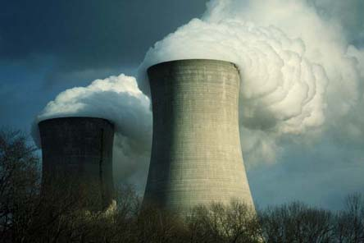
Limerick Generating Station
Located NW of Philadelphia in Montgomery County.
PECO owns and operates facility.
Generates enough electricity for over 1 million homes.
2 natural draft cooling
towers, each 507 feet
tall.

Slide 54
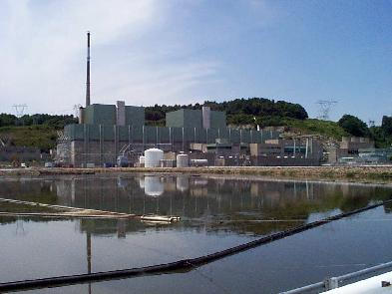
Peach Bottom Atomic Power Station
Located on the Susquehanna River in York County.
Originally 3 units, but unit 1 closed in 1974.
Units 2 and 3 are capable of generating 2,186 megawatts of power.
Owned by Exxelon Energy.

Slide 55
Susquehanna
Located in Berwick, Pa.
2,248 megawatt facility.
Owned and operated by PPL
Renovation underway that would increase output by 100 megawatts by replacing current turbines with more efficient turbines.

Slide 56
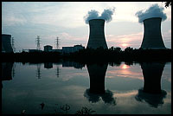
Three Mile Island
Located in Middletown, Pa.
Capable of generating 875 megawatts.
Plant began operations in 1974.
Accident occurred in 1979.

Slide 57
What Happened at Three Mile Island?
4 AM Wednesday March 28, 1979.
A pump that circulates water to a cooling system in Unit 2 failed.
Without cooling water, heat generated in the reactor rose above the boiling point and pressure inside the core climbed to 2,350psi.

Slide 58
What Happened at Three Mile Island?
Control rods were dropped into the core due to the increased temperature and pressure which stopped nuclear fission.
However, a valve failed and a reported 100,000 gallons of radioactive water spilled into the containment building.
Radioactive particles were then vented into the air.

Slide 59
The Fear that Followed
It is only 1979.
7AM- Pennsylvania Emergency Management Agency is notified.
PEMA puts Lancaster, York, Dauphin, Cumberland counties on alert.
At 8:10 the alert is cancelled.
Mass confusion set in as reports varied.

Slide 60
Thursday March 29, 1979
Officials between Met-Ed and the NRC began disagreeing over the course of action to take.
However, it seemed more likely that the reactor core had been damaged.
The surrounding counties prepared for possible mass evacuation orders to go into effect.

Slide 61
Friday March 30, 1979
A sudden and uncontrolled burst of radiation came from Three Mile Island.
The Governor urged people with a ten mile radius to remain indoors with windows closed but issued no widespread evacuation orders.
Schools began to close early.

Slide 62
Saturday March 31 and Sunday April 1 1979
Pregnant women and young children were encouraged to evacuate the area.
Approximately 200,000 people chose to evacuate.
The Governor announced late on Sunday school and state employees should report as usual Monday morning- that did not occur.

Slide 63
The Aftermath
The area remained deserted much of the following week.
Despite reports that things were back to normal at Three Mile Island.
People were unlikely to believe that things were safe after the conflicting reports in the first days of the accident.

Slide 64
Conclusions from Three Mile Island
All taken from Washington Post Articles
1989: Residents lose faith.
1989: Pennsylvania Health Secretary Gordon MacLeod found an increase in the number of thyroid problems.
1990: Independent Review finds no increase in cancer.
1997: Cancer rate increase blamed on radioactive release.
*All cases have been refuted back and forth as data can be molded to support different viewpoints.*

Slide 65
References
Energy Policy For Pennsylvania: Displacing Foreign Petroleum. Report of the Task Force on 21st Century Energy Policy for Pennsylvania. June 2002. Joint State Government Commission.
Three Mile Island: A Time Of Fear. Staley, John and Seip, Roger. RFJ Inc. Harrisburg, Pennsylvania.
Nuclear Energy Institute. “Nuclear Power in Pennsylvania.” 2000. Accessed April 1, 2002.
Washington Post. “A Look Back.” and “Nuclear Nightmare in Pennsylvania.” Accessed April 1, 2002.
Pittsburgh Business Journal. Online Article. Westinghouse provides fuel to Beaver Valley Plant. Accessed on April 1, 2002.
Nuclear Tourist. Com. “The Pennsylvania Plants.” Accessed on April 1, 2002.

