Slide 1
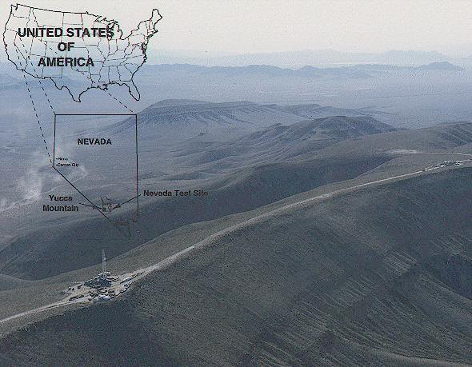
Yucca Mountain
High-level Nuclear
Waste Repository

Slide 2
The purpose of the Yucca Mountain Site Characterization Project is to determine if Yucca Mountain, Nevada, is a suitable site for a spent nuclear fuel and high-level radioactive waste repository. These materials are a result of nuclear power generation and national defense programs and will remain highly radioactive for thousands of years.

Slide 3
Disposal options
Shallow land burial, in variously engineered facilities.
Deep geological disposal.
Disposal on the sea bed in continental shelf waters.
Disposal beneath the sea bed in continental shelf waters.
Disposal beneath the sea bed of the deep ocean.
Disposal into space.
Storage at surface until decay to below exemption levels.

Slide 4
Advantages of deep geologic disposal
If properly chosen, host-rock should be able to absorb radiation and dissipate heat.
Accidental or malicious intrusion can be prevented by depth below the surface.
Migration of radionuclides can be minimized by construction of multiple barriers.
Underground repositories require minimal to no maintenance.
Flexibility of rock types available.
Construction of repositories is feasible from an engineering viewpoint.
Waste can be retrievable if necessary.

Slide 5
Risks to be evaluated
The presence and movement of gases, water or brine within the repository host rocks.
The response of the host rock to the input of heat from the waste.
The behavior of radionuclides in the host rock and their potential migration routes.
Degradation of the packaging of the radwaste and barriers designed to contain radionuclides.
Risk of disruption of the repository by geological events (earthquakes, volcanic eruptions, subsidence, sea-level rise, formation of continental ice sheets).

Slide 6
After more than 20 years and $4 billion in scientific study, the U.S. Congress approved Yucca Mountain, Nevada, as the nation’s first long-term geologic repository for spent nuclear fuel and high-level radioactive waste.
Experts throughout the world agree that the most feasible and safe method for disposing of highly radioactive materials is to store them deep underground. Based on this consensus, the United States Congress passed the Nuclear Waste Policy Act of 1982 that directs the Department of Energy to find a site and characterize it.
The project involves extensive scientific study on Yucca Mountain's geology, hydrology, biology, and climate. If found suitable, Yucca Mountain could be part of the nation's first long-term solution to a compelling environmental problem.

Slide 7
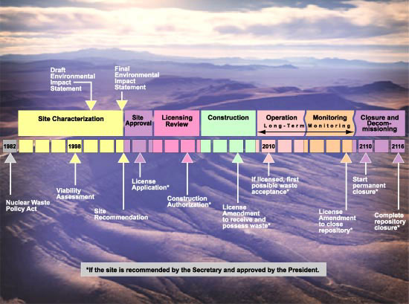

Slide 8
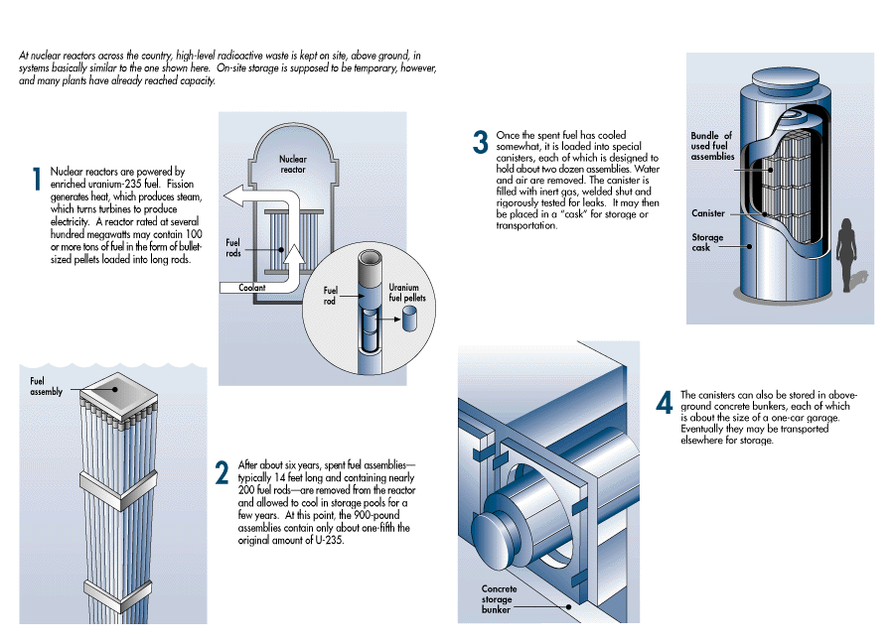

Slide 9
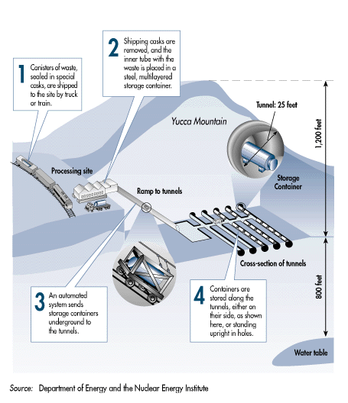

Slide 10
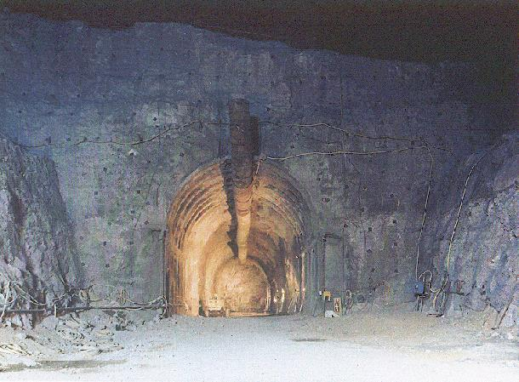
Night view of the starter tunnel

Slide 11
Nuclear reactors
Generate heat via a controlled chain reaction based on fission of ²³⁵U by thermal neutrons.
Fission-product radionuclides and transuranium elements (Pu, Np, Am, Cm - formed by neutron capture reactions with ²³⁵U and ²³⁸U) accumulate in the fuels rods.
Fuel rods become highly radioactive and do not decay back to level of U ore until after 10,000-100,000 years.
Wastes are radiotoxic and generate heat.

Slide 12
Effects of ionizing radiation
The amount of tissue damage due to exposure to ionizing radiation depends on:
The intensity and energy of the radiation.
The distance between source and object being irradiated.
Degree of shielding provided by matter between source and object.
The duration of the exposure.
The type of radiation.
The tissue being irradiated.

Slide 13
Types of nuclear waste
High-level nuclear waste (HLW) - Generates significant decay heat. Spent fuel or products from the immobilization of highly active liquid wastes arising from fuel reprocessing.
Spent unreprocessed fuel (SURF) - The uranium fuel remaining after use and not reprocessed to recover ²³⁵U.
Low-level nuclear waste (LLW) - Wide range of materials from fuel fabrication, reprocessing and reactor operation, and from outside nuclear power industry.

Slide 14
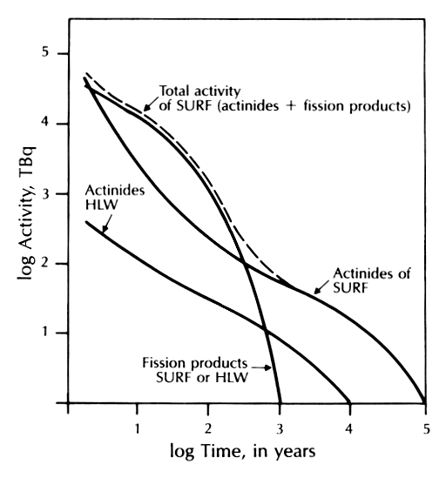
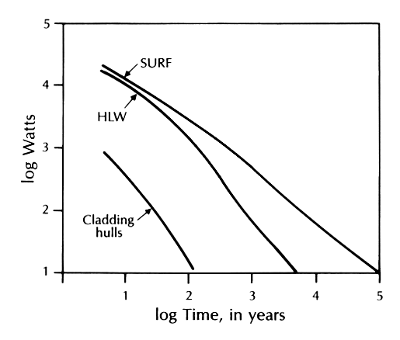
Decay rate of reprocessed high-level waste and spent unreprocessed fuel rods. The data pertain to a pressurized water reactor generating 33 GW day tonne⁻¹ after five years of cooling. From Faure (1998).
Heat output from SURF, HLW and cladding hulls as a function of time. The data pertain to a pressurized water reactor generating 33 GW day tonne⁻¹ after five years of cooling. From Faure (1998).

Slide 15
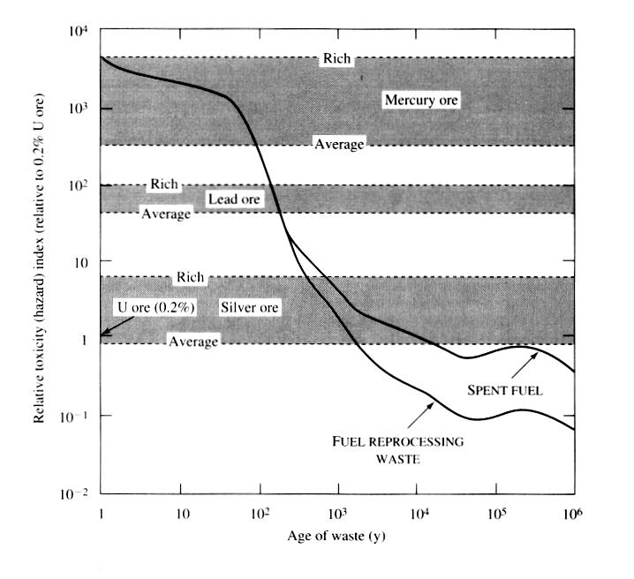
Relative toxicity hazard (relative to 0.2% uranium ore) of ingesting a given weight of HLW or spent fuel and the same weight of various metal ores. From Langmuir (1997).

Slide 16
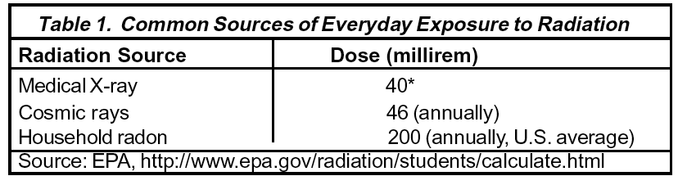
How do EPA’s final standards protect public health?
The final public health and environmental protection standards for Yucca Mountain address all potential sources of exposure: air, ground water, and soil. EPA designed the standards to protect people living closest to the repository to a level within the Agency's acceptable risk range for environmental pollutants
The standards limit an individual's annual radiation exposure from all pathways (ingestion, inhalation, physical contact, etc.) to no greater than 15 millirem (a measure of the actual biological effects of radiation absorbed in human tissue) per year--roughly the radiation dose from three chest x-rays per year. At this level, no more that 3 people in 10,000 have a lifetime risk of developing a fatal cancer.
Before the Yucca Mountain repository can open and accept waste, the Department of Energy must demonstrate to the Nuclear Regulatory Commission that it can meet the standards both under normal conditions and also in the unlikely event of "human intrusion" – if actions such as drilling for water or other resources breach the waste containers. In both situations, the public must not be exposed to more than 15 millirem of radiation per year.

Slide 17
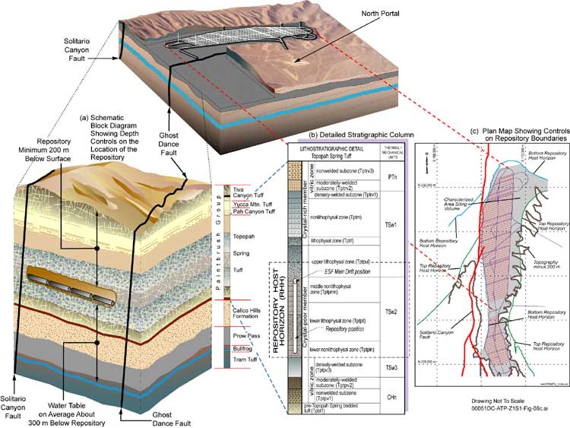
copyright: http://www.ymp.gov/documents/ser_b/figures/chap1/f01-11.htm

Slide 18
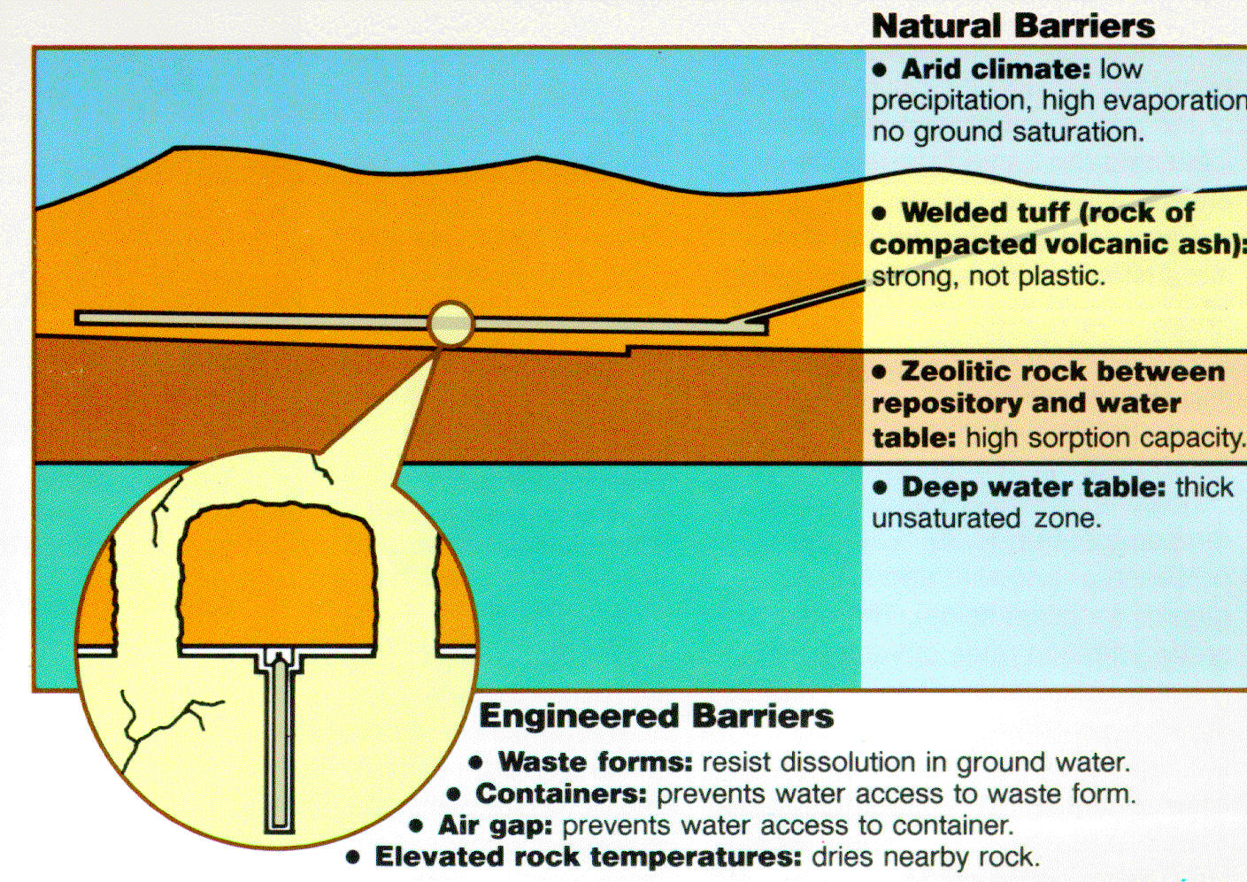

Slide 19
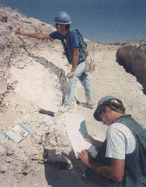
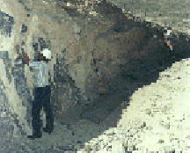
Earthquakes and Faults
Field investigations of faults,
monitoring of earthquakes, and tests
involving nuclear explosions at the NTS
suggest that underground structures
can withstand ground motion.
Trenches allow better exposure of
faults and help to understand the
history of movement.

Slide 20
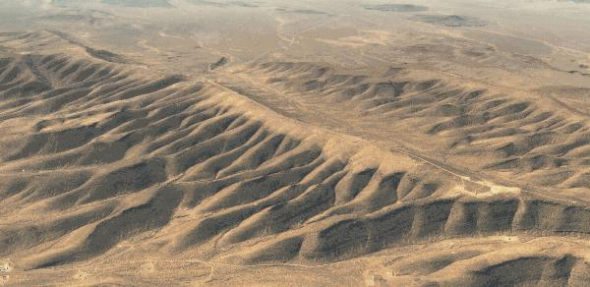
Desert Climate - Deep Water Table
This makes it possible to put a repository about 300 meters
(1,000 feet) underground and still have it be about 240
meters (800 feet) above the water table.

Slide 21
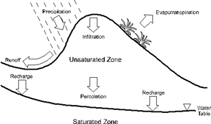
Low Rainfall at Yucca Mountain
Precipitation
Evapotranspiration
Infiltration
Runoff
Unsaturated
Zone
Recharge
Recharge
Percolation
Water
Table
Saturated
Zone
• ~16 cm (6”) rainfall per year
• small fraction available for infiltration
• concern about corrosion of waste containers
& transport of waste away from repository
• deep water table >2,000 ft.

Slide 22
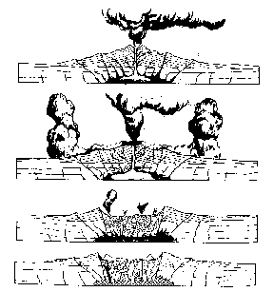
Volcanic Activity
Caldera Formation
The caldera complex,
the source of Yucca
Mountain's welded tuffs,
is about 20 miles across
and centered about 17
miles north of the
mountain.

Slide 23
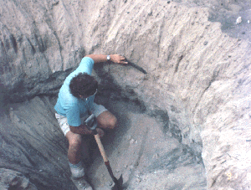
Volcanic History
“Volcano that formed Yucca Mountain
is long extinct, but scientists are
studying seven small and long
inactive volcanoes in the Yucca
Mountain area. They want to
determine if one might erupt in the
next 10,000 years and if an eruption
might affect an underground nuclear repository. By studying
layers of soil and rock to learn about past volcanic activities,
scientists have been able to make predictions about the future.
The probability of a future volcanic eruption directly intersecting
a repository at Yucca Mountain is estimated to be about one in
70,000,000 per year, as confirmed by an independent panel of
experts. This is in line with earlier estimates by Project scientists.”
source: OCRWM

Slide 24
How would the waste be transported to the repository?
DOE must meet Department of Transportation routing regulations and guidelines before shipping any radioactive waste to the Yucca Mountain repository.
The waste would be shipped in casks that are heavily shielded to contain the radioactive waste. The casks are certified by the NRC to withstand accidents, impact, puncture, and exposure to fire and water.
DOE’s current plan is to transport the waste to Nevada by truck and rail. Transportation routes would go through 43 states. Prior to transporting waste, the federal government would work with state, local, and tribal governments to develop emergency response plans.

Slide 25
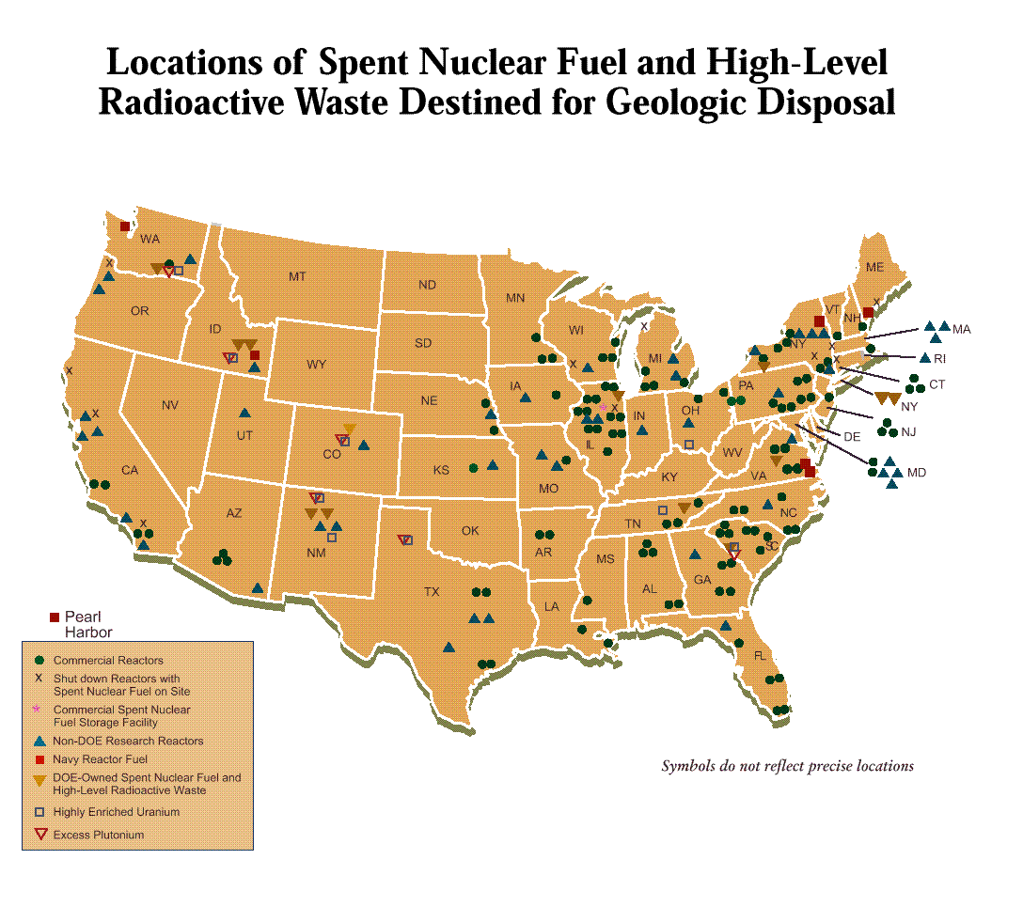

Slide 26
