Slide 1
International Cooperation in Nuclear Security
David Ek
Office of Nuclear Security

Slide 2
Objective of Presentation
Address questions…
  What is relationship between domestic and international security
  What is international community role in nuclear security
  How can international security be strengthened

Slide 3
Nuclear Security
Nuclear Security is a National Responsibility
…but is not a matter of indifference to the other States whether and to what extent the responsibility is fulfilled.

Slide 4
Nuclear Security Regime
National Nuclear Security Regime to meet responsibility is established by
  National Framework for Nuclear Security
    Legal structure
    Associated regulatory and other guidance
  Activities, systems, equipment, procedures, and personnel required to implement framework

Slide 5
Nuclear Security on Global Scale
How is nuclear security from a global perspective achieved?
  Global Nuclear Security is only the combination of national nuclear security systems

Slide 6

Global Nuclear Security
Like a Chain, Global Nuclear Security is composed of national
nuclear security systems (links).
The chain is only as strong as the weakest link.
A weak link may be targeted by adversaries.

Slide 7
International Instruments
To strengthen Global Nuclear Security, International community developed legal instruments
  CPPNM and Amendment
  Nuclear Terrorism and other Conventions
  UN SC Resolutions
  Safeguards agreements and Additional protocols
  Non-binding instruments

Slide 8
International Instruments
CPPNM
  Entered into force, 1987, 130 Parties
  Provides requirements for protection during international transport
  Establishes general framework for cooperation in protection, recovery and return of stolen material
  Lists offences which States should make punishable, and for which extradition should be accommodated

Slide 9
International Instruments
CPPNM Amendment
  Adopted in July, 2005 (not yet entered into force)
  Includes Fundamental Principles of PP
  Requires States to establish and maintain PP regime to protect nuclear material and facilities in domestic use, storage, and transport
  Expands cooperation to locate and recover stolen or trafficked nuclear material, mitigate or minimize radiological consequences of sabotage
  Expands list of punishable acts

Slide 10
International Instruments
Convention on the Suppression of Acts of Nuclear Terrorism
  Adopted in April 2005 by UN General Assembly
  Entered into force on 7 July 2007, 30 ratifications
  Details offences related to possession and use of radioactive materials and associated facilities
  States required to adopt measures to criminalize offences or extradite
  “States Parties to make every effort to adopt appropriate measures to ensure the protection of radioactive material, taking into account relevant recommendations and functions of the…. Agency”

Slide 11
International Instruments
Un Security Council Resolution 1540
  Adopted in April 2004 by UN Security Council
  Establishes binding obligations to all States regarding measures aimed at preventing the proliferation of nuclear, chemical and biological weapons and related materials
  Requires States to:
    (a) to develop and maintain appropriate effective measures to account for and secure such items in production, use, storage or transport;
    (b) to develop and maintain appropriate effective physical protection measures; and
    (c) to develop and maintain appropriate effective border controls and law enforcement efforts to deter, prevent, detect and combat the illicit trafficking and brokering in such items

Slide 12
International Instruments
Un Security Council Resolution 1373
  Calls for States to become parties as soon as possible to the relevant international conventions and protocols relating to terrorism
  Requires all States to take the necessary steps to prevent the commission of terrorist acts

Slide 13
Non-Binding Instruments
Code of Conduct for Safety and Security of Radioactive Sources
  Guidance on the safety and security of radioactive sources
    for the development and harmonization of policies, laws and regulations
    for the establishment of an adequate system of regulatory control

Slide 14
International Nuclear Security Regime
International Framework for Nuclear Security
  International Obligations
  Guidance to meet obligations*
Activities, systems, equipment, procedures, and personnel required to implement framework
  International advisory missions, training, technical assistance*
* IAEA provides support to regime

Slide 15
IAEA Role in International Regime
United Nations Global Counter-Terrorism Strategy
  Adopted in September 2006
  Encourages “the International Atomic Energy Agency and the Organization for the Prohibition of Chemical Weapons to continue their efforts, within their respective mandates, in helping States to
    build capacity to prevent terrorists from accessing nuclear, chemical or radioactive material,
    to ensure security at related facilities, and
    to respond effectively in the event of an attack using such materials”

Slide 16
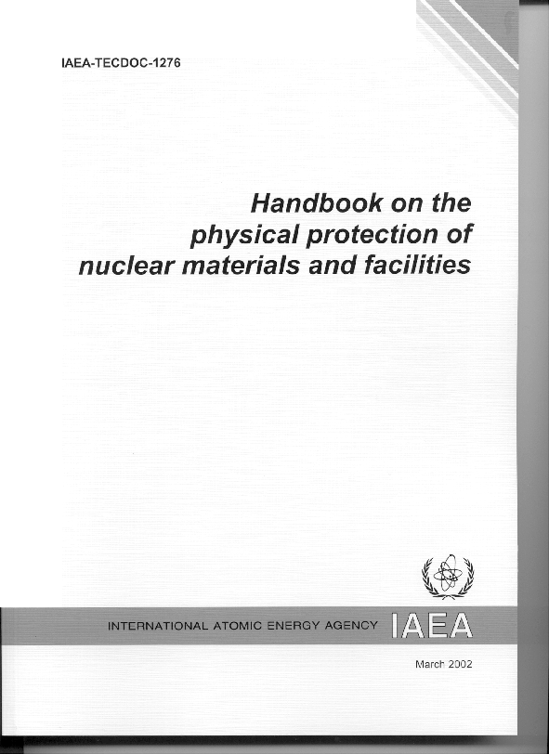
IAEA Guidance to meet Obligations
IAEA Nuclear Security Series
  Undertaken to assist States to meet obligations
  Part of the International Nuclear Security Framework
  International coordinated series of guidance
  Comprehensive series (4 tiers)
    Principles, concepts, approaches

Slide 17
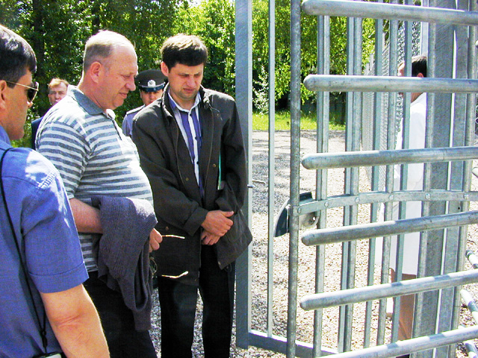
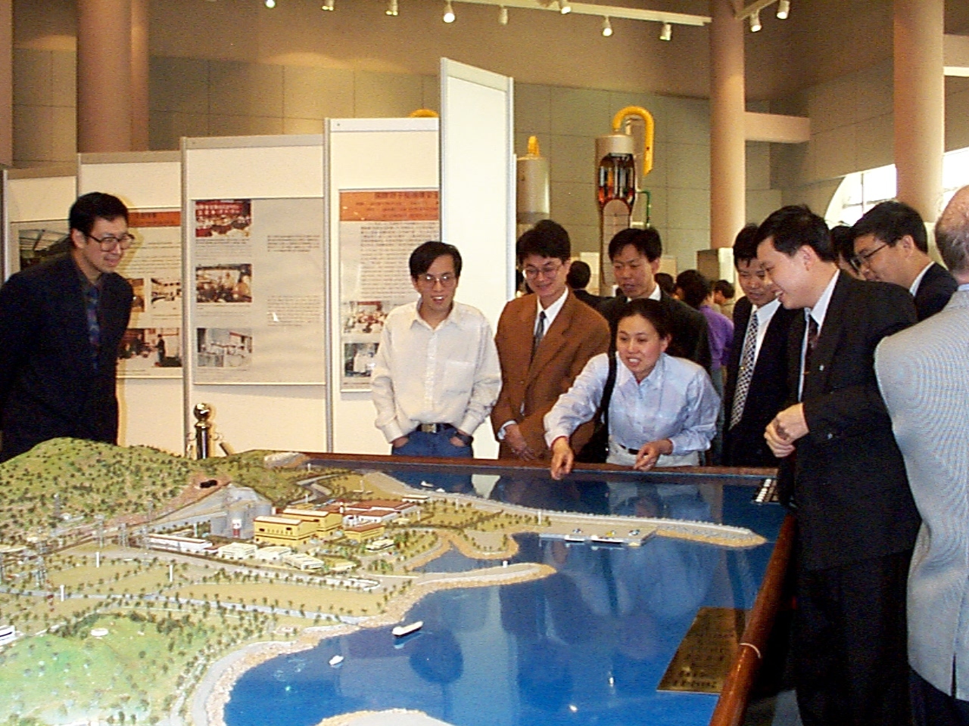
IAEA Activities to implement Framework
Activities, systems, equipment, procedures, and personnel required to implement framework
  Regulatory support
  International advisory missions,
  Training course, workshops, seminars
  Technical assistance
    Assisting PP design
    Assistance with equipment
    Assistance with installation

Slide 18
Balancing Global Nuclear Security
Determining how much security is needed
Risk Tolerance
Perceived Threat
Consequence
PPS Criteria

Slide 19
Balancing Global Nuclear Security
Maintaining tolerable risk
Increasing Protection
Consequence
Perceived Threat

Slide 20
Balancing Global Nuclear Security
Protection levels vs threat
  Performance of PPS equipment, procedures, personnel versus potential threat capabilities
    Effectiveness of assessed detection
    Timeliness of response
      (delay after detection versus response time)
    Effectiveness of response to stop adversary actions
      (numbers, tactics, training, equipment)

Slide 21
Balancing Global Nuclear Security
Examples of threat dependence of PPS measures
  From 225/6.2.1.3
    “The Central Alarm Station should be hardened so that its function can continue in the presence of the Design Basis Threat.”
    For DBT which includes explosives, CAS requires much stronger walls/doors tan for that which does not.
  From 225/6.2.1.4
    The objective (of response) should be the arrival of adequately armed response forces in time to counter …
    Speed of response depends of DBT ability to penetrate, number of respondents that are adequate depends on number of adversaries, their weapons, and skill.

Slide 22
Balancing Global Security
Goal of International Regime to balance, coordinate global security
  Levels of implemented security depend on capabilities of perceived threat
    Threat is a nationally sensitive issue
    Limited coordination of threat
  Difficult to coordinate levels in isolation from threat

Slide 23
Global Threat
Threats not limited by national boundaries
  Terrorists, criminals
  Regional threats, international threats
National threat assessment must consider global threat component
  No State is isolated from global threat
∴ There should be a common thread across national threat statements

Slide 24
Balancing Global Nuclear Security
A baseline international threat statement would be useful
  To provide balance to baseline international protection levels
  To provide baseline global threat component to be incorporated into national threat statement
A baseline international threat statement could be
  Based on open information
  Based on those threats of global nature
Such a statement would need to be modified by each State to reflect national threat issues

Slide 25
Summary
Global nuclear security depends on national infrastructures
International Nuclear Security Regime developed for effective and balanced global security
  International Obligations developed to establish baseline protection
  Protection level depends on threats assessed
    Balanced protection levels requires coordinated threats
  Some threats are of global nature, and pose risk to us all
International regime could be improved by including baseline international threat statement

