Slide 1

Elena K. Sokova
Executive Director, VCDNP
INMM Luncheon
February 1, 2012

Slide 2

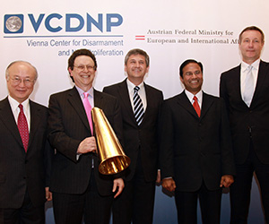


Establishment of the VCDNP
May 2010 initiative of the Austrian government
Vision – a hub to foster debate and exchange between governments, international organizations, and civil society on nuclear nonproliferation and disarmament
Open competition
James Martin Center for Nonproliferation (CNS) at the Monterey Institute of International Studies (MIIS) selected to manage and operate the new center
VCDNP Opening Ceremony
February 25, 2011

Slide 3
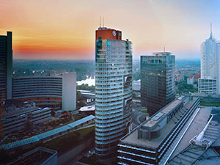
Vision and Mission of the VCDNP
International non-governmental organization
Mission -- to promote international peace and security by providing a platform for independent analysis and dialogue in the field of nuclear disarmament and non-proliferation
Result-oriented discussion among international organizations, national governments, non-governmental experts, scholars, and civil society
“Three Pillars”:
  Research
  Outreach
  Education and Training
Foundation -- partnership with other government and private organizations, academic institutions, and civil society
Andromeda Tower – location
of the VCDNP

Slide 4
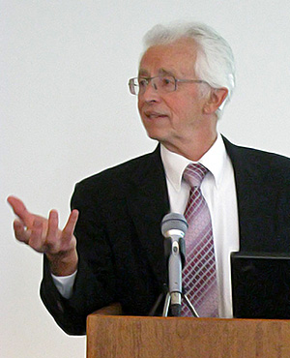
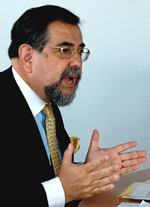
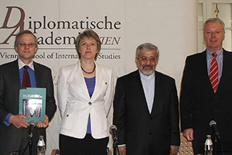
Activities and Programs
Monthly seminar series
Briefings/expert meetings; track 1 ½ discussions
Professional development courses on nonproliferation and disarmament for diplomats and specialists
Conferences and meetings
Research and dissemination of findings
VCDNP briefings for the media

Slide 5
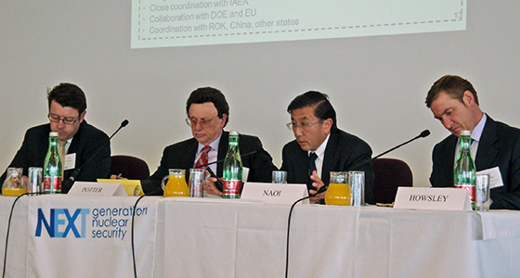
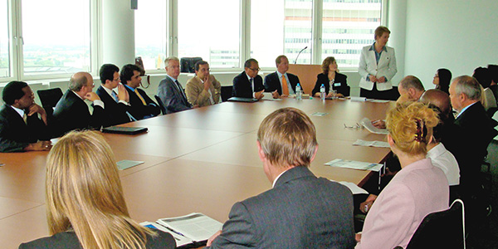
Partnership
With International Institute for Strategic Studies -- on the „Iranian WMD Dossier“ panel, May 2011
With the Fissile Material Working Group -- "Next Generation Nuclear Security: Measuring Progress and Charting the Way Forward“ conference, April 2011
With Stanley Foundation -- Briefing by a former US DOE official on lessons learned from the Nuclear Security Summit in Washington DC, July 2011
With Polish Intitute of International Affairs – Joint seminar on the reform of the UN disarmanent machinery, July 2011
With Nuclear Threat Initiative and Center for Energy and Security Studies (Russian NGO) on nuclear security in Southeast Asia, October 2011
With the Embassy of Poland – Seminar on Nuclear Arms Control and Disarmament, December 2011

Slide 6
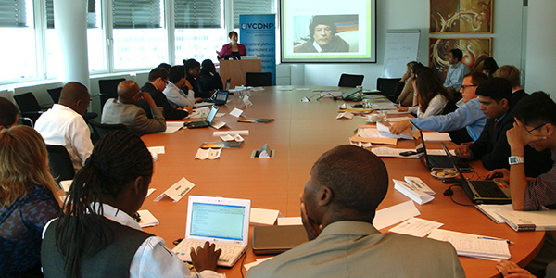
Planned Activities
February
Briefing/seminar on leasing sensitive nuclear fuel cycle sites (with NRDC)
Experts meeting on CTBT entry into force (with Arms Control Association)
March
Second course on nuclear non-proliferation and disarmament
April-May
6-7 events on the
margins of the
NPT PrepCom
including a high-
school program
(Critical Issues Forum)

Slide 7
Research Areas
Mostly Nuclear (other WMD and related fields possibly)
Nuclear Disarmament and Arms Control
Non-Proliferation
International Safeguards
Nuclear Terrorism and Nuclear Security
Strategic Trade Controls
International Nonproliferation Regimes and Organizations
Nuclear Fuel Cycle Policies
Verification
Education and Training
  Mostly policy issues
  Intersection of Policy and Science/Technical issues

Slide 8
Contact Information
Elena Sokova
esokova@vcdnp.org
or
info@vcdnp.org
Vienna Center for Disarmament and Non-Proliferation
  www.vcdnp.org

