Slide 1

Introduction to Squirrel Programming
Learn how scopes work

Slide 2
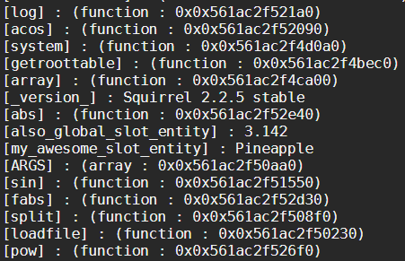
The Squirrel Scope Table
In Squirrel, everything is global when you declare a binding:
When you create a binding, it is stored in a table called root. This is the scripts table of global variables.
Each script has its own dedicated memory and cache – like a computer! (root table)
my_awesome_slot_entity <- "Pineapple"
also_global_slot_entity <- 3.142
foreach ( k, v in getroottable() )
print("[" + k + "] : " + v + "\n")

Slide 3
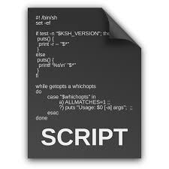
The Issue
Let’s say you have 2 scripts and need to make usage of a script:
game_logic.nut
game_util.nut
game_logic contains all the variables and functions to make the minigame work, but the creator created awesome functionality to the script game_util which makes debugging and logic making easier!
But we hit an issue…

Slide 4
The Squirrel Scope Table
If we go back to the expression “Each script has its own dedicated memory and cache” and assume each computer is hooked up to the same network – How could we communicate between each device?
This is another way to visualize how the Squirrel VM works
Squirrels VM
Colour | Meaning
RED | One Direction Only (Respond)
ORANGE | Two Directions Available (Fetch/Respond)
GREEN | Uni – Direction (All above)
Shared Memory
and Cache
Personal memory and cache
Personal memory and cache

Slide 5
Example explained further
Squirrels VM
Each VM has a global scope table, shown as “Shared Memory and Cache”
This means Squirrel can communicate with any variable, table or function that is in that block.
This is the main table in charge for consistent communication of data between each script.
All scripts can communicate, fetch and grab information from this table without any problems.
Shared Memory
and Cache
Personal memory and cache
Personal memory and cache

Slide 6
Example explained further
Squirrels VM
Notice as each script can grab information from the shared memory and cache!
Every script can see what is stored in that block and can invoke or use its slots when ever is required.
At this stage, you can link a script to its own table and use it functionality! But linking can be a little bit hard to remember and can cause issues further on!
Shared Memory
and Cache
Personal memory and cache
Personal memory and cache

Slide 7
Example explained further
Squirrels VM
We’ve now hit rock bottom as now we’re in the script!
Remember that everything in this script is only visible to itself, even if its global!
If we required a function from this script, we’ll get an error as Squirrel doesn’t understand the call!
Shared Memory
and Cache
Personal memory and cache
Personal memory and cache

Slide 8
How to communicate without linking
Linking is a solution to avoid this but could cause issues further on when you expand the project.
If you have a function that is the same in very script, you might as well make one global implementation of it.
Squirrels VM
So we need to make usage
and declare a function in this
block using the script!
Shared Memory
and Cache
Personal memory and cache
Personal memory and cache

Slide 9
The Squirrel Scope Table Explained
Since Squirrels declarations are mostly global, using common terms will be difficult… So I produced some:
Squirrels VM
External Global
Variables & Functions
(Global table)
Internal Global
Variables & Functions
(Root table)
Read
Write
Write
Read
The Global table Cannot Read or Write to the scripts Personal (root) Table
But the Personal (root) Table Can Read or Write to the Global Table

Slide 10
(my) Squirrel Scope Terms
To make things simple, I decided the only terms are suitable for the given declaration.
These aren’t actual terms used by everyone, so interpolate it to how you want it to be called.
Term | Declaration
External Global Scope | ::hello_word <- “Hello!” ( With prefix :: )
Internal Global Scope | hello_word <- “Hello!”
Internal Local Scope | local hello_word = “Hello!”

Slide 11
Creating a fake event handler
This example make usage of a fake event handler, which invokes when a certain area in the script is called for.
With this, the user can customize their script to their liking, without changing the implementing of the script itself.
From this example, I’ve created the following events:
Parent class (base.nut)
OnEntityFound
OnNameChanged
Child Class (player.nut)
OnEntityFound (Carried from parent class)
OnNameChanged (Carried from parent class)
OnHealthCall

Slide 12
Invoking the event
Squirrel has a way to invoke a function with specific parameters – this is how I’ve achieved the fake event handler to work with different information!
The event name
First param is the caller, itself (acall)
The parameter which is a function which returns a table
The event table
(table of event handlers)
The function caller
(invoker)
::events["OnHealthCall"].acall( [this, CreateResponce(Responce.FAIL, { param = amount.tostring(), param_t = param_type, reason = "Health cannot be assigned less than 0" })]);
NOTE: Validation is important, not included in this slide due to complication of logic!
Then we assign our custom function to that event using: ::events.OnHealthCall <- function(data) { // Code here }
Where the param data is a table with the information we need!
This means the user can make their code suitable to their needs – double win for the implementor and user!

