Slide 1

Introduction to Squirrel Programming
Understanding Big-O with
Squirrel

Slide 2
What is Big-O?
Big-O is a form of showing a cost of an function depending on the output of the size (n), known as Time Complexity.
The main cost of functions are the complexity and performance – this helps you the programmer decide what is the best algorithm to use which doesn’t impact the programs performance or speed.
Big-O is an order function, so O(1) is read as “Order of 1”
With Big-O you have to ignore lower-order terms, which means the highest represents the algorithm!
Here are the order from best to worst (low to high):
O(1) | O(log n) | O(n) | O (n log n) | O(n²) | O(n!)
Constant | Logarithmic | Linear | Linearithmic | Quadratic | Factorial
BEST
In terms of cost/performance impact
WORST

Slide 3
Order of 1:
This is the best case in terms of cost and performance but could also be the worst in terms of searching for an item in a list!
O(1) is considered to be instant, its shorthand name is “Constant”! Which means its calculated or managed in single time – this is what you want to aim for, but cannot always get in an algorithm!
The following below are considered to be in Order of 1:
Assignments
local player = EntityGroup[5]
player_score <- 5
player_score += 1
Calculations
local player_acc = (targets_hit / total_targets) * 100
player_acc_new <- ( getTargetsHit() / getTotalTargets() ) * 100
//Assuming both functions are O(1) and not O(n)

Slide 4
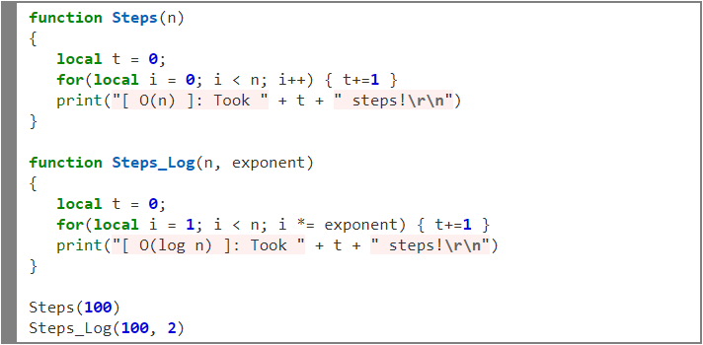
Order of log(n):
This has got to do with multiplying or dividing the number of n (base) with the exponent (how much by).
This is used to break down as many steps until x may be found – used for Binary Search!
Take this algorithm made in Squirrel for this example – steps to get to 100 :
This algorithm is O(n) which took 100 steps to get to 100
This algorithm is O(log 2(n)) which took 7 steps to get to 100

Slide 5
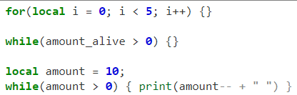
Order of n:
Order of n is in linear time, meaning it will iterate from 0 to x or vice versa, if you used loops – you’ve coded the algorithm in O(n)! You could even increment or decrement in steps!

Slide 6
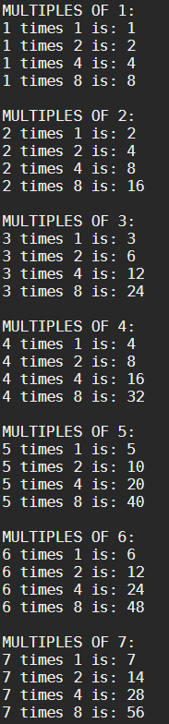
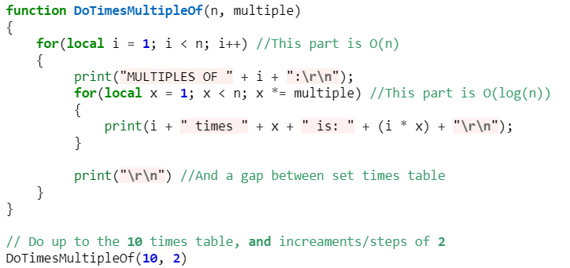
Order of n log(n):
The usage of combing an O(log(n)) inside an O(n) loop!

Slide 7
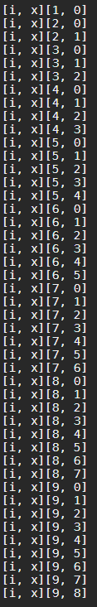
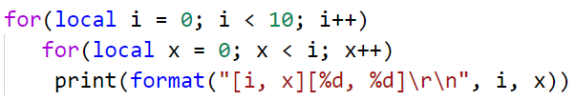
Order of n²
This tends to be the worst one for efficiency, this is used for nested loops!
Sometimes – not likely – this will have better performance than O(n) itself! Weird…
O(n)
O(n)

Slide 8
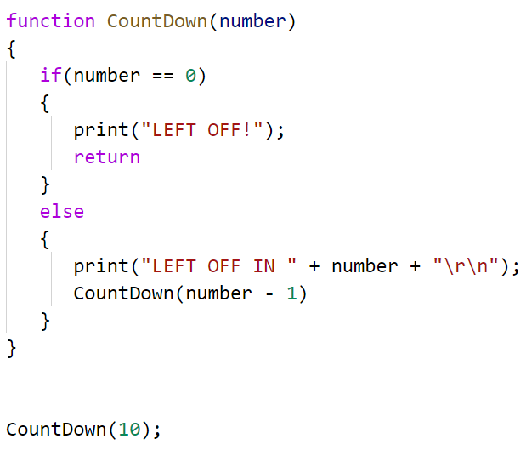
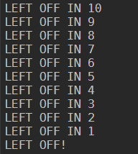
Order of n! :
Recursion is the process of calling itself and is denoted with a exclamation mark. The method will make usage of the parameter provided until it reached base case which it returns itself until out of the stack.
This demo doesn’t return anything, so this will simply call return to stop itself from continuing onwards.
Reached
Base case
Work towards
Base case

