Slide 1
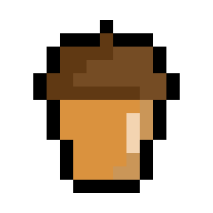
Introduction to Squirrel Programming
Introduction into OOP
Object-Oriented Programming

Slide 2
What is OOP?
Object-Oriented Programming is a programming language model where instead of commonly relying on functions and logic, it relies on organising the data as objects.
OOP Benefits:
Reusability
Scalability
Efficiency
It is always used in video games, Java and almost every C# and C++ program… (And many more!)

Slide 3
Why OOP?
OOP focuses on how you can manipulate an object instead of relying on how the logic is used to manipulate them. OOP is fantastic for large and further expanding projects due to how easy it is to manipulate objects.
OOP is fantastic for group work as OOP doesn’t depend on other classes to develop – in most cases…

Slide 4
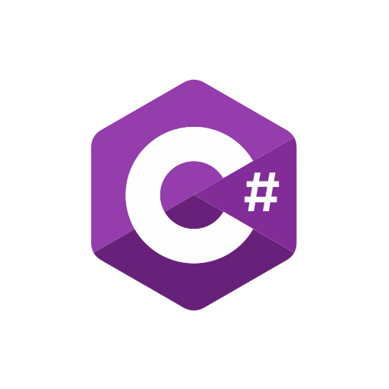
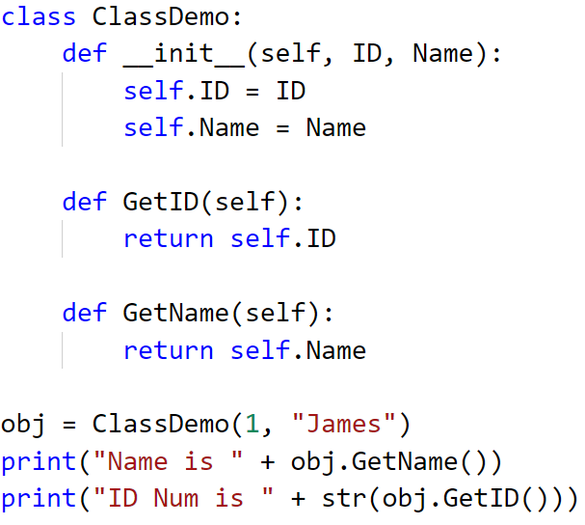
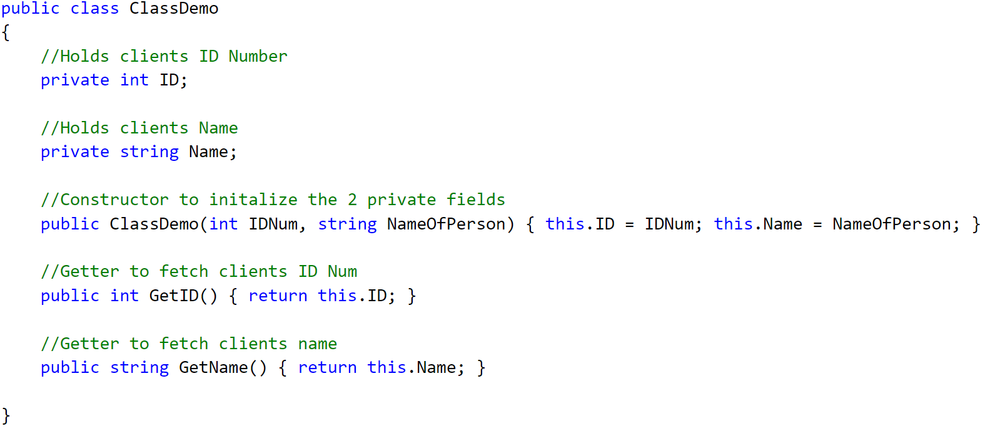

Squirrel in OOP
Squirrels take on OOP isn't complex compared to C# and Java.
For this example, we’ll compare C# to Python – then Python to Squirrel
Statistically typed -> Dynamically typed -> Dynamically typed -> Dynamically typed

Slide 5

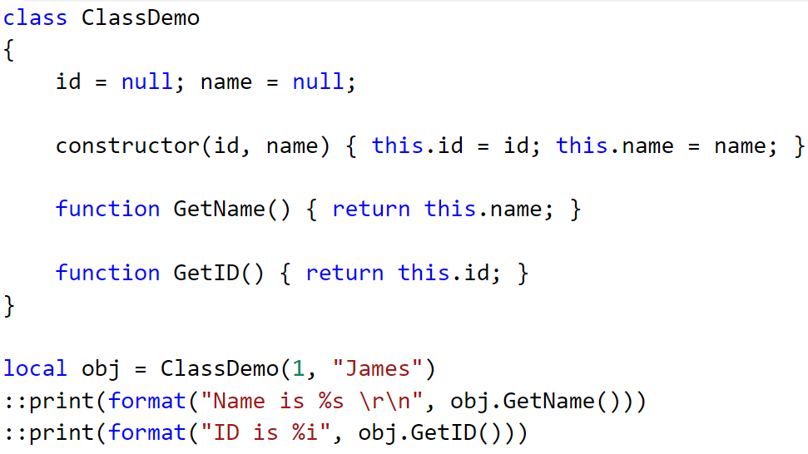
Python to Squirrel

Slide 6
Syntax of C# to Squirrel

Slide 7


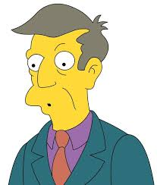
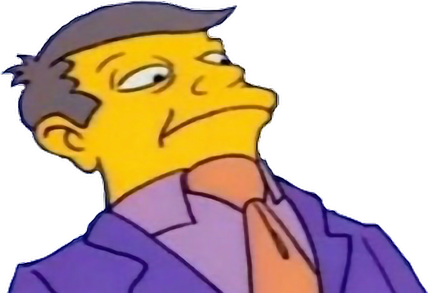

The 4 principles of OOP
Class
Encapsulation
Abstraction
Inheritance
Polymorphism

Slide 8
Encapsulation
Encapsulation is the mechanism of hiding implementation from the user, all fields should be private and should be only changed (Getters/Setters) with public methods if it’s referenced out with the class.
Getter
A public method or function which fetches and grabs the information from the class:
Good practice to start with Prefix “Get”, but it’s up to you to decide what Prefix to use…
Setter
A public method which assigns the field inside the class with the object that is passed in from the parameter:
Good practice to start with Prefix “Set”, but again – it’s up to you.
In OOP, fields SHOULDN’T be assigned directly… with exceptions (we’ll see later on!)
Getter – Tends to have “Get” prefix in method/function name, always contains return if it’s a function.
Setter – Doesn’t return back a value (with exceptions), doesn’t use return but assigns the field directly.

Slide 9
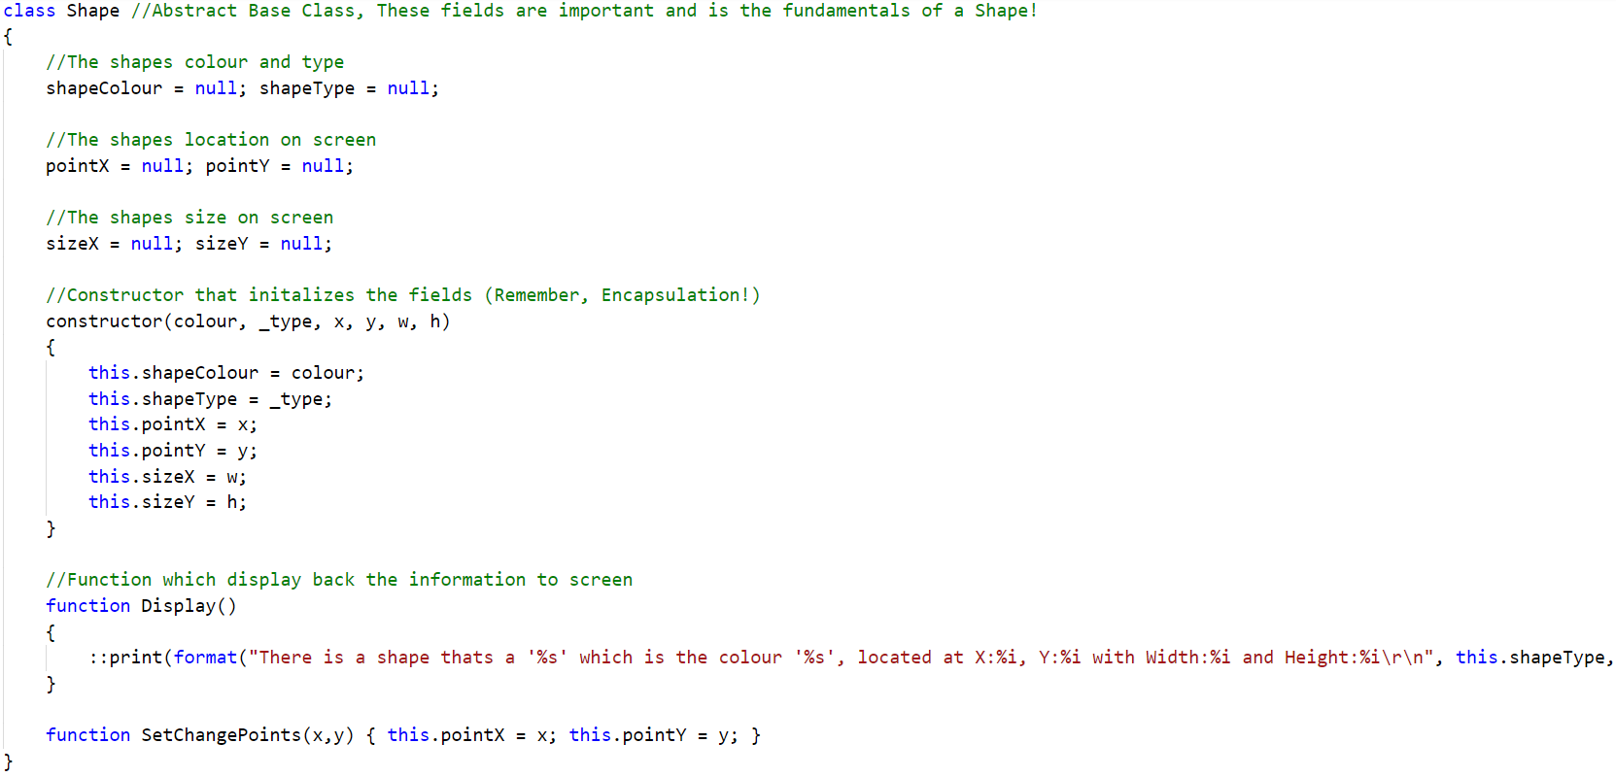
Abstraction
The opposite of Encapsulation, it shows what’s important to the class to implement. It’s kind of like a contract. All fields and methods are exposed out in the open. You are forced to implement the features which are stated when you inherit it.
You are unable to do this with Squirrel natively, but it is still achievable.

Slide 10
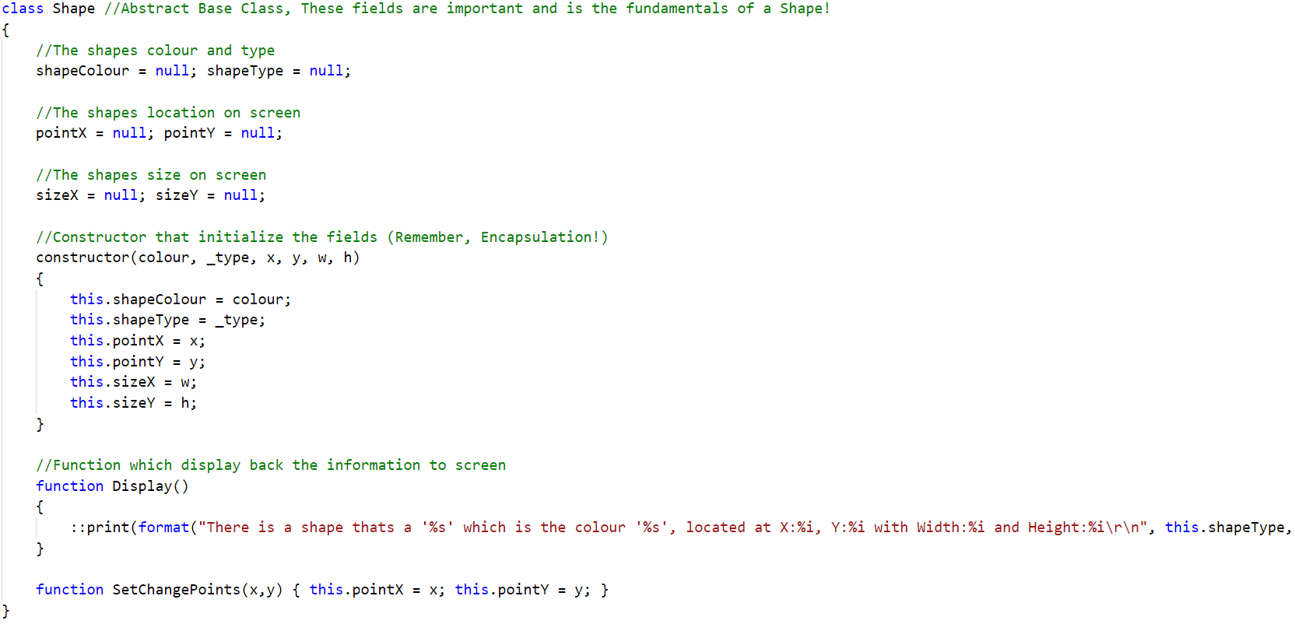
Abstraction Example
For this demonstration, lets start with the contract (base class):

Slide 11
The fields that make a shape – the fundamentals…
The constructor which initializes the fields from the parameters that are passed into it, remember: Encapsulation!
Normal method, can be classed as a Getter (No prefix used in method name)
A setter with a prefix to change the shapes properties.
Note: No return, direct assignment to the fields!

Slide 12
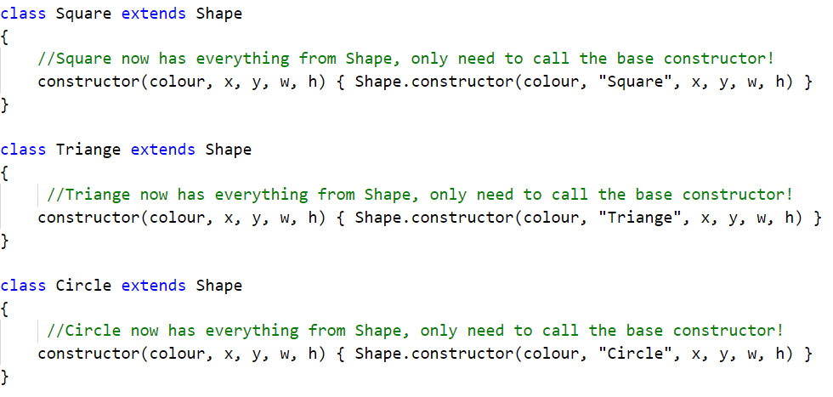
Abstraction with Classes (extends)
Now we can extend it to our 3 shapes!
Since Abstraction is like a contract, each shape has signed an agreement to use the fields and methods/functions from the Shape class – without implementing it!
This means these classes can access or change the behaviour while not affecting the Base class!

Slide 13
Abstraction with Classes (extends)
Once extended, you can overwrite or add functions on top of the base class!
Now, let’s invoke and make some shapes!

Slide 14
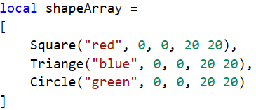
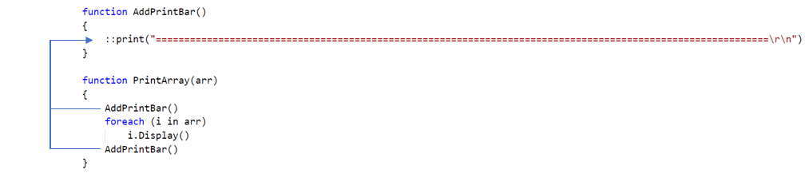
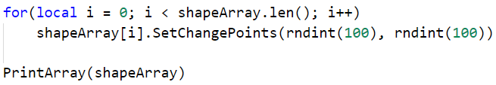
The Code
We have an array initialized using an array literal (Square brackets!)
Then we iterate over the array with the foreach loop (read-only!)
Then we change each shapes position using a for loop (direct access!) and print out again!
shapeArray[0] is a Square, which is red…
shapeArray[1] is a Triange, which is blue…
shapeArray[2] is a Circle, which is green…

Slide 15
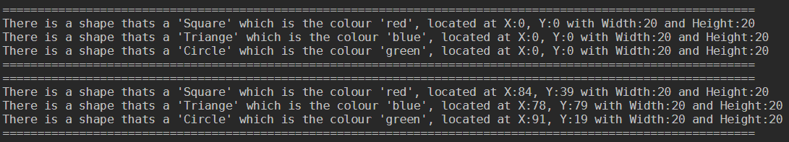
Result
Success! We’ve manage to change each shapes position! This is only with one constructor and no extra implements!
The for loop randomises from 0 to 100 for each shapes x and y coordinates.
This is polymorphism, the ability to make operator or function achieve different results based on inputs.
The class is a blueprint, it just holds what information the class has. We have to invoke it to gain some results! Each element is unique in it’s own way, therefor making your project more scalable!

Slide 16
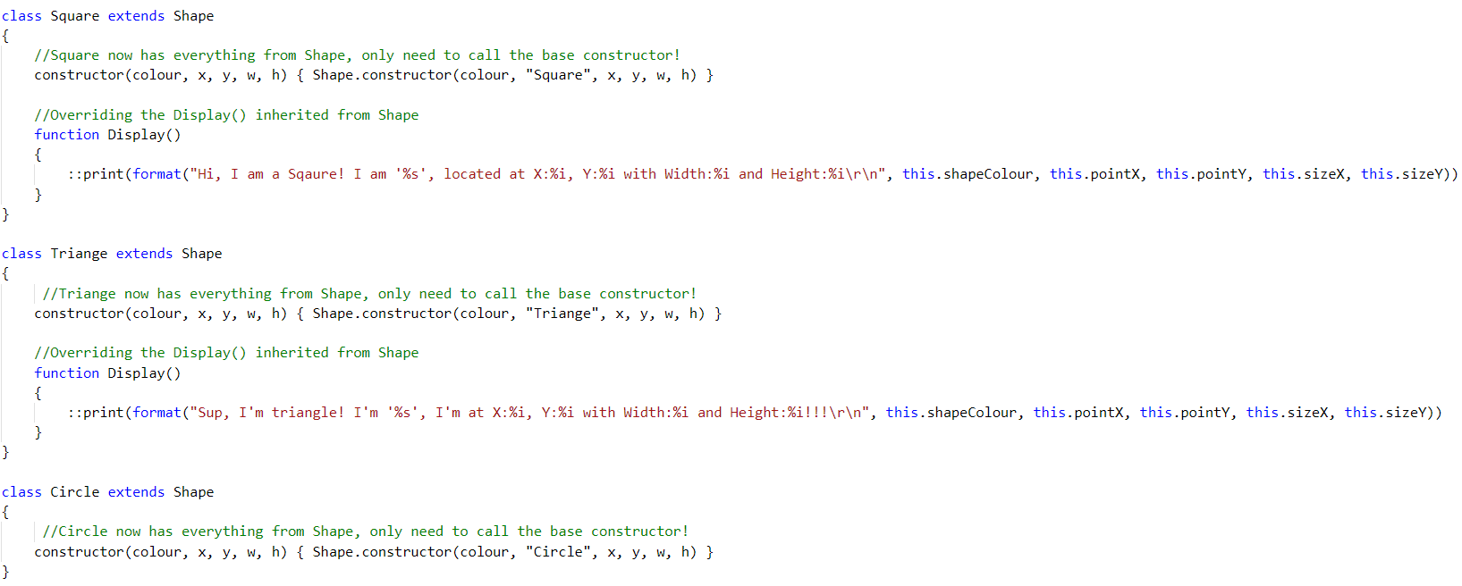
Inheritance
If your family has a history of Dyslexia or Irlen – there is a chance you might inherit it…
Inheritance in OOP is just like that, but with more control of what to inherit.
Using the same class (Shape Class) we can make a shape inherit it’s own way of displaying back information! It’s called Overriding…

Slide 17
Old against new
Both Square and Triangle implement a new Display() method which overrides the base Display() method.
Circle’s Display method hasn’t been overrided, so it still uses the base Display() from Shape class!
Inheritance gives your classes a different behaviour, So create a base class and stop implementing the same patterns!

