Slide 1

Task Reminder and Management System
A Web-Based Application for Task Tracking and Reminders
Presented by: Santhosh Kumar S

Slide 2




Problem Statement: The Challenge of Manual Task Management
Missed Deadlines
Poor Organisation
Reduced Productivity
Security Concerns
Manual tracking often leads to critical tasks being overlooked, impacting project timelines.
Lack of a centralised system results in scattered information and inefficient task handling.
Without proper authentication, sensitive task information can be vulnerable.
Time spent organising tasks manually detracts from actual work, lowering overall output.
A significant need exists for an automated, secure, and user-friendly system to manage tasks effectively.

Slide 3
Project Objectives: Enhancing Task Management Efficiency
1
2
3
Automated Management
Status Tracking
Timely Reminders
To develop a system that automates the creation, assignment, and monitoring of tasks.
To implement features for tracking task progress: pending, completed, and overdue statuses.
To provide configurable notification mechanisms to ensure no deadline is missed.
4
5
Secure Authentication
Boost Productivity
To integrate OTP-based authentication for enhanced user data security.
To ultimately improve user efficiency and reduce the cognitive load associated with task organisation.

Slide 4
Technology Stack
Backend Technologies
Frontend Technologies
Java: Core programming language
Spring Boot: Rapid application development framework
Spring Security: Comprehensive authentication and access control
HTML: Structure of web pages
CSS: Styling and presentation
JavaScript: Interactive functionality
Thymeleaf: Server-side Java template engine
Database & ORM
Tools & Utilities
MySQL: Relational database management system
Hibernate JPA: Object-relational mapping for Java persistence
IntelliJ IDEA: Integrated Development Environment
Git & GitHub: Version control system and hosting
Java Mail API: For sending email notifications (e.g., OTPs, reminders)

Slide 5
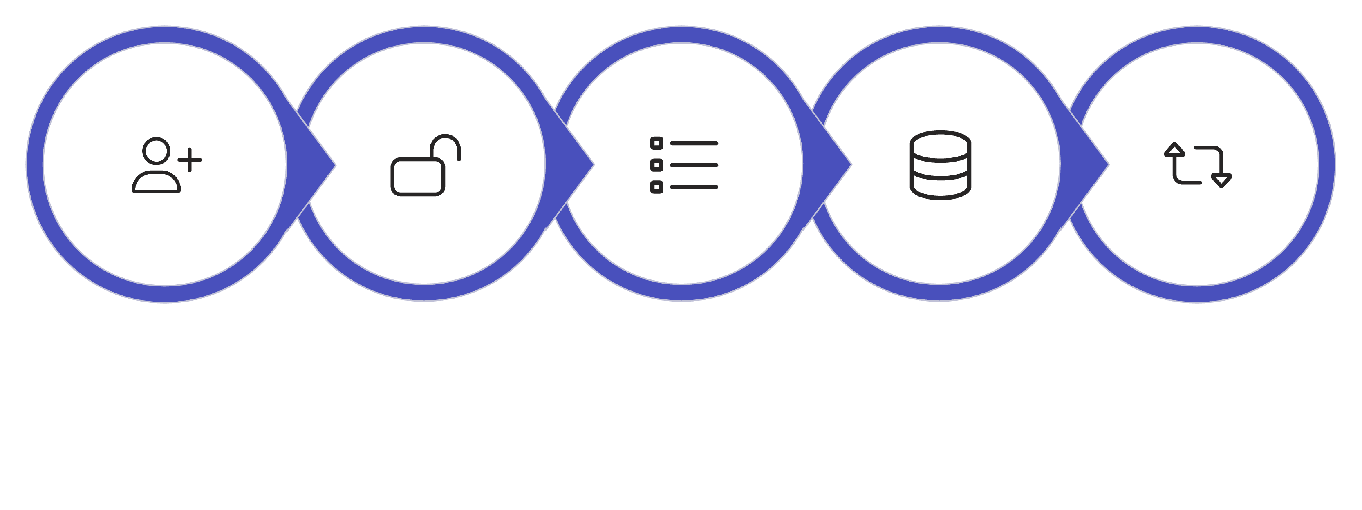





System Workflow: From Registration to Reminder
Auto Tracking
Register
Secure Login
Create Tasks
Database
This streamlined process ensures users can efficiently manage tasks, from initial setup to receiving critical reminders.

Slide 6
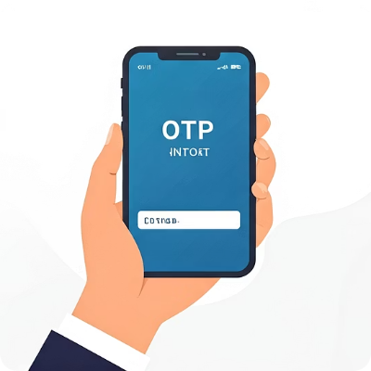

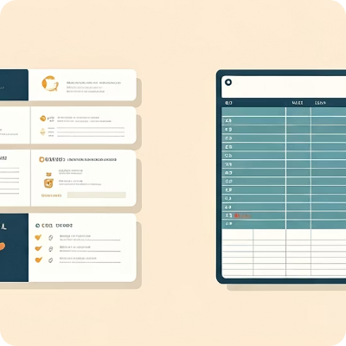



Key Features and Modules: Enhancing User Experience
OTP-Based Authentication
Comprehensive Task Management
Flexible View Options
Ensures secure access and verifies user identity for enhanced data protection.
Allows users to create, edit, delete, and prioritise tasks with ease.
Supports both list view and card view for adaptable task visualisation.
Filtering and Sorting
Overdue Task Indicators
Task Export Functionality
Enables users to quickly locate tasks based on priority, due date, or status.
Visually highlights tasks that have passed their deadline, prompting immediate attention.
Provides options to export task lists for offline reference or integration with other tools.

Slide 7
User Interface
Login Page - Clean OTP-based login interface
Task Dashboard - Overview of task statistics and metrics
List View - Detailed task list with due dates and status
Card View - Visual card-based task representation
Calendar View - Calendar integration showing tasks by date
The user interface is designed for clarity and ease of use, ensuring a seamless experience across all key functions.

Slide 8
Challenges and Learnings: Overcoming Development Hurdles
Key Challenges Encountered
Valuable Learnings Gained
Implementing robust OTP authentication and verification flows.
Effectively managing user sessions and ensuring data integrity.
Developing accurate logic for overdue task detection and notification.
Maintaining consistent UI/UX across various screens and functionalities.
Configuring Spring Security for granular access control and protection.
Deep understanding of Spring Boot architecture and best practices.
Proficiency in integrating frontend and backend components seamlessly.
Effective utilisation of Git and GitHub for collaborative development and version control.
Enhanced debugging and problem-solving skills in a full-stack environment.
Appreciation for secure coding principles and user experience design.

Slide 9
Future Enhancements: Expanding System Capabilities
1
Mobile Application Support
Develop native iOS/Android applications for on-the-go task management.
2
Push Notifications
Integrate real-time push notifications for urgent reminders and updates.
3
Role-Based Access Control (RBAC)
Implement different user roles (e.g., admin, team lead, member) with specific permissions.
4
Calendar Integration
Synchronise tasks with external calendar applications (Google Calendar, Outlook).
5
Cloud Deployment
Deploy the application to a cloud platform for scalability and accessibility.
6
Advanced Task Analytics
Provide insights into productivity, task completion rates, and bottlenecks.

Slide 10
Thank You

