Slide 1
Introduction to Operating Systems
Spring 2018 Lecture Notes
Chapter 3
adapted from Tom Anderson’s slides on OSPP web site

Slide 2
The Programming Interface

Slide 3
O/S Design Questions
What functions should O/S provide?
Where should this functionality be located?
In library routines that run in user mode?
In the kernel?
In O/S server processes that run in kernel mode?
In O/S server processes that run in user mode?
(Note that clients and servers will need to make kernel calls to communicate.)

Slide 4
Each system call can be limited in functionality. Provides primitives that you can “mix and match”.
“thin waist”

Slide 5
Main Points
Creating and managing processes
fork, exec, wait
Performing I/O
open, read, write, close
Communicating between processes
pipe, dup, select, connect
Example: implementing a shell

Slide 6
Shell
A shell is a job control system
Allows programmer to create and manage a set of programs to do some task
Windows, MacOS, Linux all have shells
Example: to compile a C program
cc –c sourcefile1.c
cc –c sourcefile2.c
ln –o program sourcefile1.o sourcefile2.o

Slide 7
Question
If the shell runs at user-level, what system calls does it make to run each of the programs?
Ex: cc, ln

Slide 8
Windows CreateProcess
System call to create a new process to run a program
Create and initialize the process control block (PCB) in the kernel
Create and initialize a new address space
Load the program into the address space
Copy arguments into memory in the address space
Initialize the hardware context to start execution at ``start'’
Inform the scheduler that the new process is ready to run

Slide 9
Windows CreateProcess API (simplified)
if (!CreateProcess(
NULL, // No module name (use command line)
argv[1], // Command line
NULL, // Process handle not inheritable
NULL, // Thread handle not inheritable
FALSE, // Set handle inheritance to FALSE
0, // No creation flags
NULL, // Use parent's environment block
NULL, // Use parent's starting directory
&si, // Pointer to STARTUPINFO structure
&pi ) // Pointer to PROCESS_INFORMATION structure
)
Notes:
Ok, pretty complex! But its because there are a lot of aspects to a process

Slide 10
UNIX Case Study
Creating and managing processes
fork(), exec(), wait()
Performing I/O
open(), read(), write(), close()
Communicating between processes
pipe(), dup2(), select(), connect()

Slide 11
UNIX Process Management
UNIX fork() – system call to create a copy of the current process, and start it running
No arguments!
UNIX exec() – system call to change the program being run by the current process
UNIX wait() – system call to wait for a process to finish
UNIX signal() – system call to send a notification to another process
Notes:
UNIX splits creating a process into two steps, each of them a lot simpler.

Slide 12
UNIX Process Management
UNIX fork – system call to create a copy of the current process, and start it running
No arguments!
UNIX exec – system call to change the program being run by the current process
UNIX wait – system call to wait for a process to finish
UNIX signal – system call to send a notification to another process
Notes:
UNIX splits creating a process into two steps, each of them a lot simpler.

Slide 13
UNIX Process Management
Notes:
How is this used – typically, fork a process, child and parent are now both running the same program. One sets up the child program, and runs exec – becoming the new program
The parent, usually, waits for the child to finish

Slide 14
Question: What does this code print?
int child_pid = fork();
if (child_pid == 0) { // I'm the child process
printf("I am process #%d\n", getpid());
return 0;
} else { // I'm the parent process
printf("I am parent of process #%d\n", child_pid);
return 0;
}
Notes:
Parent could print first, or child could print first – you don’t know!

Slide 15
Questions
Can UNIX fork() return an error? Why?
Can UNIX exec() return an error? Why?
Can UNIX wait() ever return immediately? Why?

Slide 16
Implementing UNIX fork
Steps to implement UNIX fork
Create and initialize the process control block (PCB) in the kernel
Create a new address space
Initialize the address space with a copy of the entire contents of the address space of the parent
Inherit the execution context of the parent (e.g., any open files)
Inform the scheduler that the new process is ready to run

Slide 17
Implementing UNIX exec
Steps to implement UNIX fork
Load the program into the current address space
Copy arguments into memory in the address space
Initialize the hardware context to start execution at ``start'’
(note that exec() does not create a new process)

Slide 18
UNIX I/O
Uniformity
All operations on all files, devices use the same set of system calls: open, close, read, write
Open before use
Open returns a handle (file descriptor) for use in later calls on the file
Byte-oriented
Kernel-buffered read/write
Explicit close
To garbage collect the open file descriptor

Slide 19
UNIX File System Interface
UNIX file open is a Swiss Army knife:
Open the file, return file descriptor
Options:
if file doesn’t exist, return an error
If file doesn’t exist, create file and open it
If file does exist, return an error
If file does exist, open file
If file exists but isn’t empty, nix it then open
If file exists but isn’t empty, return an error
…

Slide 20
Interface Design Question
Why not separate syscalls for open/create/exists?
if (!exists(name))
create(name); // can create fail?
fd = open(name); // does the file exist?

Slide 21
Command Interpreter (“Shell”)
Interactive interface to O/S system calls
Finds executable file associated with a command and creates a process (passing any parameters)
Typically extended as a mini-language (e.g., control structures, macros)
Shell scripts (“batch files” on Windows)
Start-up files (e.g., .cshrc) and environment variables (predefined macros)
Handles I/O redirection

Slide 22
Implementing a Shell
char *prog, **args;
int child_pid;
// Read and parse the input a line at a time
while (readAndParseCmdLine(&prog, &args)) {
child_pid = fork(); // create a child process
if (child_pid == 0) {
exec(prog, args); // I'm the child process. Run program
// NOT REACHED
} else {
wait(child_pid); // I'm the parent, wait for child
return 0;
}
}

Slide 23
Interprocess Communication (IPC) Using Pipes
Connect the I/O of two programs on the command line using a pipe (“|”)
Combine applications into complex structures

Slide 24
Client-Server IPC Using Pipes
Server process can wait on input from multiple client processes using select()

Slide 25
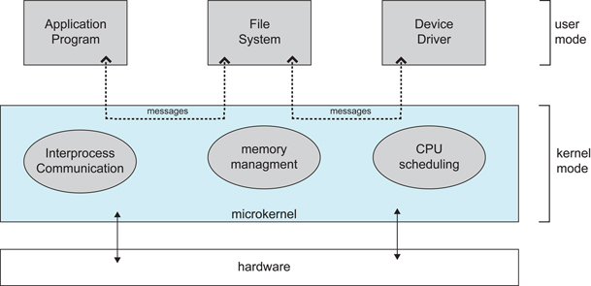
O/S Structure Design Choice
Large kernel provides all or most system services
Sometimes called a “bloated kernel”
Microkernel provides minimal services
Other services provided by user-mode servers
Diagram 2.14 from Silberschatz, Galvin, and Gagne, O/S concepts, 9th ed.

Slide 26
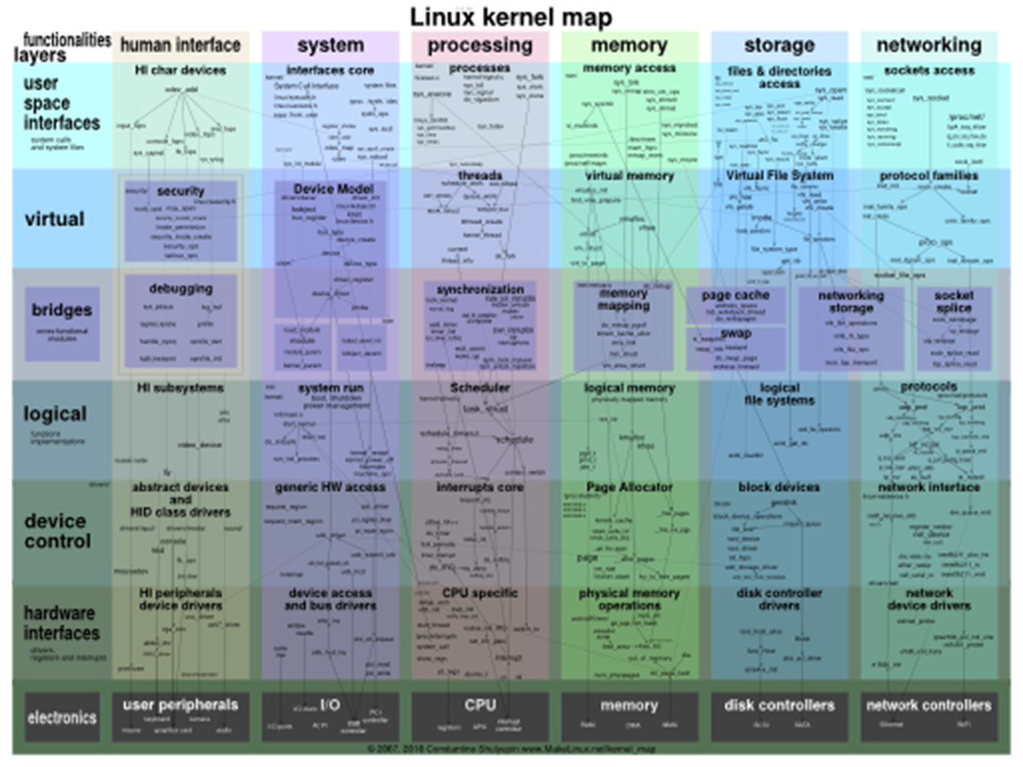
Diagram from http://www.makelinux.net/kernel_map/

