Slide 1
Cryptography & Encryption
University of Melbourne Information Security Club

Slide 2
Why we need cryptography
Confidentiality
CIA triad
Integrity
Availability

Slide 3
Cryptography
Plaintext
Encryption algorithm
Ciphertext
Decryption algorithm
Plaintext
https://www.youtube.com/watch?time_continue=4&v=Kf9KjCKmDcU

Slide 4
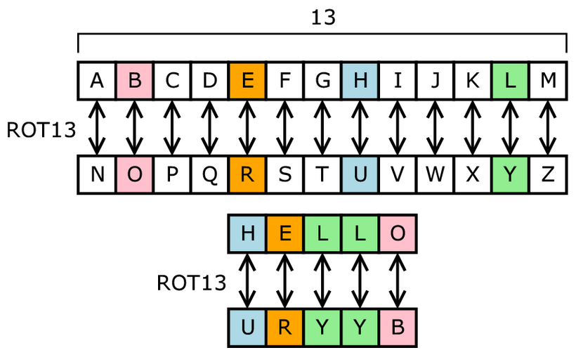
Ancient cryptography
Monoalphabetic Cipher uses fixed substitution over the entire message
E.g.
Credit : Matt Crypto

Slide 5
Ancient cryptography
Polyalphabetic Cipher uses a number of substitutions at different positions in the message

Slide 6
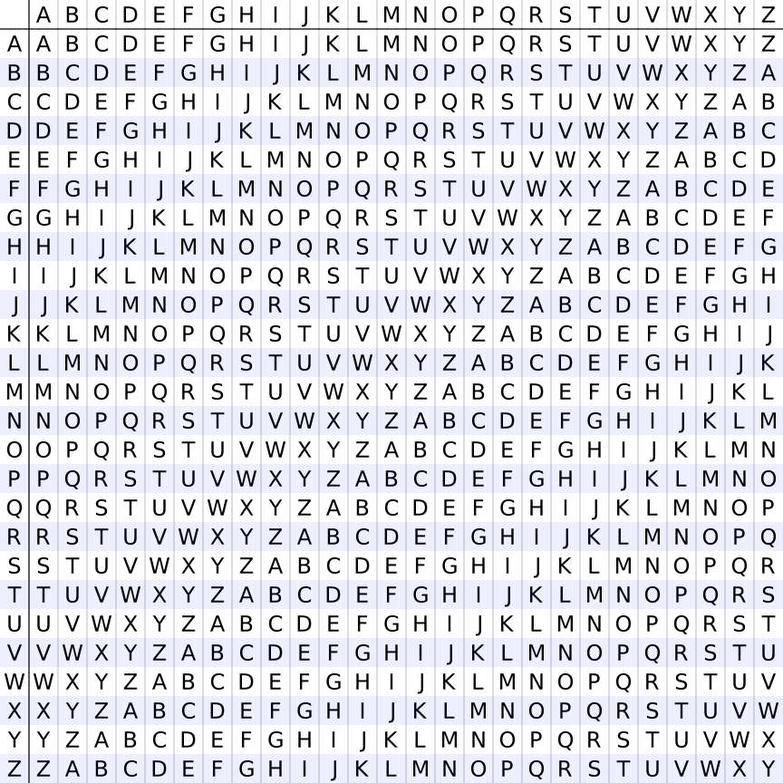
Vigenere cipher
E,g.
Plaintext：attackatdawn
Key ：lemonlemonle
Ciphertext: lxforpvefrnhr

Slide 7
Modern cryptography
Symmetric Cryptography
Asymmetric Cryptography
Hash Function
Digital Signature

Slide 8
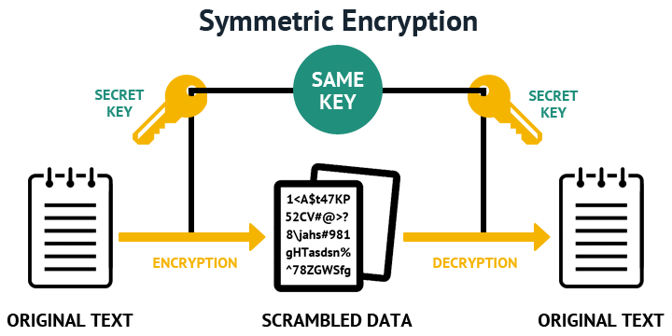
Symmetric cryptography
Use the same cryptographic keys for both encryption of plaintext and decryption of ciphertext.

Slide 9
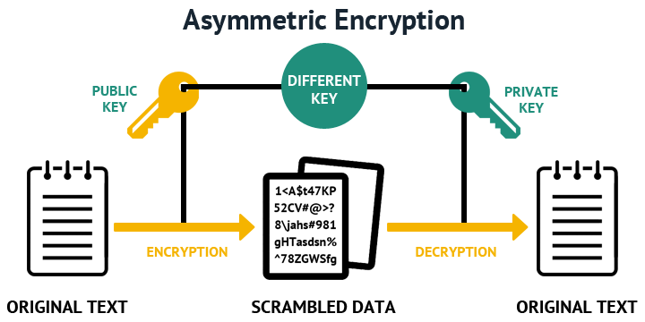
Asymmetric Cryptography
Need a pair of public and private keys

Slide 10
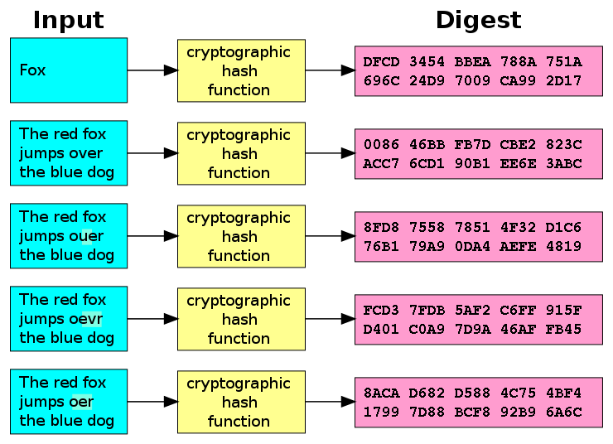
Hash Function
Notes:
A hash is a string or number generated from a string of text. The resulting string or number is a fixed length, and will vary widely with small variations in input. multiple inputs can have same hash value. so it’s no use that we know the hash value, we cannot know the exact input. But it doesn’t matter. We just need to find something that can produce the same hash value, which is also called collision. how does computer verify the user? They compare hash values. Hash is a one-way function while encryption is two –way funciton.

Slide 11
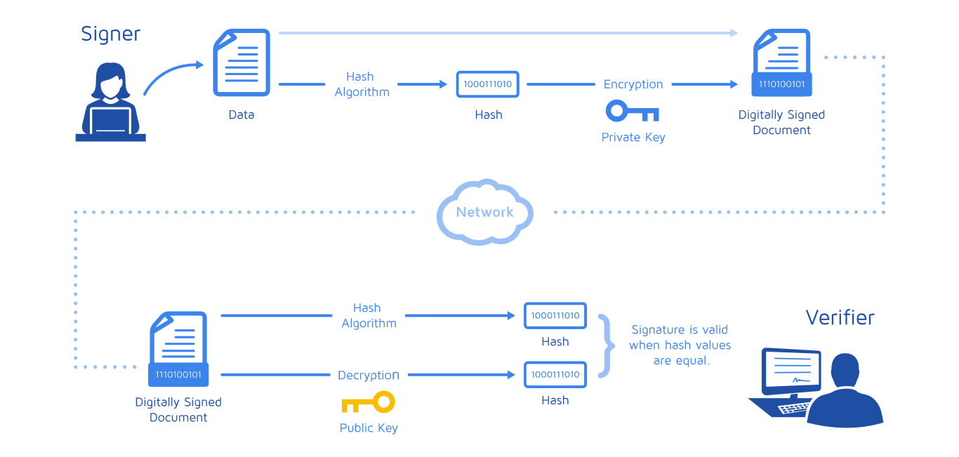
Digital Signature

Slide 12
Task 1
Password Cracking using Hashcat

Slide 13
Task 2
krypton challenges
http://overthewire.org/wargames/krypton/

