Slide 1
Http
University of Melbourne Information Security Club

Slide 2
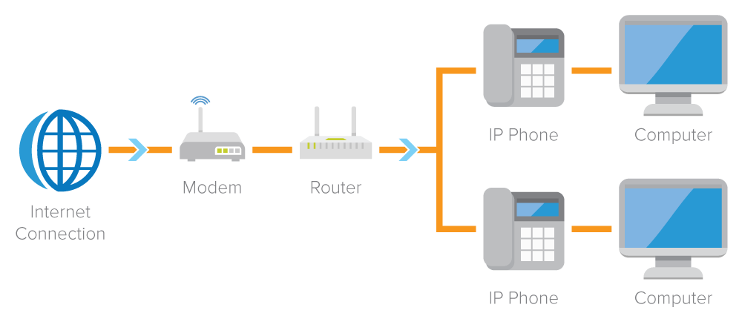
How can we connect with Internet

Slide 3
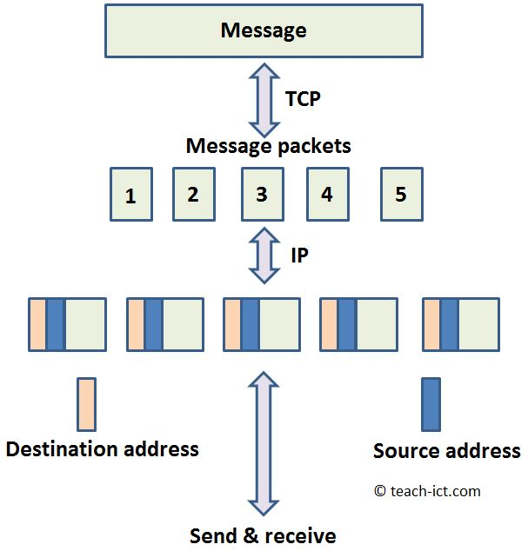
How information is transmitted

Slide 4
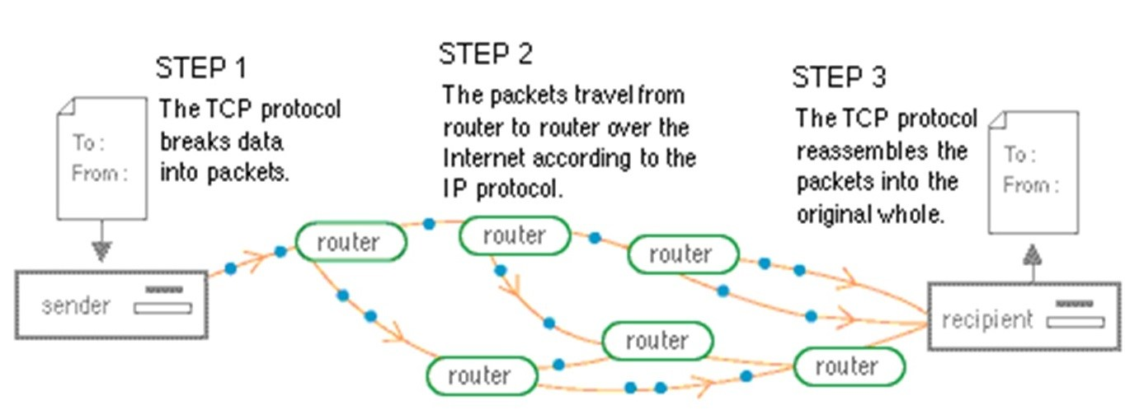
More about TCP/IP

Slide 5
Packet sniffing
Packet sniffing, a network attack strategy, captures network traffic at the Ethernet frame level. After capture, this data can be analyzed and sensitive information can be retrieved.
Tool: Wireshark

Slide 6
Challenge

